Slide 1

Meta-Analysis of Randomized Experiments
Applications to Heavy-Tailed Response Data

Slide 2
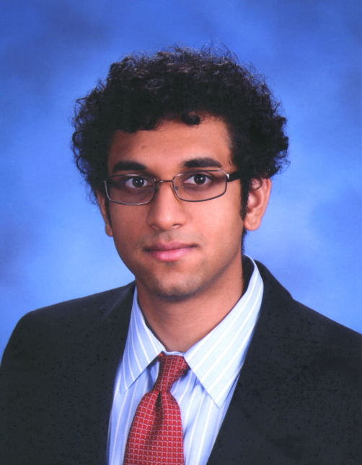



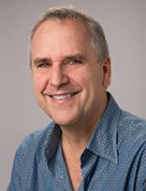
Contributors
SCOT ASIN Forecasting
ML Researcher
Google
Principal Research
Scientist
Principal Applied
Scientist
Sr. Principal
Scientist
Distinguished Prof.
UC Berkeley
Nilesh Tripuraneni
Dominique Perrault-Joncas
Dhruv Madeka
Dean Foster
Michael Jordan

Slide 3

Amazon’s Supply Chain North Star
1
Incrementally improve Free Cash Flow
2
Measured via Labs
a
Average Treatment Effect (ATE)
b
Launch Decision

Slide 4
Difference-in-Means (DM) Estimator
Difference-in-Means is Model-Free and Unbiased for ATE:

Slide 5
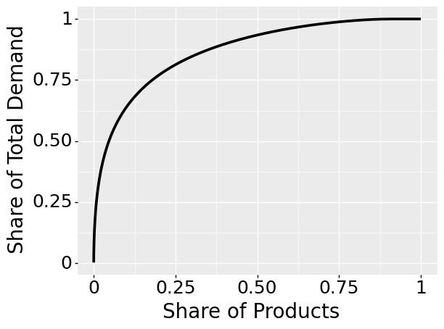
Heavy-Tails at Amazon

Slide 6
Heavy-Tail Solutions
1
Pretreatment regression adjustments:
Pretreatment Free Cash Flow
Pretreatment Demand
Etc.
2
“Robustify”:
Weighted OLS
Winzorize
Etc.

Slide 7
How to Evaluate ATE Estimator?
1
Split treatment and control groups:
2
Compute MSE of Estimator E relative to DM:
3
MSE can be used to compare estimators:

Slide 8
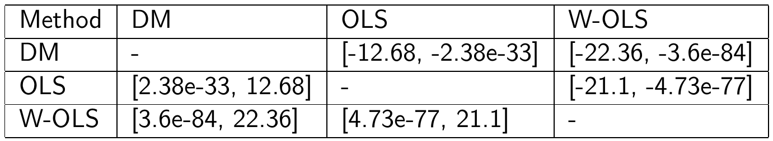
MSE Estimators Comparison
Normalized MSE Score:
Results:

Slide 9
How to Evaluate Launch Decision?
1
Free Cash Flow Improvement:
2
Same split trick as for MSE:
3
Unbiased:

Slide 10
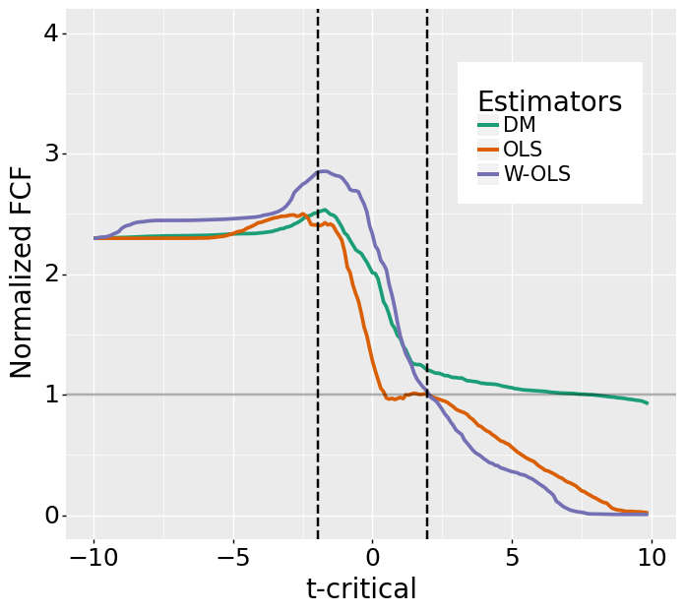
Launch Decision

Slide 11
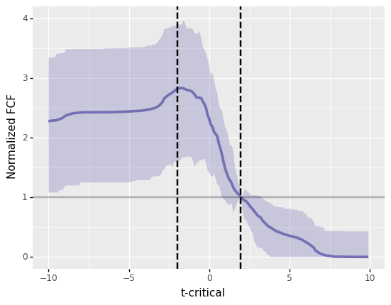
W-OLS Confidence Intervals

Slide 12
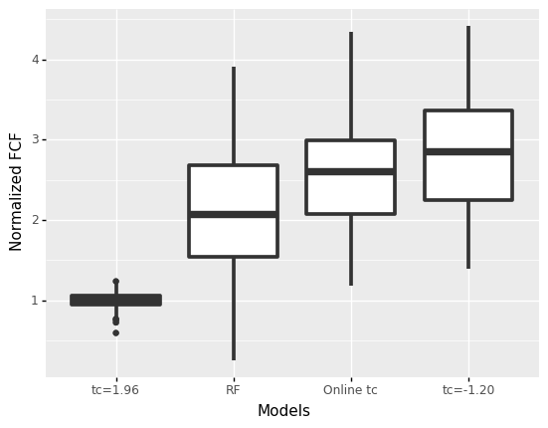
Non-Linear Decision Model

Slide 13
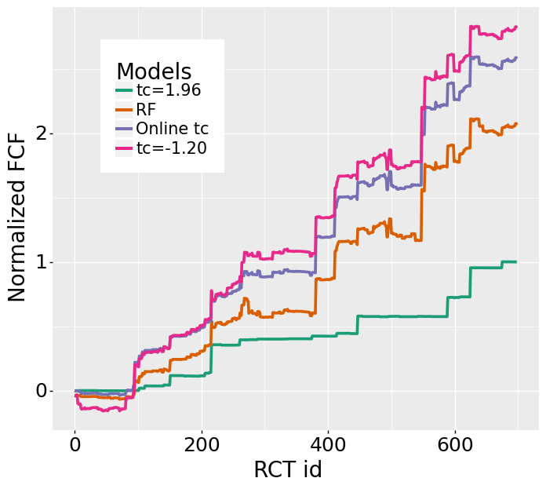
Online Decision Problem

Slide 14

Conclusions
Data-driven methodology to compare ATE estimators and rollout decision rules
Down weighting largest values improves bias-variance trade-off
Controlling type I and type II errors is not always the
natural way to approach rollout decisions
Notes:
We have developed a data-driven methodology to compare the performance of ATE estimators and decision rules
We applied to the IPC lab our corpus we have concluded that robust estimators are beneficial for SCOT RCTs. We have also concluded that the unofficial policy of launching anything unless it is negative and statistically significant is a good empirical choice
It is worth re-iterating that these two last points only apply to our RCT corpus. The methodology can by applied to any RCT corpus but the conclusions might be very different.

Slide 15
THANK YOU!
Acknowledgements: The authors thank Robert Stine, Edo Airoldi, and Kenny Shirley for their valuable comments and feedback.

