Slide 1

Balanced Graph Edge Partition
Florian Bourse
ENS
Marc Lelarge
INRIA-ENS
Milan Vojnovic
Microsoft Research
ACM KDD 2014

Slide 2
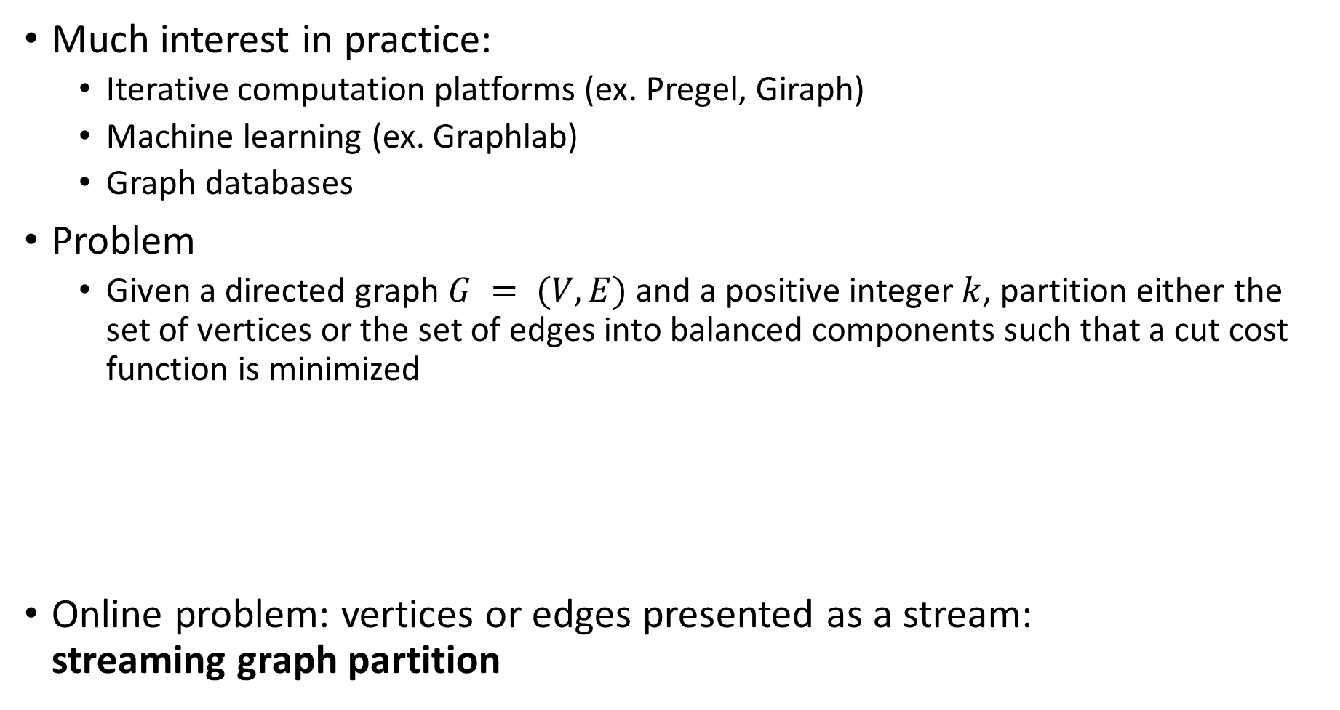
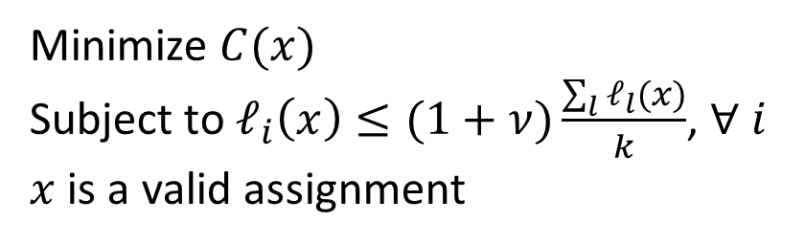
Balanced Graph Partition
Much interest in practice:
  Iterative computation platforms (ex. Pregel, Giraph)
  Machine learning (ex. Graphlab)
  Graph databases
Problem
  Given a directed graph $G = (V,E)$ and a positive integer $k$, partition either the set of vertices or the set of edges into balanced components such that a cut cost function is minimized
Online problem: vertices or edges presented as a stream:
streaming graph partition
Minimize $C(x)$
Subject to $ℓ_{i}\left(x\right)≤(1+ν)\frac{\sum_{l}{ℓ_{l}(x)}}{k}$, $∀ i$
$x$ is a valid assignment

Slide 3
Different Variants
VP
VPA
No Aggregation
traditional
?
u
EP
u
u
Aggregation
?
?
u
PowerGraph
[OSDI 2012]
EPA
u
u
Vertex partition
Edge partition

Slide 4
Questions
Performance benefits of using balanced edge partition as opposed to using more traditional balanced vertex partition ?
Practical algorithms for balanced edge partition w/o aggregation and their theoretical guarantees ?
Streaming heuristics for balanced edge partition ?

Slide 5
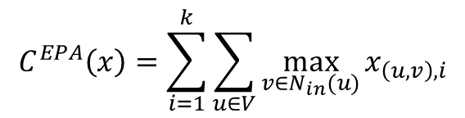

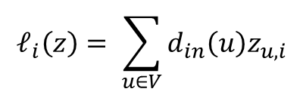
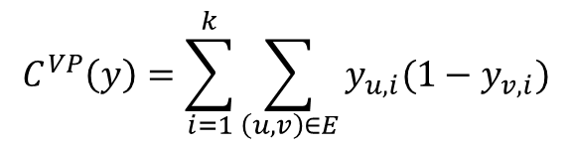
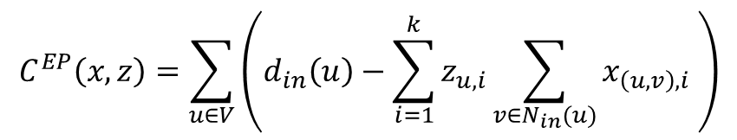

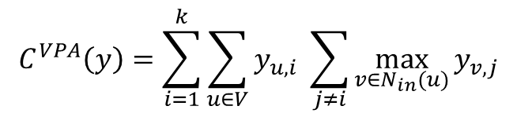

Costs: Cuts and Loads
Master vertex assignment
$$C^{VP}\left(y\right)=\sum_{i=1}^{k}{\sum_{\left(u,v\right)∈E}{y_{u,i}(1−y_{v,i})}}$$
$$C^{EP}\left(x,z\right)=\sum_{u∈V}{\left(d_{in}\left(u\right)−\sum_{i=1}^{k}{z_{u,i}\sum_{v∈N_{in}(u)}{x_{\left(u,v\right), i} }}\right)}$$
$$ℓ_{i}\left(y\right)= \sum_{u∈V}{a_{u}y_{u,i}}$$
$$ℓ_{i}\left(z\right)= \sum_{u∈V}{d_{in}\left(u\right)z_{u,i}}$$
$$C^{VPA}\left(y\right)=\sum_{i=1}^{k}{\sum_{u∈V}{y_{u,i} \sum_{j≠i}{\max_{v∈N_{in}(u)}{y_{v,j}}}}}$$
$$C^{EPA}\left(x\right)=\sum_{i=1}^{k}{\sum_{u∈V}{\max_{v∈N_{in}(u)}{x_{\left(u,v\right),i}}}}$$
$$ℓ_{i}\left(y\right)= \sum_{u∈V}{a_{u}y_{u,i}}$$
$$ℓ_{i}\left(x\right)= \sum_{e∈E}{x_{e,i}}$$

Slide 6

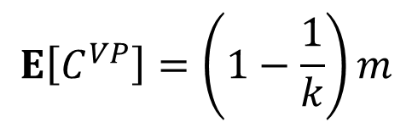
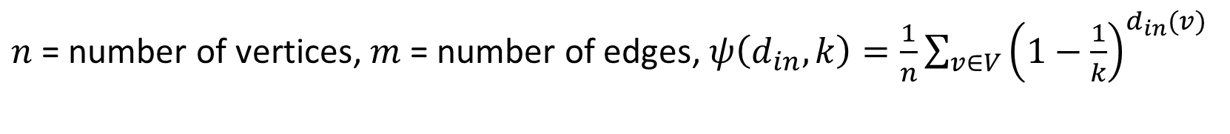
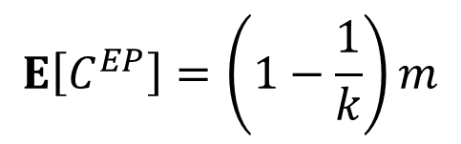

Expected Costs of Random Assignments
$$E\left[C^{VP}\right]=\left(1−\frac{1}{k}\right)m$$
$$E\left[C^{EP}\right]=\left(1−\frac{1}{k}\right)m$$
$$E\left[C^{VPA}\right]=(k−1)n\left(1−ψ\left(d_{in},k\right)\right)$$
$$E\left[C^{EPA}\right]=kn\left(1−ψ\left(d_{in},k\right)\right)−n$$
$n$ = number of vertices, $m$ = number of edges, $ψ\left(d_{in},k\right)=\frac{1}{n}\sum_{v∈V}{{\left(1−\frac{1}{k}\right)}^{d_{in}(v)}}$

Slide 7

Random Assignment Comparison
$E\left[C^{EPA}\right]< E\left[C^{EP}\right]$ if $n≥\frac{m}{k}$
$E\left[C^{VPA}\right]<E\left[C^{VP}\right]$
$E\left[C^{EPA}\right]<E\left[C^{VPA}\right]$
Gap: $E\left[C^{EPA}\right]= E\left[C^{VPA}\right] − nψ(d_{in},k)$

Slide 8
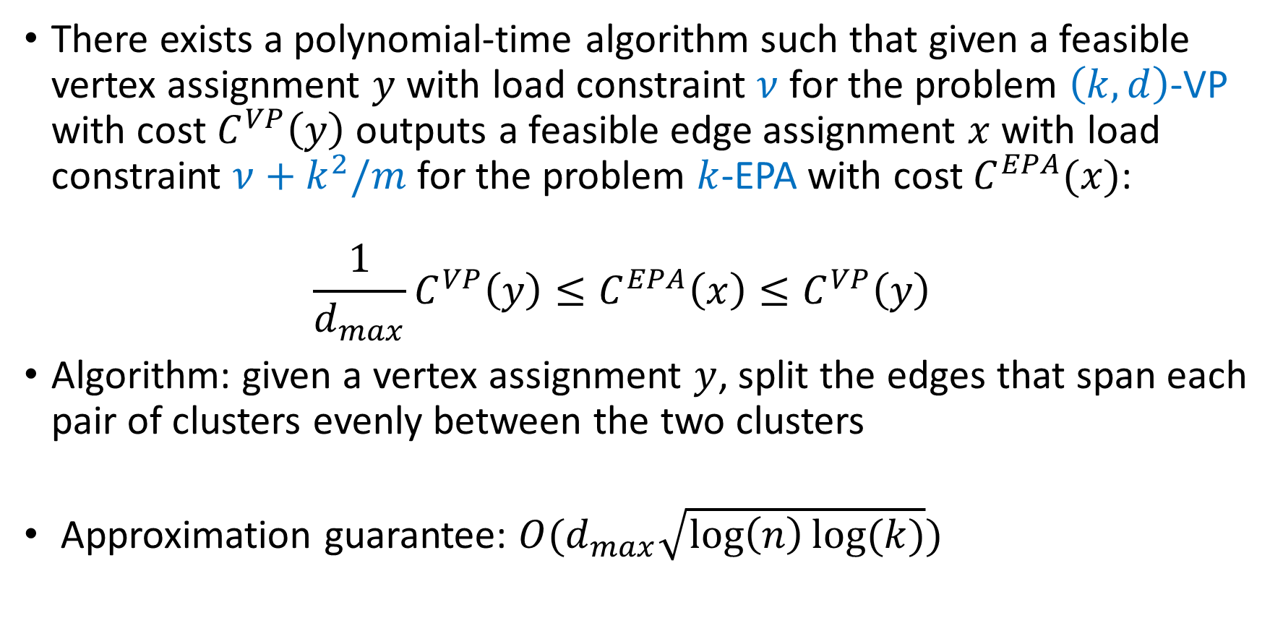
Approximation Guarantees
There exists a polynomial-time algorithm such that given a feasible vertex assignment $y$ with load constraint $ν$ for the problem $\left(k,d\right)$-VP with cost $C^{VP}\left(y\right)$ outputs a feasible edge assignment $x$ with load constraint $ν+k^{2}/m$ for the problem $k$-EPA with cost $C^{EPA}(x)$:
${\frac{1}{d_{max}}C^{VP}\left(y\right)≤C}^{EPA}\left(x\right)≤C^{VP}\left(y\right)$
Algorithm: given a vertex assignment $y$, split the edges that span each pair of clusters evenly between the two clusters
Approximation guarantee: $O(d_{max}\sqrt{\log\left(n\right)log⁡(k)})$

Slide 9
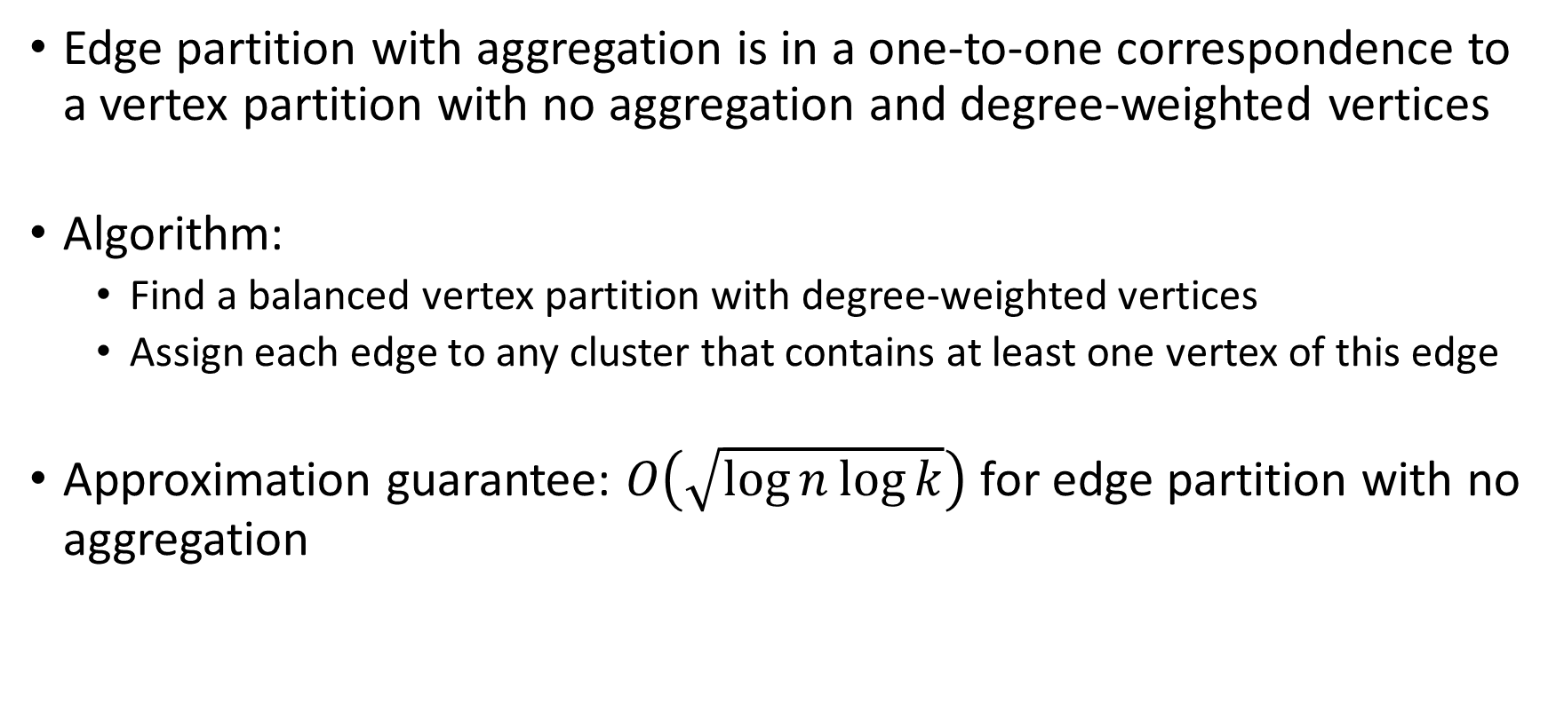
Approximation Guarantees (cont’d)
Edge partition with aggregation is in a one-to-one correspondence to a vertex partition with no aggregation and degree-weighted vertices
Algorithm:
  Find a balanced vertex partition with degree-weighted vertices
  Assign each edge to any cluster that contains at least one vertex of this edge
Approximation guarantee: $O\left(\sqrt{\log{n\log{k}}}\right)$ for edge partition with no aggregation

Slide 10
Streaming Heuristics
Online assignment of vertices or edges as they are observed in an input stream
Irrevocable assignments
  Reassignments are expensive in web-scale systems
  (consistency of distributed state)
Use local graph knowledge (neighbourhood sets)
Scalable
    One pass through the vertices or edges
Previously proposed streaming heuristic: PowerGraph [OSDI 2012]

Slide 11

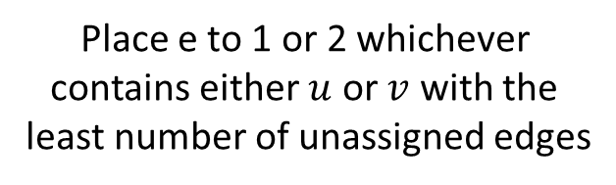




PowerGraph Streaming Heuristic
$$u$$
$$v$$
1
$$v$$
1
1
$$e=(u,v)$$
$$u$$
2
2
2
3
3
3
Place e to 1
Place e to 1 or 2 whichever
contains either $u$ or $v$ with the
least number of unassigned edges
Place e to a least
loaded cluster
Prioritizes assignment of edges to clusters that already contain its end vertices: prone to large load imbalance

Slide 12
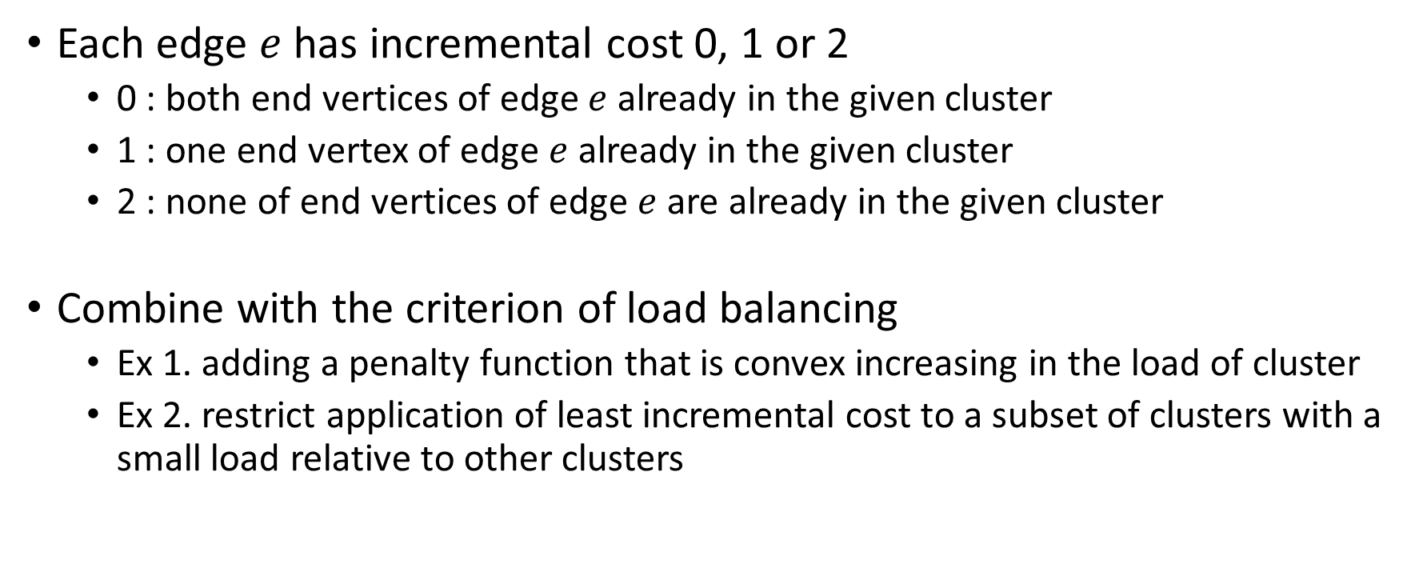
Greedy: Least Incremental Cost
Each edge $e$ has incremental cost 0, 1 or 2
  0 : both end vertices of edge $e$already in the given cluster
  1 : one end vertex of edge $e$ already in the given cluster
  2 : none of end vertices of edge $e$ are already in the given cluster
Combine with the criterion of load balancing
  Ex 1. adding a penalty function that is convex increasing in the load of cluster
  Ex 2. restrict application of least incremental cost to a subset of clusters with a small load relative to other clusters

Slide 13
Experimental Evaluation

Slide 14
Performance of Random Assignment
Graph: Amazon

Slide 15
Streaming Heuristics
Graph: Amazon

Slide 16
Performance of Random Assignment (cont’d)
Graph: Youtube

Slide 17
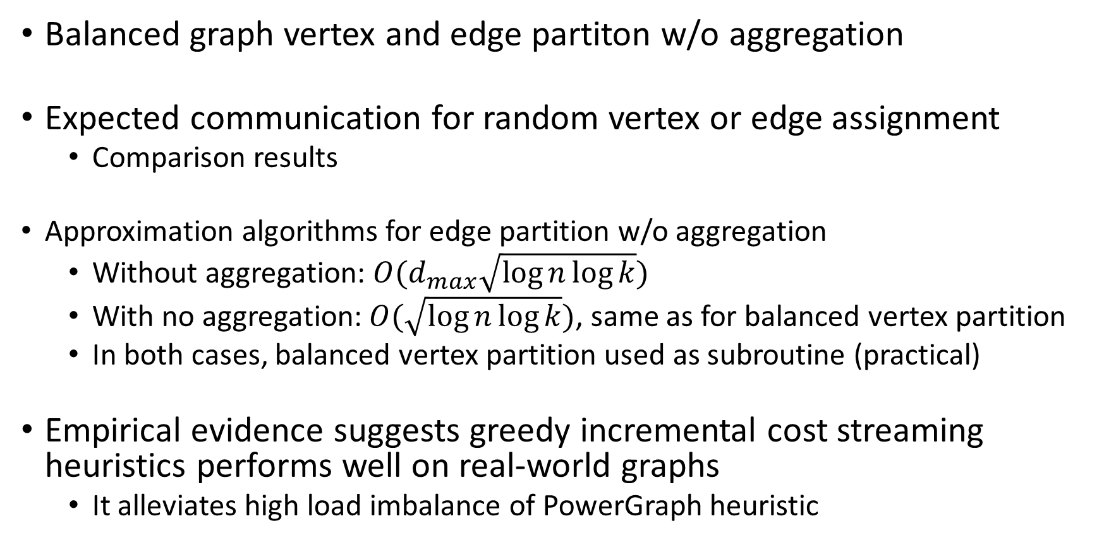
Concluding Remarks
Balanced graph vertex and edge partiton w/o aggregation
Expected communication for random vertex or edge assignment
  Comparison results
  Approximation algorithms for edge partition w/o aggregation
  Without aggregation: $O(d_{max}\sqrt{\log{n}\log{k}})$
  With no aggregation: $O(\sqrt{\log{n}\log{k}})$, same as for balanced vertex partition
  In both cases, balanced vertex partition used as subroutine (practical)
Empirical evidence suggests greedy incremental cost streaming heuristics performs well on real-world graphs
  It alleviates high load imbalance of PowerGraph heuristic

Slide 18
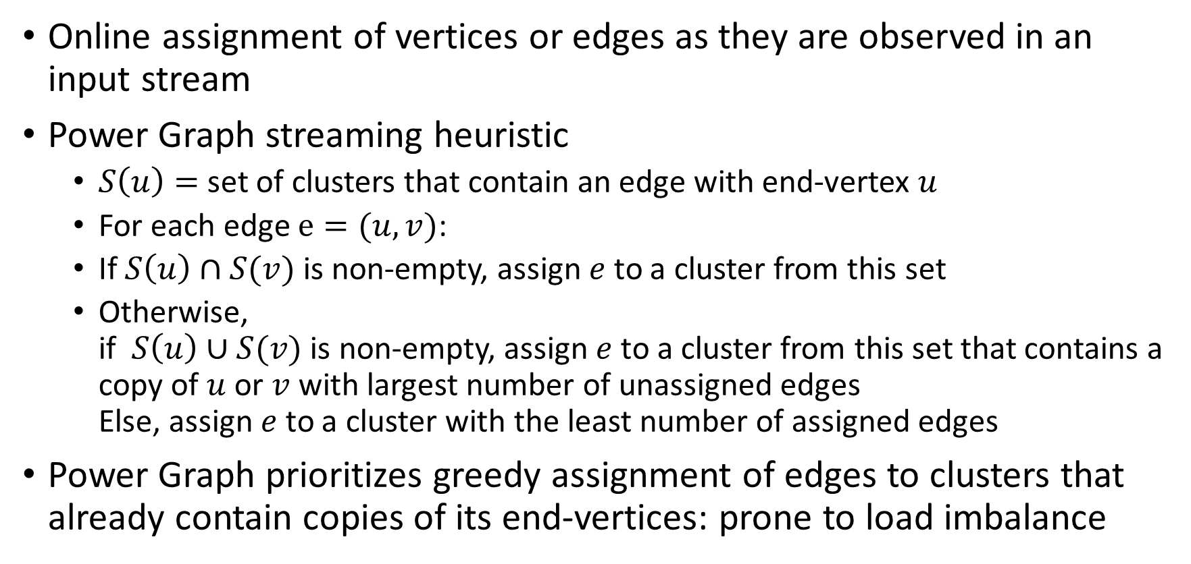
Streaming Heuristics
Online assignment of vertices or edges as they are observed in an input stream
Power Graph streaming heuristic
  $S\left(u\right)=$ set of clusters that contain an edge with end-vertex $u$
  For each edge $e=(u,v)$:
  If $S\left(u\right)∩S(v)$ is non-empty, assign $e$ to a cluster from this set
  Otherwise,
  if $S\left(u\right)∪S(v)$ is non-empty, assign $e$ to a cluster from this set that contains a copy of $u$ or $v$ with largest number of unassigned edges
  Else, assign $e$ to a cluster with the least number of assigned edges
Power Graph prioritizes greedy assignment of edges to clusters that already contain copies of its end-vertices: prone to load imbalance

