Slide 1
ARC Meeting – overview research
Ingrid Vliegen

Slide 2
Background
MSc in Industrial Engineering and Management at the Eindhoven University of Technology (TU/e)
Final project on Spare Parts management at ASML
PhD project at the School of Industrial Engineering, TU/e
Focus on service tools
In collaboration with ASML
Thesis defended: November 25, 2009
Visiting PhD student at Carnegie Mellon University, Pittsburgh
August – November 2007
ARC Meeting
2011-10-17
<numéro>

Slide 3
Background (2)
Assistant professor TU/e
Temporary appointment
September 2009 – May 2010
Assistant professor University of Twente (UT)
May 2010 – current
Visiting postdoctoral research associate, The Wharton School, University of Pennsylvania, Philadelphia, USA
Jan 2011 – July 2011
ARC Meeting
2011-10-17
<numéro>

Slide 4
Contents presentation
Optimization of stock levels for service tool inventory
Co-authors: Ana Bušić, Alan Scheller-Wolf, Geert-Jan van Houtum
Some ongoing studies:
Integrated planning of spare parts and service engineers
  Co-author: Morris Cohen
Hospital projects
  Several co-authors
ARC Meeting
2011-10-17
<numéro>

Slide 5
Integrated resource planning for maintenance actions

Slide 6
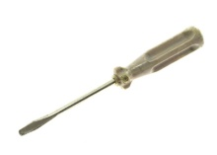
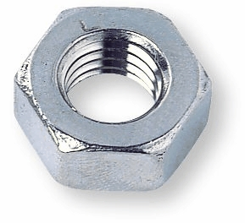
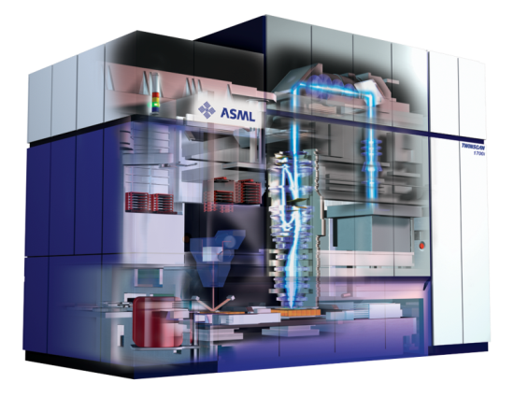

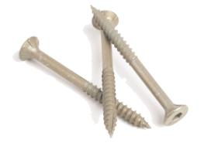
resource planning for maintenance actions
ARC Meeting
2011-10-17
<numéro>

Slide 7
Current status
Both in literature and practice
Focus on either spare parts or engineers
  The other resources are assumed to be available when determining capacity requirements
  Separate departments within companies
Service tools have not been studied at all
But a maintenance action can only start if all resources are available.
ARC Meeting
2011-10-17
<numéro>

Slide 8
What is the value of integrated planning models?
ARC Meeting
2011-10-17
<numéro>

Slide 9
Optimization of stock levels for service tool inventory
Service tools: Why bother?
Co-authors:
Ana Bušić
Alan Scheller-Wolf - CMU
Geert-Jan van Houtum – TU/e

Slide 10
introduction
ASML: High tech company produces technical machines
Responsible for machine uptime
To ensure uptime:
preventive maintenance
corrective maintenance
Needed for maintenance:
service engineers
spare parts
service tools
ARC Meeting
2011-10-17
<numéro>

Slide 11
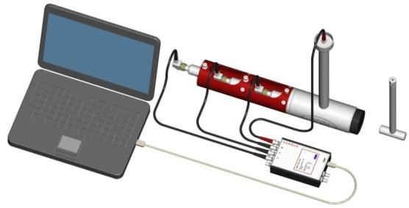
Introduction – service tools
Tools used for, among others, the repair, cleaning and/or calibration of machines
Expensive
Low demand rates
Many different tools
So, no screw drivers…
ARC Meeting
2011-10-17
<numéro>

Slide 12
Introduction - Differences parts and tools
Main differences with spare parts:
Tools are usually demanded in sets
  Coupling in demands
Spare parts are consumed, while tools are only used
  After usage returned to stock point together
  Coupling in returns
Now the question is:
Do we need to develop new heuristics for the stock planning of service tools? Or can we (continue to) use available heuristics for spare parts?
ARC Meeting
2011-10-17
<numéro>

Slide 13
Introduction – main question
Service tools: why bother?
ARC Meeting
2011-10-17
<numéro>

Slide 14



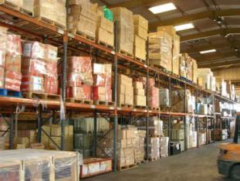



Introduction – situation
AFTER REPAIR ACTION, TOOLS ARE RETURNED
DEMAND OCCURS AT NEAREST WAREHOUSE
IF AVAILABLE, ENGINEER TAKES TOOLS
MACHINE REPAIRED, TOOLS RETURNED
DEMAND FOR MULTIPLE TOOLS
MACHINE BREAK DOWN
WAREHOUSES NEAR CUSTOMERS
Central warehouse
Local warehouse
ARC Meeting
2011-10-17
<numéro>

Slide 15


Introduction – Situation
TOOLS NOT AVAILABLE, EMERGENCY SUPPLY
MACHINES REPAIRED, TOOLS RETURNED
TOOLS ARE RETURNED
NOT ALL NEEDED TOOLS IN STOCK
Central warehouse
Local warehouse
ARC Meeting
2011-10-17
<numéro>

Slide 16
Introduction – goal study
Objective ASML:
Min Inventory holding costs
s.t. Service level ≥ Target service level
Goal of research:
Develop an efficient heuristic to determine near-optimal stock levels for service tools for this optimization problem
Compare heuristic with known heuristic for the planning of spare parts
ARC Meeting
2011-10-17
<numéro>

Slide 17
Outline
Introduction
Literature
Model
Approach
Results
Conclusions & Implications
Ongoing research
ARC Meeting
2011-10-17
<numéro>

Slide 18
Literature
Spare parts:
No coupling in demands
Repair kit problem:
Single period problem
Kit management problem:
Slightly different model, but analysis differs considerably
Assemble-to-order:
Mostly backordering
Lost sales: no coupled returns
ARC Meeting
2011-10-17
<numéro>

Slide 19
outline
Introduction
Literature
Model
Approach
Results
Conclusions & Implications
Ongoing research
ARC Meeting
2011-10-17
<numéro>

Slide 20
model
Central warehouse
Local warehouse
Available tools to customer, rest of demand satisfied via emergency shipment:
lost sale for warehouse under consideration
partial order service
Poisson process for sets of tools:
- coupled demands
Equal exponential return times
- coupled returns
Single location, multiple service tools
Base stock policy per tool
ARC Meeting
30-09-2010
<numéro>
2011-10-17

Slide 21
outline
Introduction
Literature
Model
Approach
Results
Conclusions
Implications
Ongoing research
ARC Meeting
2011-10-17
<numéro>

Slide 22
approach
Developed 3 heuristics
Compared costs with a lower bound
Validated whether solutions meet the target
ARC Meeting
2011-10-17
<numéro>

Slide 23
heuristics
3 Heuristics developed:
All use a greedy algorithm
Different evaluation methods
ARC Meeting
2011-10-17
<numéro>

Slide 24
Heuristic 1
Vliegen and van Houtum (2009)
Exact evaluation: very time consuming
3 approximate evaluation methods
  Overestimates the service level
  Underestimates the service level
  Weighted average of (1) and (2)
  Leads to efficient and accurate results
ARC Meeting
2011-10-17
<numéro>

Slide 25
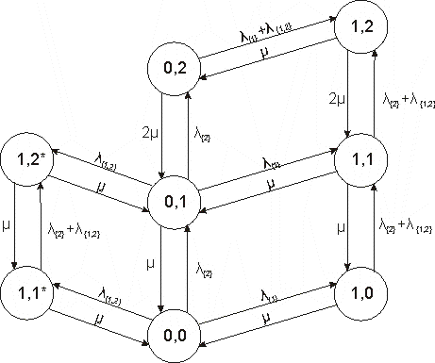
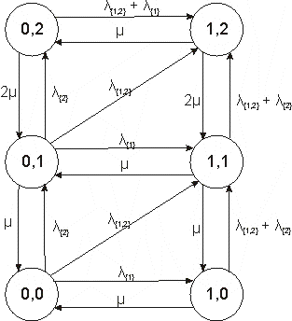
Heuristic 1 (2)
Lower bound
Original model
ARC Meeting
2011-10-17
<numéro>

Slide 26




Heuristic 2
Model currently used for spare parts
Two main assumptions:
  No coupling in demands
  No coupling in returns
The demand for sets of tools is decoupled into demands for each separate tool
Where
  is the aggregate order fill rate approximated by method 2
  is the aggregate demand rate for item i
  is the total demand rate
  is the fill rate for item i (using Erlang loss formula)
ARC Meeting
2011-10-17
<numéro>

Slide 27


Heuristic 3
Similar to Schaefer (1983)
Two main assumptions:
  No coupling in returns
  On hand stock levels are independent
Where
  is the order fill rate for demand stream k approximated by evaluation method 3
  is the set of tools demanded by demand stream k
  is the fill rate for item i (using Erlang loss formula)
ARC Meeting
2011-10-17
<numéro>

Slide 28
Approach
Developed 3 heuristics
Compared costs with a lower bound
Validated whether solutions meet the target
ARC Meeting
2011-10-17
<numéro>

Slide 29
Lower bound - steps
Using Lagrangian relaxation (Fisher, 1981);
Splitting the problem in smaller subproblems;
Using bounds on the service level (Busic, Vliegen, Scheller-Wolf, 2011);
Using enumeration.
ARC Meeting
2011-10-17
<numéro>

Slide 30
Small intermezzo – precedence relation method on sets of states
Original model
ARC Meeting
2011-10-17
<numéro>

Slide 31
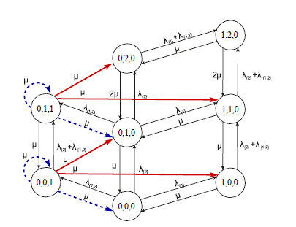
Small intermezzo – precedence relation method on sets of states
Redirecting sets of states
ARC Meeting
2011-10-17
<numéro>

Slide 32
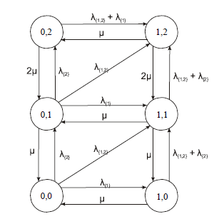
Small intermezzo – precedence relation method on sets of states
Aggregation
=
ARC Meeting
2011-10-17
<numéro>

Slide 33
Small intermezzo – precedence relation method on sets of states
Theorem
ARC Meeting
2011-10-17
<numéro>

Slide 34
Approach
Developed 3 heuristics
Compared costs with a lower bound
Validated whether solutions meet the target
Simulation tool:
Establish solution’s fill rate
Tune solutions
ARC Meeting
2011-10-17
<numéro>

Slide 35
Validation – establish fill rate
ARC Meeting
2011-10-17
<numéro>

Slide 36
Validation – tune solution
ARC Meeting
2011-10-17
<numéro>

Slide 37
Outline
Introduction
Literature
Model
Approach
Results
Conclusions & Implications
Ongoing research
ARC Meeting
2011-10-17
<numéro>

Slide 38
Results
Test bed:
972 instances:
  Amount of demand streams
  Demand rate
  Size of demand streams
  Service level
  Division of demand over demand streams with different sizes
  Relation between tool demand and price
ARC Meeting
2011-10-17
<numéro>

Slide 39
Results - accuracy
ARC Meeting
2011-10-17
<numéro>

Slide 40
Results – variability of accuracy
ARC Meeting
2011-10-17
<numéro>

Slide 41
Results – cost efficiency
ARC Meeting
2011-10-17
<numéro>

Slide 42
Results – running time
ARC Meeting
2011-10-17
<numéro>

Slide 43
Outline
Introduction
Literature
Model
Approach
Results
Conclusions & Implications
Ongoing research
ARC Meeting
2011-10-17
<numéro>

Slide 44
Conclusions – Heuristic 1
Most detailed
Leads to lowest costs
But very high running times
Cannot be used in practice
ARC Meeting
2011-10-17
<numéro>

Slide 45
Conclusions - Heuristic 2
Very fast (seconds)
Very inaccurate & accuracy variable
Highest costs (7% higher)
So, spare parts models are not appropriate to be used for the stock planning of service tools
ARC Meeting
2011-10-17
<numéro>

Slide 46
Conclusions – heuristic 3
Takes into account coupling in demands, but not in returns
Very accurate
Higher costs than Heuristic 1 (5% higher)
→ Use Heuristic 3
ARC Meeting
2011-10-17
<numéro>

Slide 47
Implications
ASML has started collecting data on:
What sets are demanded
Demand rates for these sets
A business case is being carried out to see the implications for the whole network
A case study is done to see the performance of Heuristic 1 and 3 in a multi-location setting
ARC Meeting
2011-10-17
<numéro>

Slide 48
Outline
Introduction
Literature
Model
Approach
Results
Conclusions & Implications
Ongoing research
ARC Meeting
2011-10-17
<numéro>

