Slide 1

“From my sixth year, I had a perfect mania for drawing every object that I saw.
When I had reached my fiftieth year, I had published a vast quantity of drawing;
but I am unsatisfied with all that I have
produced before my seventieth year”.
Hokusai

Slide 2
Community detection & Ramanujan graphs:
A proof of the
"spectral redemption conjecture"
Charles Bordenave, Marc Lelarge, Laurent Massoulié

Slide 3








Community Detection
→ Identification of groups of similar objects within overall population based on their observed graph of interactions
→ Closely related objectives: clustering and embedding
Profile space

Slide 4






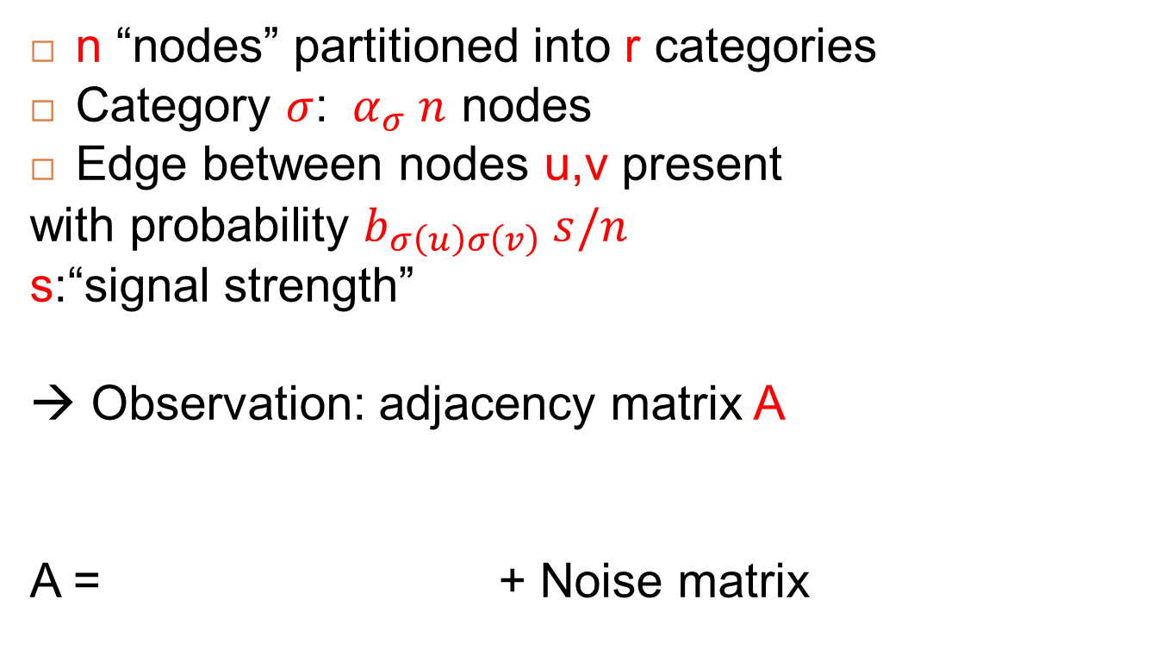
The Stochastic Block Model
[Holland-Laskey-Leinhardt’83]
n “nodes” partitioned into r categories
Category $σ$: ${ α}_{σ} n$ nodes
Edge between nodes u,v present
with probability $b_{σ\left(u\right)σ\left(v\right)} s/n$
s:“signal strength”
→ Observation: adjacency matrix A
A = + Noise matrix

Slide 5
Outline
  Basic spectral methods for “rich signal” case
    Ramanujan-like spectrum separation
  The “weak signal” case (sparse observations)
    Phase transition on detectability
    Non-backtracking matrices and “spectral redemption”

Slide 6
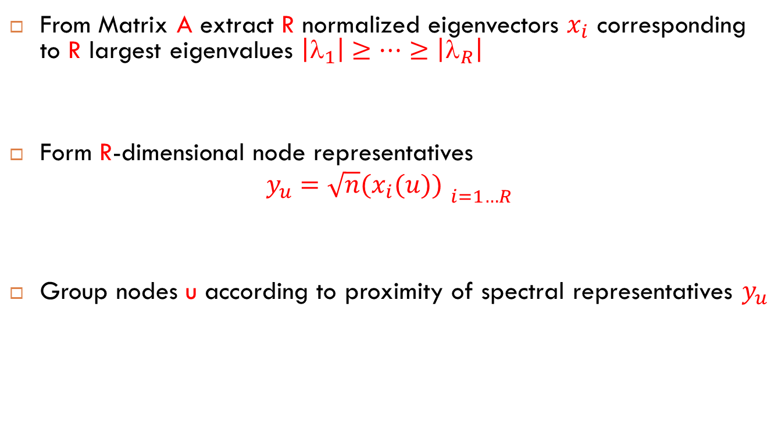
Basic spectral clustering
From Matrix A extract R normalized eigenvectors $x_{i}$ corresponding to R largest eigenvalues $\left|_{1}\right|≥…≥$ $\left|_{R}\right|$
Form R-dimensional node representatives
$$y_{u}={\sqrt{n}(x_{i}(u)) }_{i=1…R}$$
Group nodes u according to proximity of spectral representatives $y_{u}$

Slide 7
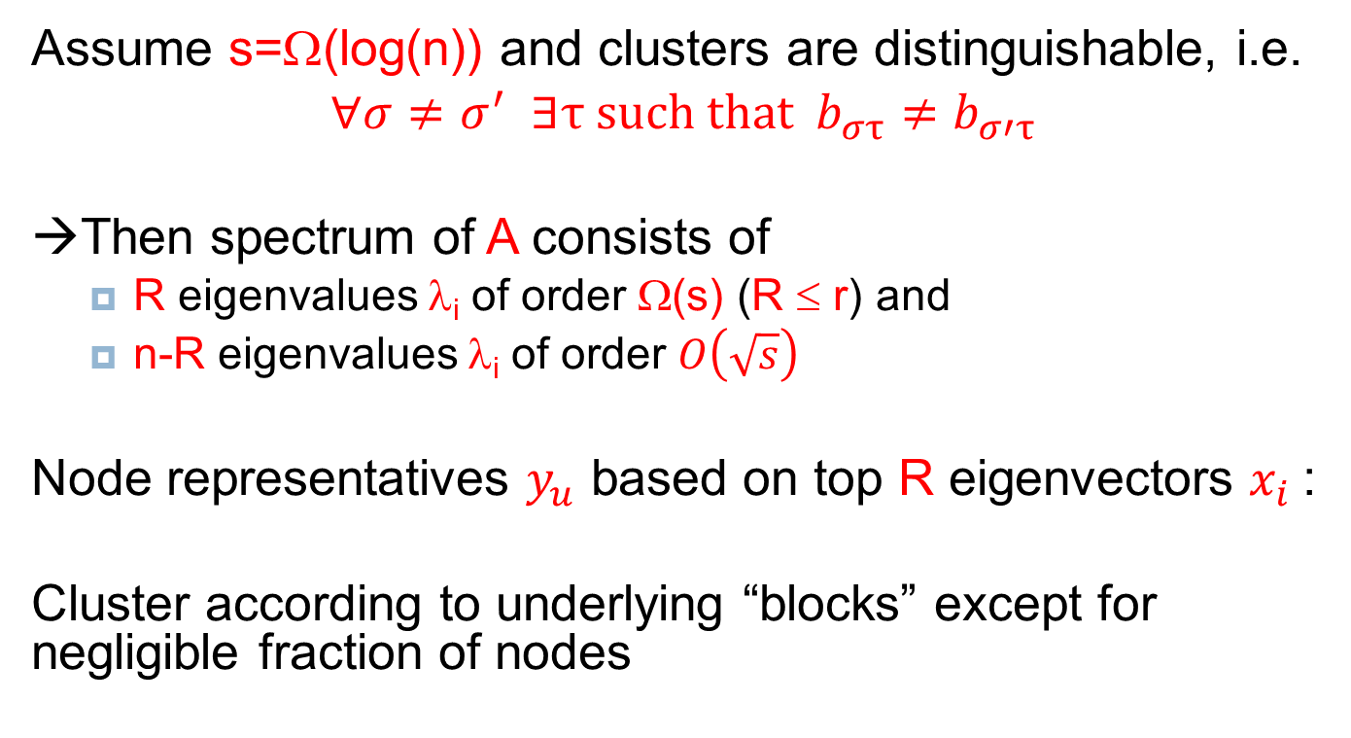
Result for “logarithmic” signal strength s
Assume s=Ω(log(n)) and clusters are distinguishable, i.e.
$∀σ≠$ $σ^{′} ∃τ \text{such} \text{that} b_{στ}≠b_{σ′τ}$
→Then spectrum of A consists of
  R eigenvalues λ_{i} of order Ω(s) (R ≤ r) and
  n-R eigenvalues λ_{i} of order $O\left(\sqrt{s}\right)$
Node representatives $y_{u}$ based on top R eigenvectors $x_{i}$:
Cluster according to underlying “blocks” except for negligible fraction of nodes
Notes:
Also assumes s=O(n^1/5)

Slide 8
Proof arguments
Control spectral radius of noise matrix
+ perturbation of matrix eigen-elements
(for symmetric matrices: Weyl’s inequalities, Courant-Fisher variational characterization,…)
A = + random “noise” matrix
Block matrix
non-zero eigenvalues: Θ(s)

Slide 9
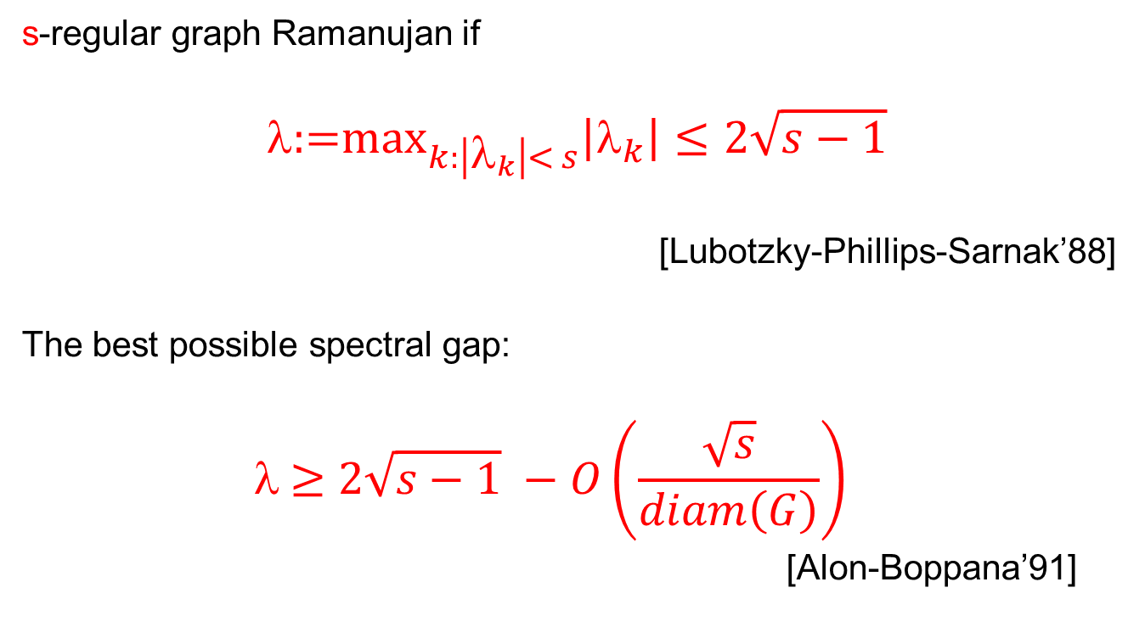
spectral separation properties
“à la Ramanujan”
s-regular graph Ramanujan if
$$\text{:=}{\text{max}}_{k:\left|λ_{k}\right|< s}\left|λ_{k}\right|≤2\sqrt{s−1}$$
[Lubotzky-Phillips-Sarnak’88]
The best possible spectral gap:
$$ \text{≥}{ 2\sqrt{s−1} −O\left(\frac{\sqrt{s}}{diam\left(G\right)}\right) }_{}$$
[Alon-Boppana’91]

Slide 10
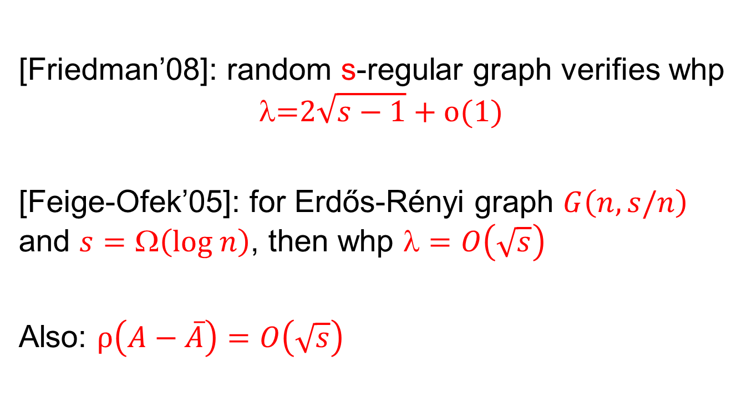
spectral separation properties
“à la Ramanujan”
[Friedman’08]: random s-regular graph verifies whp
$$\text{=}2\sqrt{s−1}+o(1)$$
[Feige-Ofek’05]: for Erdős-Rényi graph $G\left(n,s/n\right)$ and $s=\text{Ω}\left(\text{log} n\right)$, then whp $=O\left(\sqrt{s}\right)$
Also: $ρ\left(A−\overline{A}\right)=O\left(\sqrt{s}\right)$

Slide 11
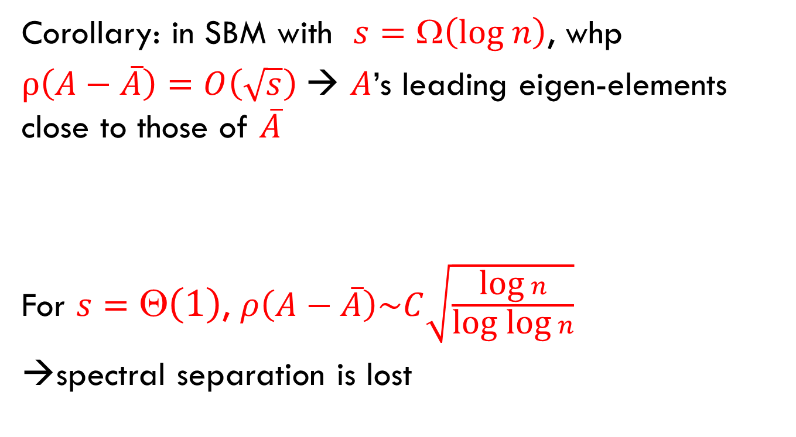
spectral separation properties
“à la Ramanujan”
Corollary: in SBM with $s=\text{Ω}\left(\text{log} n\right)$, whp
$ρ\left(A−\overline{A}\right)=O\left(\sqrt{s}\right)$→ $A$’s leading eigen-elements close to those of $\overline{A}$
For $s=\text{Θ}\left(1\right)$, $ρ\left(A−\overline{A}\right)\sim C\sqrt{\frac{\text{log} n}{\text{log} \text{log} n}}$
→spectral separation is lost

Slide 12
Outline
  Basic spectral methods for “rich signal” case
    Ramanujan-like spectrum separation
  The “weak signal” case (sparse observations)
    Phase transition on detectability
    Non-backtracking matrices and “spectral redemption”

Slide 13


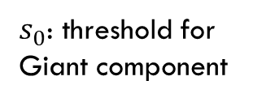

Weak signal strength: s = $\text{}$(1)
Correct classification of all but negligible fraction of nodes impossible (isolated nodes…)
→ Assess performance of clustering $\hat{σ}$ by overlap metric:
Overlap
Overlap
Signal
strength s
$s_{0}$: threshold for
Giant component
$$s_{0}$$
$$s_{c}$$
Signal strength s

Slide 14

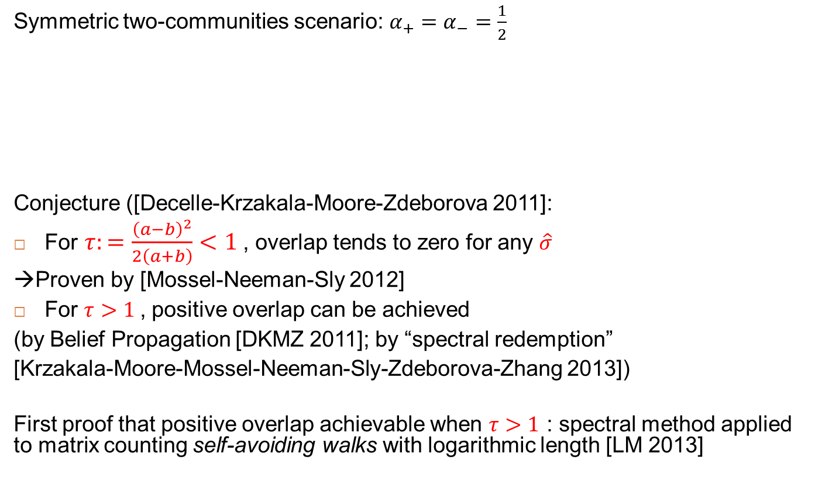
Weak signal strength : s=1
Symmetric two-communities scenario: $α_{+}=α_{−}=\frac{1}{2}$
Conjecture ([Decelle-Krzakala-Moore-Zdeborova 2011]:
For $τ:=\frac{{\left(a−b\right)}^{2}}{2\left(a+b\right)}<1$, overlap tends to zero for any $\hat{σ}$
→Proven by [Mossel-Neeman-Sly 2012]
For $τ>1$, positive overlap can be achieved
(by Belief Propagation [DKMZ 2011]; by “spectral redemption”
[Krzakala-Moore-Mossel-Neeman-Sly-Zdeborova-Zhang 2013])
First proof that positive overlap achievable when $τ>1$ : spectral method applied to matrix counting self-avoiding walks with logarithmic length [LM 2013]
Notes:
Interesting for two reasons: tells how much subsampling can be tolerated; methods achieving positive overlap up to transition are likely robust.

Slide 15
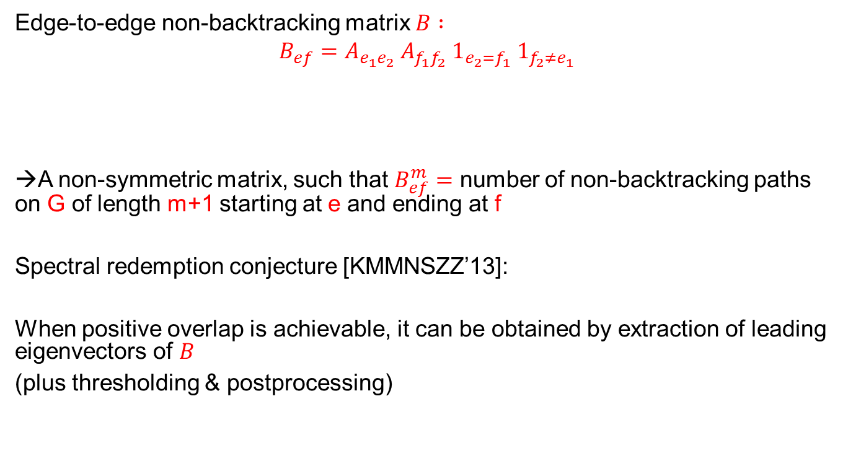
“Spectral redemption” and the non-backtracking matrix
Edge-to-edge non-backtracking matrix $B :$
$$B_{ef}=A_{e_{1}e_{2}}{ A}_{f_{1}f_{2}} 1_{e_{2}=f_{1}} 1_{f_{2}≠e_{1}}$$
→A non-symmetric matrix, such that $B_{ef}^{m}=$ number of non-backtracking paths on G of length m+1 starting at e and ending at f
Spectral redemption conjecture [KMMNSZZ’13]:
When positive overlap is achievable, it can be obtained by extraction of leading eigenvectors of $B$
(plus thresholding & postprocessing)
e
f
e
f

Slide 16
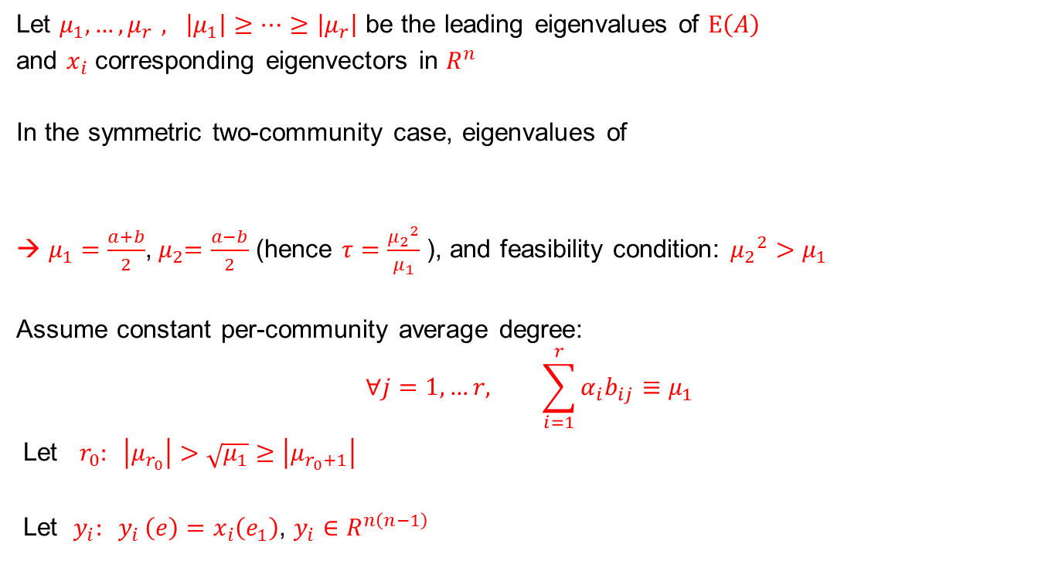
“Spectral redemption” and the non-backtracking matrix
Let $μ_{1},{…,μ}_{r}, \left|μ_{1}\right|≥…≥\left|μ_{r}\right|$ be the leading eigenvalues of $E\left(A\right)$
and $x_{i}$ corresponding eigenvectors in $R^{n}$
In the symmetric two-community case, eigenvalues of
→ $μ_{1}=\frac{a+b}{2}$,${ μ}_{2}=\frac{a−b}{2}$ (hence $τ=\frac{{μ_{2}}^{2}}{μ_{1}}$ ), and feasibility condition: ${μ_{2}}^{2}>μ_{1}$
Assume constant per-community average degree:
$$∀j=1,…r, \sum_{i=1}^{r}{α_{i}b_{ij}}≡μ_{1}$$
Let ${ r}_{0}: \left|μ_{r_{0}}\right|>\sqrt{μ_{1}}≥\left|μ_{r_{0}+1}\right|$
Let $y_{i}{: y}_{i}\left(e\right)=x_{i}\left(e_{1}\right)$, $y_{i}∈R^{n\left(n−1\right)}$
a/2
b/2
b/2
a/2

Slide 17
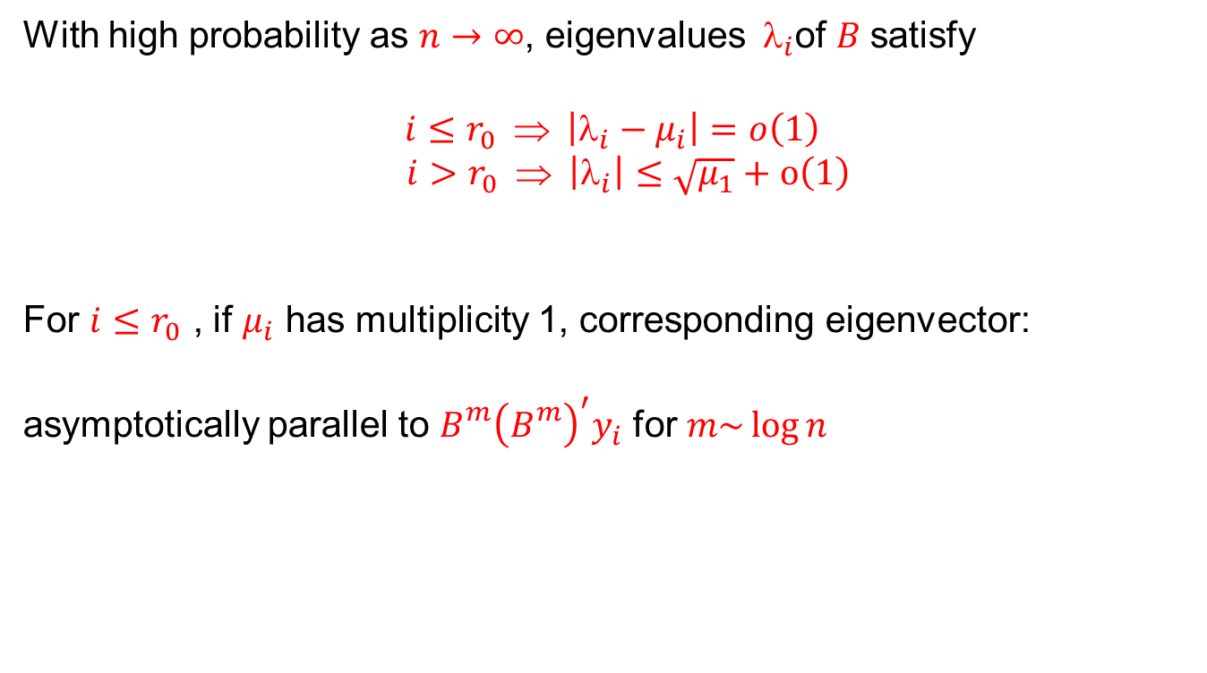
Main result
With high probability as $n→∞$, eigenvalues $_{i}$of$B$ satisfy
$$i≤r_{0} ⇒ \left|λ_{i}−μ_{i}\right|=o\left(1\right)$$
$$i>r_{0} ⇒ \left|λ_{i}\right|≤\sqrt{μ_{1}}+o\left(1\right)$$
For $i≤r_{0}$ , if $μ_{i}$ has multiplicity 1, corresponding eigenvector:
asymptotically parallel to ${B_{}^{m}{\left(B_{}^{m}\right)}^{′}y}_{i}$ for $m\sim \log{n}$

Slide 18
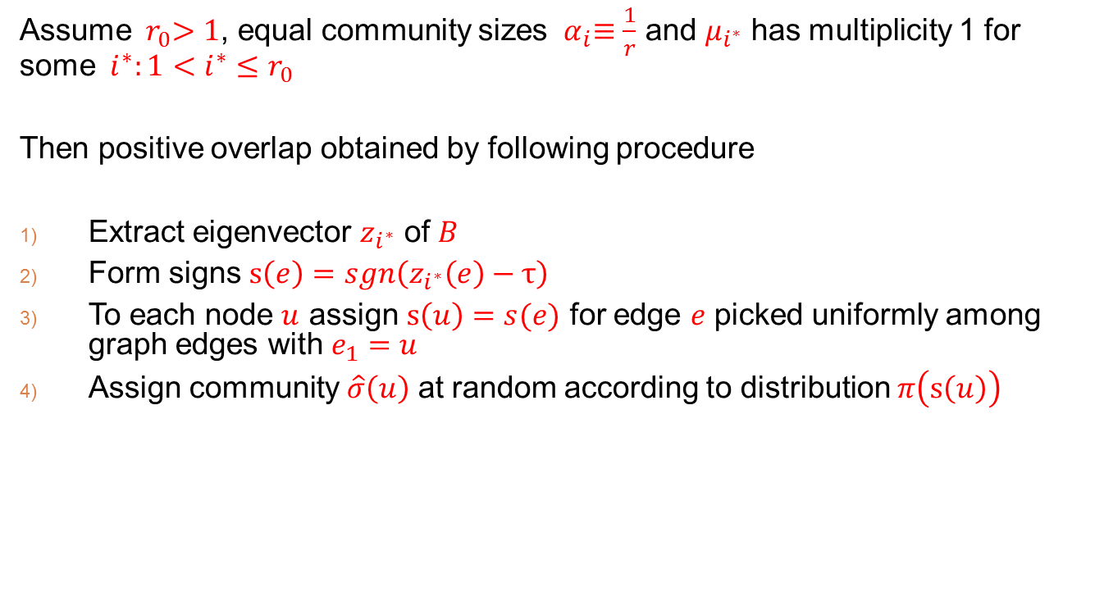
Corollary 1
Assume ${ r}_{0}>1$, equal community sizes ${ α}_{i}≡\frac{1}{r}$ and $μ_{i^{∗}}$ has multiplicity 1 for some ${ i^{∗}:1<i^{∗}≤r}_{0}$
Then positive overlap obtained by following procedure
Extract eigenvector $z_{i^{∗}}$ of $B$
Form signs $s\left(e\right)=sgn\left(z_{i^{∗}}\left(e\right)−τ\right)$
To each node $u$ assign $s\left(u\right)=s(e)$ for edge $e$ picked uniformly among graph edges with $e_{1}=u$
Assign community $\hat{σ}\left(u\right)$ at random according to distribution $π\left(s\left(u\right)\right)$
e
u
e’
e’’

Slide 19

Illustration for 2-community symmetric Stochastic block model
$$_{i^{∗}}$$

Slide 20
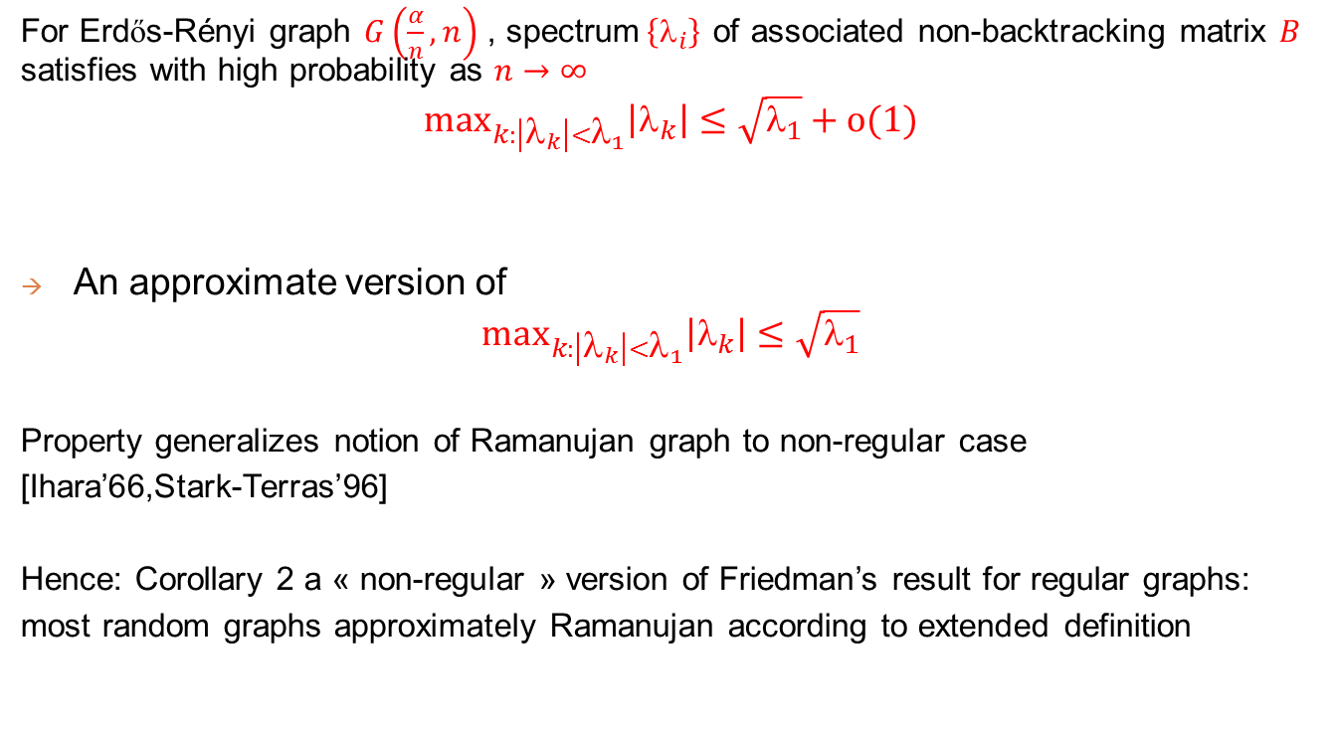
Corollary 2
For Erdős-Rényi graph $G\left(\frac{α}{n},n\right)$ , spectrum$\left\{_{i}\right\}$ of associated non-backtracking matrix $B$ satisfies with high probability as $n→∞$
$${\text{max}}_{k:\left|λ_{k}\right|<λ_{1}}\left|λ_{k}\right|≤\sqrt{λ_{1}}+o(1)$$
An approximate version of
$${\text{max}}_{k:\left|λ_{k}\right|<λ_{1}}\left|λ_{k}\right|≤\sqrt{λ_{1}}$$
Property generalizes notion of Ramanujan graph to non-regular case
[Ihara’66,Stark-Terras’96]
Hence: Corollary 2 a « non-regular » version of Friedman’s result for regular graphs:
most random graphs approximately Ramanujan according to extended definition

Slide 21

Illustration for Erdős-Rényi graph with$n=500, α=4$

Slide 22
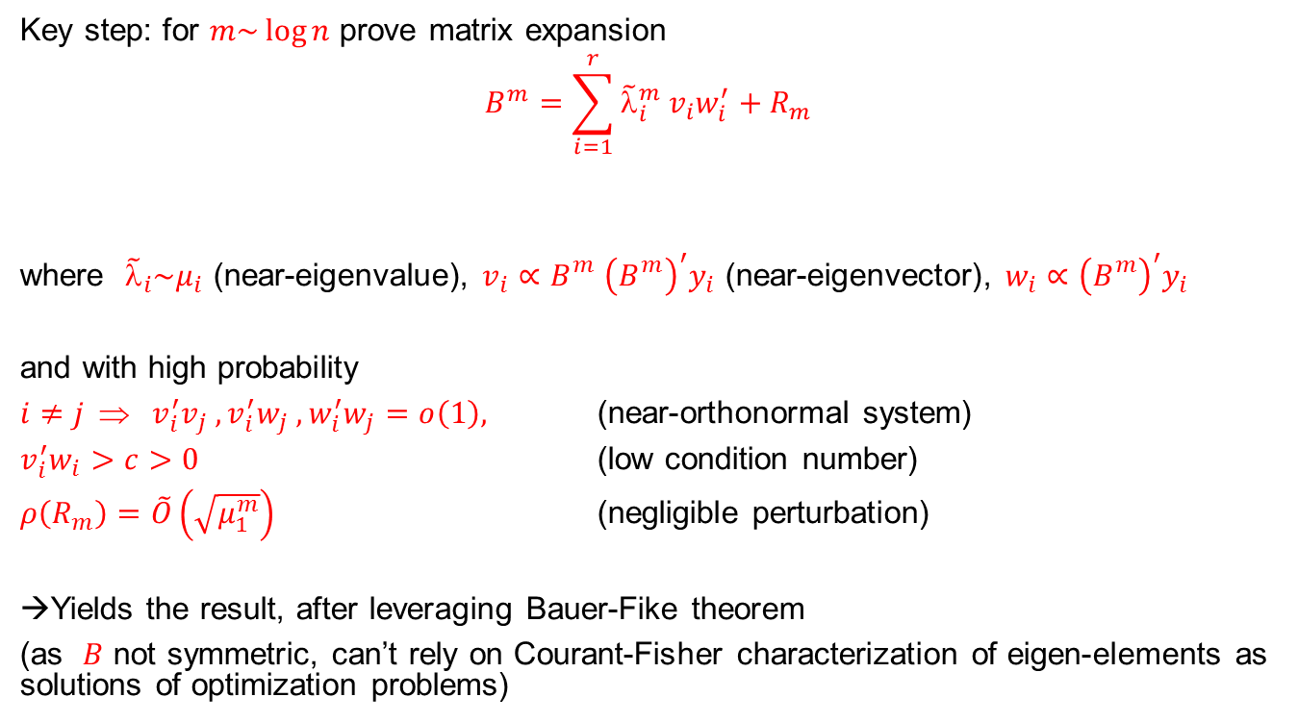
Proof elements
Key step: for $m\sim \log{n}$ prove matrix expansion
$$B^{m}=\sum_{i=1}^{r}{{\tilde{λ}}_{i}^{m}{ v}_{i}w_{i}^{′}+R_{m}}$$
where ${\tilde{λ}}_{i}\sim μ_{i}$ (near-eigenvalue), $v_{i}{{∝B}_{}^{m}{\left(B_{}^{m}\right)}^{′}y}_{i}$ (near-eigenvector), $w_{i}{∝{\left(B_{}^{m}\right)}^{′}y}_{i}$
and with high probability
${i≠j ⇒ v}_{i}^{′}v_{j} , v_{i}^{′}w_{j} ,w_{i}^{′}w_{j}=o\left(1\right),$ (near-orthonormal system)
$v_{i}^{′}w_{i}>c>0$ (low condition number)
$ρ\left(R_{m}\right)=\tilde{O}\left(\sqrt{μ_{1}^{m}}\right)$ (negligible perturbation)
→Yields the result, after leveraging Bauer-Fike theorem
(as $B$ not symmetric, can’t rely on Courant-Fisher characterization of eigen-elements as solutions of optimization problems)
Low-rank

Slide 23
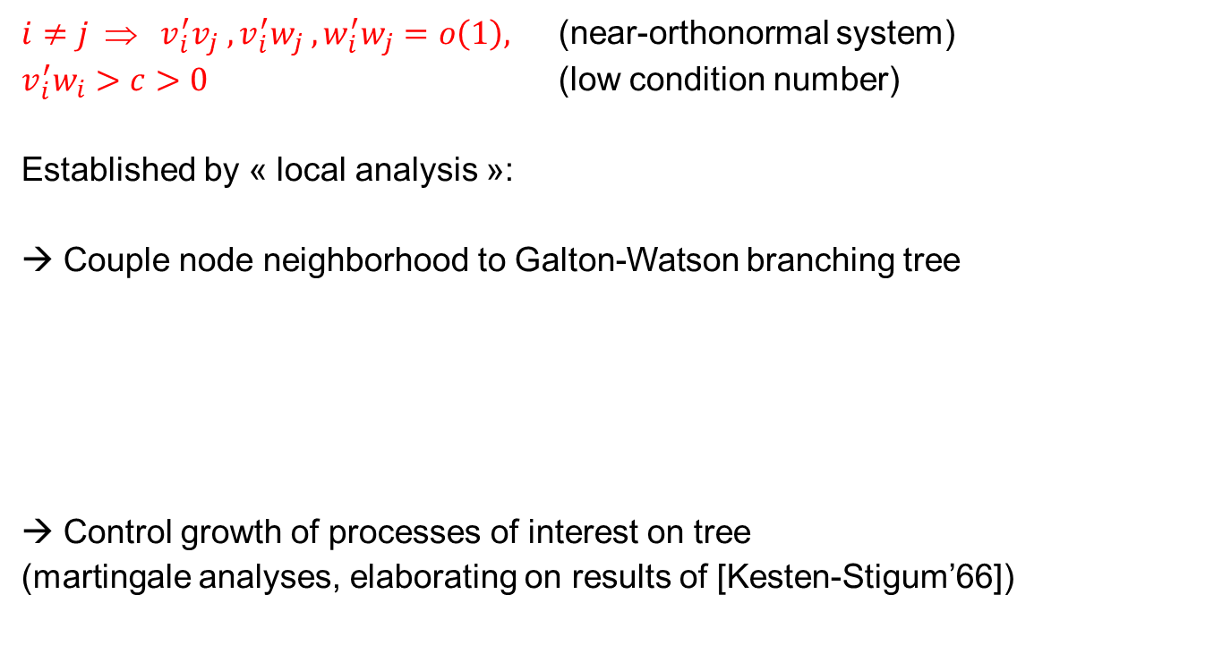
Proof elements (local analysis)
${i≠j ⇒ v}_{i}^{′}v_{j} , v_{i}^{′}w_{j} ,w_{i}^{′}w_{j}=o\left(1\right),$ (near-orthonormal system)
$v_{i}^{′}w_{i}>c>0$ (low condition number)
Established by « local analysis »:
→ Couple node neighborhood to Galton-Watson branching tree
→ Control growth of processes of interest on tree
(martingale analyses, elaborating on results of [Kesten-Stigum’66])
i
+
+
+
-
-

Slide 24

Proof elements (local analysis)
i
          Nb of distance t neighbors: $S_{t}\left(i\right)$
          Sum of spins of distance t neighbors: $D_{t}\left(i\right)$
  →then whp: $S_{t}\left(i\right)=α^{t−l}S_{l}\left(i\right)+\tilde{O}\left(α^{t/2}\right)$
  $D_{t}\left(i\right)=β^{t−l}D_{l}\left(i\right)+\tilde{O}\left(α^{t/2}\right)$
+
+
+
-
-

Slide 25
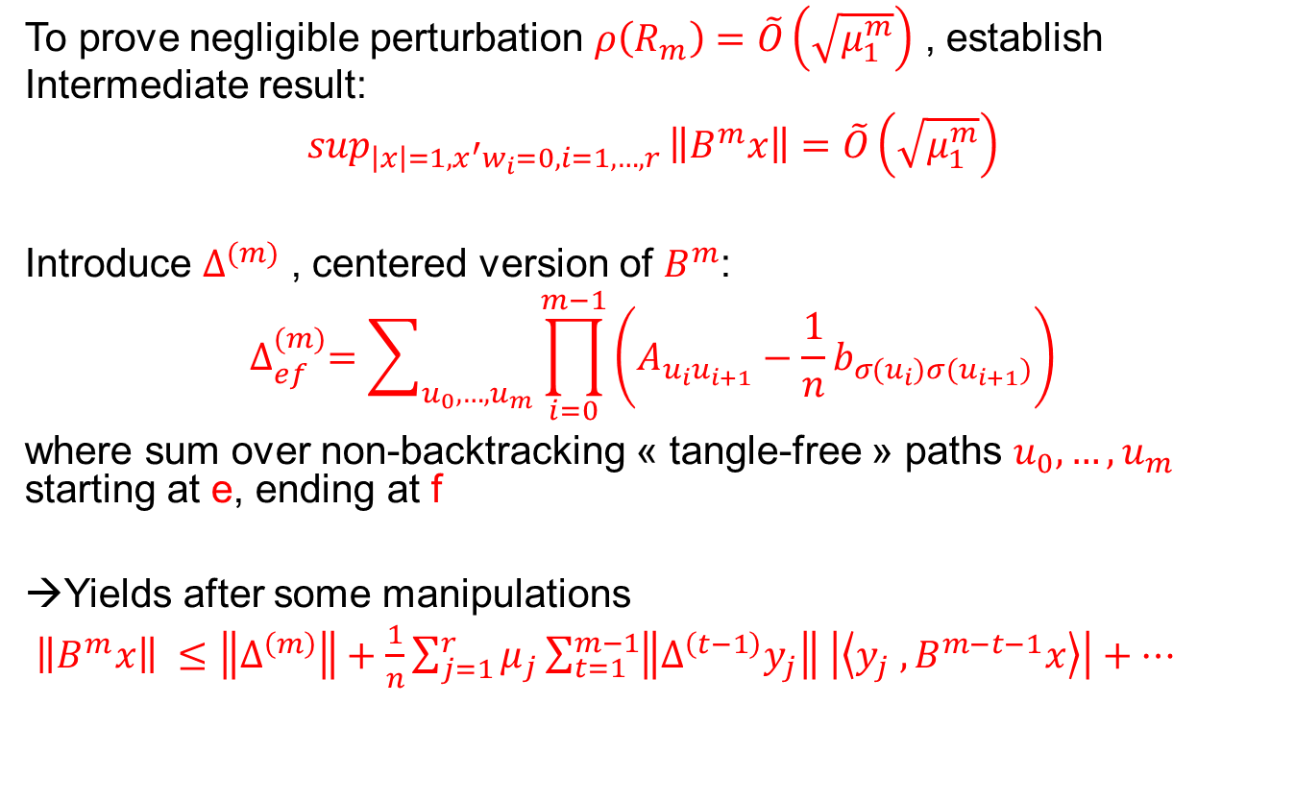
Proof elements (ctd)
To prove negligible perturbation $ρ\left(R_{m}\right)=\tilde{O}\left(\sqrt{μ_{1}^{m}}\right)$ , establish Intermediate result:
$$\sup_{\left|x\right|=1,x^{′}w_{i}=0, i=1,…,r }\left\|B^{m}x\right\|=\tilde{O}\left(\sqrt{μ_{1}^{m}}\right)$$
Introduce $∆^{(m)}$ , centered version of $B^{m}$:
$$∆_{ef}^{(m)}=\sum_{u_{0},…,u_{m}}{\prod_{i=0}^{m−1}{\left(A_{u_{i}u_{i+1}}−\frac{1}{n}b_{σ(u_{i}){σ(u}_{i+1})}\right)}}$$
where sum over non-backtracking « tangle-free » paths $u_{0},…,u_{m}$ starting at e, ending at f
→Yields after some manipulations
$\left\|B^{m}x\right\| ≤\left\|∆^{\left(m\right)}\right\|+\frac{1}{n}\sum_{j=1}^{r}{μ_{j}\sum_{t=1}^{m−1}{\left\|∆^{\left(t−1\right)}y_{j}\right\| \left|\left\langle y_{j}{ ,B}^{m−t−1}x\right\rangle \right|}}+…$

Slide 26
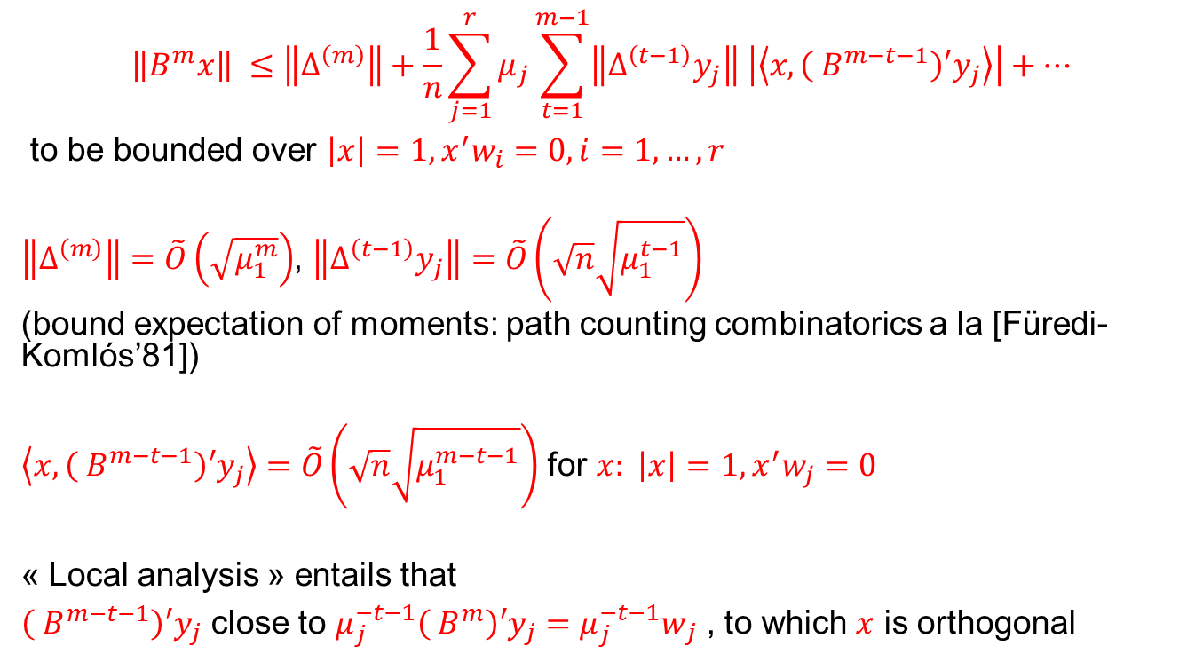
Proof elements (ctd)
$$\left\|B^{m}x\right\| ≤\left\|∆^{\left(m\right)}\right\|+\frac{1}{n}\sum_{j=1}^{r}{μ_{j}\sum_{t=1}^{m−1}{\left\|∆^{\left(t−1\right)}y_{j}\right\| \left|\left\langle x, {\left({ B}^{m−t−1}\right)′y}_{j}\right\rangle \right|}}+…$$
to be bounded over $\left|x\right|=1,x^{′}w_{i}=0, i=1,…,r$
$\left\|∆^{\left(m\right)}\right\|=\tilde{O}\left(\sqrt{μ_{1}^{m}}\right)$, $\left\|∆^{\left(t−1\right)}y_{j}\right\|=\tilde{O}\left(\sqrt{n}\sqrt{μ_{1}^{t−1}}\right)$
(bound expectation of moments: path counting combinatorics a la [Füredi-Komlós’81])
$\left\langle x, {\left({ B}^{m−t−1}\right)′y}_{j}\right\rangle =\tilde{O}\left(\sqrt{n}\sqrt{μ_{1}^{m−t−1}}\right)$ for $x: \left|x\right|=1,x^{′}w_{j}=0$
« Local analysis » entails that
${\left({ B}^{m−t−1}\right)′y}_{j}$ close to ${μ_{j}^{−t−1}\left({ B}^{m}\right)′y}_{j}={μ_{j}^{−t−1}w}_{j}$ , to which $x$ is orthogonal

Slide 27
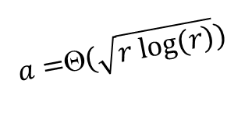
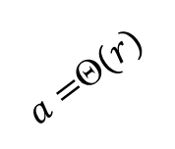
Remaining mysteries about SBM’s (1)
Conjectured “phase diagram” for more than 2 blocks
(assuming fixed inter-community parameter b)
Detection hard but feasible
(how? In polynomial time?)
Intra-community
parameter a
Detection easy
(spectral methods
or BP)
$a=$Θ$(r)$
$a=$Θ$(\sqrt{r log⁡(r)})$
Detection infeasible
r=4
r=5
Number of
communities r

Slide 28
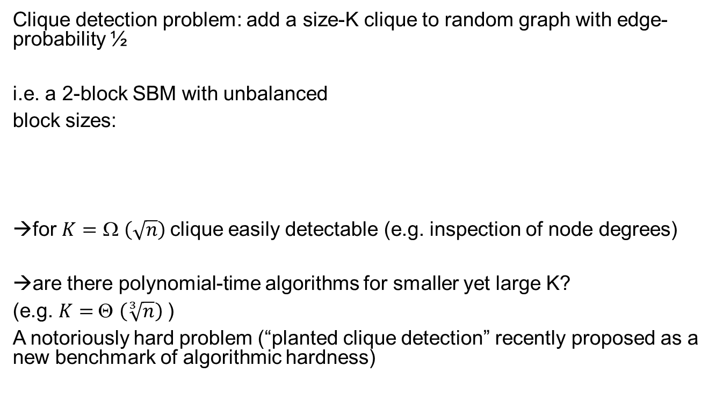
Remaining mysteries about SBM’s (2)
Clique detection problem: add a size-K clique to random graph with edge-probability ½
i.e. a 2-block SBM with unbalanced
block sizes:
→for $K=$ Ω $\left(\sqrt{n}\right)$clique easily detectable (e.g. inspection of node degrees)
→are there polynomial-time algorithms for smaller yet large K?
(e.g. $K=$Θ $\left(\sqrt[3]{n}\right)$)
A notoriously hard problem (“planted clique detection” recently proposed as a new benchmark of algorithmic hardness)
½
K
½
½
n-K

Slide 29
Conclusions and Outlook
Variations of basic spectral methods still to be invented: interesting mathematics and practical relevance
Detection in SBM = rich playground for analysis of computational complexity with methods of statistical physics
Computationally efficient methods for “hard” cases (planted clique, intermediate phase for multiple communities)?
Non-regular Ramanujan graphs: theory still in its infancy (strong analogue of Alon-Boppana’s theorem still missing, but…)

Slide 30
Thanks!

