Slide 1
Introduction on FB.
Did you know that …

Slide 2
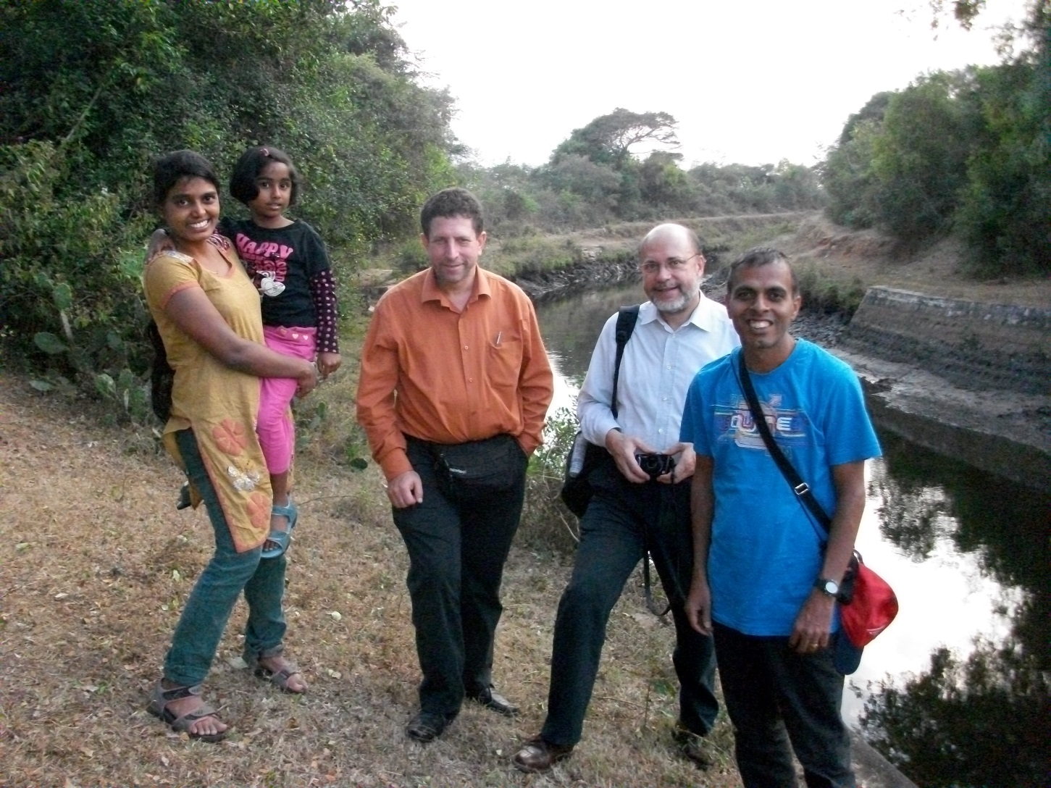
Maths has no frontier for Francois

Slide 3
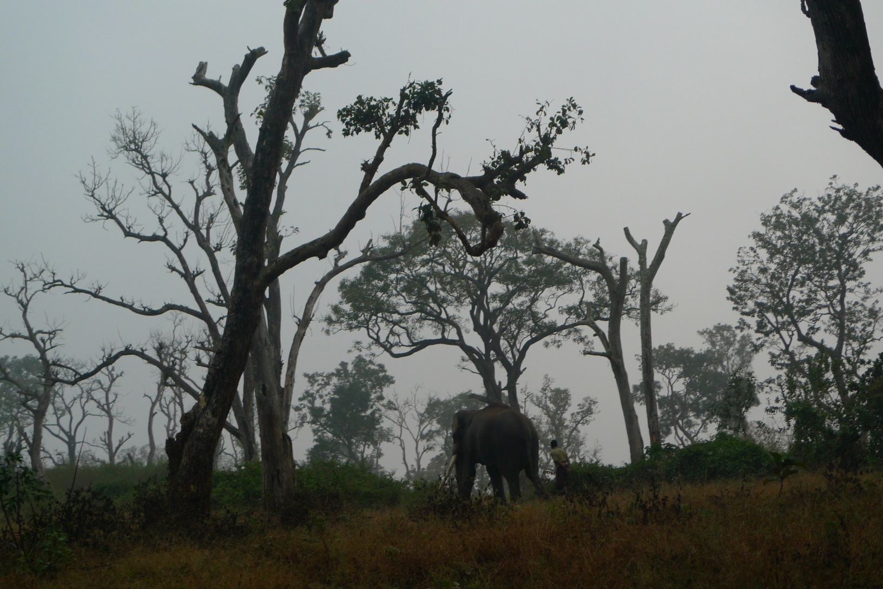
Discovery of rare wildlife

Slide 4
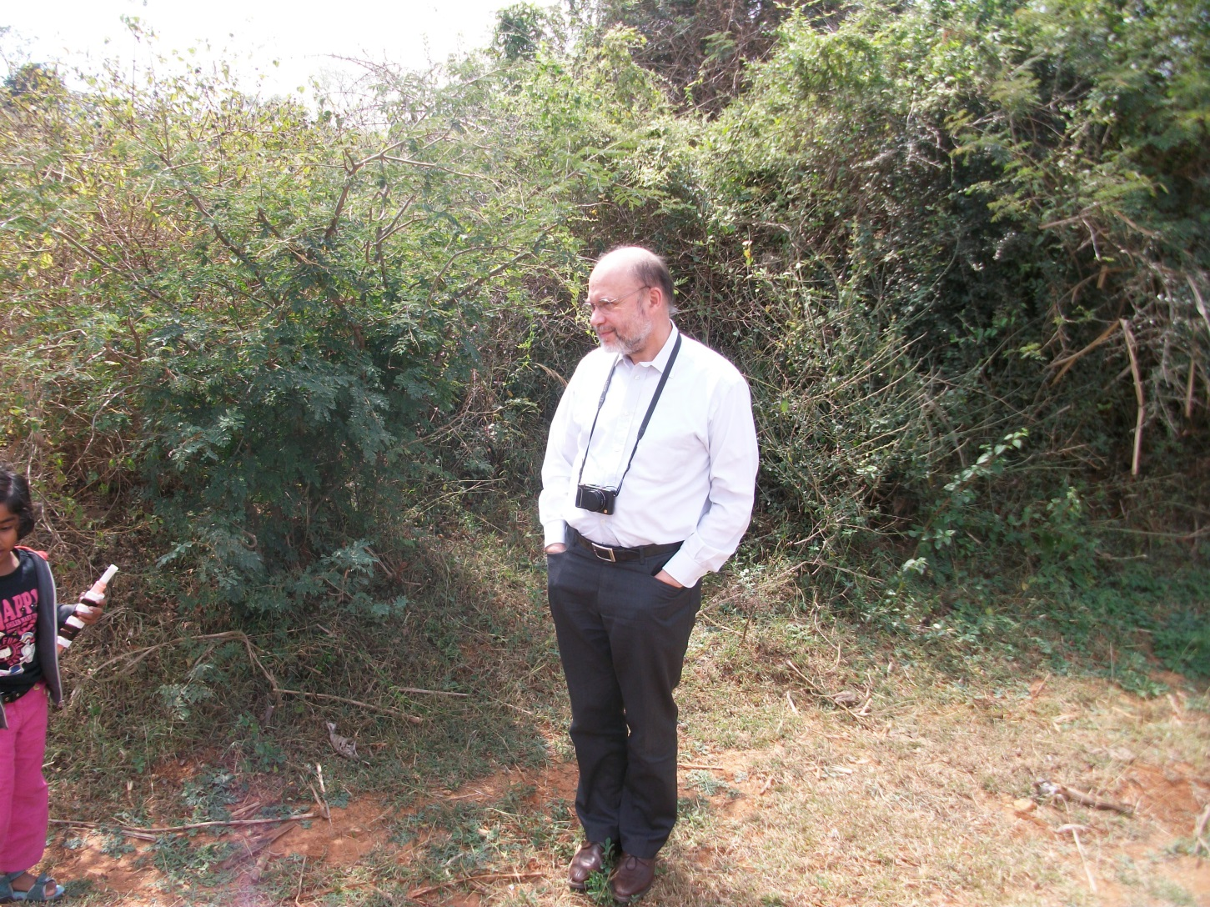
Photograph

Slide 5

FB: specialist of american indigenous art

Slide 6
Actions for the society
Author of the report: « Communication networks of the future » handled to the general management of the French enterprises (Direction générale des Entreprises). Co-auteurs V. BADRINATH, F. BOURDONCLE, C. DIOT, S. FDIDA et D. KOFMAN.
FB published a shorter version in RÉALITÉS INDUSTRIELLES, nov. 2010

Slide 7
Deterministic Branching
Eitan Altman
(joint with Dieter Fiems)

Slide 8

Driving sequence
Standard Branching:
Bn is the immigration. We take Bn constant
Xi_i^n are iid driving sequences. We shall replace by a single sequence

Slide 9
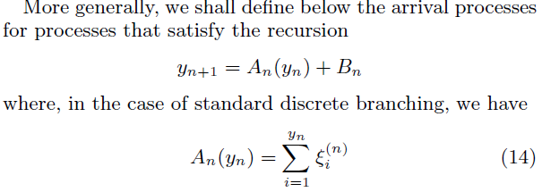
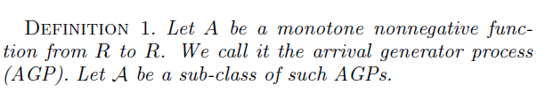

Slide 10
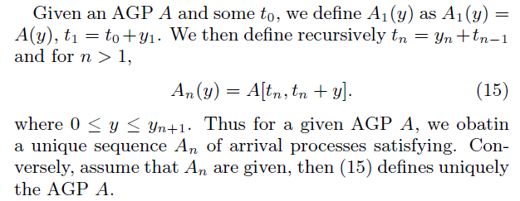
Create the sequence A_n from A

Slide 11
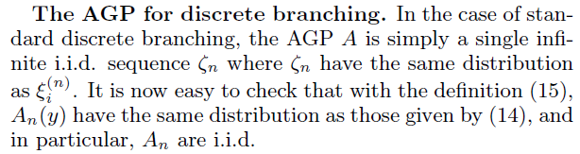
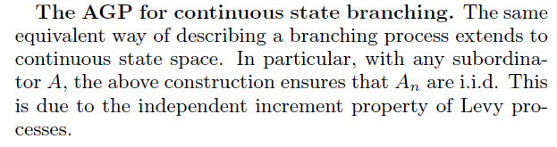

Slide 12
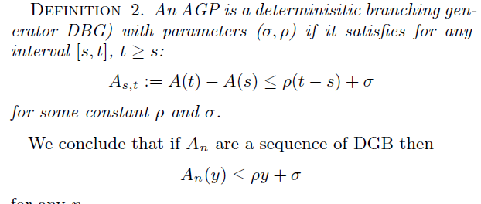
Network calculus and branching

Slide 13
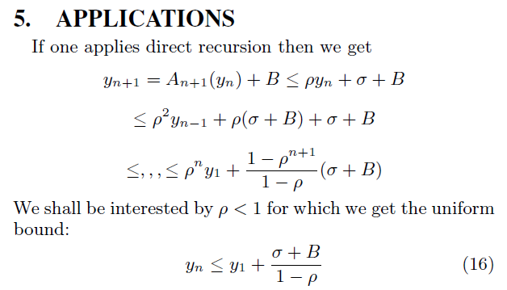
Uniform bound

Slide 14
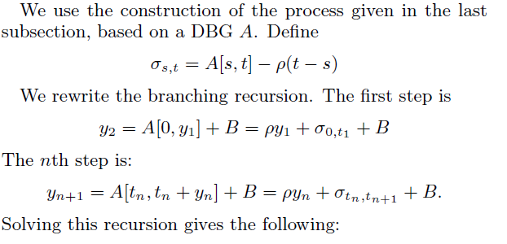
Improvement [S Foss]

Slide 15
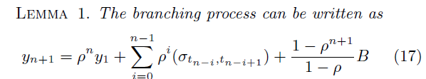
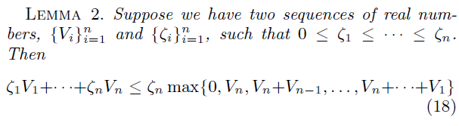

Slide 16
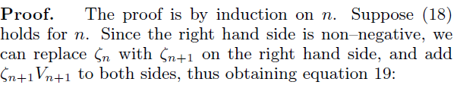
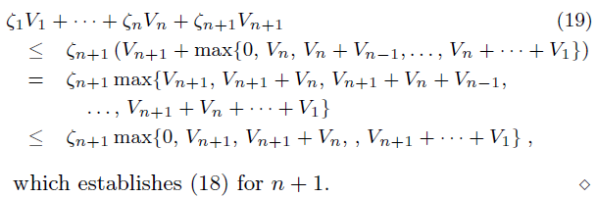

Slide 17
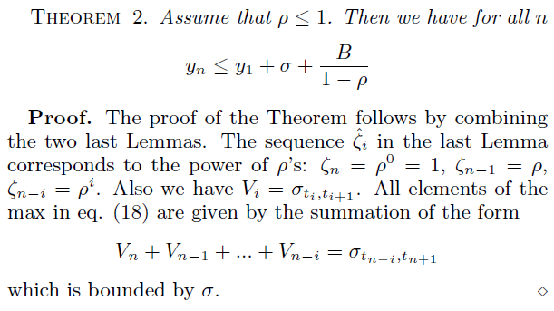

Slide 18
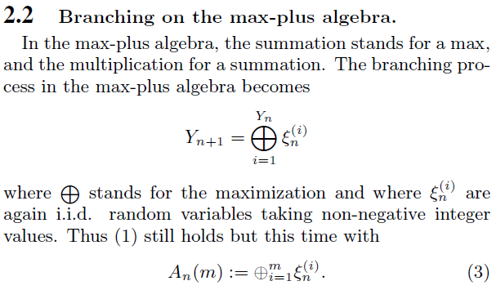
Max + branching

Slide 19
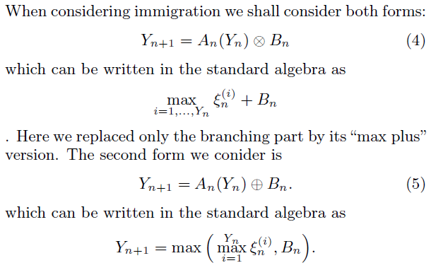
Adding immigration

Slide 20
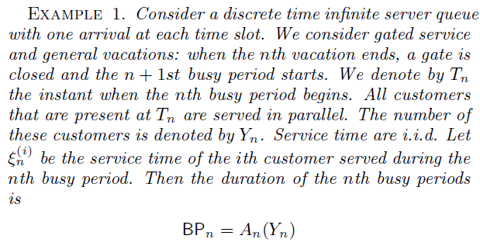
Branching ex

Slide 21
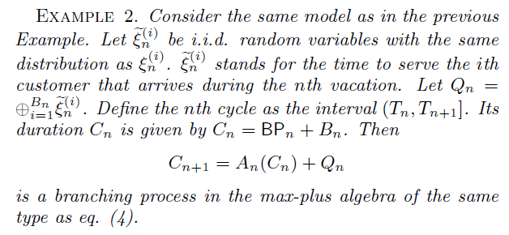

Slide 22
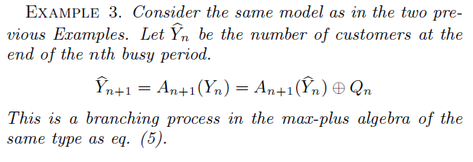

Slide 23
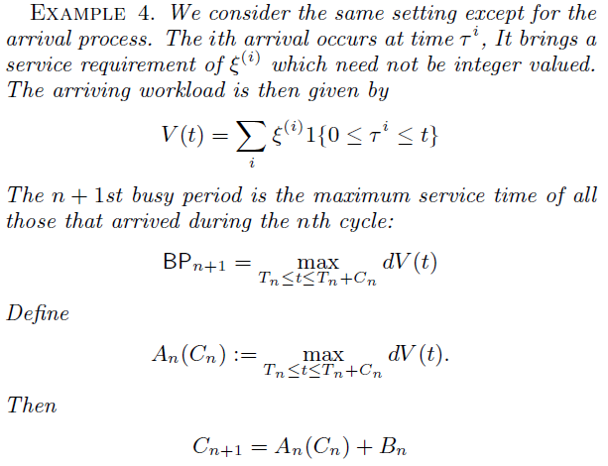

Slide 24
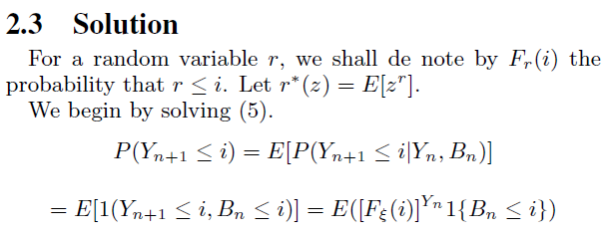
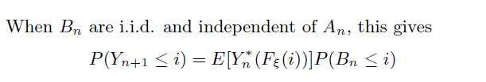

Slide 25
