Slide 1


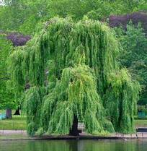


Seeing 3D chairs:
Exemplar part-based 2D-3D alignment using a large dataset of CAD models
Mathieu Aubry (INRIA)
Daniel Maturana (CMU)
Alexei Efros (UC Berkeley)
Bryan Russell (Intel)
Josef Sivic (INRIA)

Slide 2
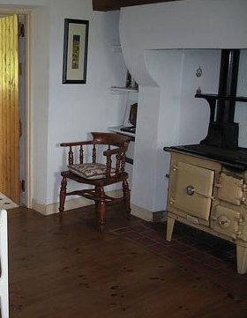


Sit on the chair!
Notes:
Imagine you have a robot,
And he is tired, so you want him to sit down.
Let’s see what there is in our computer vision toolbox to help him.

Slide 3
Classification
CHAIR
Ex: ImageNet Challenge, Pascal VOC classification.
Notes:
The first thing we have in our toolbox, is classification methods.
Guess what! There is a chair somewhere in this image.
However, that will probably not help your robot much.

Slide 4

Detection
chair
Ex: Pascal VOC detection.
Notes:
No problem, we can localize the chair, we can also do detection, so maybe we can try to sit the robot on the bounding box…
Unfortunately, he falls down…

Slide 5
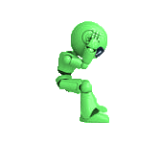
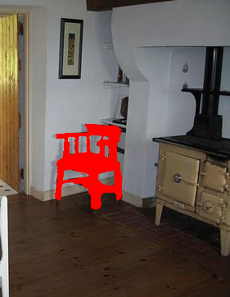
Segmentation
Ex: Pascal VOC segmentation.
Notes:
Let’ s try do something more precise, let’s do semantic segmentation.
No, that doesn’t work either.

Slide 6
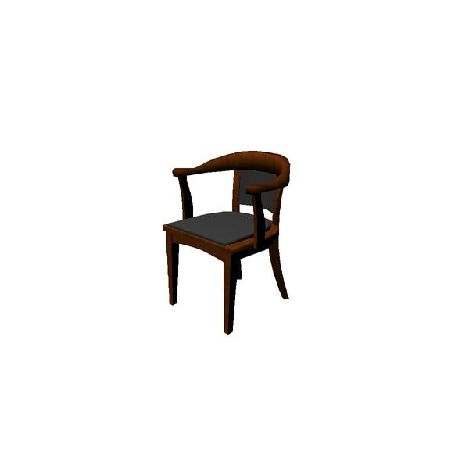

Our goal
Notes:
Well, let’s think a bit: what we would really need for an assisted sitting system is to bring 3D into the scene.
And that is exactly what this paper is about. Given such an image, we are able to select and align an approximate model of the chair.
And now our robot can sit down, and rest.
In fact, that’s only bringing back an old idea,

Slide 7
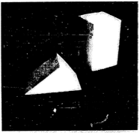
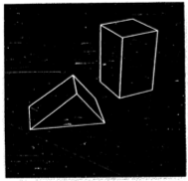
From the beginning of computer vision
First PhD in computer vision, MIT 1963
Lawrence G. Roberts
Machine perception of three-dimensional solids
Photograph
3D model
Notes:
Maybe the first idea of CV: understanding 3D from a single 2D image.

Slide 8
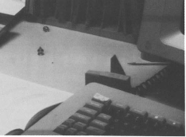
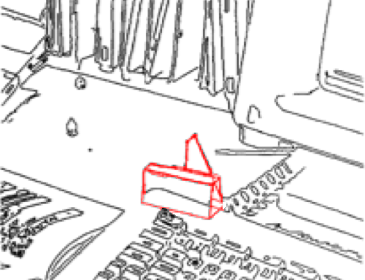
1980s: 2D-3D Alignment
[Huttenlocher and Ullman IJCV 1990]
[Lowe AI 1987]
[Faugeras&Hebert’86], [Grimson&Lozano-Perez’86], …
Notes:
And in the 80s, that was really a problem people focused on a lot: aligning a CAD model to an image, mainly by trying to detect and align edges.
Recognizing solid objects by alignment with an image
DP Huttenlocher and Ullman IJCV 1990
Three-Dimensional Object Recognition from Single
Two-Dimensional Images
DG Lowe - Artificial intelligence, 1987
Object recognition in the geometric era: a retrospective
J-L Mundy, Lecture Notes in computer science, 2006

Slide 9
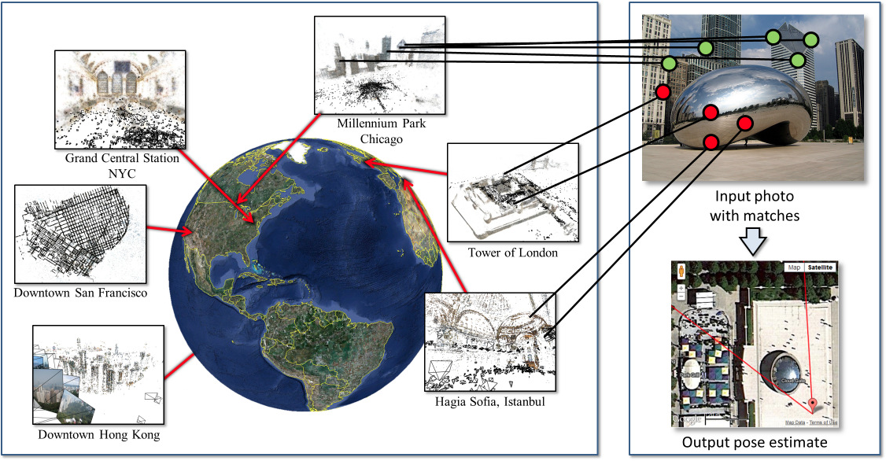
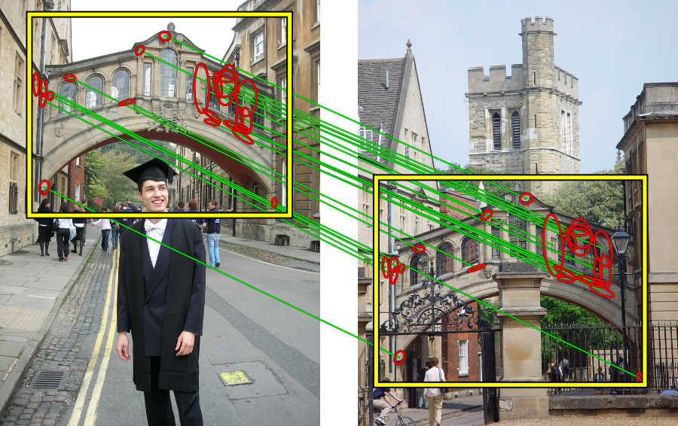
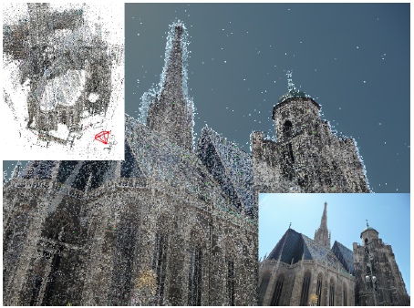
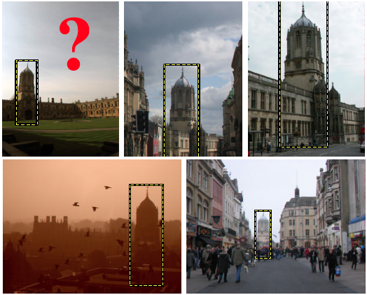
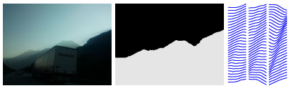
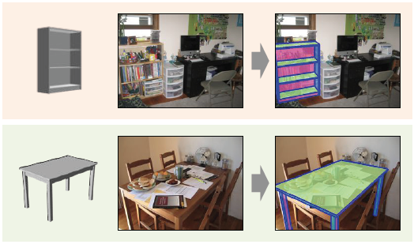
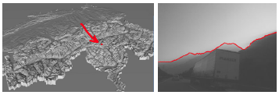
Exact Instance alignment
[Philbin et al. CVPR 2007]
[Sattler et al. ICCV 2011]
[Baatz et al. ECCV 2012]
[Lim et al. ICCV 2013]
See also [Rothganger et al. CVPR 2003] ,[Arandjelovic ́and Zisserman ICCV 2011],
[Li et al. ECCV 2012], [Snavely et al. SIGGRAPH 2006] …
Notes:
And in fact, instance alignment is still an important problem. Today people tend to use more keypoints, such as SIFT, but there are also some recent work using on contours.
Y. Li, N. Snavely, D. Huttenlocher, and P. Fua. Worldwide pose estimation using 3D point clouds. In ECCV, 2012.
J.Philbin,O.Chum,M.Isard,J.Sivic,andA.Zisserman.Ob- ject retrieval with large vocabularies and fast spatial matching. In CVPR, 2007. 2
T. Sattler, B. Leibe, and L. Kobbelt. Fast image-based lo- calization using direct 2D-to-3D matching. In ICCV, 2011.
G. Baatz, O. Saurer, K. Ko ̈ser, and M. Pollefeys. Large scale visual geo-localization of images in mountainous terrain. In ECCV, 2012.
J. Lim, H. Pirsiavash, and A. Torralba. Parsing IKEA objects: Fine pose estimation. In ICCV, 2013.
F. Rothganger, S. Lazebnik, C. Schmid, and J. Ponce. 3D ob- ject modeling and recognition using affine-invariant patches and multi-view spatial constraints. In CVPR, 2003.
R. Arandjelovic ́ and A. Zisserman. Smooth object retrieval using a bag of boundaries. In ICCV, 2011.
Noah Snavely, Steven M. Seitz, Richard Szeliski, "Photo tourism: Exploring photo collections in 3D," ACM Transactions on Graphics (SIGGRAPH Proceedings), 25(3), 2006

Slide 10
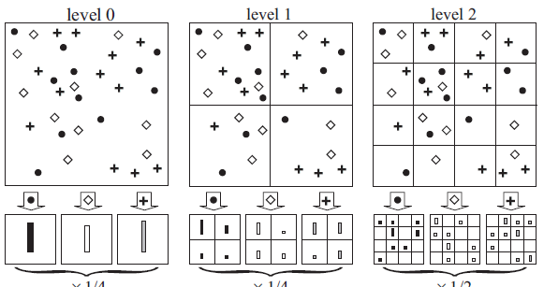
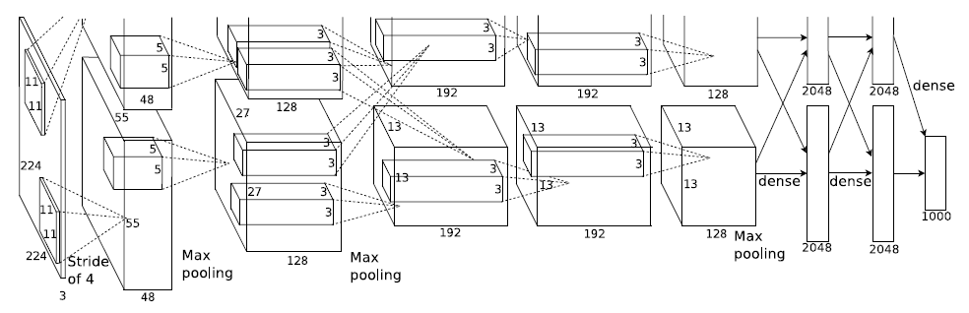
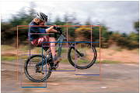
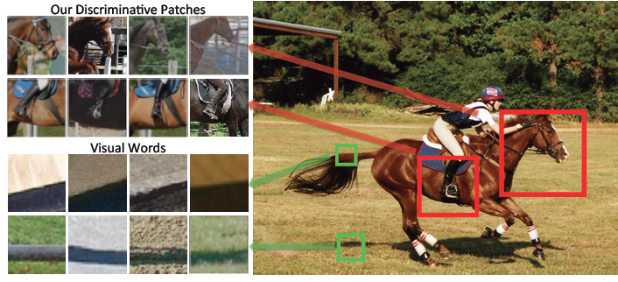

2D category recognition
[Lazebnik et al. CVPR 2006]
[Krizhevsky et al. NIPS 2012]
[Felzenszwalb et al.PAMI 2010]
[Singh et al. ECCV 2012]
See also : [Dalal and Triggs CVPR 2005], [Bourdev and Malik ICCV 2009], [Malisiewicz et al. ICCV 2011] ...
Notes:
However, what we want to do is be able to work not only with instances, but with full categories. For category recognition the work has focused mainly on 2D analysis.
P.Felzenszwalb,R.Girshick,D.McAllester,andD.Ramanan. Object detection with discriminatively trained part based mod- els. IEEE PAMI, 32(9), 2010.
L. Bourdev and J. Malik. Poselets: Body part detectors trained using 3D human pose annotations. In ICCV, 2009
T. Malisiewicz, A. Gupta, and A. A. Efros. Ensemble of exemplar-svms for object detection and beyond. In ICCV, 2011
S. Singh, A. Gupta, and A. A. Efros. Unsupervised discovery of mid-level discriminative patches. In ECCV, 2012.
N. Dalal and B. Triggs. Histograms of Oriented Gradients forHuman Detection. In CVPR, 2005.
J. Philbin, O. Chum, M. Isard, J. Sivic, and A. Zisserman. Object retrieval with large vocabularies and fast spatial matching. In CVPR, 2007.

Slide 11
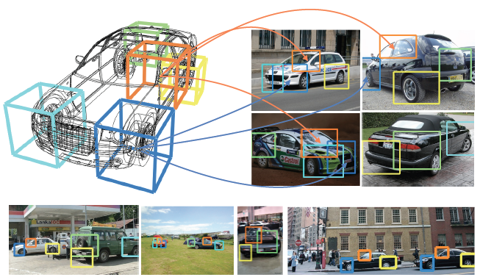
3D category recognition
3D DPMs: [Herjati&Ramanan’12],
[Pepik et al.12], [Zia et al.’13], …
Simplified part models: [Xiang&Savarese’12], [Del Pero et al.’13]
[Pepik, Stark, Gehler and Schiele 2012]
Cuboids: [Xiao et al.’12] [Fidler et al.’12]
Blocks world revisited: [Gupta et al.’12]
See also: [Glasner et al.’11], [Fouhey et al.’13], [Satkin&Hebert’13], [Choi et al. ‘ 13],
[Hejrati and Ramanan ‘14], [Savarese and Fei-Fei ‘ 07]…
Notes:
and 3D category recognition is typically limited to simplified models such as deformable basis, collection of planar parts, or cuboids,
But such simple models may not represent accurately complex categories.
S. Savarese and L. Fei-Fei. 3D generic object categorization,
localization and pose estimation. Proc. of IEEE International Conf. in
Computer Vision (ICCV), 1-8, Brazil, October, 2007
W. Choi, Y. Chao, C. Pantofaru, and S. Savarese. Understanding
indoor scenes using 3D geometric phrases. In CVPR,
2013.
M. Hejrati and D. Ramanan. Analyzing 3D objects in clut- tered images. In NIPS, 2012.
B. Pepik, M. Stark, P. Gehler, and B. Schiele. Teaching 3D geometry to deformable part models. In CVPR, 2012.
M. Zia, M. Stark, B. Schiele, and K. Schindler. Detailed 3Drepresentations for object recognition and modeling. IEEE PAMI, 2013. 2
Y. Xiang and S. Savarese. Estimating the aspect layout ofobject categories. In CVPR, 2012.
L. Del Pero, J. Bowdish, B. Kermgard, E. Hartley, and K. Barnard. Understanding Bayesian rooms using composite 3D object models. In CVPR, 2013
J. Xiao, B. Russell, and A. Torralba. Localizing 3D cuboidsin single-view images. In NIPS, 2012
S. Fidler, S. Dickinson, and R. Urtasun. 3D object detection and viewpoint estimation with a deformable 3D cuboid model. In NIPS, 2012.
A. Gupta, A. A. Efros, and M. Hebert. Blocks world revis- ited: Image understanding using qualitative geometry and mechanics. In ECCV, 2010.

Slide 12
Why chairs?
Notes:
Chairs are a good example of such a difficult category: they have a difficult geometry, and a huge intra-class variation.
Interestingly, they are also one of the most difficult category for detection in Pascal.
So, in this paper we will take the chair category as our running example.

Slide 13
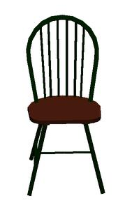
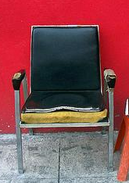
Difficulty: style
Notes:
Let’s try to break down difficulties.
The first obvious difficulty is the huge class variation.
It will clearly be difficult to align a 3D model of a chair with an image of a completely different chair.

Slide 14
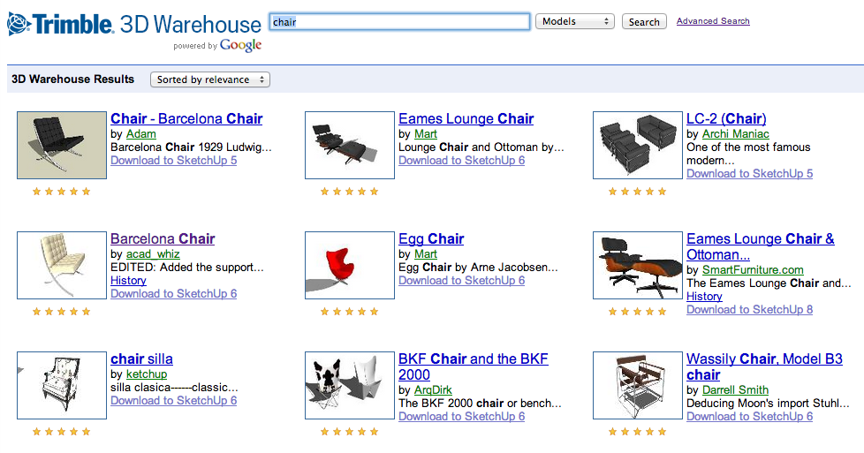
Approach: data-driven
1394 3D models from internet
Notes:
To solve this problem, we downloaded more than 1000 3D models from the internet

Slide 15
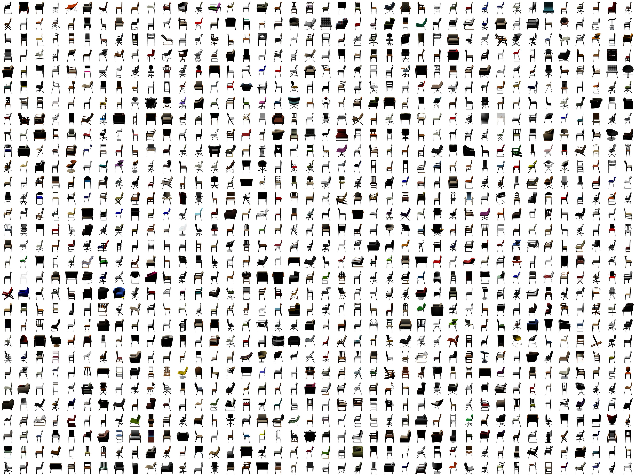
Notes:
And we represent the chair category with this very big collection of models.

Slide 16
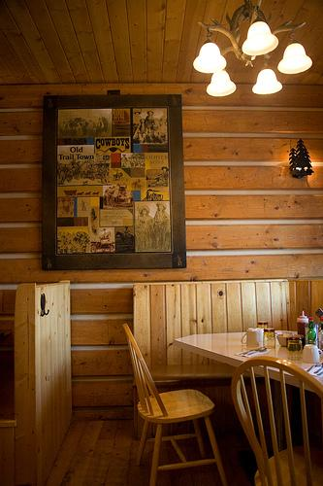
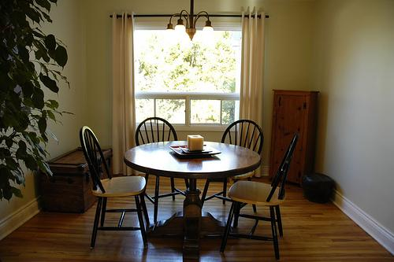
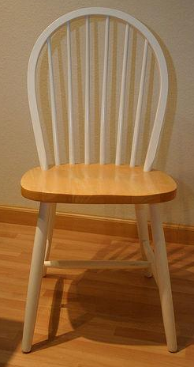
Difficulty: viewpoint
Notes:
Now, the second difficulty we face is that due to their complex geometry, the appearance of chairs change completely with the viewpoint

Slide 17
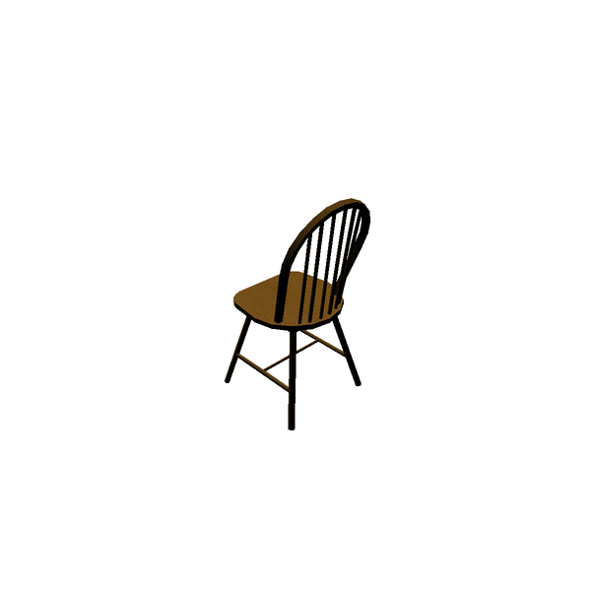
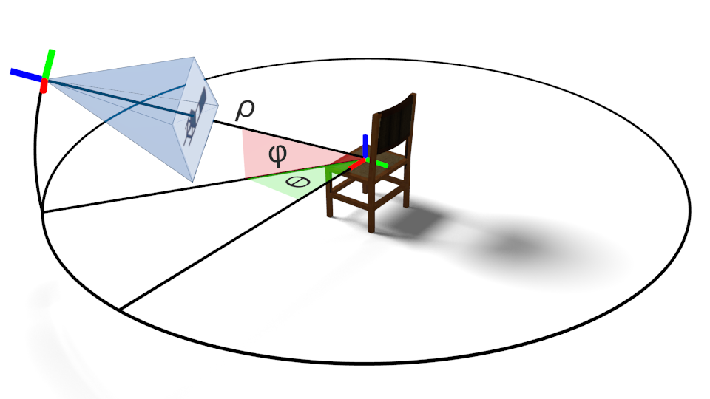
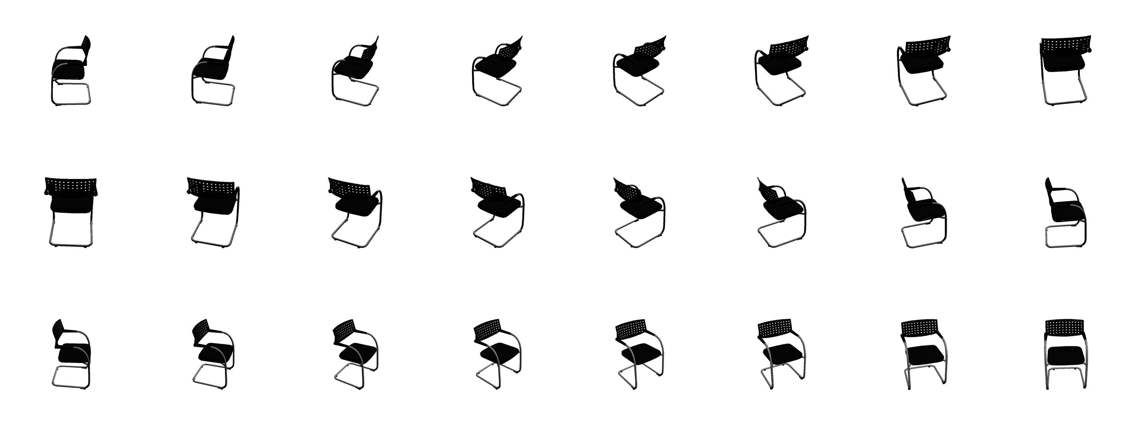
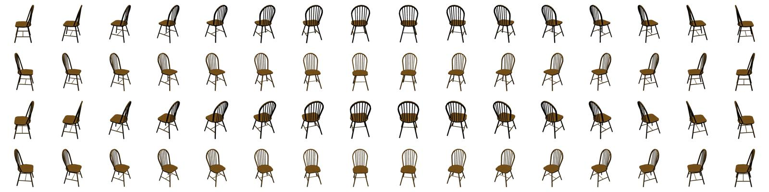
Approach: use 3D models
62 views
Notes:
So to be able to deal with this variation, we render approximately 60 representative view of each of our chair model.

Slide 18
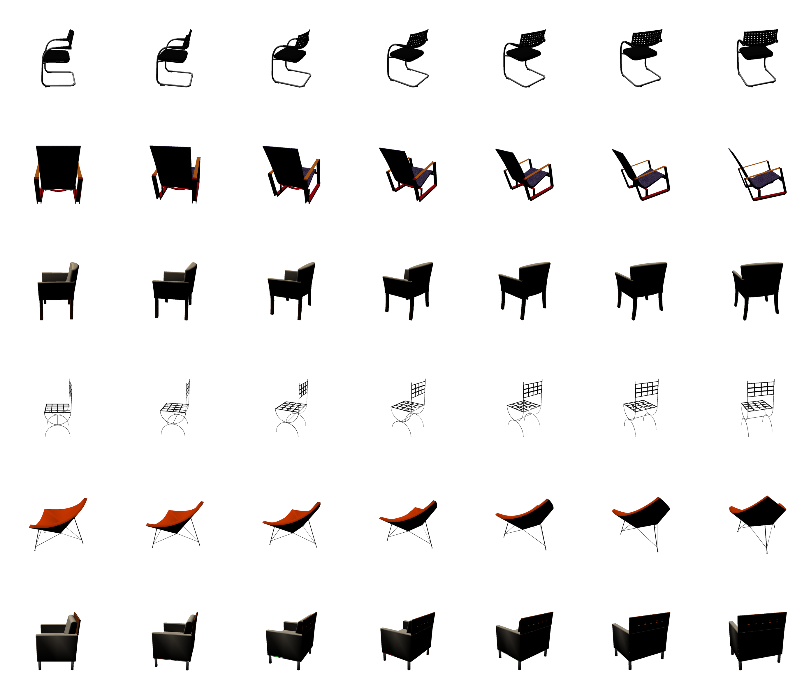
Style
Viewpoint
Notes:
So at this point, we have a discrete 2d representation of the chair category, one dimension being style, and the other one viewpoint.

Slide 19
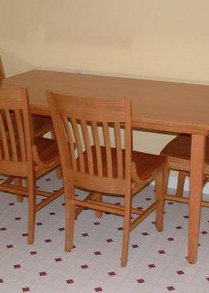
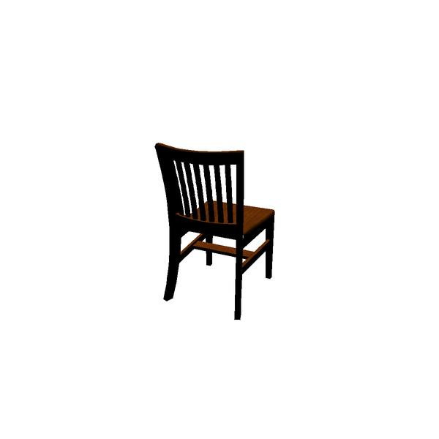
Difficulty: approximate style
Notes:
However, even with all our models we'll never be able to get an exact match with all image.
For example, this match looks good,

Slide 20
Difficulty: approximate style
Notes:
but if you try, you'll realize that you will not be able to align precisely the 3D model with the image.

Slide 21
Difficulty: approximate style
Notes:
For example, the top of the model is not high enough, the legs are oriented differently, and there is a bar on the image but not in the model.

Slide 22
Approach: part-based model
Notes:
The way we address it is to break the rendered views into parts, which can move with respect to each other

Slide 23

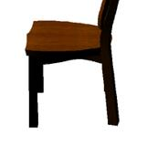
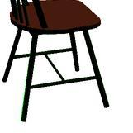
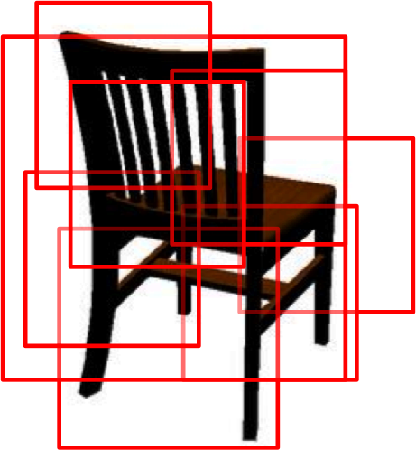
Approach overview
Match CG->real image
3D collection
Render views
Select the best matches
Select parts
Notes:
The pipeline we will follow is will have to follow is now clear.
First we collect a large collection of 3D chairs,
then we render representative views from the models,
we select parts in those views,
we match these computer-generated parts to real images,
and finally we select the best matches and accumulate them to form alignments.
But these three last parts are actually quite challenging.

Slide 24
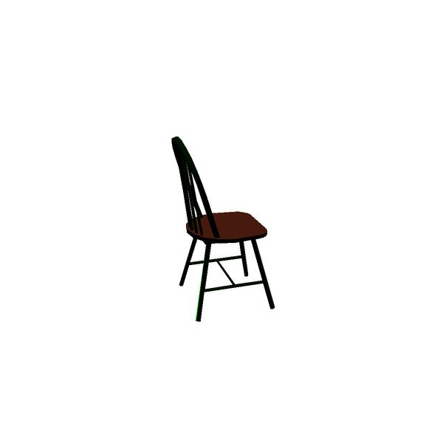
How to select discriminative parts?
Notes:
The first challenge we face is to select discriminative patches. Given a rendered view, how do you know which parts are informative and which parts are not ?
Well let’s take all possible patches from a chair, and look at them in the space of patches. There we can compare them to a set of random patches. The chair patches that are not interesting will be difficult to separate from those random patches.
But the chair patches that are informative will be easily linearly separated from the other patches. If you use an exemplar LDA classifier, you can efficiently evaluate all the chair patches this way, and select the best ones.
M. Gharbi, T. Malisiewicz, S. Paris, and F. Durand. A Gaussian
approximation of feature space for fast image similarity.
Technical report, MIT, 2012. 3
B. Hariharan, J. Malik, and D. Ramanan. Discriminative
decorrelation for clustering and classification. In ECCV, 2012.
T. Malisiewicz, A. Gupta, and A. A. Efros. Ensemble of
exemplar-svms for object detection and beyond. In ICCV,
2011.

Slide 25







































How to select discriminative parts?
Best exemplar-LDA classifiers
[Hariharan et al. 2012] [Gharbi et al 2012]
[Malisiewicz et al 2011]
Notes:
The first challenge we face is to select discriminative patches. Given a rendered view, how do you know which parts are informative and which parts are not ?
Well let’s take all possible patches from a chair, and look at them in the space of patches. There we can compare them to a set of random patches. The chair patches that are not interesting will be difficult to separate from those random patches.
But the chair patches that are informative will be easily linearly separated from the other patches. If you use an exemplar LDA classifier, you can efficiently evaluate all the chair patches this way, and select the best ones.
M. Gharbi, T. Malisiewicz, S. Paris, and F. Durand. A Gaussian
approximation of feature space for fast image similarity.
Technical report, MIT, 2012. 3
B. Hariharan, J. Malik, and D. Ramanan. Discriminative
decorrelation for clustering and classification. In ECCV, 2012.
T. Malisiewicz, A. Gupta, and A. A. Efros. Ensemble of
exemplar-svms for object detection and beyond. In ICCV,
2011.

Slide 26
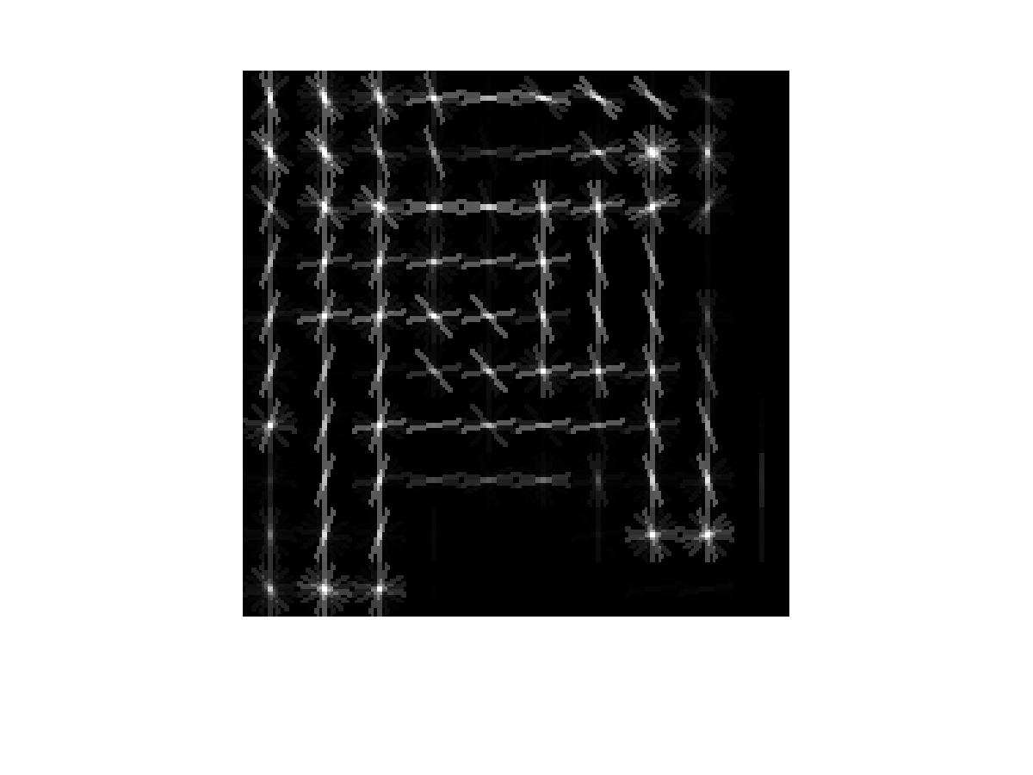
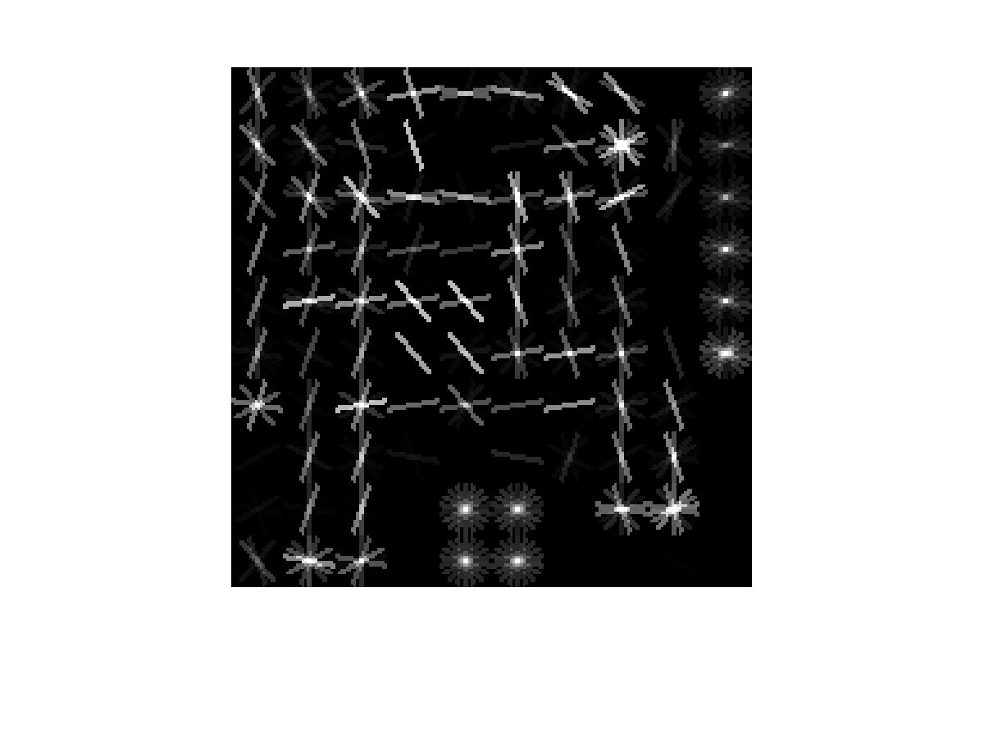
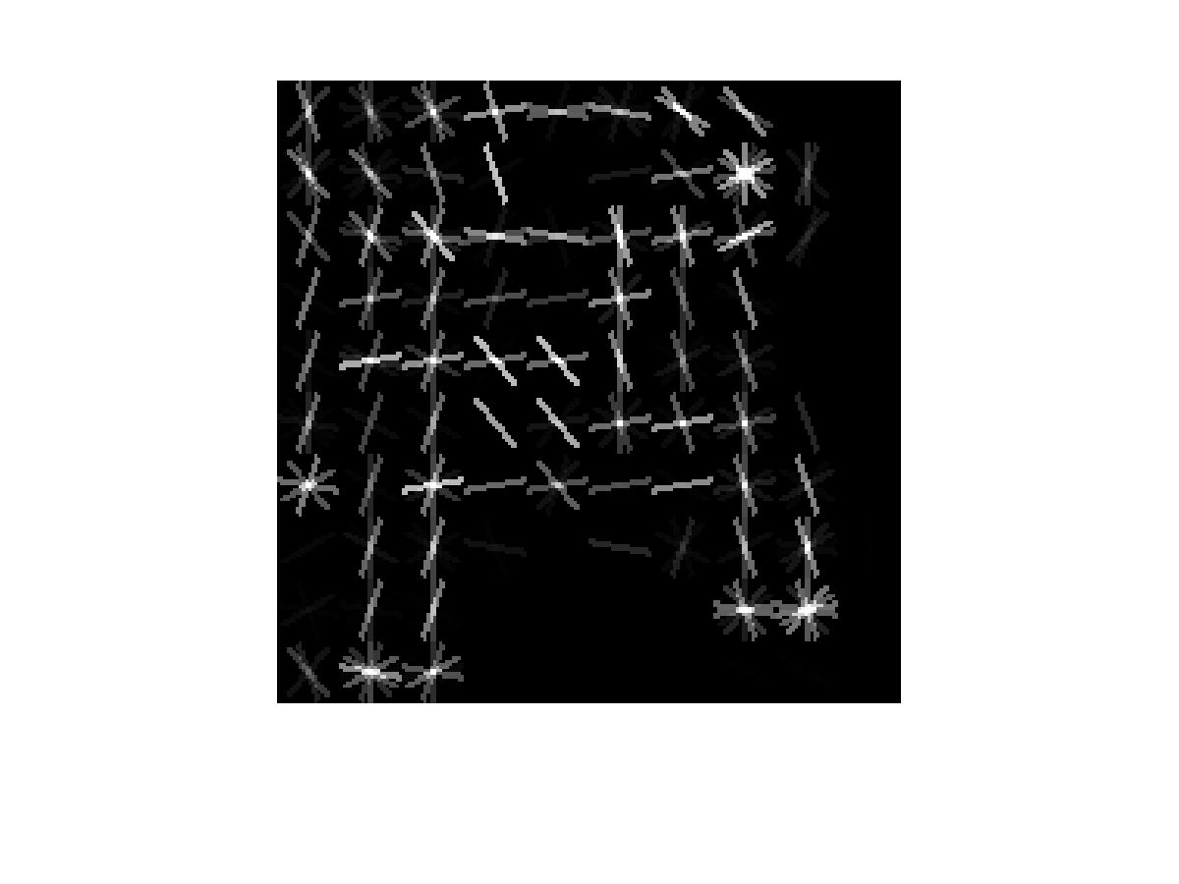


How to match CG to photograph?
HOG
Classifier
Masked classifier
HOG mask
See also:
[Shrivastava et al. 2011]
Implementation: exemplar-LDA
Notes:
So at this point, we are able to get informative patches from rendered views, but we need to match them to real images, and that is not easy, because we have to deal with two different domains, which have very different image statistic.
To overcome this challenge we cast the matching as a classification task.
We first represent the patches by their HOG descriptors, which capture softly their edges, that we will be able to recover in the real image. From this HOG descriptor we learn an exemplar-LDA classifier, which further emphasize the most distinctive boundaries. But if you look at it you will notice that it learns weights from parts where there is actually no information from the 3D model.
So we extract a mask from the 3D model and apply it to the classifier.
Finally, we apply this masked classifier to the image
Data-driven Visual Similarity for Cross-domain Image Matching
Abhinav Shrivastava, Tomasz Malisiewicz, Abhinav Gupta, Alexei A. Efros
in SIGGRAPH Asia 2011

Slide 27
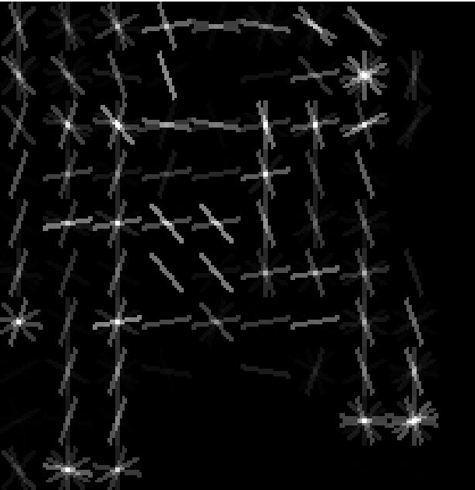
Approach: CG-to-photograph
Implementation: exemplar-LDA
Notes:
In a sliding window approach, which is standard for object detection

Slide 28
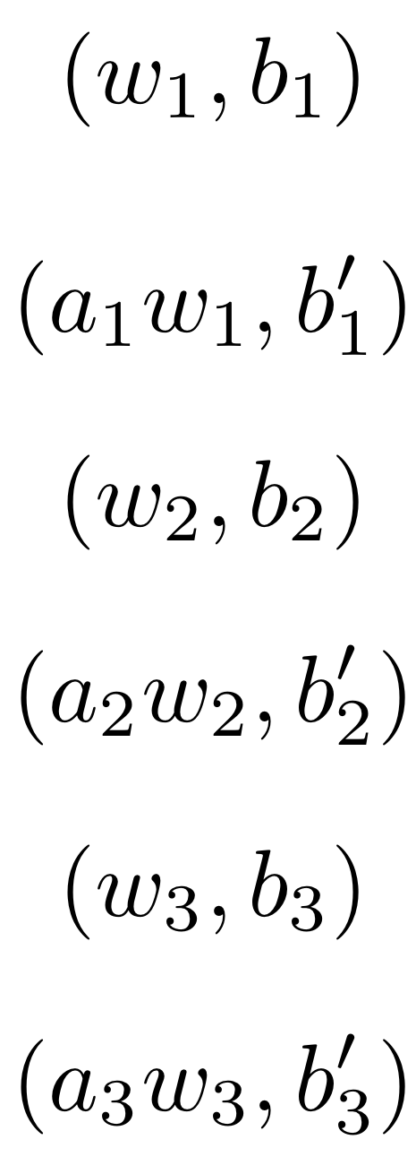
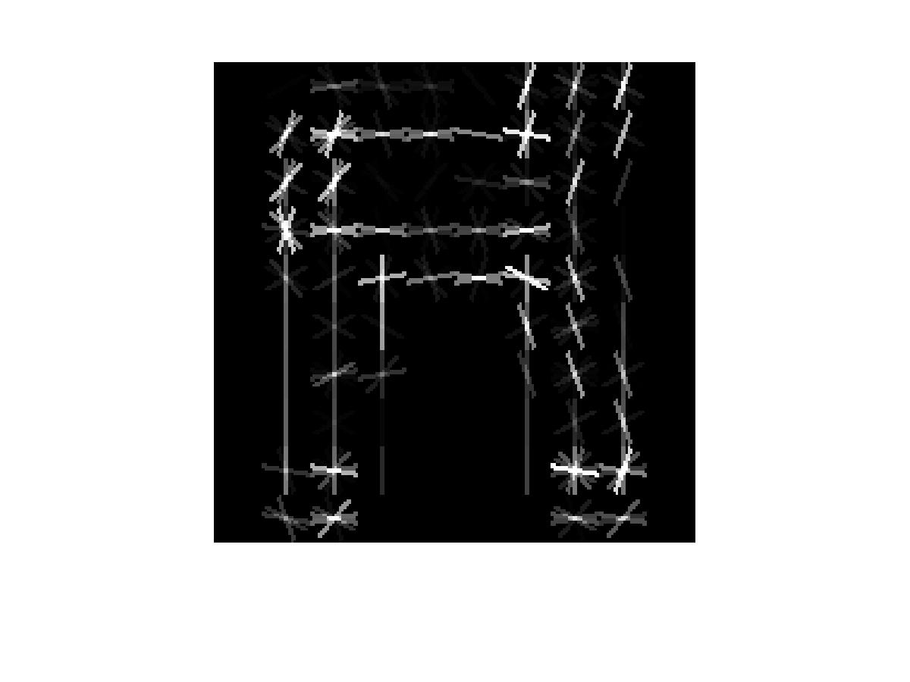
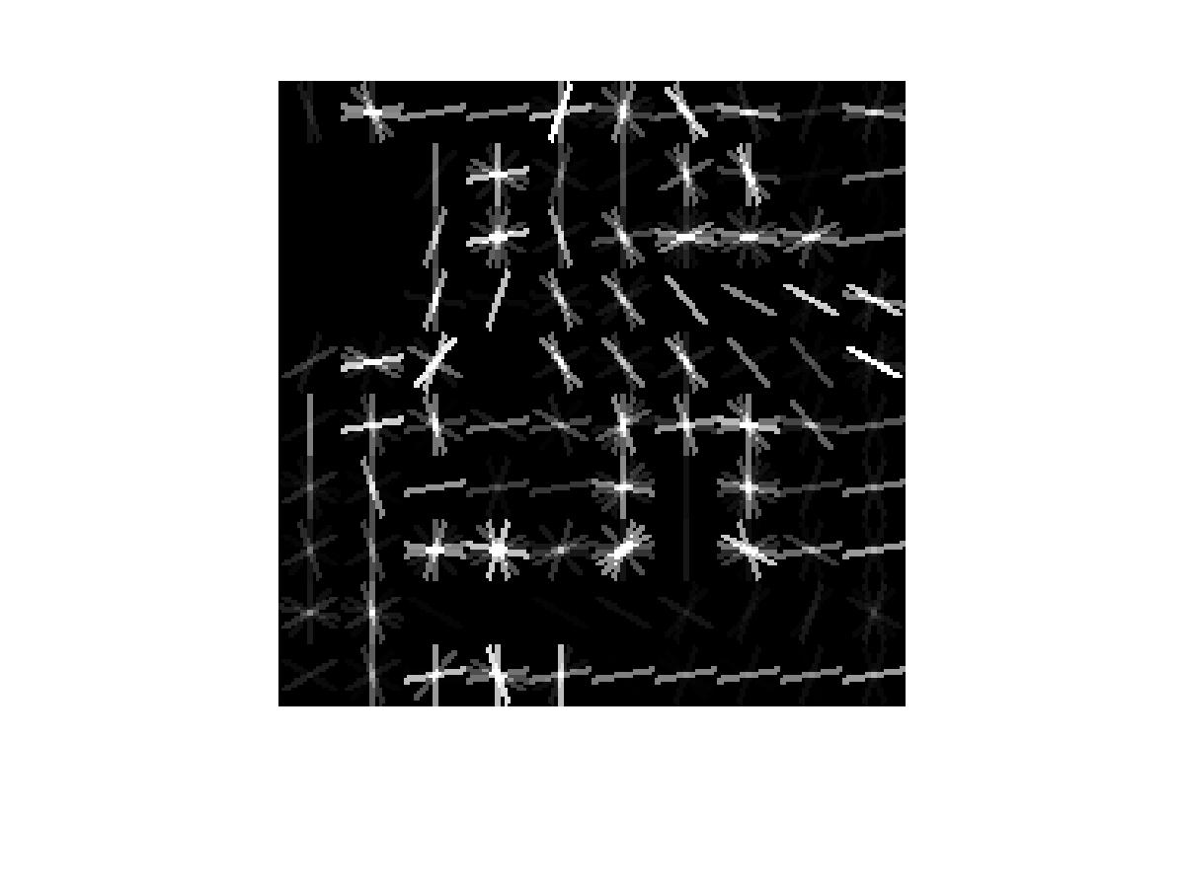
How to compare matches?
Patches
Detectors
Matches
Notes:
So now, from a patch, we are able to detect potential matches. But the problem is that we have many patches and classifiers, which give many potential matches. Since they are trained independently, their scores will not be directly comparable, and a false match, for example the one in the top right, could have the best score. How can we deal with this problem?

Slide 29
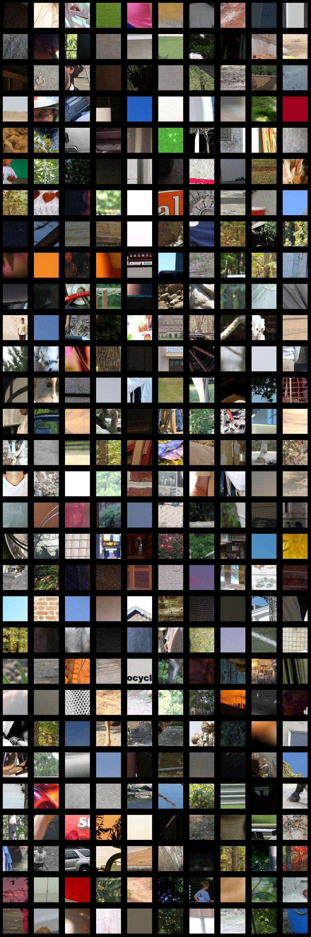
How to compare matches?
Affine Calibration
with negative data
Patches
Detectors
Matches
See paper for details
Notes:
To adress this challenge, we present in the paper an efficient and effective strategy to calibrate all the detectors in an affine way. Since we have a single positive example, we use only negative data. That’s a very important and necessary step and you can see the details of how it is done in the paper.
After this calibration, we are able to say that the most confident match is not the one on the top right, but the one in bright red on the bottom right, and we can accumulate the scores of the parts to define the score of chair matches in a meaningful way.

Slide 30
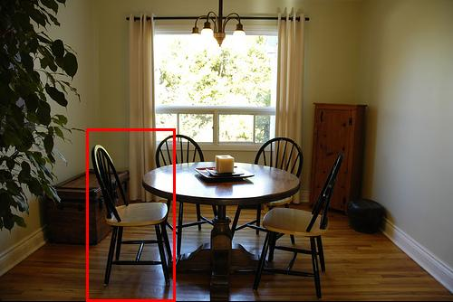
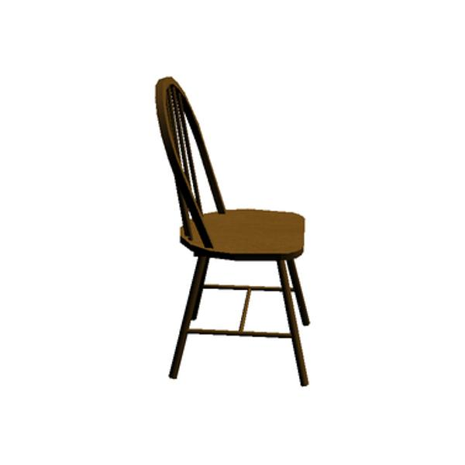
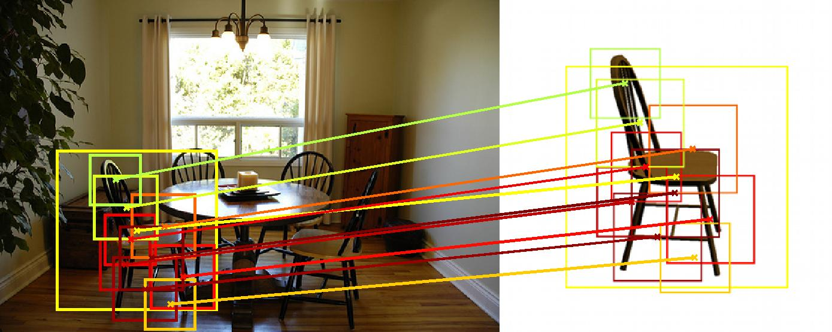
Example I.
Notes:
Let's look at some qualitative results of this matching procedure.
From this image, we detect this chair, with this 3D model, and the underlying part matches are those shown here. Warmer color mean more confident matches.

Slide 31



Example II.
Notes:
Here is another example, where you can see that the top of the chairs are very different, but we are still able to detect the match because we are able to match reliably the bottom parts.

Slide 32



Example III.
Notes:
Here, the chairs are actually quite different but we still can match them, by accumulating evidence, showing that our matching procedure is very robust.

Slide 33
Input image
DPM output
Our output
3D models
Notes:
But most importantly we can do more than just detection, we get approximate 3D model for the matches and we can visualize it by superimposing the 3D models we detect to the input image. This is much more informative than just DPM-detection with approximate parts location.

Slide 34
Input image
DPM output
Our output
3D models
Notes:
In this other example, you can see again that the 3D models are quite different but the matches still make sense and give a feeling of really understanding what is in the image.

Slide 35



Results
Test set:
  179 images from Pascal VOC 2012 (subset of validation data)
  247 annotated chair bounding boxes
Baselines:
1. Exemplar LDA:
[Hariharan et al. 2012],
[Gharbi et al 2012],
[Malisiewicz et al 2011]
2. DPM:
[Felzenszwalb et al. 2010]
Notes:
As a sanity check, we evaluated our method on detection, on a subset of Pascal VOC.
First we compare it with exemplar-LDA, using a full object template, without parts, which performs much worse, showing the importance of our part matching procedure.
DPM performs better than us, but the results are still comparable.
And we can improve them if we combine the results of our method with those of DPM, which demonstrate that the two methods are complementary.

Slide 36





Subjective human evaluation
Orientation quality at 25% recall
 | Good | Bad
Exemplar-LDA | 52% | 48%
Ours | 90% | 10%
Notes:
But more important for us are the qualitative results. Our method returns chairs with good orientations in 90% of the cases, much more than the exemplar-LDA baseline.

Slide 37




Subjective human evaluation
Style consistency at 25% recall
 | Exact | Ok | Bad
Exemplar-LDA | 3% | 31% | 66%
Ours | 21% | 64% | 15%
Notes:
And it returns chairs with coherent styles in 85% of the cases. It is interesting to notice that the matches look exact to a human in only 20% of the cases, showing that even a big collection is far from covering all existing chair styles.

Slide 38



Our related ToG 2014 paper
(to be presented at SIGGRAPH 14)
Painting-to-3D Model Alignment Via Discriminative Visual Elements
M. Aubry, B. Russell and J. Sivic
Notes:
Before concluding, let me mention that if you are interested in 2D-3D alignment, we adress a related problem our SIGGRAPH paper : Aligning a 3D model of an architectural site to a non-photographic and historical depiction.

Slide 39
Summary
Large collection of 3D models
  Part score calibration
Render views from 3D
  CG-real matching
Part based matching
  Finding parts
Data and (soon) code: http://www.di.ens.fr/willow/research/seeing3Dchairs
Notes:
To conclude, we have shown how to do 3D category detection for a complex object class, using 3 main idea:
Using a large collection of 3D models
Using a set of rendered views from those models
Representing those views by discriminative parts.
Each of this idea comes with technical challenges that we show how to overcome in the paper:
We present a method to calibrate efficiently many different detectors.
We show how to match a Computer Generated image to a photograph.
And we show how to extract informative parts from an image.
Our training data is available on our webpage and our code soon will be

Slide 40
Questions ?

Slide 41

Insight

Slide 42
Approach
Define a detector for each element
-> use a linear classifier on 10x10 HOGs given by the least squares loss.
-> affine calibration with negative data by imposing that the score of the mean HOG feature is -1 and that the false positive rate is 0.01%
calibrated score
density
0.01% of the scores
-1
Initial score

