Slide 1




Learning Graphs to Match
Inria Paris – WILLOW
Minsu Cho
Karteek Alahari
Jean Ponce

Slide 2
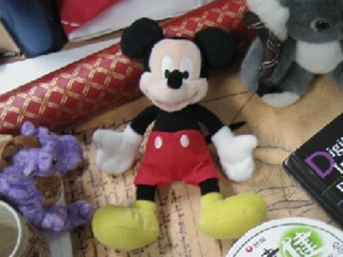
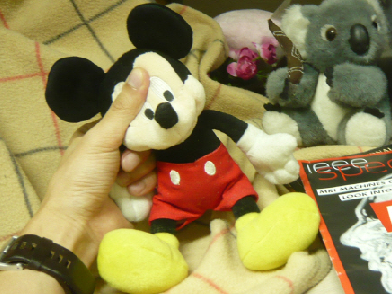
Graph Matching in Vision
Finding matches between two IMAGES
  Non-rigid or deformable objects
  Feature matching by minimizing distortion

Slide 3
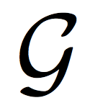
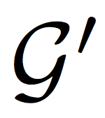
Graph Matching
Finding matches between two GRAPHS
  y_{ia}= 1 if node i in G corresponds to node a in G’
  y_{ia}= 0 otherwise

Slide 4
Graph Matching
Maximizing the matching score S

Slide 5
Graph Matching
How to measure the matching score S ?
  Each node & each edge has its own attribute
  Node similarity function

Slide 6
Graph Matching
How to measure the matching score S ?
  Each node & each edge has its own attribute.
  Node similarity function
  Edge similarity function

Slide 7
Graph Matching
How to measure the matching score S ?
  Sum of S_{V} and S_{E} values for the assignment y

Slide 8
Advances in Graph Matching
Quadratic assignment problem
  NP-hard, thus exact solution is infeasible
Advances in approximate algorithms
  Relaxation and Projection
Hyper-graph extensions
  High-order potentials
  Generalized formulation
Boosting techniques
  Online-update of GM
  Factorization of GM
Cour et al. ’07, Leordeanu et al. ’09
Zaslavskiy et al. ’09
Zass & Shashua ’08, Duchenne et al. ’10
Lee et al. ’11, Leordeanu et al. ’12
Cho & Lee ’12
Zhu & Torre ’12

Slide 9
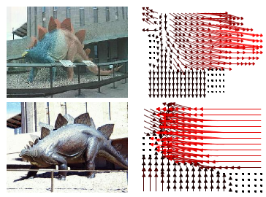
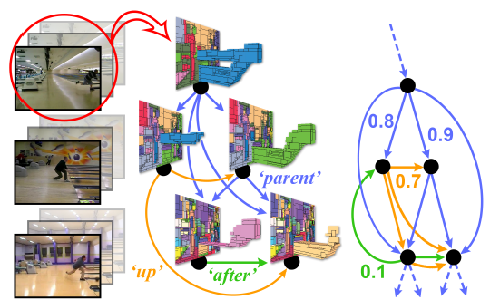
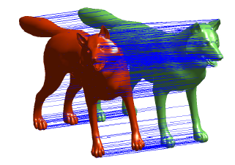
Recent applications in Vision
Object Recognition
Action Recognition
Duchenne et al.
ICCV 2011
Zhang et al.
CVPR 2013
Brendel & Todorovic
ICCV 2011
Yao & Fei-Fei
ECCV 2012
Shape Matching
Image Matching
Zheng et al.
CVPR 2010
Smeets et al.
CVPR 2011
Cho & Lee
CVPR 2012
Leordeanu et al.
IJCV 2012

Slide 10
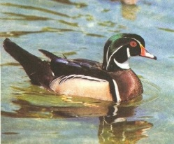
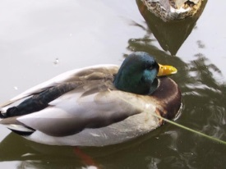
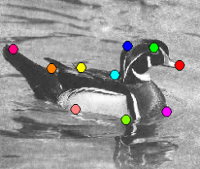
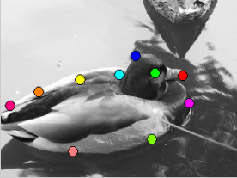
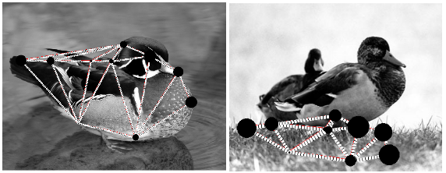
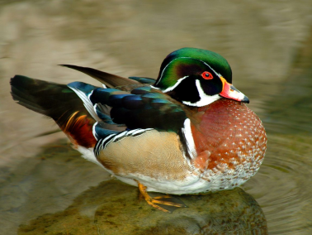
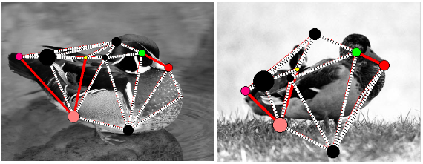
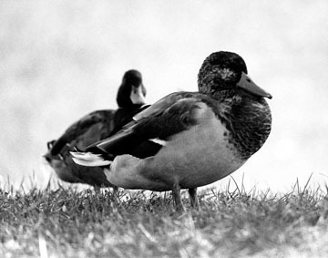
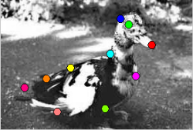
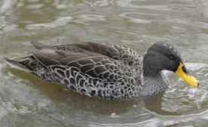
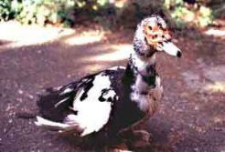
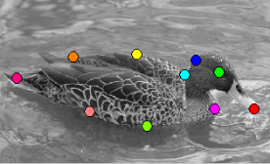
Motivation
How to improve matching by learning?
  A hand-crafted matching score function performs poor in many practical problems
  Learn parameters of the matching score function to better match two instances
Caetano et al. ’07
Torresani et al. ’08
Leordeanu et al. ’12
Pachauri et al. ’12
Annotated dataset
Learning
the matching
score function
two input images
e.g. weights on similarity functions

Slide 11
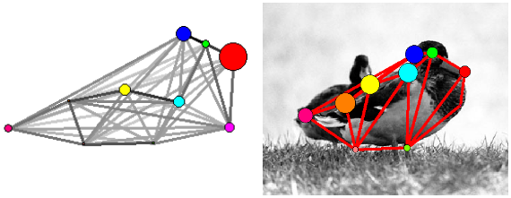
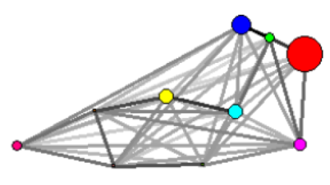
Our Approach
How to obtain a graph model for matching?
  Learn the class-specific graph model from training data, and use it to match to instances of the class
  Related to generic graph learning
Lee et al. ’06
Hofling & Tibshirani ’09
Nowozin et al. ’10
Annotated dataset
Learning
a graph model
Learned model
Input image

Slide 12
What to Learn? : Previous Approaches
Shared weights on nodes & on edges
  All nodes share the same weight β_{V}
  All edges share the same weight β_{E}
βV
βE
β
βV•
βE•
Caetano et al. ’07
Torresani et al. ’08
Leordeanu et al. ’12
Pachauri et al. ’12

Slide 13
What to Learn? : Generalization
Discriminative weights
  Each node and edge has its own weight
  This generalizes the previous learning approaches
β1
β12
1
2
β2
β13
β23
3
β3
β35
β45
β56
β4
4
5
6
β6
β57
β5
β58
7
β78
8
β8
β7
β
βi•
βij•

Slide 14
What to Learn? : Graph Model
Model and weights
  Goal: learn model graph G* and weights β
  How to parameterize G* and β ?
β1
β12
1
2
β2
β13
β23
3
β3
β35
β45
β56
β4
4
5
6
β6
β57
β5
β58
7
β78
8
β8
β7
β
βi•
βij•

Slide 15
Parameterization
Assume the similarity function is the dot product of two attributes:
  Then, the attributes of the model graph can be factored out and combined with the weights:
Model and weights
Feature map

Slide 16

Max-Margin Learning
Learned in the standard SSVM framework
  Given training data ,
  Minimize
    Predictor:
    Loss function:
    Regularization:
  Optimization by the cutting plane method
(Normalized Hamming loss)
Caetano et al. ’09
Joachims et al. ’09

Slide 17
Graph Representation
Proposition
  For any graph representation where dot product between two attributes is defined as their similarity, both of the model graph attributes and their weights can be jointly learned as a single vector.
Our proposal for visual matching problems
  Histogram-Attributed Relational Graph (HARG)
    Node attribute: histograms of gradient bins
    (SIFT in this work)
    Edge attribute: histograms of log-polar bins
    (as follows)
Lowe ’04
Dalal & Triggs ’05

Slide 18
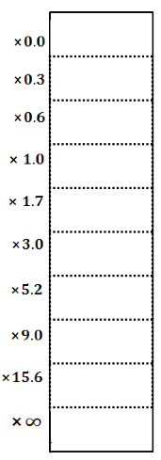
Graph Representation
Edge attribute
  histograms of log-polar bins
    Concatenation of length and angle histograms

Slide 19
Graph Representation
Edge attribute
  histograms of log-polar bins
    Concatenation of length and angle histograms

Slide 20
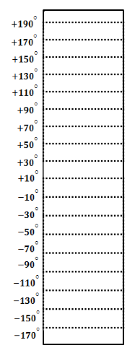
Graph Representation
Edge attribute
  histograms of log-polar bins
    Concatenation of length and angle histograms
  Non-parametric length and angle distribution
  Robust to variation, and effective in learning

Slide 21
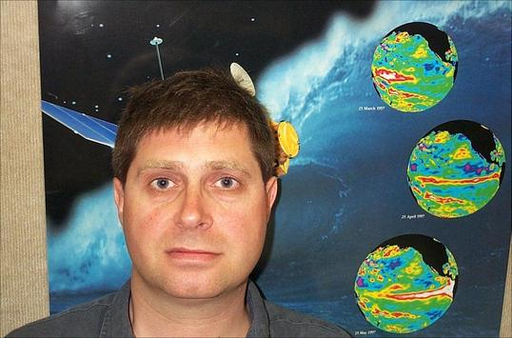
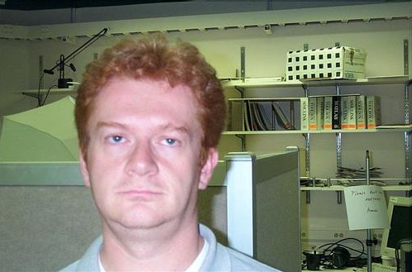
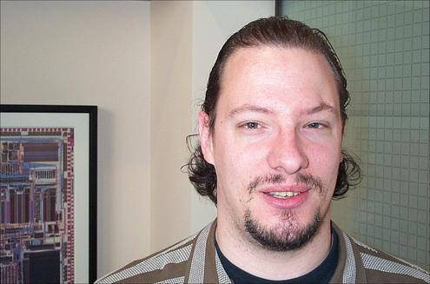
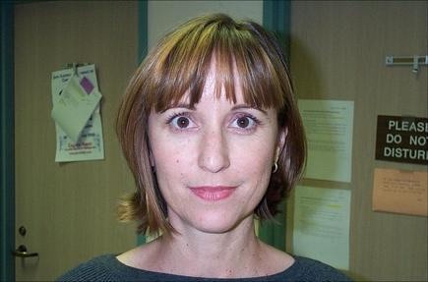

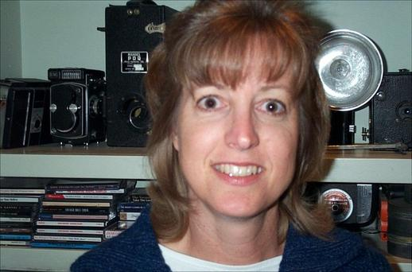
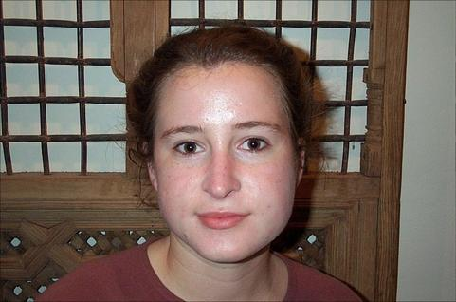
Max-Margin Learning
Example of a learned graph model
  Face images with 10 point annotations
…

Slide 22
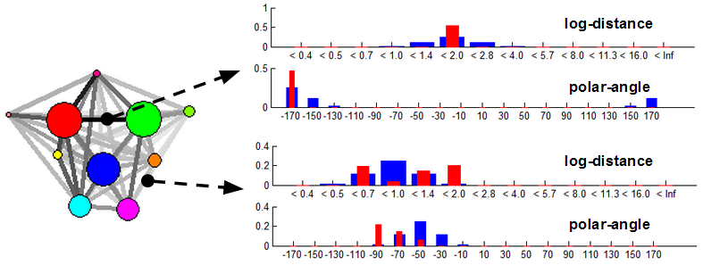
Max-Margin Learning
Example of a learned face model
  Larger weights on darker edges & bigger nodes
  Examples of learned edge attributes
    Blue histograms: attributes from a training image
    Red histograms: attributes from the learned model

Slide 23
Experimental Evaluation
On synthetic and real image datasets
  Synthetic point sets
  CMU House/Hotel
  Object classes (5 classes from Caltech-256 & PASCAL VOC 2007)
Graph construction and matching
  Fully-connected graph as an initial graph
  Graph matching module: RRWM
Cho et al. ’10

Slide 24
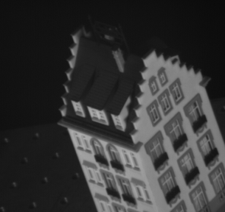
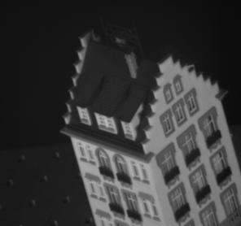
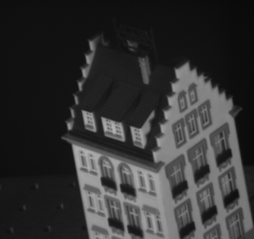
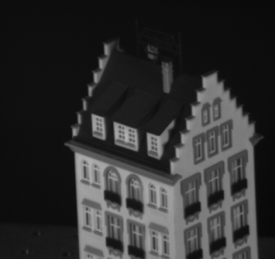
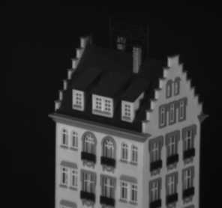
Experiments: CMU House/Hotel
Image sequence with varying viewpoints
  111 images for House, 101 images for Hotel
  30 annotated points for each frame
Caetano et al., 2007
Hotel sequence
Learned model
Matching results

Slide 25
Experiments: Object Classes
Annotated object class dataset
  5 object classes constructed using images from Caltech-256 and PASCAL VOC datasets
  (Face:109, Duck: 50, Wine bottle: 66, Motorbike: 40, Car: 40)
  10 distinctive points annotated for each image
Quantitative evaluation
  20 images for training and the rest for testing
  Endpoint error for each match w.r.t object size
    True match if the error < 0.15
  Average performance over the 20 random splits

Slide 26
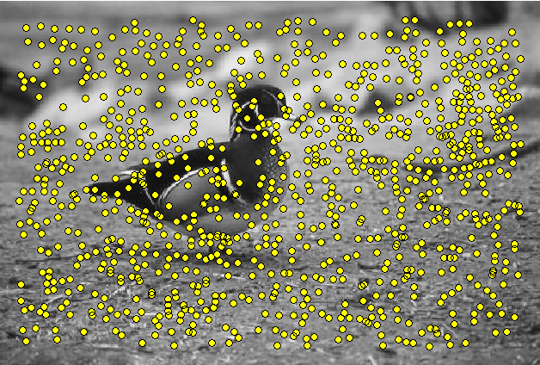
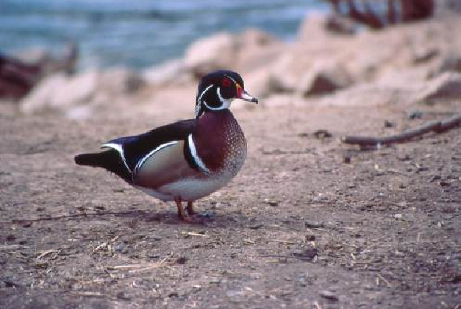
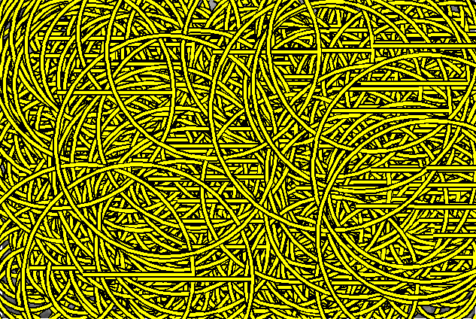
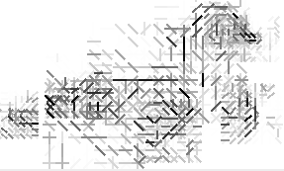

Experiments: Object Classes
Duck
Learned model
Input image
• Node color: feature identity
• Bigger nodes: larger weights
• Darker edges: larger weights
• Node color: matching feature
• Bigger nodes: higher similarity
• Red edges: connecting true ones

Slide 27
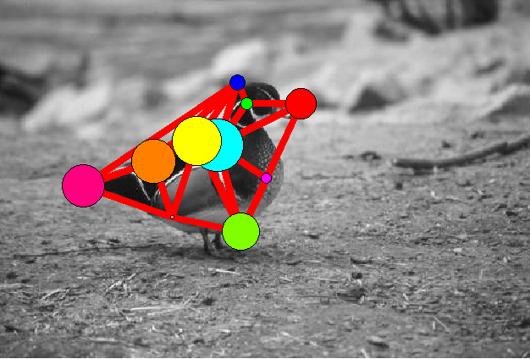
Experiments: Object Classes
Duck
Learned model
Input image
• Node color: feature identity
• Bigger nodes: larger weights
• Darker edges: larger weights
• Node color: matching feature
• Bigger nodes: higher similarity
• Red edges: connecting true ones

Slide 28
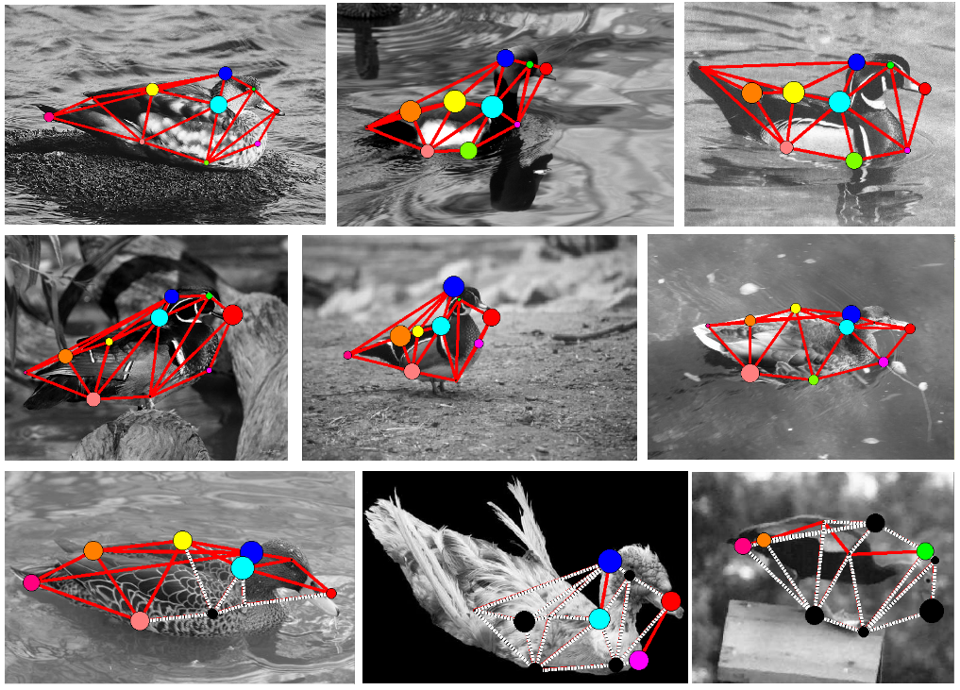
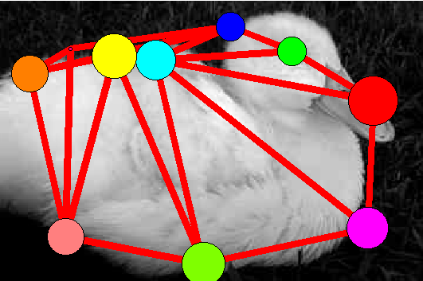
Experiments: Object Classes
Duck
  Black nodes: false matches

Slide 29
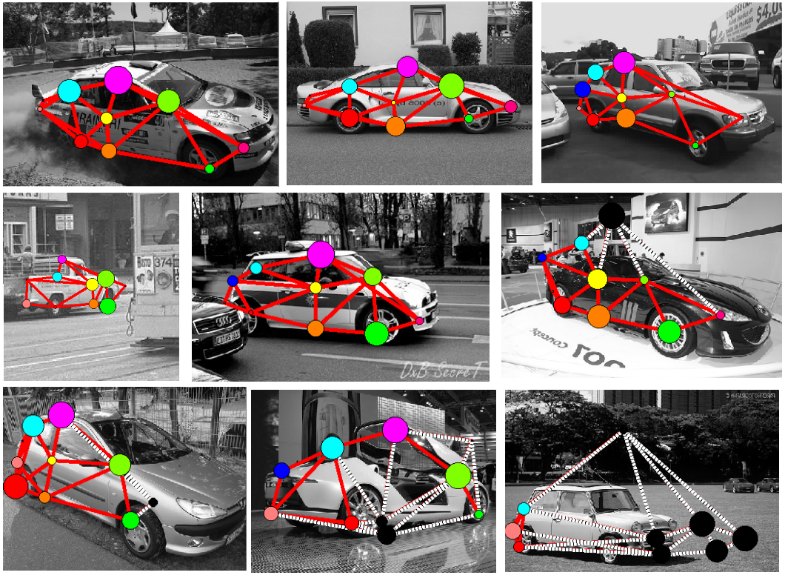
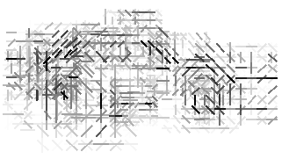
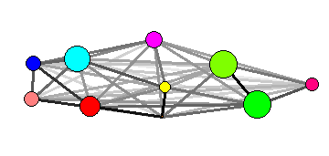
Experiments: Object Classes
Car
  Black nodes: false matches

Slide 30
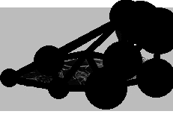
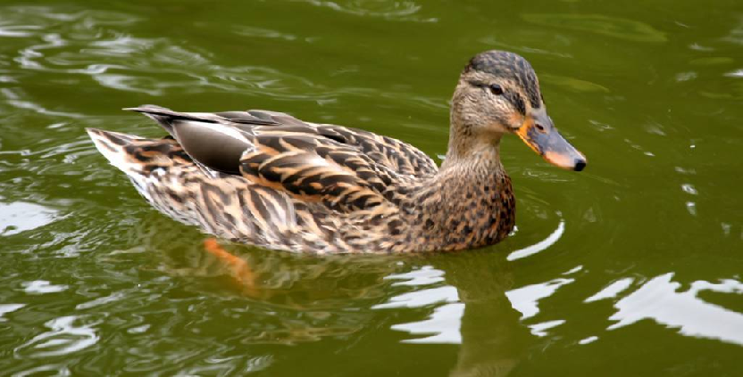
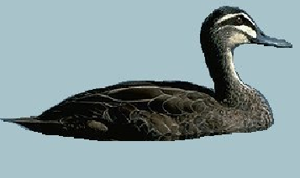
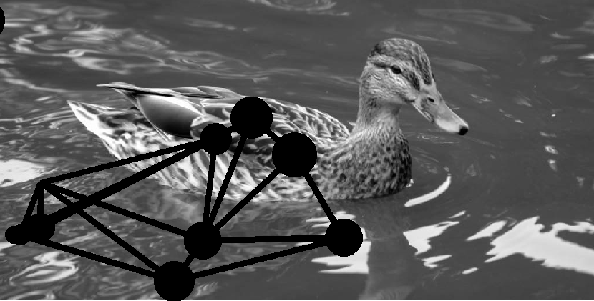
Experiments: Object Classes
Comparison
  w/o learning: uniform weights without learning

Slide 31
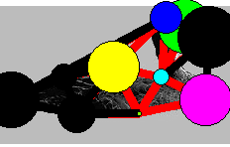

Experiments: Object Classes
Comparison
  w/o learning: uniform weights without learning
  SW-SSVM: shared weights, learned in SSVM
Caetano et al., 2007

Slide 32


Experiments: Object Classes
Comparison
  w/o learning: uniform weights without learning
  SW-SSVM: shared weights, learned in SSVM
  SW-SPEC: shared weights, learned by
Caetano et al., 2007
Leordeanu et al., 2012

Slide 33


Experiments: Object Classes
Comparison
  w/o learning: uniform weights without learning
  SW-SSVM: shared weights, learned in SSVM
  SW-SPEC: shared weights, learned by
  DW-SSVM: individual weights, learned in SSVM
Caetano et al., 2007
Leordeanu et al., 2012

Slide 34

Experiments: Object Classes
Comparison
  w/o learning: uniform weights without learning
  SW-SSVM: shared weights, learned in SSVM
  SW-SPEC: shared weights, learned by
  DW-SSVM: individual weights, learned in SSVM
  HARG-SSVM: the proposed method
Caetano et al., 2007
Leordeanu et al., 2012

Slide 35
Experiments: Object Classes
Quantitative comparison
  The average performance on 20 random splits
  w/o learning: uniform weights without learning
  SW-SSVM: shared weights, learned in SSVM
  SW-SPEC: shared weights, learned by
  DW-SSVM: individual weights learned in SSVM
  HARG-SSVM: the proposed method
Caetano et al., 2007
Leordeanu et al., 2012

Slide 36
Summary
Effective learning of class-specific models
  Useful for a variety of practical matching problems
Annotated datasets & code soon available:
  http://www.di.ens.fr/willow/research/graphlearning/
❖ This research was supported in part by
the ERC advanced grant VideoWorld, Institut Universitaire de France, and the Quaero programme funded by the OSEO.

