Slide 1
SMOOTH SURFACES AND
THEIR OUTLINES
Elements of Differential Geometry
The second fundamental form
Koenderink’s Theorem
Aspect graphs
More differential geometry
A catalogue of visual events
Computing the aspect graph
http://www.di.ens.fr/~ponce/geomvis/lect6.pptx
http://www.di.ens.fr/~ponce/geomvis/lect6.pdf

Slide 2
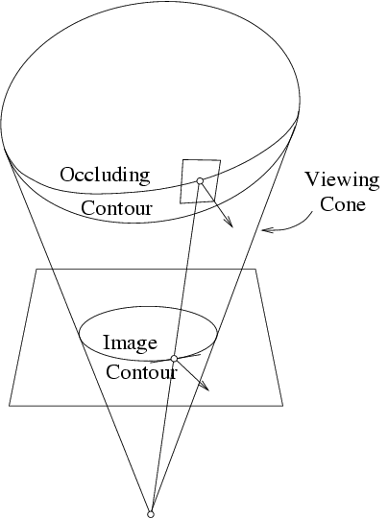
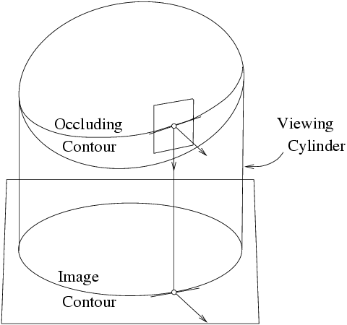
Smooth Shapes and their Outlines
Can we say anything about a 3D
shape from the shape of its
contour?

Slide 3
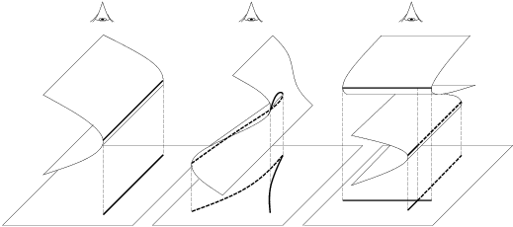
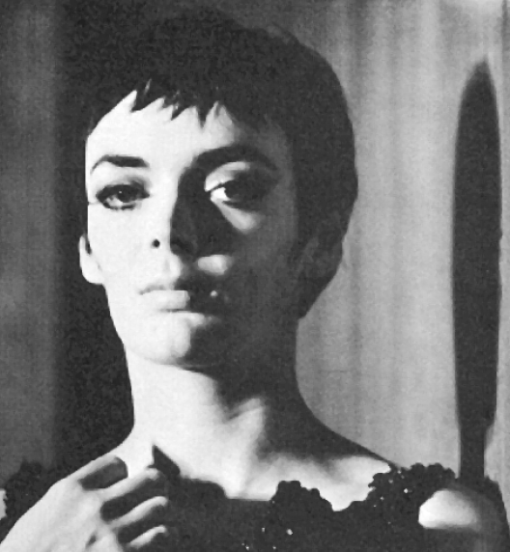
What are the contour stable features??
Reprinted from “Computing Exact
Aspect Graphs of Curved Objects:
Algebraic Surfaces,” by S. Petitjean,
J. Ponce, and D.J. Kriegman, the
International Journal of Computer
Vision, 9(3):231-255 (1992). © 1992
Kluwer Academic Publishers.
folds
cusps
T-junctions
Shadows
are like
silhouettes..
Reprinted from “Solid Shape,” by J.J. Koenderink,
MIT Press (1990). © 1990 by the MIT.

Slide 4
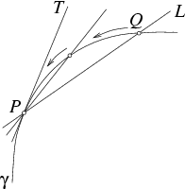
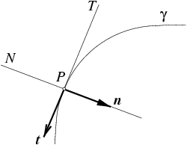
Differential geometry: geometry in the small
The normal to a curve
is perpendicular to the
tangent line.
A tangent is the limit
of a sequence of
secants.

Slide 5
What can happen to a curve in the vicinity of a point?
(a) Regular point;
(b) inflection;
(c) cusp of the first kind;
(d) cusp of the second kind.

Slide 6
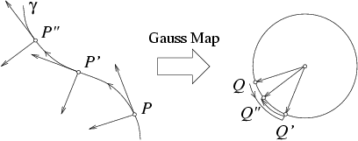
The Gauss Map
It maps points on a curve onto points on the unit circle.
The direction of traversal of the Gaussian image reverts
at inflections: it folds there.

Slide 7
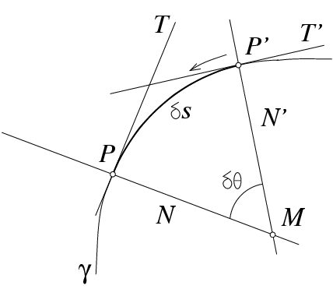
The curvature
C
C is the center of curvature;
R = CP is the radius of curvature;
κ = lim δθ/δs = 1/R is the curvature.

Slide 8
Closed curves admit a canonical orientation..
κ < 0
κ > 0
= dθ / ds Ã derivative of the Gauss map
dt/ds = κ n

Slide 9
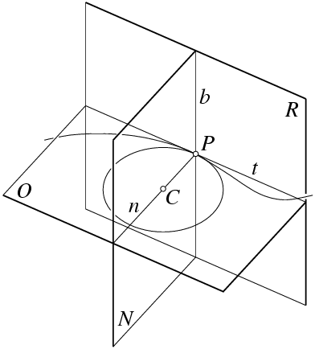
Twisted curves are more complicated animals..

Slide 10
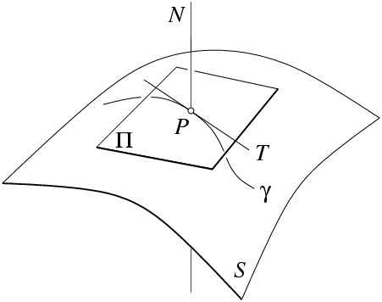
A smooth surface, its tangent plane and its normal.

Slide 11
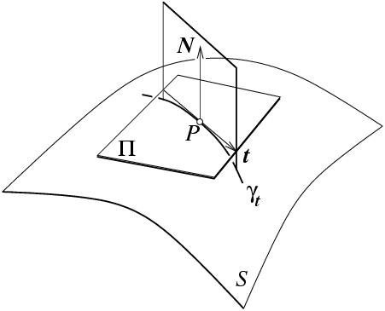
Normal sections and normal curvatures
Principal curvatures:
minimum value κ
maximum value κ
Gaussian curvature:
K = κ κ
1
1
2
2

Slide 12
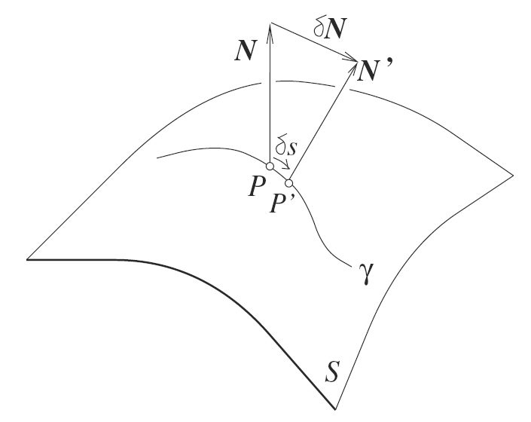
The differential of the Gauss map
dN (t)= lim_{δ s ! 0}
Second fundamental form:
II( u , v) = u^{T} dN ( v )
(II is symmetric.)
The normal curvature is κ_{t} = II ( t , t ).
Two directions are said to be conjugated when II ( u , v ) = 0.

Slide 13
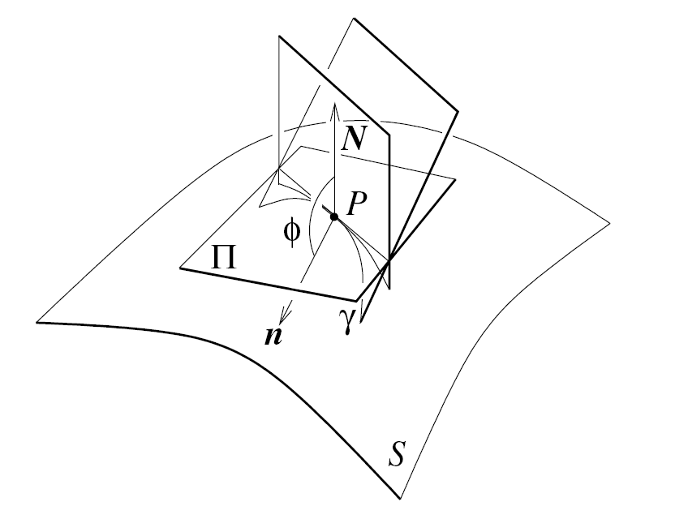
Meusnier’s theorem: κ_{t} = - κ cosφ .

Slide 14
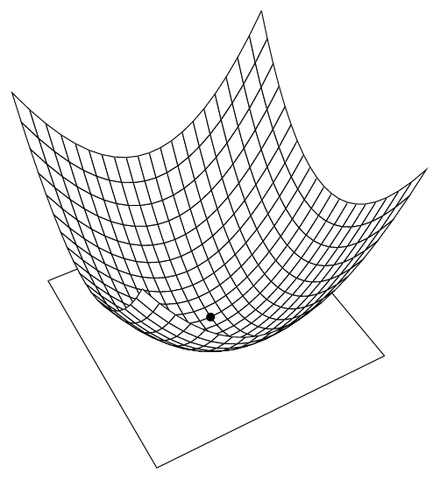
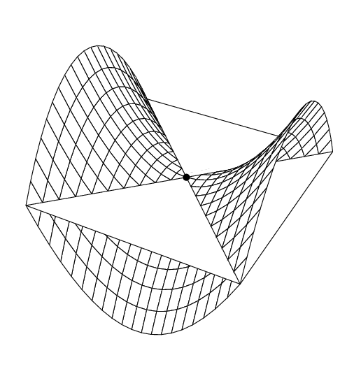
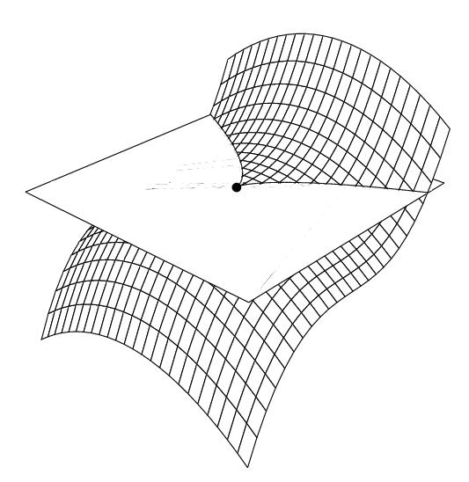
The local shape of a smooth surface
Elliptic point
Hyperbolic point
K > 0
K < 0
Reprinted from “On Computing
Structural Changes in Evolving
Surfaces and their Appearance,”
By S. Pae and J. Ponce, the
International Journal of Computer
Vision, 43(2):113-131 (2001).
© 2001 Kluwer Academic
Publishers.
Parabolic point
K = 0

Slide 15
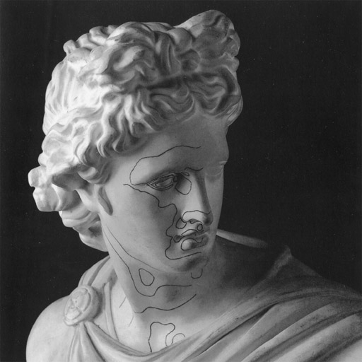
Parabolic lines marked on the Apollo Belvedere by Felix Klein

Slide 16
Asymptotic directions:
II(a,a)=0
The contour cusps when
when a viewing ray grazes
the surface along an
asymptotic direction v=a.
N . v = 0 ) II( t , v )=0

Slide 17
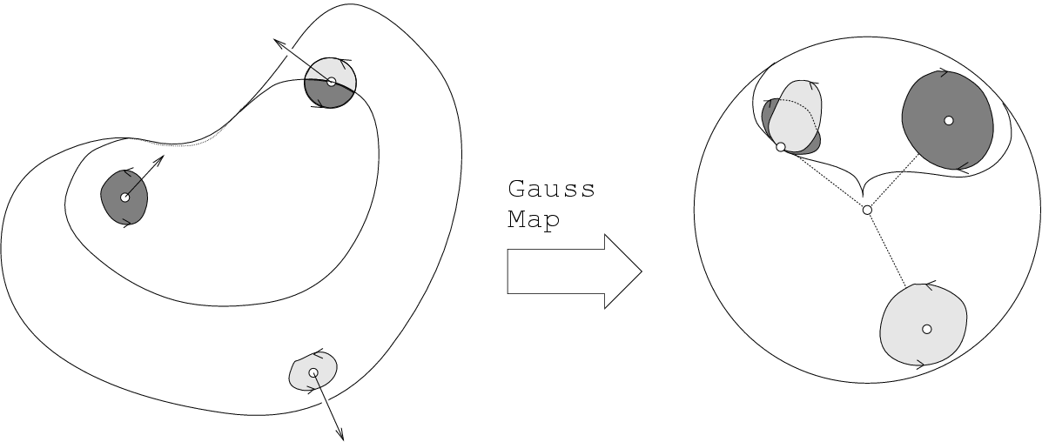
The Gauss map
The Gauss map folds at parabolic points.
Reprinted from “On Computing
Structural Changes in Evolving
Surfaces and their Appearance,”
By S. Pae and J. Ponce, the
International Journal of Computer
Vision, 43(2):113-131 (2001).
© 2001 Kluwer Academic
Publishers.
K = dA’/dA

Slide 18
Smooth Shapes and their Outlines
Can we say anything about a 3D
shape from the shape of its
contour?

Slide 19
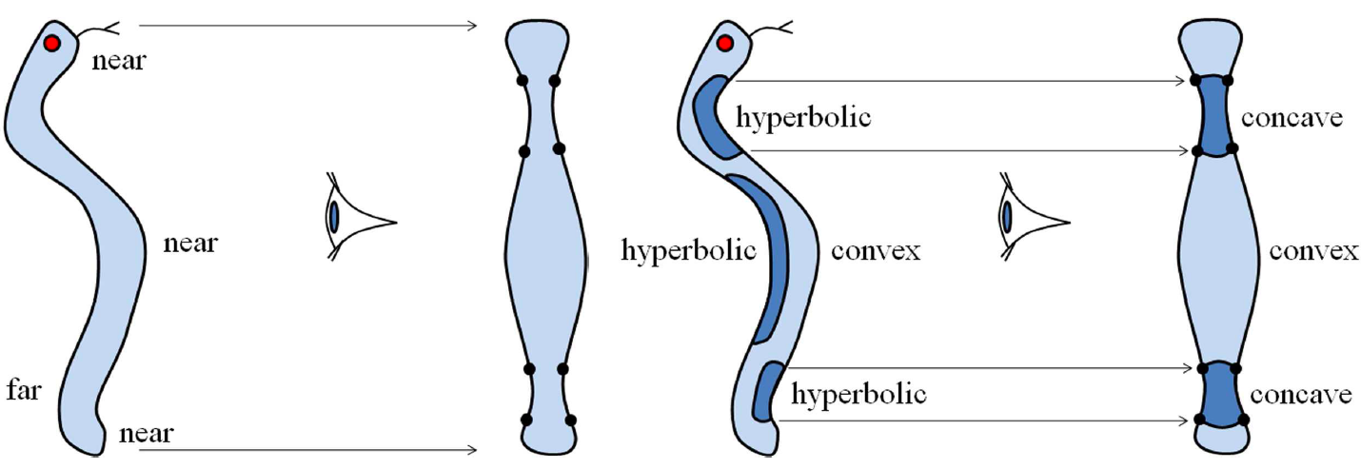
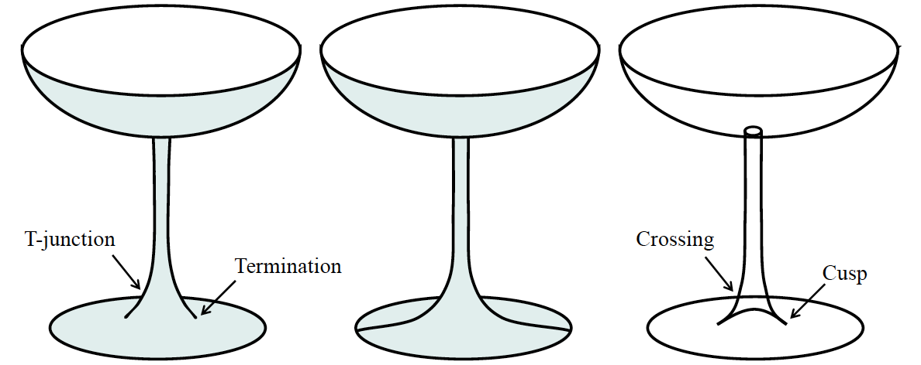
After Marr (1977) and Koenderink (1984).

Slide 20
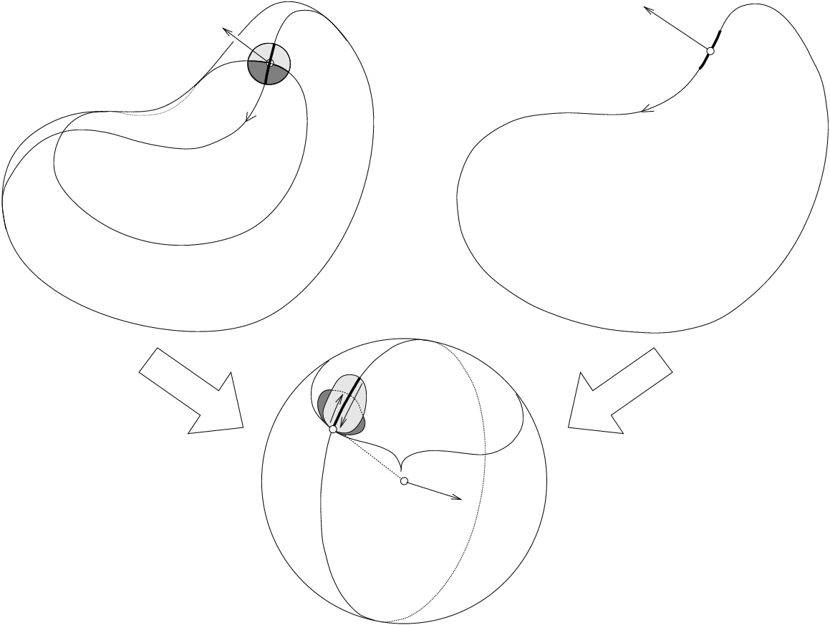
Theorem [Koenderink, 1984]: the inflections of the silhouette
are the projections of parabolic points.

Slide 21
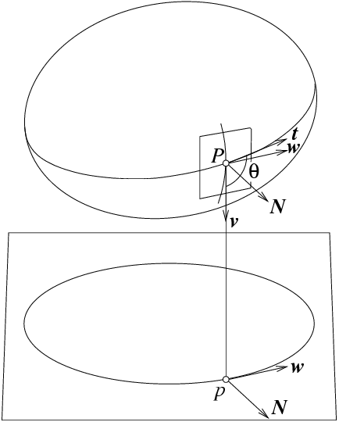
Koenderink’s Theorem (1984)
K = κ κ
r
c
Note: κ > 0.
r
Corollary: K and κ have
the same sign!
c
Proof: Based on the idea
that, given two conjugated
directions,
K sin²θ = κ_{u} κ_{v}

Slide 22
What are the contour stable features??
Reprinted from “Computing Exact
Aspect Graphs of Curved Objects:
Algebraic Surfaces,” by S. Petitjean,
J. Ponce, and D.J. Kriegman, the
International Journal of Computer
Vision, 9(3):231-255 (1992). © 1992
Kluwer Academic Publishers.
folds
cusps
T-junctions
How does the appearance of an object change with viewpoint?

Slide 23
Contacts between lines and smooth curves

Slide 24
Exceptional and Generic Curves

Slide 25
The Aspect Graph
In Flatland

Slide 26
Gauss
sphere
The Geometry of
the Gauss Map
Image of
parabolic
curve
Reprinted from “On Computing
Structural Changes in Evolving
Surfaces and their Appearance,”
By S. Pae and J. Ponce, the
International Journal of Computer
Vision, 43(2):113-131 (2001).
© 2001 Kluwer Academic
Publishers.
Moving
great
circle
Cusp of
Gauss
Concave
fold
Convex
fold
Gutterpoint

Slide 27
Asymptotic directions at ordinary
hyperbolic points
The integral curves of the asymptotic
directions form two families of
asymptotic curves (red and blue)

Slide 28
Asymptotic curves
Asymptotic curves’ images
Gauss
map
Parabolic curve
Fold
Asymptotic directions are self conjugate: a . dN ( a ) = 0
At a parabolic point dN ( a ) = 0, so for any curve
t . dN ( a ) = a . dN ( t ) = 0
In particular, the Gaussian images of the asymptotic and
parabolic curves are both orthogonal to a.

Slide 29
Gauss
sphere
The Geometry of
the Gauss Map
Image of
parabolic
curve
Reprinted from “On Computing
Structural Changes in Evolving
Surfaces and their Appearance,”
By S. Pae and J. Ponce, the
International Journal of Computer
Vision, 43(2):113-131 (2001).
© 2001 Kluwer Academic
Publishers.
Moving
great
circle
a
Cusp of
Gauss
Concave
fold
Convex
fold
Gutterpoint

Slide 30
The Lip Event
v . dN (a) = 0 ) v ¼ a
Reprinted from “On Computing
Structural Changes in Evolving
Surfaces and their Appearance,”
By S. Pae and J. Ponce, the
International Journal of Computer
Vision, 43(2):113-131 (2001).
© 2001 Kluwer Academic
Publishers.

Slide 31
The Beak-to-Beak Event
v . dN (a) = 0 ) v ¼ a
Reprinted from “On Computing
Structural Changes in Evolving
Surfaces and their Appearance,”
By S. Pae and J. Ponce, the
International Journal of Computer
Vision, 43(2):113-131 (2001).
© 2001 Kluwer Academic
Publishers.

Slide 32
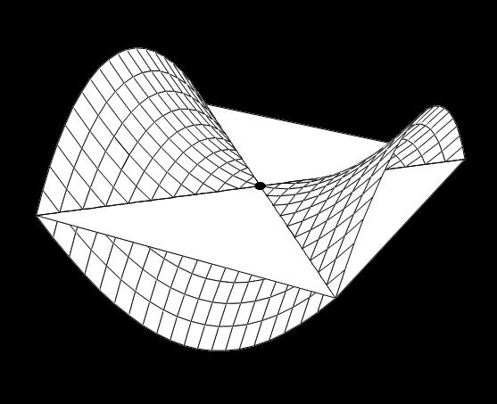
Ordinary Hyperbolic Point
Reprinted from “On Computing
Structural Changes in Evolving
Surfaces and their Appearance,”
By S. Pae and J. Ponce, the
International Journal of Computer
Vision, 43(2):113-131 (2001).
© 2001 Kluwer Academic
Publishers.
Flecnodal Point

Slide 33
Red asymptotic curves
Red asymptotic curves
Asymptotic
spherical
map
Red flecnodal curve
Red flecnodal curve
Cusp pairs appear or disappear as one crosses the fold of the
asymptotic spherical map.
This happens at asymptotic directions along parabolic curves,
and asymptotic directions along flecnodal curves.

Slide 34
The Swallowtail Event
Flecnodal Point
Reprinted from “On Computing Structural Changes in Evolving Surfaces and their Appearance,” by S. Pae and J. Ponce, the
International Journal of Computer Vision, 43(2):113-131 (2001). © 2001 Kluwer Academic Publishers.

Slide 35
The Bitangent Ray Manifold:
P’
P”
P
Ordinary
bitangents..
limiting bitangent line
..and exceptional
(limiting) ones.
Reprinted from “Toward a Scale-Space Aspect Graph: Solids of
Revolution,” by S. Pae and J. Ponce, Proc. IEEE Conf. on Computer
Vision and Pattern Recognition (1999). © 1999 IEEE.
unode

Slide 36
The Tangent Crossing Event
Reprinted from “On Computing Structural Changes in Evolving Surfaces and their Appearance,” by S. Pae and J. Ponce, the
International Journal of Computer Vision, 43(2):113-131 (2001). © 2001 Kluwer Academic Publishers.

Slide 37
The Cusp Crossing Event
After “Computing Exact Aspect Graphs of Curved Objects: Algebraic Surfaces,” by S. Petitjean, J. Ponce, and D.J. Kriegman,
the International Journal of Computer Vision, 9(3):231-255 (1992). © 1992 Kluwer Academic Publishers.

Slide 38
The Triple Point Event
After “Computing Exact Aspect Graphs of Curved Objects: Algebraic Surfaces,” by S. Petitjean, J. Ponce, and D.J. Kriegman,
the International Journal of Computer Vision, 9(3):231-255 (1992). © 1992 Kluwer Academic Publishers.

Slide 39
Tracing Visual Events
Computing the Aspect Graph
X1
F(x,y,z)=0
S1
S1
E1
E3
P₁(x₁,…,x_{n})=0
…
P_{n}(x₁,…,x_{n})=0
S2
S2
X0
After “Computing Exact Aspect Graphs of Curved Objects: Algebraic Surfaces,”
by S. Petitjean, J. Ponce, and D.J. Kriegman, the International Journal of Computer
Vision, 9(3):231-255 (1992). © 1992 Kluwer Academic Publishers.
Curve Tracing
Cell Decomposition

Slide 40
An Example

Slide 41
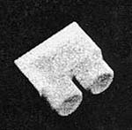
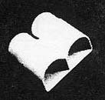
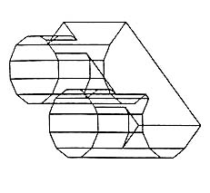
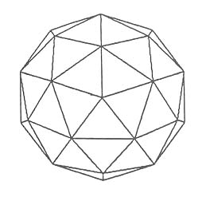
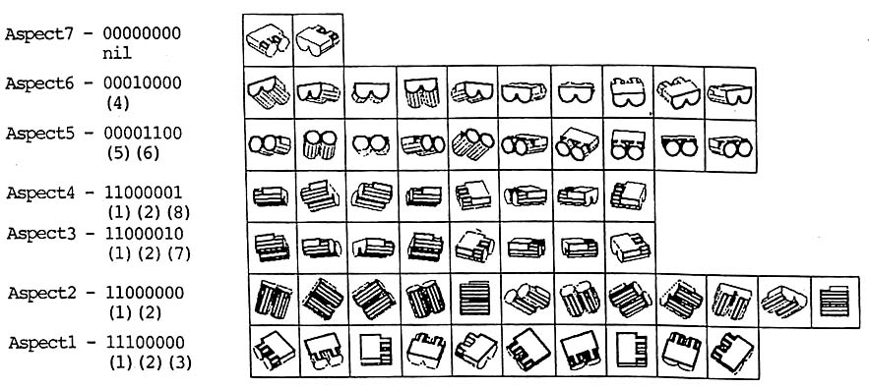
Approximate Aspect Graphs (Ikeuchi & Kanade, 1987)
Reprinted from “Automatic Generation of Object Recognition Programs,” by K. Ikeuchi and T. Kanade, Proc. of the IEEE, 76(8):1016-1035 (1988).
© 1988 IEEE.

Slide 42
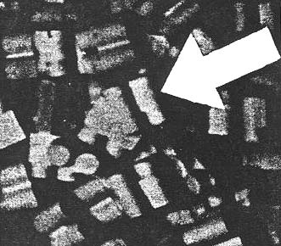
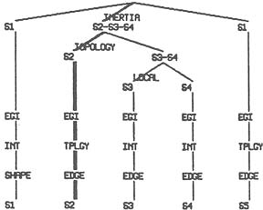
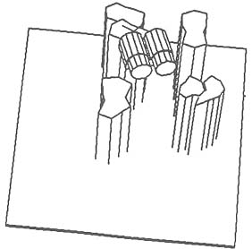
Approximate Aspect Graphs II: Object Localization
(Ikeuchi & Kanade, 1987)
Reprinted from “Precompiling a Geometrical
Model into an Interpretation Tree for Object
Recognition in Bin-Picking Tasks,” by K. Ikeuchi,
Proc. DARPA Image Understanding Workshop,
1987.

