Slide 1
Instance-level recognition I. -
Camera geometry and image alignment
Reconnaissance d’objets et vision artificielle 2011
Josef Sivic
http://www.di.ens.fr/~josef
INRIA, WILLOW, ENS/INRIA/CNRS UMR 8548
Laboratoire d’Informatique, Ecole Normale Supérieure, Paris
With slides from: S. Lazebnik, J. Ponce, and A. Zisserman

Slide 2
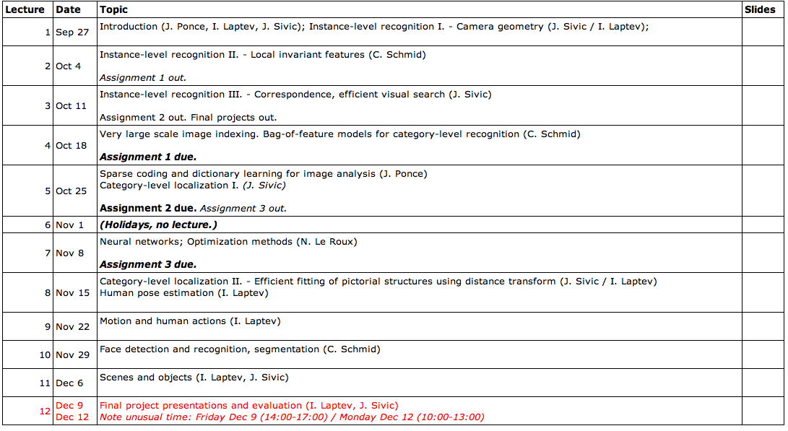
http://www.di.ens.fr/willow/teaching/recvis11/
Class webpage:
http://www.di.ens.fr/willow/teaching/recvis11/

Slide 3
Object recognition and computer vision 2011
Class webpage:
http://www.di.ens.fr/willow/teaching/recvis11/
Grading:
3 programming assignments (60%)
  Panorama stitching
  Image classification
  Basic face detector
Final project (40%)
More independent work, resulting in the report and a class presentation.

Slide 4
Matlab tutorial
Friday 30/09/2011 at 10:30-12:00.
The tutorial will be at 23 avenue d'Italie - Salle Rose.
Come if you have no/limited experience with Matlab.

Slide 5
Research
Both WILLOW (J. Ponce, I. Laptev, J. Sivic) and LEAR (C. Schmid) groups are active in computer vision and visual recognition research.
http://www.di.ens.fr/willow/
http://lear.inrialpes.fr/
with close links to SIERRA – machine learning (F. Bach)
http://www.di.ens.fr/sierra/
There will be master internships available. Talk to us if you are interested.

Slide 6
Outline
Part I - Camera geometry – image formation
Perspective projection
Affine projection
Projection of planes
Part II - Image matching and recognition with local features
Correspondence
Semi-local and global geometric relations
Robust estimation – RANSAC and Hough Transform

Slide 7
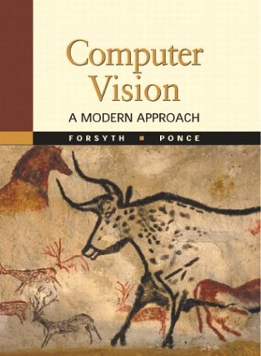
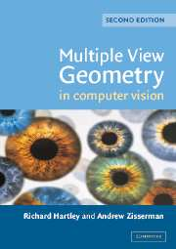
Reading: Part I. Camera geometry
Forsyth&Ponce – Chapters 1 and 2
Hartley&Zisserman – Chapter 6: “Camera models”

Slide 8
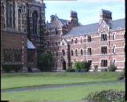

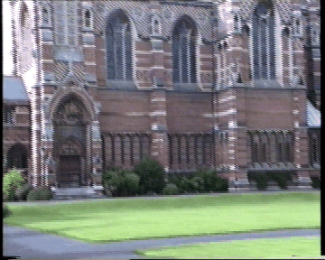
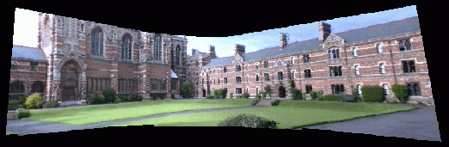
Motivation: Stitching panoramas

Slide 9
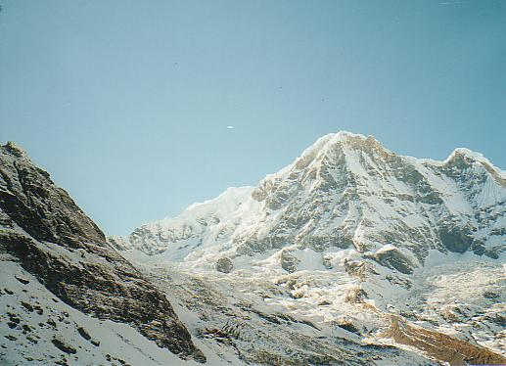
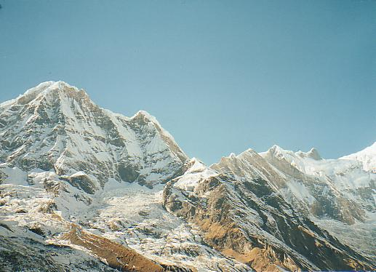
Feature-based alignment outline

Slide 10
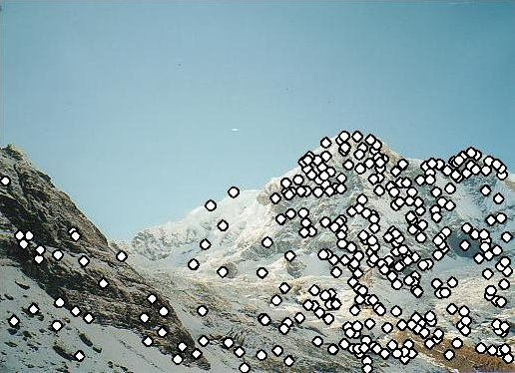
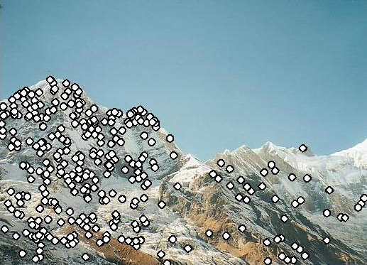
Feature-based alignment outline
Extract features

Slide 11
Feature-based alignment outline
Extract features
Compute putative matches

Slide 12
Feature-based alignment outline
Extract features
Compute putative matches
Loop:
  Hypothesize transformation T (small group of putative matches that are related by T)

Slide 13
Feature-based alignment outline
Extract features
Compute putative matches
Loop:
  Hypothesize transformation T (small group of putative matches that are related by T)
  Verify transformation (search for other matches consistent with T)

Slide 14
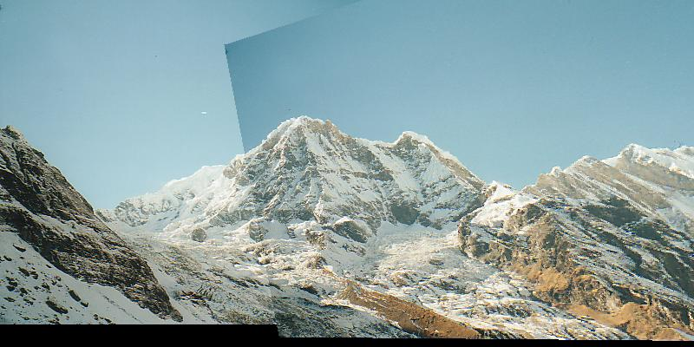
Feature-based alignment outline
Extract features
Compute putative matches
Loop:
  Hypothesize transformation T (small group of putative matches that are related by T)
  Verify transformation (search for other matches consistent with T)

Slide 15
2D transformation models
Similarity
(translation,
scale, rotation)
Affine
Projective
(homography)
Why these transformations ???

Slide 16
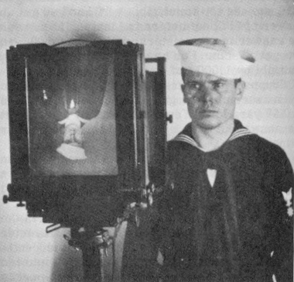
Camera geometry

Slide 17
They are formed by the projection of 3D objects.
Images are two-dimensional patterns of brightness values.
Notes:
Let’s first examine perspective projection.

Slide 18
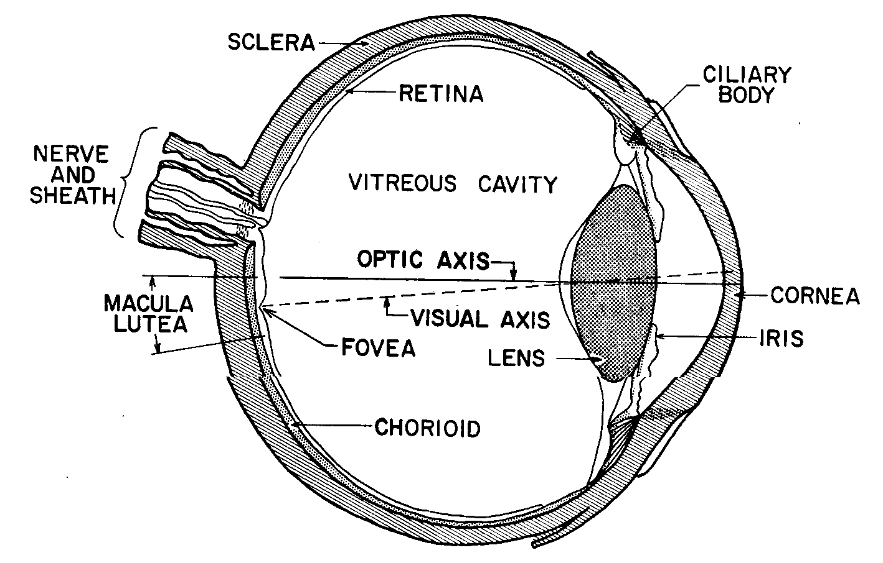
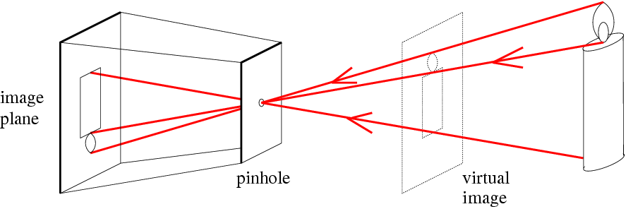
Animal eye: a looonnng time ago.
Photographic camera:
Niepce, 1816.
Pinhole perspective projection: Brunelleschi, XVth Century.
Camera obscura: XVIth Century.

Slide 19
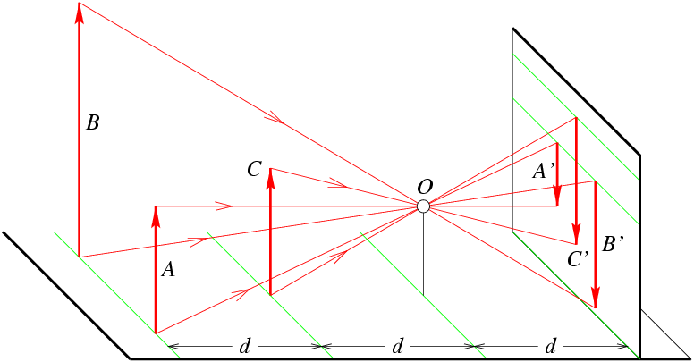
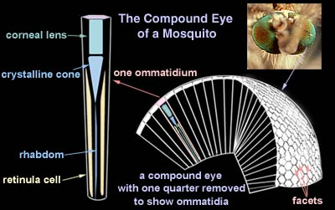

Slide 20
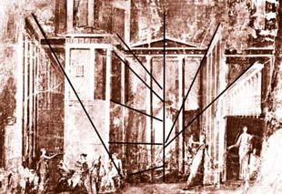
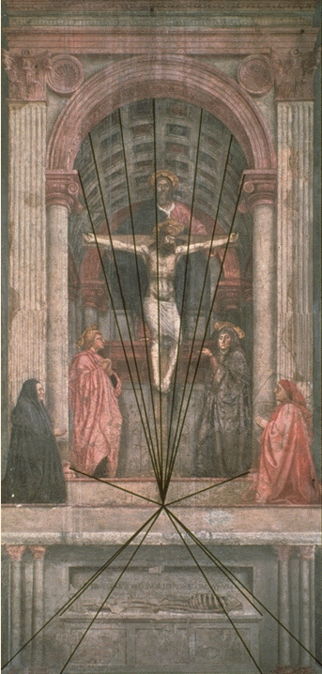
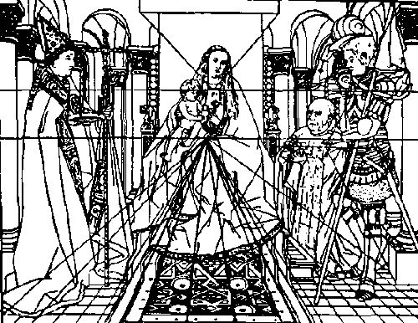
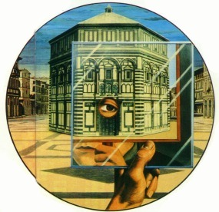
Pompei painting, 2000 years ago.
Brunelleschi, 1415
Van Eyk, XIVth Century
Massaccio’s Trinity, 1425

Slide 21
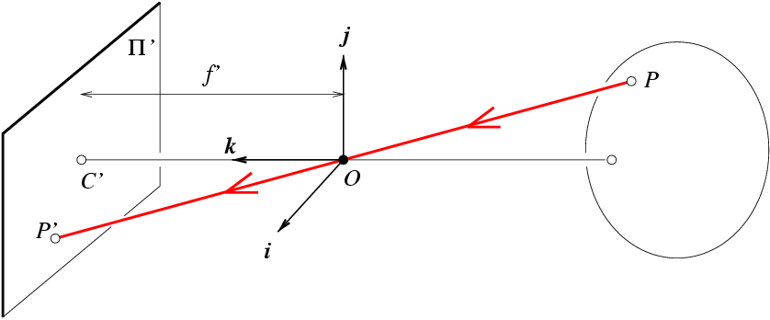
Pinhole Perspective Equation
Image plane
(retina)
Camera co-ordinate system
World point
Principal axis
Camera center
Imaged
point
NOTE: z is always negative..

Slide 22
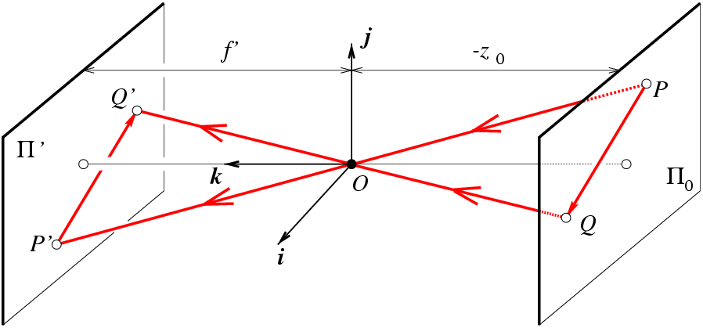
Affine projection models: Weak perspective projection
is the magnification.
When the scene relief is small compared its distance from the
Camera, m can be taken constant: weak perspective projection.

Slide 23
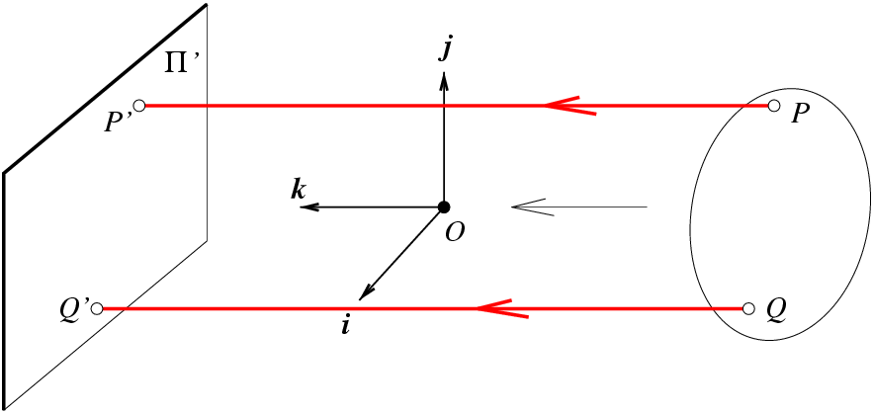
Affine projection models: Orthographic projection
When the camera is at a
(roughly constant) distance
from the scene, take m=1.

Slide 24
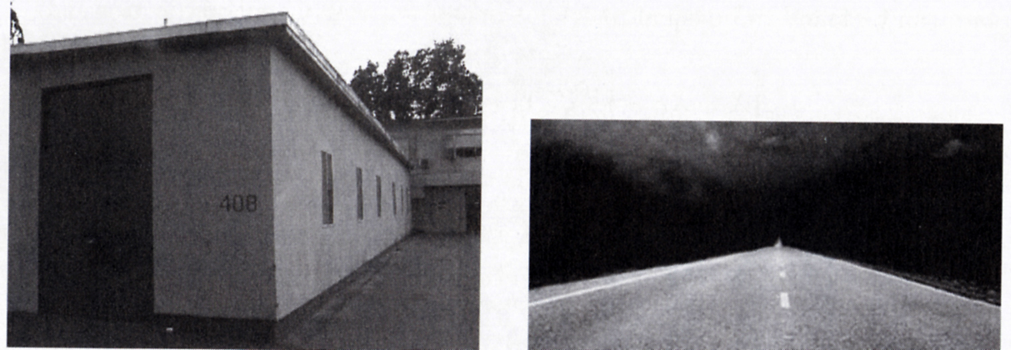
Strong perspective:
Angles are not preserved
The projections of parallel lines intersect at one point

Slide 25
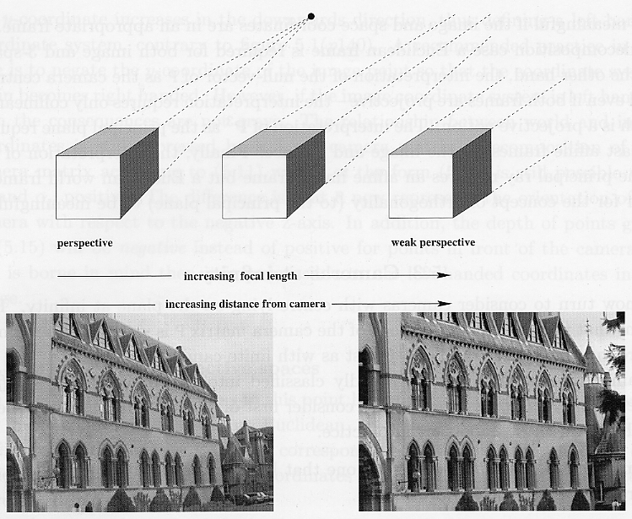
From Zisserman & Hartley

Slide 26
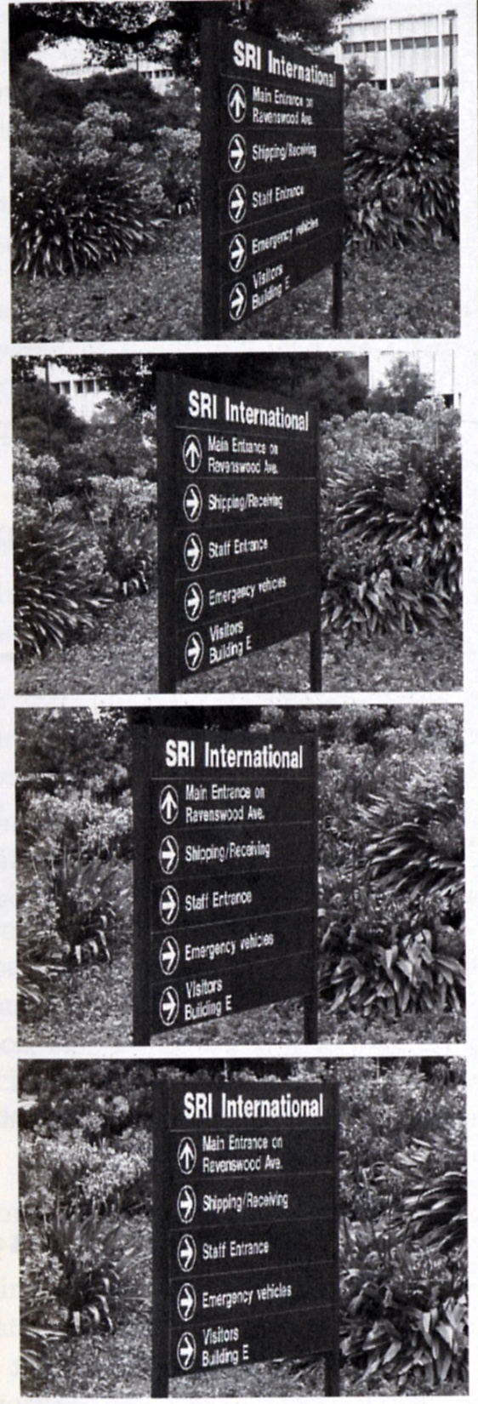
Strong perspective:
Angles are not preserved
The projections of parallel lines intersect at one point
Weak perspective:
Angles are better preserved
The projections of parallel lines are (almost) parallel

Slide 27
Beyond pinhole camera model: Geometric Distortion

Slide 28
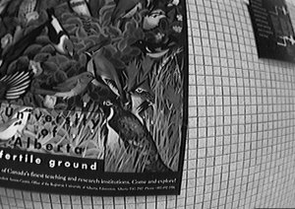
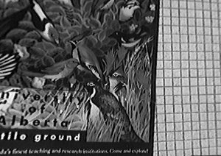
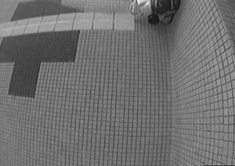
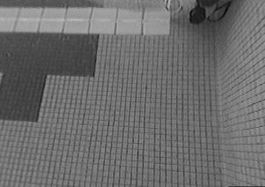
Rectification

Slide 29
Radial Distortion Model

Slide 30
Perspective Projection |  | x,y: World coordinates x’,y’: Image coordinates f: pinhole-to-retina distance
Weak-Perspective Projection (Affine) |  | x,y: World coordinates x’,y’: Image coordinates m: magnification
Orthographic Projection (Affine) |  | x,y: World coordinates x’,y’: Image coordinates
Common distortion model |  | x’,y’: Ideal image coordinates x’’,y’’: Actual image coordinates

Slide 31
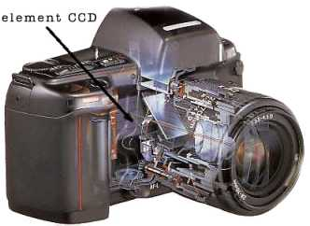
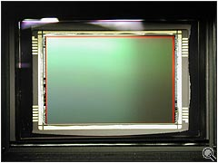
Cameras and their parameters
Images from M. Pollefeys
Notes:
Start with a recapp.

Slide 32
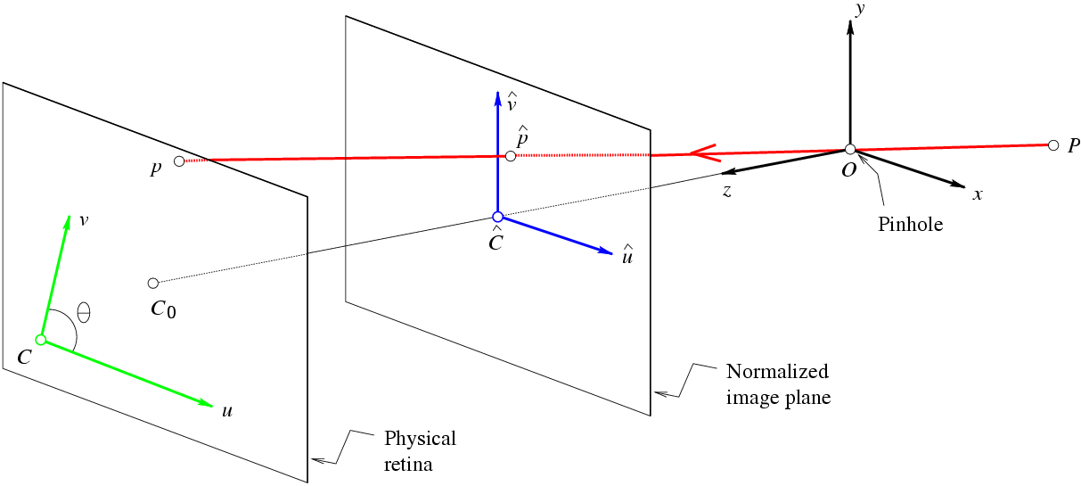
The Intrinsic Parameters of a Camera
Units:
k,l : pixel/m
f : m
α,β
: pixel
Physical Image Coordinates
Normalized Image
Coordinates
Notes:
Camera is a real device.

Slide 33
The Intrinsic Parameters of a Camera
Calibration Matrix
The Perspective
Projection Equation

Slide 34
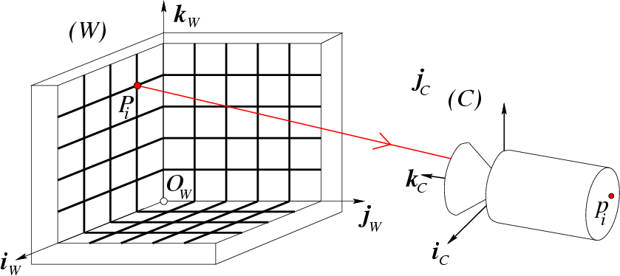
Notation
Euclidean Geometry

Slide 35
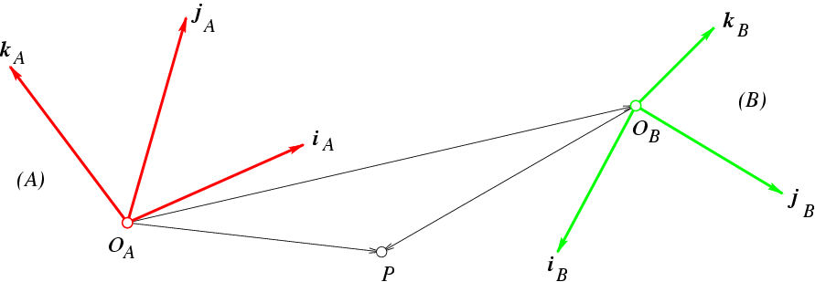
Recall:
Coordinate Changes and Rigid Transformations

Slide 36
The Extrinsic Parameters of a Camera

Slide 37
Explicit Form of the Projection Matrix
Note:
M is only defined up to scale in this setting!!

Slide 38
Weak perspective (affine) camera

Slide 39
Geometric Interpretation
Projection
equation:
Observations:
is the equation of a plane of normal direction a₁
From the projection equation, it is also
the plane defined by: u = 0
Similarly:
  (a₂,b₂) describes the plane defined by: v = 0
  (a₃,b₃) describes the plane defined by:
  That is the plane parallel to image plane
  passing through the pinhole (z = 0) – principal
  plane

Slide 40
Geometric Interpretation: The rows of the projection matrix describe the three planes defined by the image coordinate system
a₃
a₁
v
a₂
C
u

Slide 41
Other useful geometric properties
a₃
Principal axis of the camera:
The ray passing through the camera centre
with direction vector a₃

Slide 42
Other useful geometric properties
a₃
P
Depth of points:
How far a point lies from the principal plane of a camera?
But for general camera matrices:
need to be careful about the sign.
need to normalize matrix to have
||a₃||=1
If ||a₃||=1

Slide 43
Other useful geometric properties
p
P
Q: Can we compute the position of the camera center Ω?
A:
Q: Given an image point p, what is the
direction of the corresponding ray in space?
A:
Hint: Start from the projection equation. Show that the right null-space of camera matrix M is the camera center.
Hint: Start from a projection equation and write all points along direction w, that project to point p.

Slide 44
Re-cap: imaging and camera geometry
(with a slight change of notation)
perspective projection
camera centre, image point and scene point are collinear
an image point back projects to a ray in 3-space
depth of the scene point is unknown
scene
X
point
x
image
point
C
camera
centre
image plane
Slide credit: A. Zisserman

Slide 45
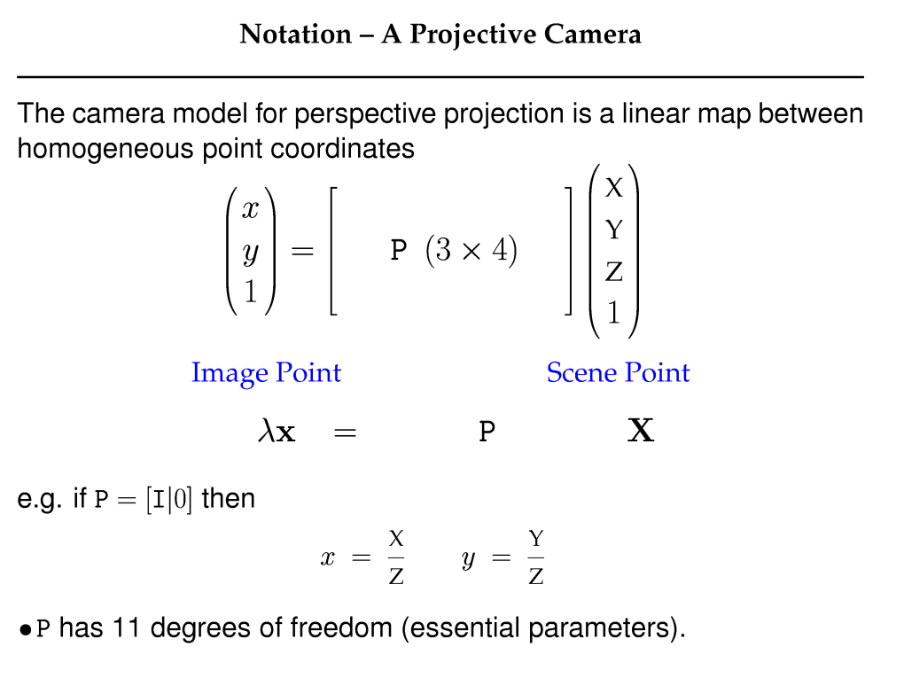
Slide credit: A. Zisserman

Slide 46
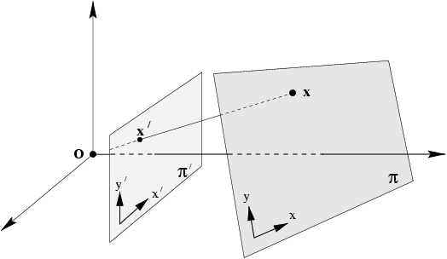
How a “scene plane” projects into an image?

Slide 47
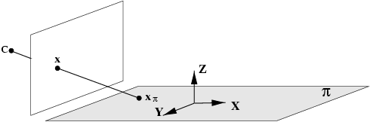
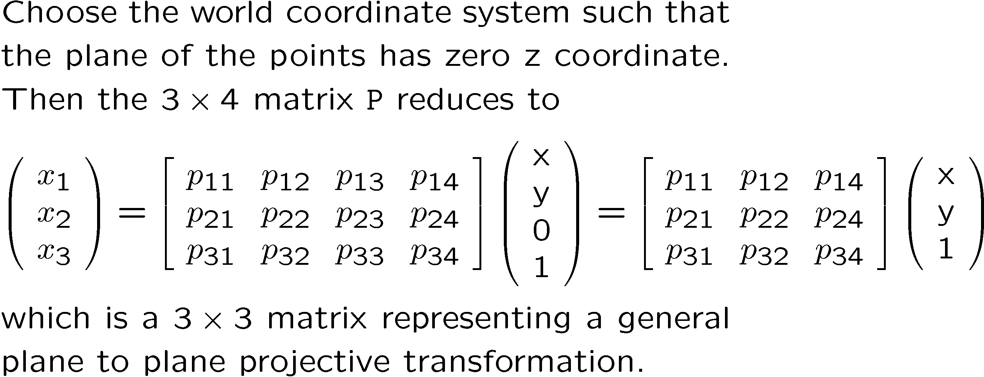
Plane projective transformations
Slide credit: A. Zisserman

Slide 48
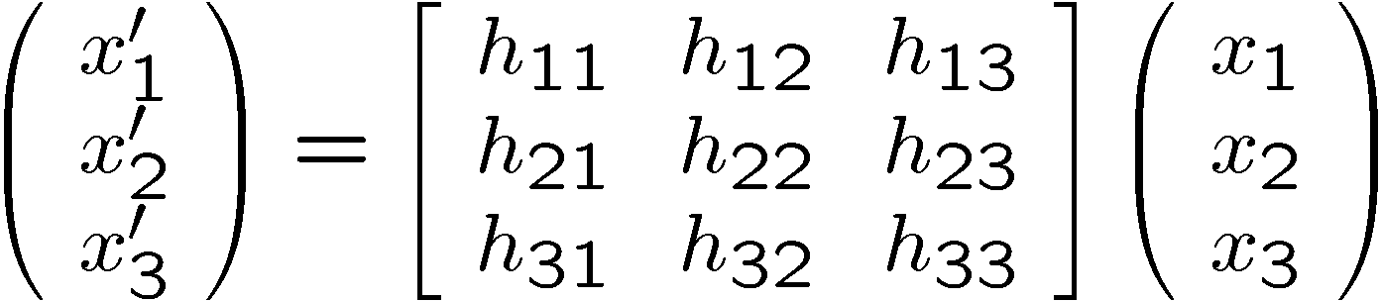

Projective transformations continued
This is the most general transformation between the world and image plane under imaging by a perspective camera.
It is often only the 3 x 3 form of the matrix that is important in establishing properties of this transformation.
A projective transformation is also called a ``homography'' and a ``collineation''.
H has 8 degrees of freedom.
Slide credit: A. Zisserman

Slide 49
Planes under affine projection
Points on a world plane map with a 2D affine geometric transformation (6 parameters)

Slide 50
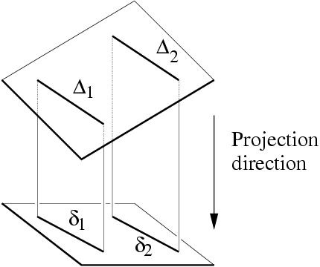
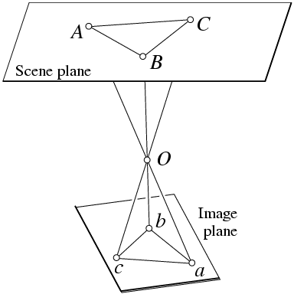
Summary
Affine projections induce affine transformations from planes
onto their images.
Perspective projections induce projective transformations from planes onto their images.

Slide 51
2D transformation models
Similarity
(translation,
scale, rotation)
Affine
Projective
(homography)

Slide 52
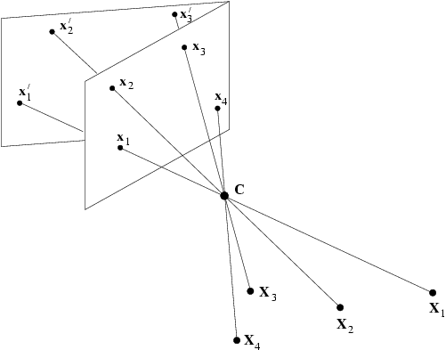
When is homography a valid transformation model?

Slide 53
Case I: Plane projective transformations
Slide credit: A. Zisserman

Slide 54
Case I: Projective transformations continued
This is the most general transformation between the world and image plane under imaging by a perspective camera.
It is often only the 3 x 3 form of the matrix that is important in establishing properties of this transformation.
A projective transformation is also called a ``homography'' and a ``collineation''.
H has 8 degrees of freedom.
Slide credit: A. Zisserman

Slide 55

Case II: Cameras rotating about their centre
image plane 2
image plane 1
P = K [ I | 0 ] P’ = K’ [ R | 0 ]
H = K’ R K^(-1)
The two image planes are related by a homography H
H depends only on the relation between the image planes and camera centre, C, not on the 3D structure
Slide credit: A. Zisserman

Slide 56
Case II: Cameras rotating about their centre
image plane 2
image plane 1
Slide credit: A. Zisserman

