Slide 1
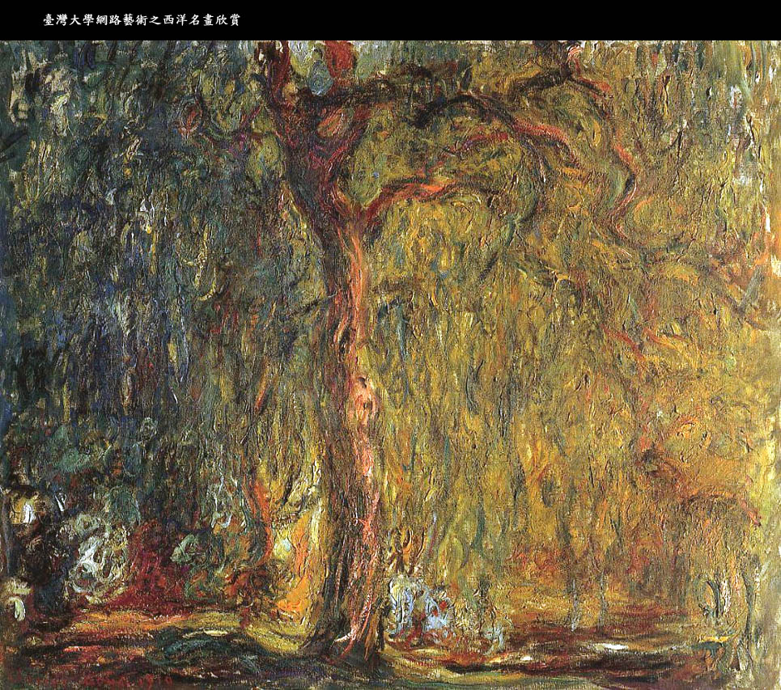

Slide 2
Reconnaissance d’objets
et vision artificielle
http://www.di.ens.fr/willow/teaching/recvis11/
Jean Ponce (ponce@di.ens.fr)
http://www.di.ens.fr/~ponce
Equipe-projet WILLOW
ENS/INRIA/CNRS UMR 8548
Laboratoire d’Informatique
Ecole Normale Supérieure, Paris

Slide 3




Jean Ponce
Cordelia Schmid
http://www.di.ens.fr/~ponce/
http://lear.inrialpes.fr/~schmid/
Josef Sivic
Ivan Laptev
http://www.di.ens.fr/~josef/
http://www.irisa.fr/vista/Equipe/People/Ivan.Laptev.html

Slide 4
Nous cherchons
toujours
des stagiaires
à la fin du cours

Slide 5
Initiation à la
vision artificielle
Jean Ponce (ponce@di.ens.fr)
Jeudis, salle U/V, 9-12h

Slide 6
Outline
What computer vision is about
What this class is about
A brief history of visual recognition
A brief recap on geometry

Slide 7
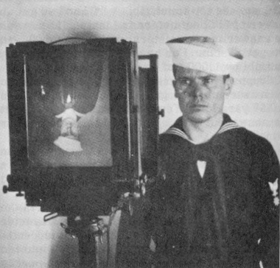
They are formed by the projection of
three-dimensional objects.
Images are brightness/color patterns drawn in a plane.

Slide 8
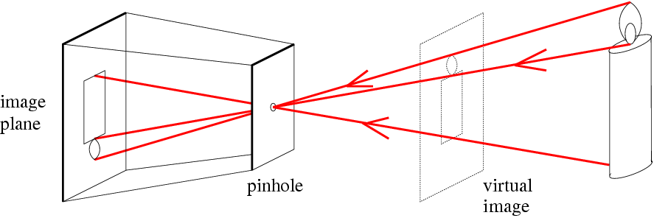
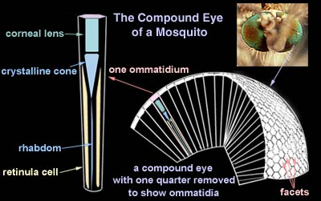
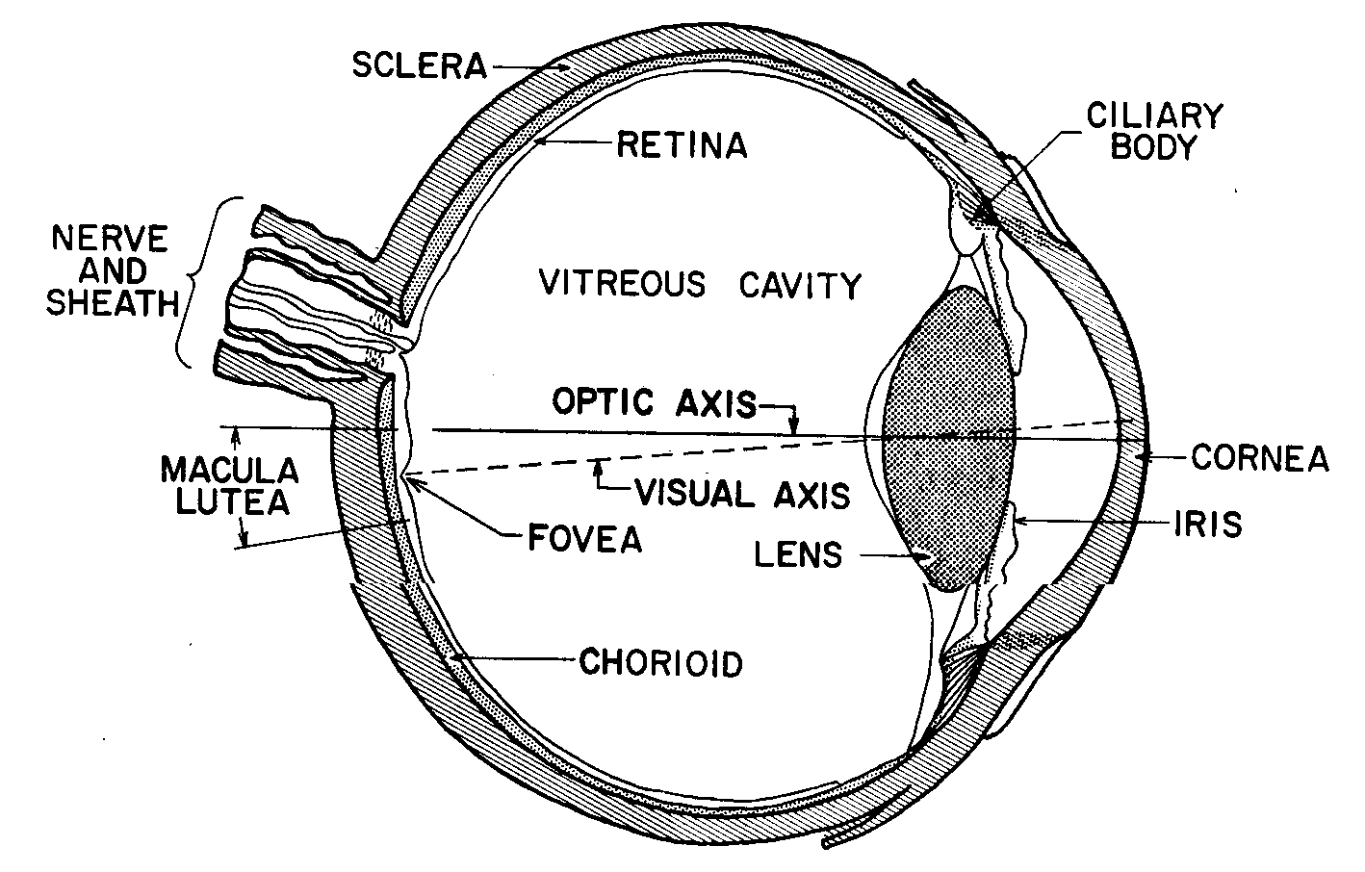

Slide 9
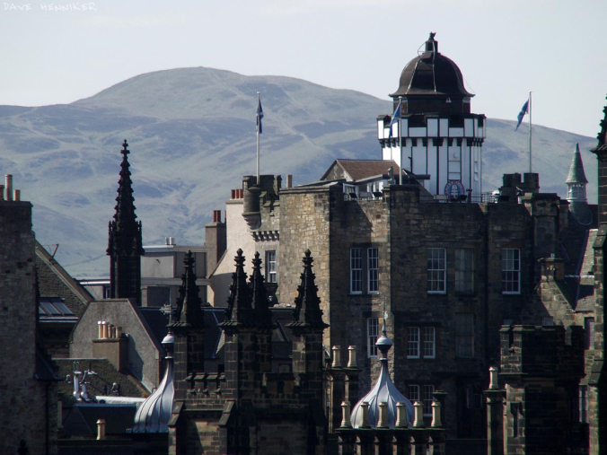
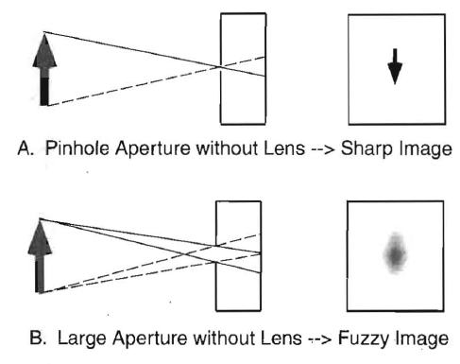
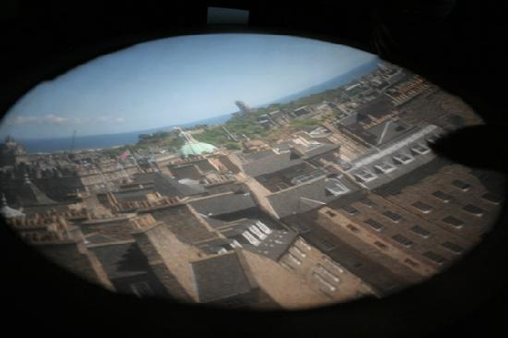
Pinhole camera: trade-off between sharpness and light transmission
Camera Obscura in Edinburgh

Slide 10
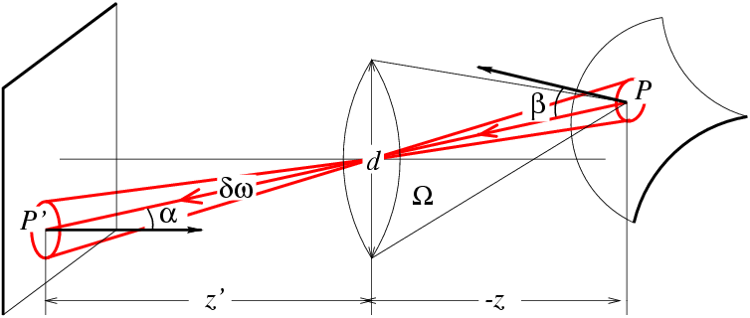
Advantages of lens systems
Lenses
can focus sharply on close and distant objects
transmit more light than a pinhole camera
E=(Π/4) [ (d/z’)² cos⁴α ] L

Slide 11
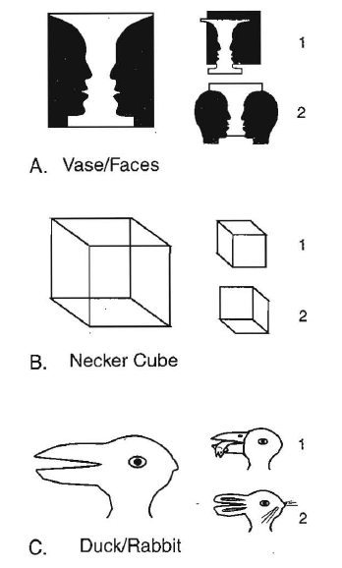
Fundamental problem I:
3D world is “flattened” to 2D images
Loss of information
3D scene
Image
Lens

Slide 12
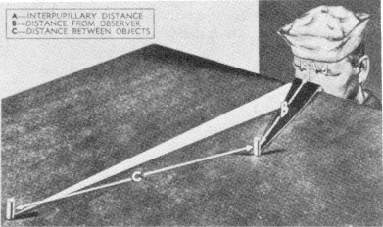
Question : how do we see “in 3D” ?
(First-order) answer: with our two eyes.

Slide 13
Epipolar Geometry

Slide 14

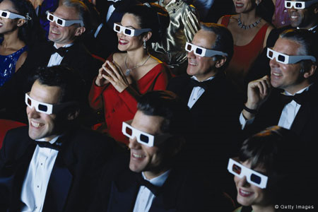
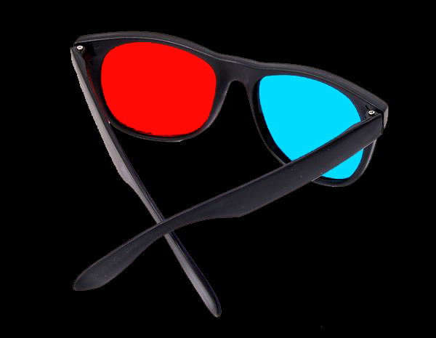
Simulated 3D perception
Disparity

Slide 15
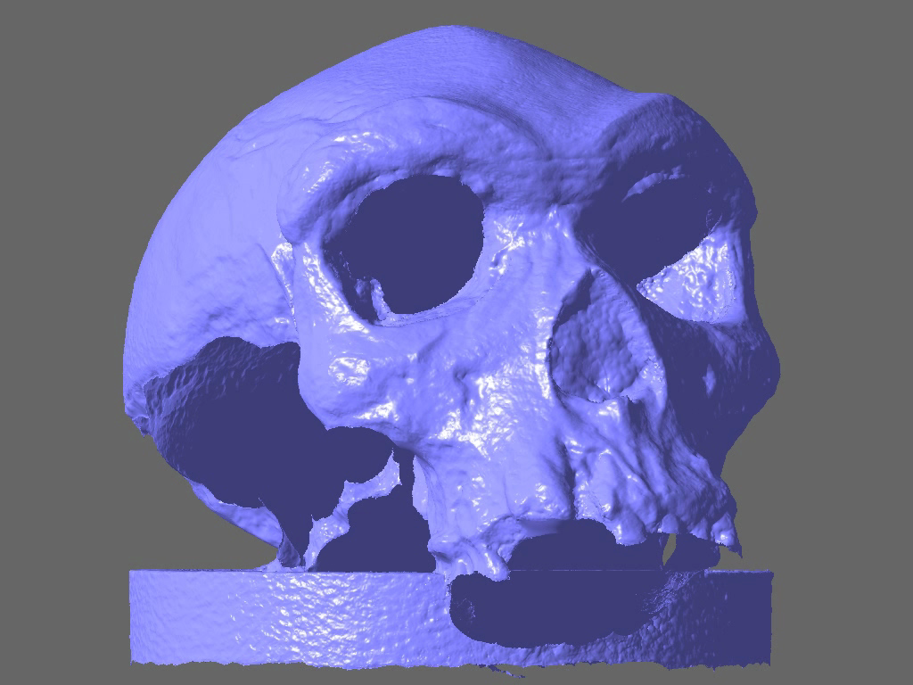
PMVS
(Furukawa & Ponce, 2010)

Slide 16

Depth cues: Linear perspective
But there are other cues..

Slide 17
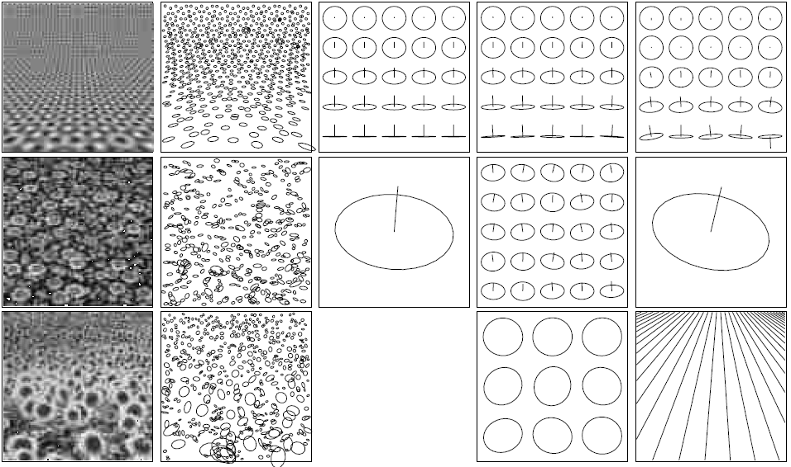
Shape from texture

Slide 18

Depth cues: Aerial perspective

Slide 19
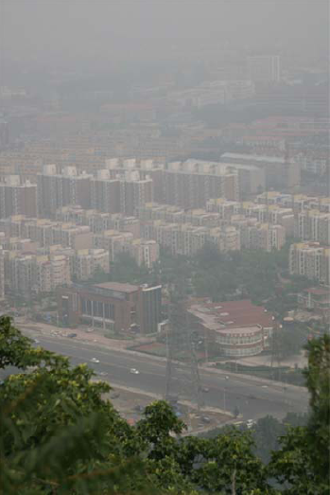
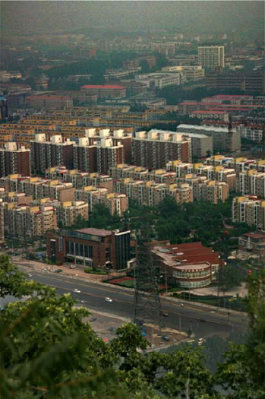

Depth from haze
Input haze image
Reconstructed images
Recovered depth map
[K. HE, J. Sun and X. Tang, CVPR 2009]

Slide 20
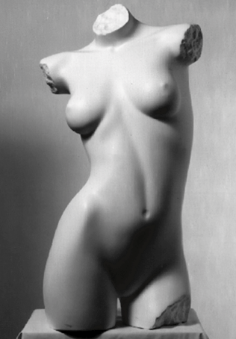
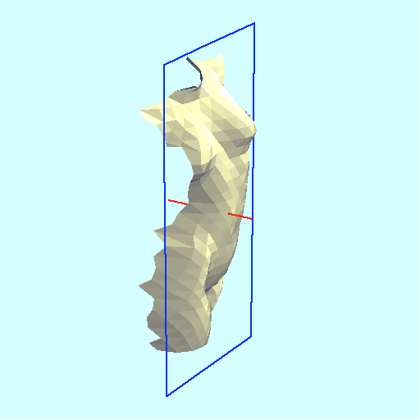
Shape and lighting cues: Shading
Source: J. Koenderink

Slide 21
Source: J. Koenderink

Slide 22
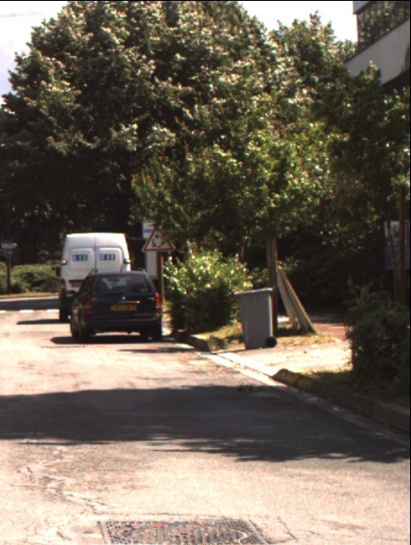
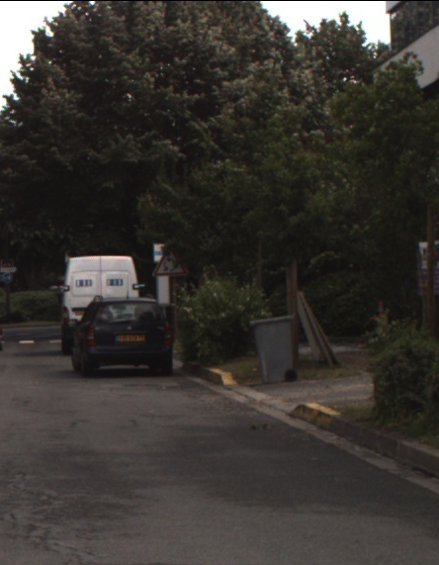
What is happening with the shadows?

Slide 23
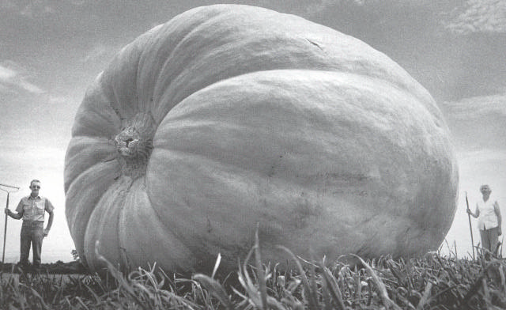
Image source: F. Durand

Slide 24
Challenges or opportunities?
Image source: J. Koenderink
Images are confusing, but they also reveal the
structure of the world through numerous cues.
Our job is to interpret the cues!

Slide 25
The goal of computer vision
To perceive the “world behind the picture”, e.g.,
as a metric measurement device
as a device for measuring “semantic” information

Slide 26
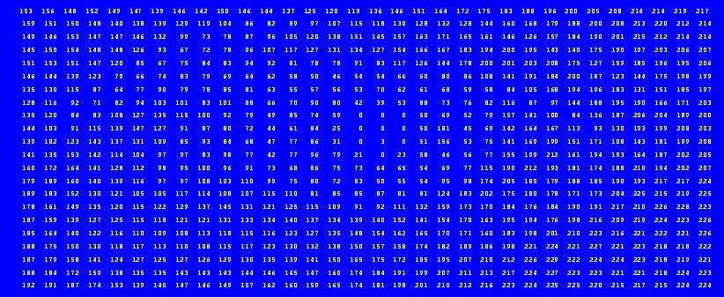
The goal of computer vision
To perceive the “world behind the picture”, e.g.,
as a metric measurement device
as a device for “measuring” semantic information

Slide 27
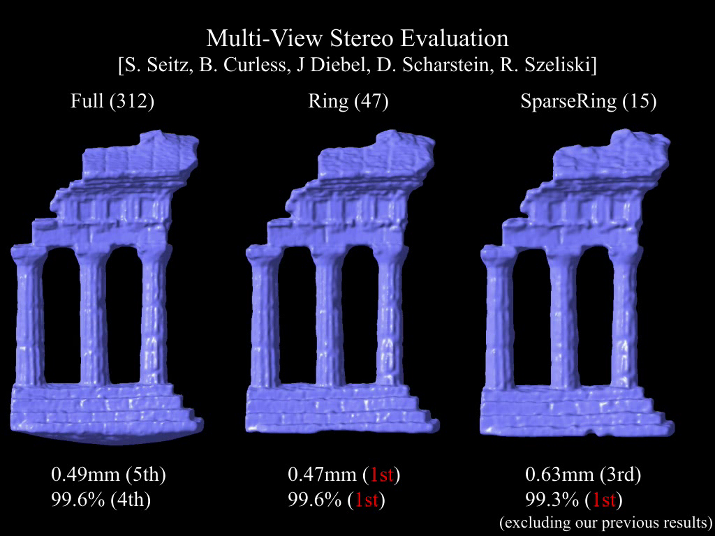
Vision as metric measurement device: Furukawa & Ponce (CVPR’07)
(cf also Keriven’s class “Vision et reconstruction 3D)

Slide 28
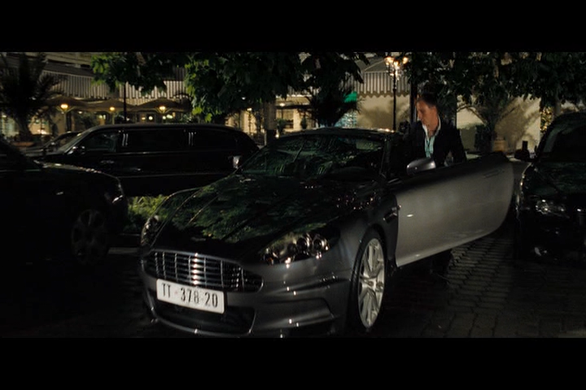
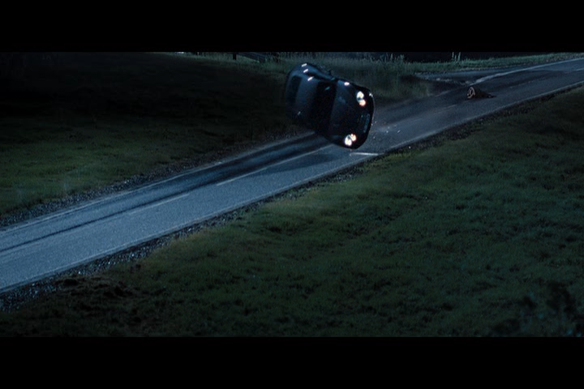
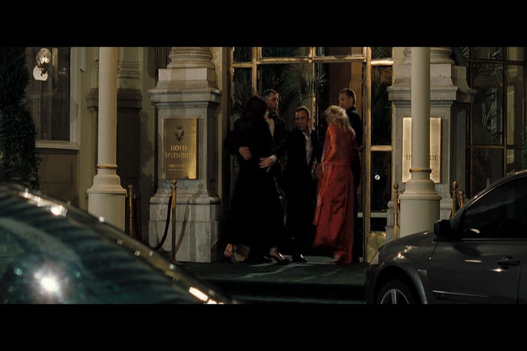
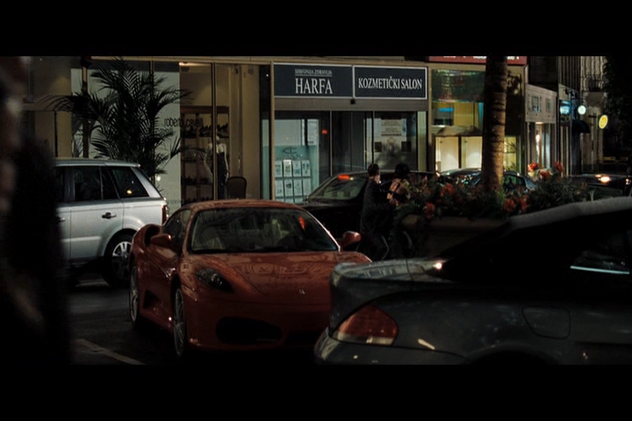

But we want much more than 3D:
ex: Visual scene analysis
outdoors
outdoors
countryside
indoors
exit through a door
outdoors
car enter
person
person
house
person
building
kidnapping
drinking
car
car crash
car
person
road
car
glass
people
field
car
street
candle
car
street
car

Slide 29
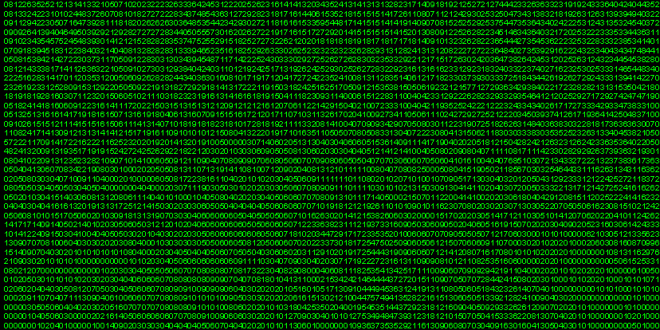
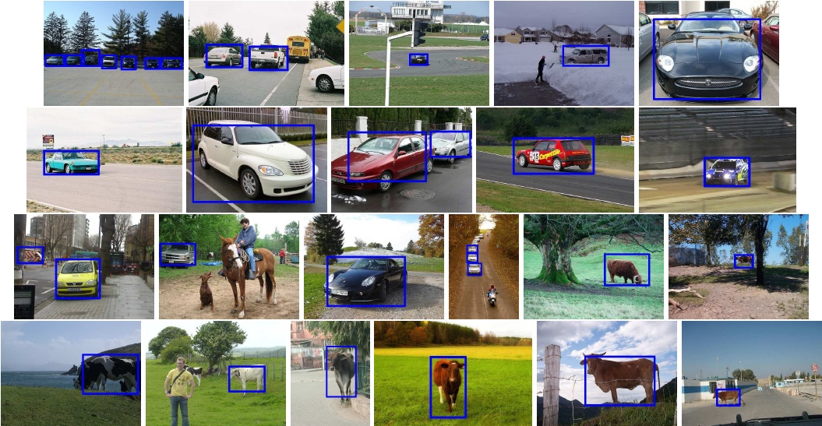
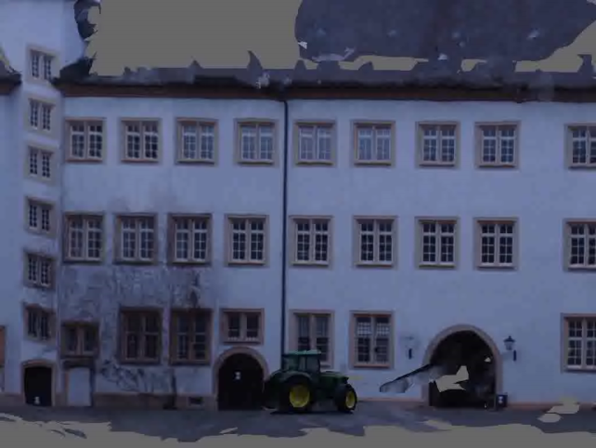
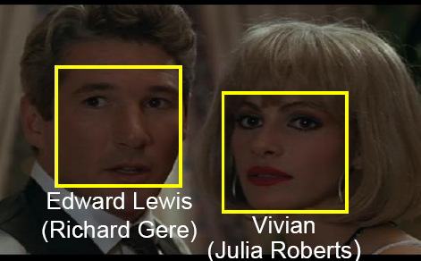
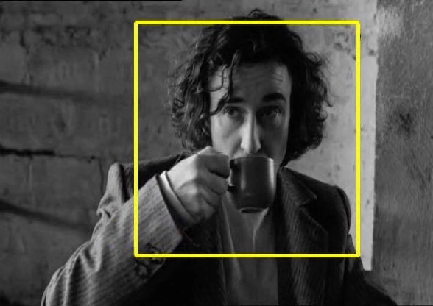
How to make sense of “pixel-chaos”?
Object class recognition
3D Scene reconstruction
Face recognition
Action recognition
Drinking

Slide 30
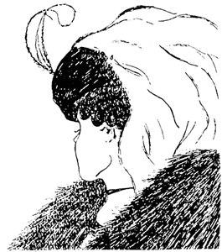
Fundamental problem II:
Images do not measure the meaning
We need lots of prior knowledge to make meaningful interpretations of an image

Slide 31
Outline
What computer vision is about
What this class is about
A brief history of visual recognition
A brief recap on geometry

Slide 32
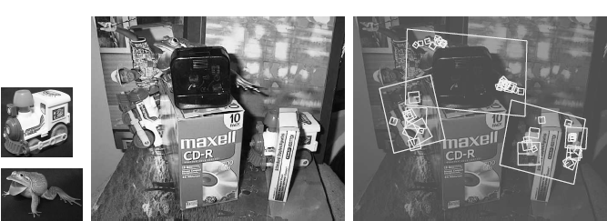
Specific object detection
(Lowe, 2004)

Slide 33

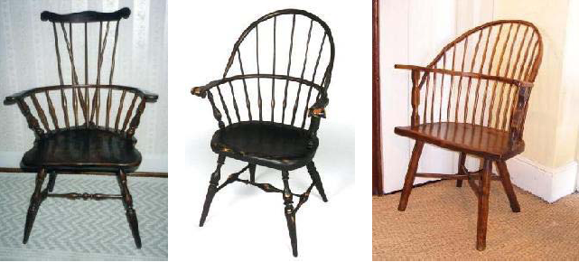
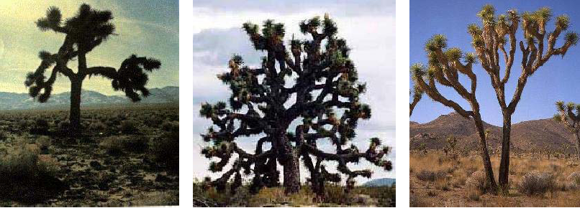
Image classification
Caltech 101 : http://www.vision.caltech.edu/Image_Datasets/Caltech101/

Slide 34
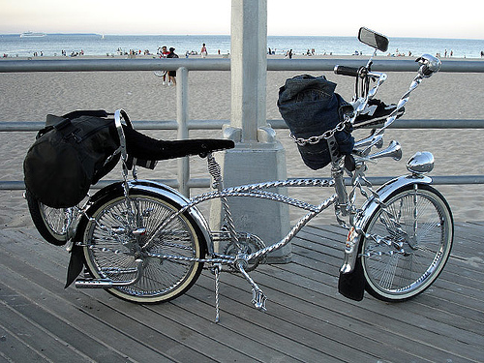
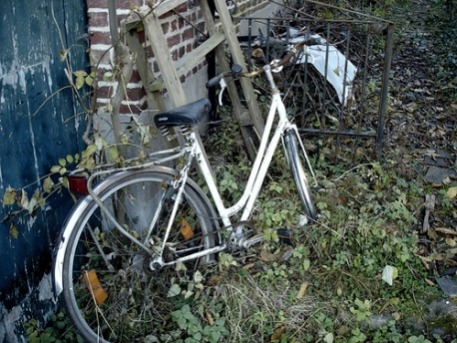

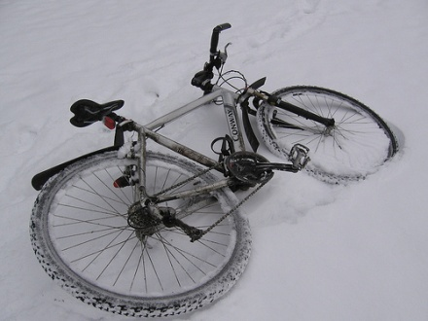
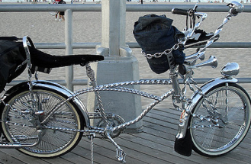
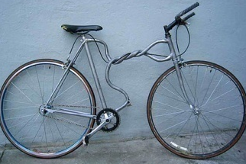

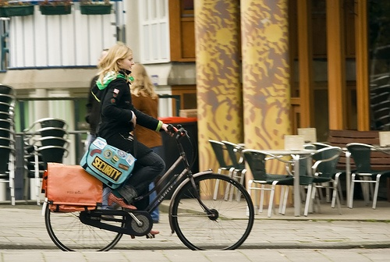
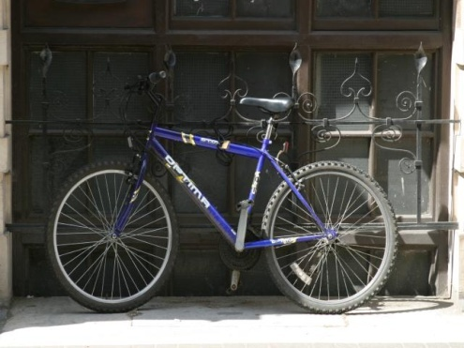

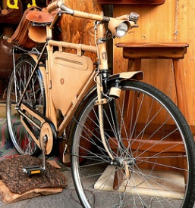
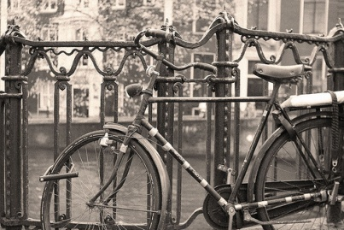
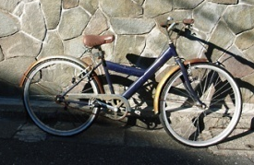
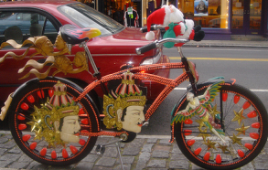
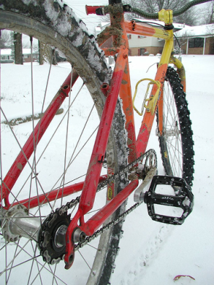
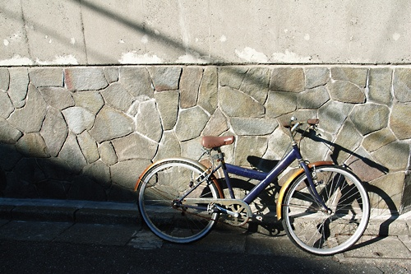



Object category detection
Light variation
Partial visibility
View variation
Within-class variation

Slide 35
Model ≡ locally rigid assembly of parts
Part ≡ locally rigid assembly of features
Qualitative experiments on Pascal VOC’07 (Kushal, Schmid, Ponce, 2008)

Slide 36

Scene understanding
Photo courtesy A. Efros.

Slide 37
Local ambiguity and global scene interpretation
slide credit: Fei-Fei, Fergus & Torralba

Slide 38
This class
1. Introduction plus recap on geometry (J. Ponce, J. Sivics)
2. Instance-level recognition I. - Local invariant features (C. Schmid)
3. Instance-level recognition II. - Correspondence, efficient visual search (J. Sivic)
4. Very large scale image indexing; bag-of-feature models for category-level recognition (C. Schmid)
5. Sparse coding (J. Ponce); object detection (J. Sivic)
6. Holiday, no lecture
7. Neural networks; optimization (N. Le Roux)
8. Object detection; pictorial structures; human pose (I. Laptev, J. Sivic)
9. Motion and human action (I. Laptev)
10. Face detection and recognition; segmentation (C. Schmid)
11. Scenes and objects (I. Laptev, J. Sivic)
12. Final project presentations (J. Sivic, I. Laptev)

Slide 39
Computer vision books
D.A. Forsyth and J. Ponce, “Computer Vision: A Modern Approach, Prentice-Hall, 2003 (2nd edition coming up Oct. 2011).
J. Ponce, M. Hebert, C. Schmid, and A. Zisserman,
“Toward category-level object recognition”,
Springer LNCS, 2007.
R. Szeliski, “Computer Vision: Algorithms and
Applications”, Springer, 2010.
O. Faugeras, Q.T. Luong, and T. Papadopoulo,
“Geometry of Multiple Images,” MIT Press, 2001.
R. Hartley and A. Zisserman, “Multiple View
Geometry in Computer Vision”, Cambridge
University Press, 2004.
J. Koenderink, “Solid Shape”, MIT Press, 1990.

Slide 40
Class web-page
http://www.di.ens.fr/willow/teaching/recvis11
Slides available after classes:
http://www.di.ens.fr/willow/teaching/recvis11/lecture01.pptx
http://www.di.ens.fr/willow/teaching/recvis11/lecture01.pdf
Note: Much of the material used in this lecture
is courtesy of Svetlana Lazebnik:,
http://www.cs.unc.edu/~lazebnik/

Slide 41
Outline
What computer vision is about
What this class is about
A brief history of visual recognition
A brief recap on geometry

Slide 42

Variability:
Camera position
Illumination
Internal parameters
Within-class variations

Slide 43
θ
Variability:
Camera position
Illumination
Internal parameters
Roberts (1963); Lowe (1987); Faugeras & Hebert (1986); Grimson &
Lozano-Perez (1986); Huttenlocher & Ullman (1987)

Slide 44


Origins of computer vision
L. G. Roberts, Machine Perception of Three Dimensional Solids, Ph.D. thesis, MIT Department of Electrical Engineering, 1963.

Slide 45

Huttenlocher & Ullman (1987)

Slide 46
Variability Invariance to:
Camera position
Illumination
Internal parameters
Duda & Hart ( 1972); Weiss (1987); Mundy et al. (1992-94);
Rothwell et al. (1992); Burns et al. (1993)

Slide 47
Example: affine invariants of coplanar points
Projective invariants (Rothwell et al., 1992):
BUT: True 3D objects do not admit monocular
viewpoint invariants (Burns et al., 1993) !!

Slide 48
Empirical models of image variability:
Appearance-based techniques
Turk & Pentland (1991); Murase & Nayar (1995); etc.

Slide 49

Eigenfaces (Turk & Pentland, 1991)

Slide 50


Appearance manifolds
(Murase & Nayar, 1995)

Slide 51

Correlation-based template matching (60s)
Ballard & Brown (1980, Fig. 3.3). Courtesy Bob Fisher
and Ballard & Brown on-line.
• Automated target recognition
• Industrial inspection
• Optical character recognition
• Stereo matching
• Pattern recognition

Slide 52



In the late 1990s, a new approach emerges:
Combining local appearance, spatial constraints, invariants,
and classification techniques from machine learning.
Query
Lowe’02
Retrieved (10º off)
Mahamud & Hebert’03
Schmid & Mohr’97

Slide 53






Representing and recognizing object
categories is harder
ACRONYM (Brooks and Binford, 1981)
Binford (1971), Nevatia & Binford (1972), Marr & Nishihara (1978)

Slide 54







Parts and invariants
The Blum transform, 1967
Generalized cylinders
(Binford, 1971)

Slide 55


Generalized cylinders
(Binford, 1971; Marr & Nishihara, 1978)
(Nevatia & Binford, 1972)

Slide 56


Parts and invariants II
Ponce et al. (1989)
Ioffe and Forsyth (2000)
Zhu and Yuille (1996)

Slide 57


In the early 2000’s, a new approach ?
Fergus, Perona & Zisserman (2003)

Slide 58

The “templates and springs” model
(Fischler & Elschlager, 1973)
Ballard & Brown (1980, Fig. 11.5). Courtesy
Bob Fisher and Ballard & Brown on-line.

Slide 59



Object
Bag of ‘words’
slide credit: Fei-Fei, Fergus & Torralba

Slide 60

Color histograms (S&B’91)
Local jets (Florack’93)
Spin images (J&H’99)
Sift (Lowe’99)
Shape contexts (B&M’95)
Texton histograms (L&M’97)
Gist (O&T’05)
Spatial pyramids (LSP’06)
Hog (D&T’06)
Phog (B&Z’07)
Convolutional nets (LC’90)

Slide 61

Locally orderless structure of images (K&vD’99)

Slide 62

Felzwenszalb, McAllester, Ramanan (2007)
[Wins on 6 of the Pascal’07 classes, see Chum
& Zisserman (2007) for the other big winner.]

Slide 63

Number of research papers with key-words “object recognition”, source: Springer.com

Slide 64

Numbers of papers with key-words “epipolar geometry”
source: Springer.com
Object Recognition
Visual Geometry

Slide 65




Visual Geometry:
  Problems: Camera calibration, 3D reconstruction, Structure and motion estimation, …
  Tools: Bundle adjustment, Wide baseline matching, …
Scale/affine – invariant regions: SIFT, Harris-Laplace, etc.

Slide 66
Outline
What computer vision is about
What this class is about
A brief history of visual recognition
A brief recap on geometry -> J. Sivic

Slide 67


