Slide 1
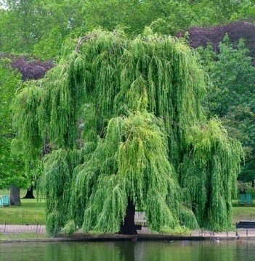
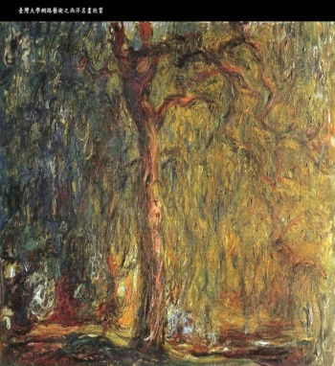



Sparse Coding
for
Image and Video Understanding
Jean Ponce
http://www.di.ens.fr/willow/
Willow team, LIENS, UMR 8548
Ecole normale supérieure, Paris
Joint work with Julien Mairal, Francis Bach,
Guillermo Sapiro and Andrew Zisserman

Slide 2

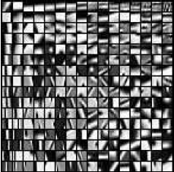
Linear signal models
Dictionary:
D=[d₁,...,dp]2R^{m x p}
Signal: x2 R^{m}
…
1
2
3
…
p
x ≈ ®₁d₁ + ®₂d₂ + ... + ®_{p}d_{p} = D®, with ®2R^{p}

Slide 3
Sparse linear models
Dictionary:
D=[d₁,...,dp]2R^{m x p}
Signal: x2 R^{m}
x ≈ ®₁d₁ + ®₂d₂ + ... + ®_{p}d_{p} = D®, with |®|₀ « p
(Olshausen and Field, 1997; Chen et al., 1999; Mallat, 1999; Elad and Aharon, 2006)
(Kavukcuoglu et al., 2009; Wright et al., 2009; Yang et al., 09; Boureau et al., 2010)

Slide 4
Sparse coding and dictionary learning:
A hierarchy of optimization problems
min ® 1/2 | x – D® |₂²
min ® 1/2 | x – D® |₂² + ¸ |®|₀
min ® 1/2 | x – D® |₂² + ¸ Ã(®)
min _{DєC,®1,..., ®n}∑_{1≤i≤n} [ 1/2 | x_{i} – D®_{i} |₂² + ¸ Ã(®_{i}) ]
min _{DєC,®1,..., ®n}∑_{1≤i≤n} [ f (x_{i}, D, ®_{i}) + ¸ Ã(®_{i}) ]
min _{DєC,®1,..., ®n}∑_{1≤i≤n} [ f (x_{i}, D, ®_{i}) + ¸ ∑_{1≤k≤q} Ã(d_{k}) ]
Least squares
Sparse coding
Dictionary learning
Learning for a task
Learning structures

Slide 5
Outline
Sparse linear models of image data
Unsupervised dictionary learning
Non-local sparse models for image restoration
Learning discriminative dictionaries for image classification
Task-driven dictionary learning and its applications
Ongoing work
Notes:
Les deux focus sont la partie 3D et la partie apprentissage. Le reste est presente assez brievement.

Slide 6
Dictionary learning
Given some loss function, e.g.,
L ( x, D ) = 1/2 | x – D® |₂² + ¸ |®|₁
One usually minimizes, given some data
x_{i}, i = 1, ..., n, the empirical risk:
min _{D} f_{n} ( D ) = ∑_{1≤i≤n} L ( x_{i}, D )
But, one would really like to minimize the
expected one, that is:
min _{D} f ( D ) = E_{x} [ L ( x, D ) ]
(Bottou& Bousquet’08 ! Stochastic gradient descent)

Slide 7
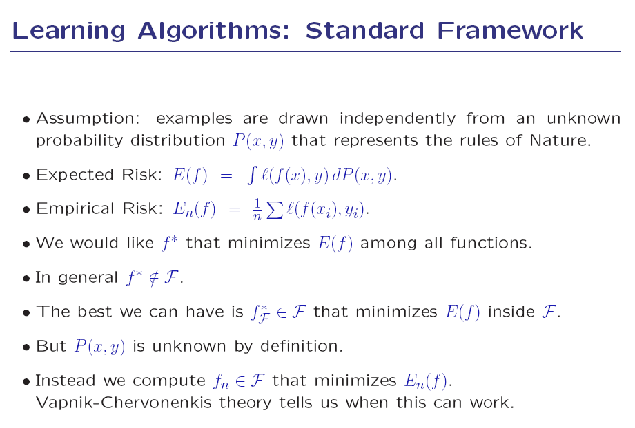
!! Short detour !!
Léon bottou on large-scale learning..

Slide 8
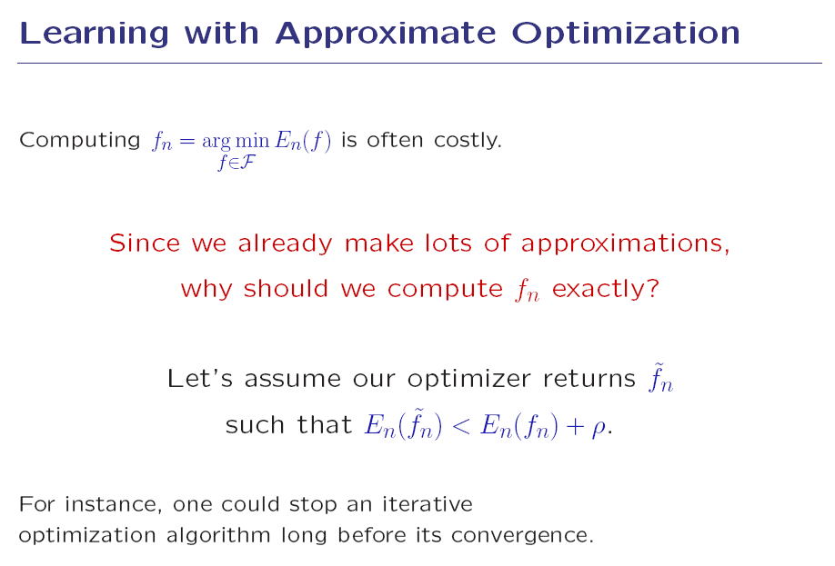
Léon bottou on large-scale learning..

Slide 9
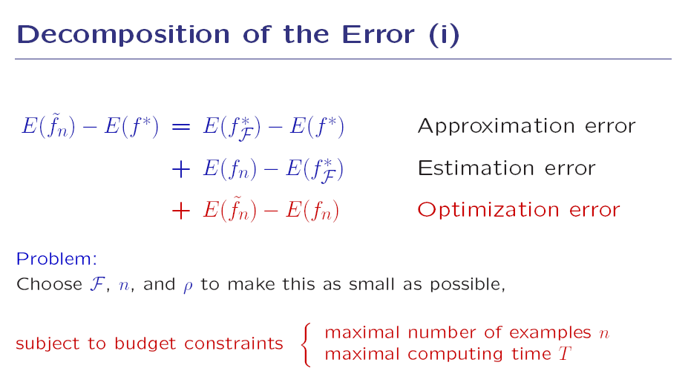
Léon bottou on large-scale learning..

Slide 10
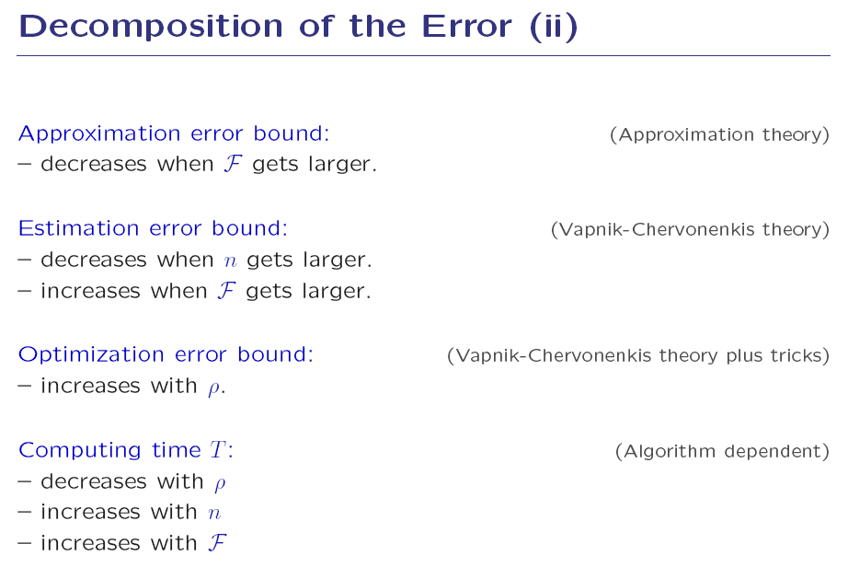
Léon bottou on large-scale learning..

Slide 11
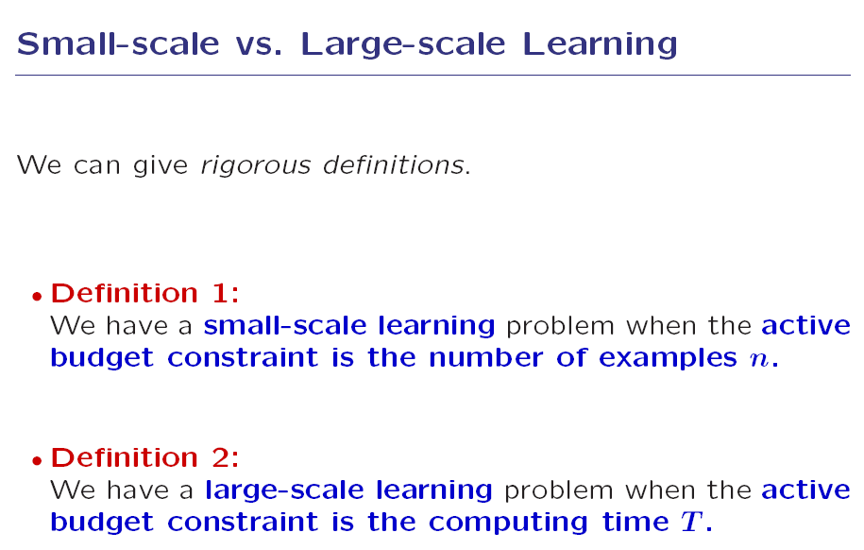
Léon bottou on large-scale learning..

Slide 12
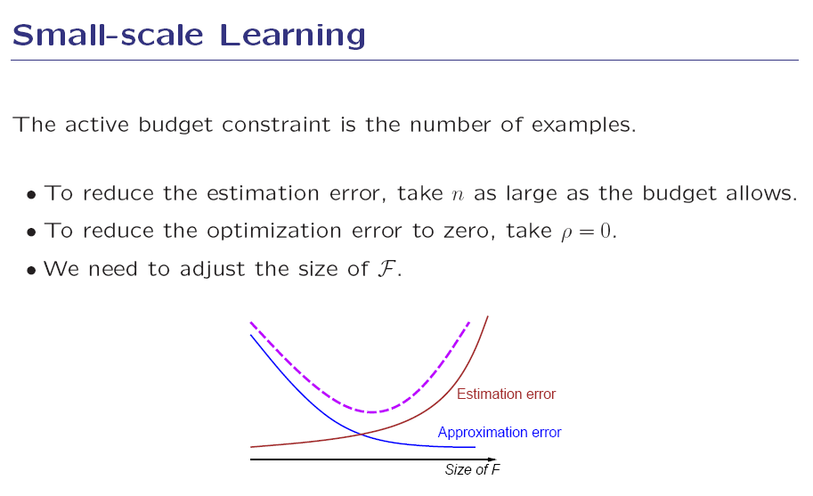
Léon bottou on large-scale learning..

Slide 13
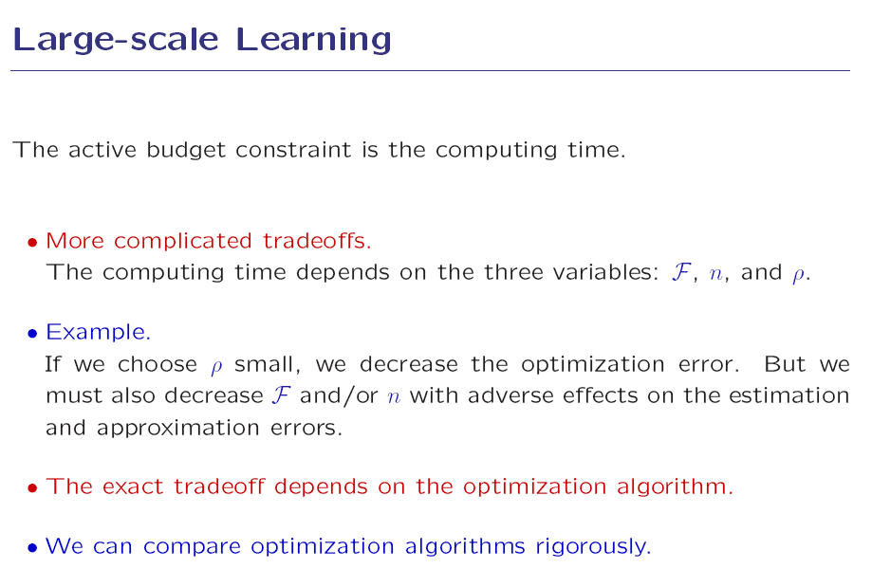
Léon bottou on large-scale learning..

Slide 14
Online sparse matrix factorization
(Mairal, Bach, Ponce, Sapiro, ICML’09, JMLR’10)
Problem:
min _{DєC,®1,..., ®n}∑_{1≤i≤n} [ 1/2 | x_{i} – D®_{i} |₂² + ¸ |®_{i}|₁ ]
min _{DєC, A} [ 1/2 | X – DA |_{F}² + ¸ |A|₁ ]
Algorithm:
Iteratively draw one random training sample x_{t}
and minimize the quadratic surrogate function:
g_{t} ( D ) = 1/t ∑_{1≤i≤t}[ 1/2 | x_{i} – D®_{i} |₂² + ¸ |®_{i}|₁ ]
(Lars/Lasso for sparse coding, block-coordinate descent with warm
restarts for dictionary updates, mini-batch extensions, etc.)
Notes:
Version l1. Nouveaux algorithmes efficaces pour la reconstruction et la discrimination.

Slide 15
Online sparse matrix factorization
(Mairal, Bach, Ponce, Sapiro, ICML’09, JMLR’10)
Proposition:
Under mild assumptions, D_{t} converges with
probability one to a stationary point of the
dictionary learning problem.
Proof: Convergence of empirical processes (van der Vaart’98)
and, a la Bottou’98, convergence of quasi martingales (Fisk’65).
Extensions:
Non negative matrix factorization (Lee & Seung’01)
Non negative sparse coding (Hoyer’02)
Sparse principal component analysis (Jolliffe et
al.’03; Zou et al.’06; Zass& Shashua’07;
d’Aspremont et al.’08; Witten et al.’09)
Notes:
Version l1. Nouveaux algorithmes efficaces pour la reconstruction et la discrimination.

Slide 16
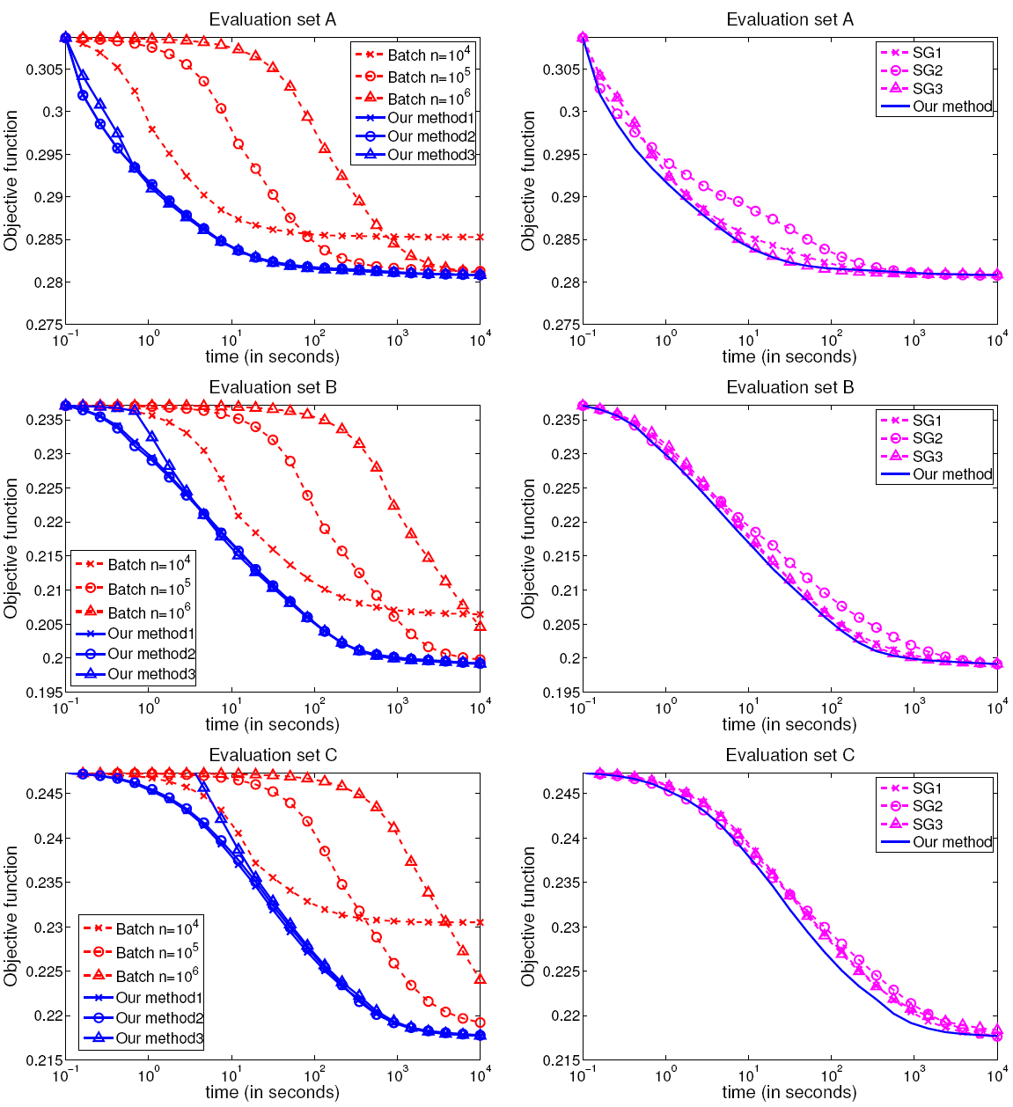
Performance evaluation
Three datasets constructed from 1,250,000 Pascal’06
patches (1,000,000 for training, 250,000 for testing):
A: 8£8 b&w patches, 256 atoms.
B: 12£16£3 color patches, 512 atoms.
C: 16£16 b&w patches, 1024 atoms.
Two variants of our algorithm:
Online version with different choices of parameters.
Batch version on different subsets of training data.
Online vs batch
Online vs stochastic
gradient descent

Slide 17
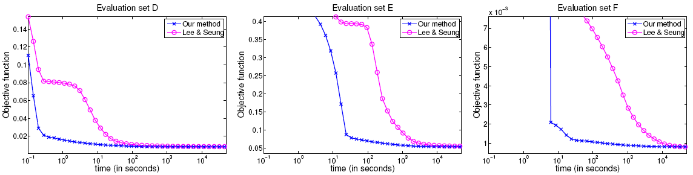
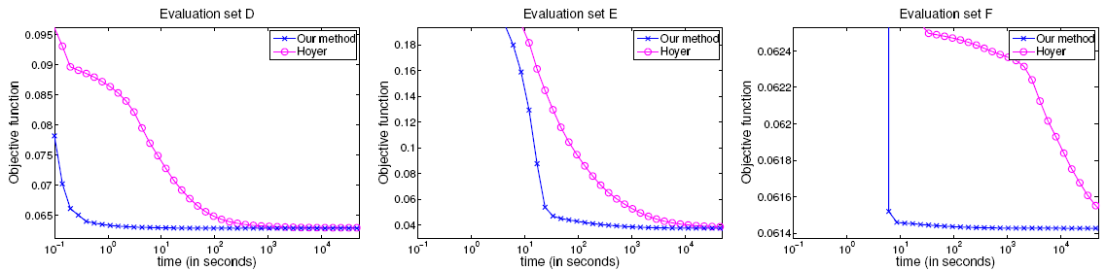
Sparse PCA: Adding sparsity on the atoms
Three datasets:
D: 2429 19£19 images from MIT-CBCL #1.
E: 2414 192£168 images from extended Yale B.
F: 100,000 16£16 patches from Pascal VOC’06.
Three implementations:
Hoyer’s Matlab implementation of NNMF (Lee & Seung’01).
Hoyer’s Matlab implementation of NNSC (Hoyer’02).
Our C++/Matlab implementation of SPCA (elastic net on D).
SPCA vs NNMF
SPCA vs NNSC

Slide 18
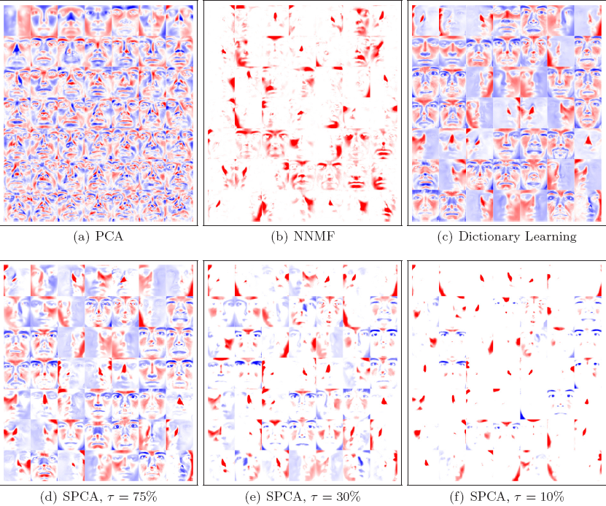
Faces

Slide 19
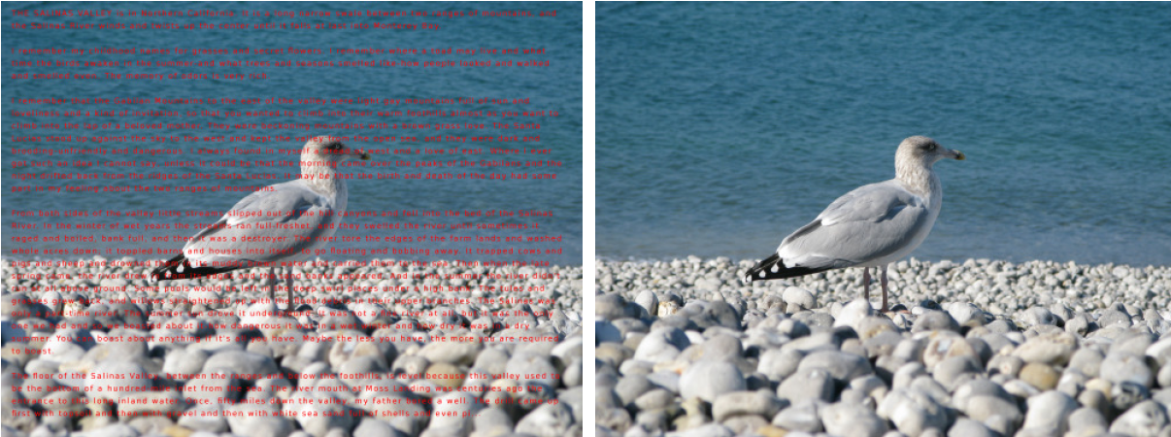
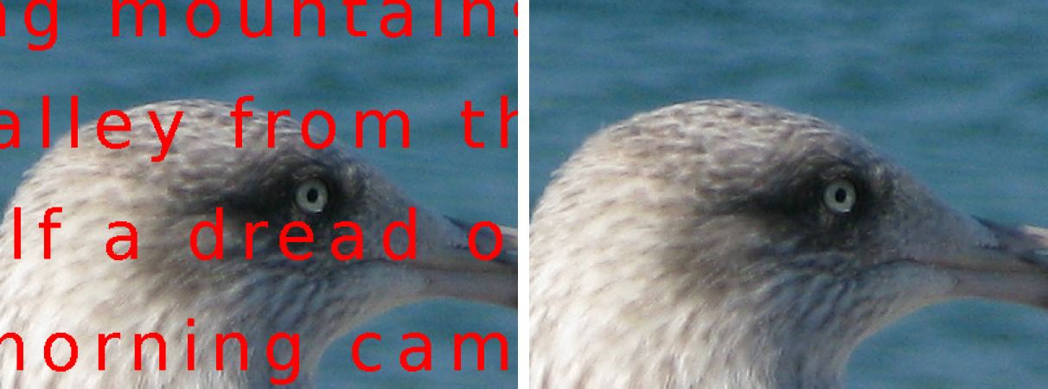
Inpainting a 12MP image with a
dictionary learned from 7x10⁶
patches (Mairal et al., 2009)
Notes:
Resultats d’inpainting sur une image de 12MP grace a l’algorithme stochastique de Julien soumis a ICML-09.

Slide 20
State of the art in image denoising
Non-local means filtering
(Buades et al.’05)
Dictionary learning for denoising (Elad & Aharon’06;
Mairal, Elad & Sapiro’08)
min _{DєC,®1,..., ®n}∑_{1≤i≤n} [ 1/2 | x_{i} – D®_{i} |₂² + ¸ |®_{i}|₁ ]
x = 1/n ∑_{1≤i≤n} R_{i}D®_{i}

Slide 21
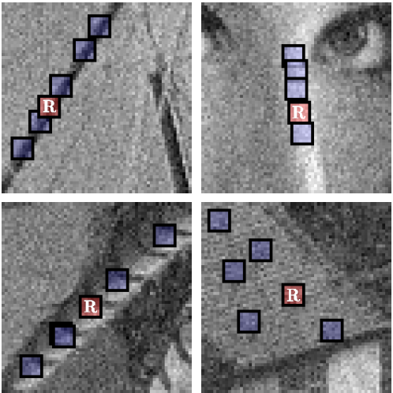

State of the art in image denoising
BM3D (Dabov et al.’07)
Non-local means filtering
(Buades et al.’05)
Dictionary learning for denoising (Elad & Aharon’06;
Mairal, Elad & Sapiro’08)
min _{DєC,®1,..., ®n}∑_{1≤i≤n} [ 1/2 | x_{i} – D®_{i} |₂² + ¸ |®_{i}|₁ ]
x = 1/n ∑_{1≤i≤n} R_{i}D®_{i}

Slide 22
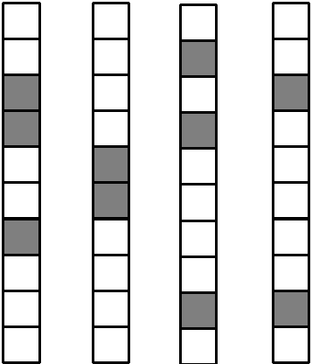
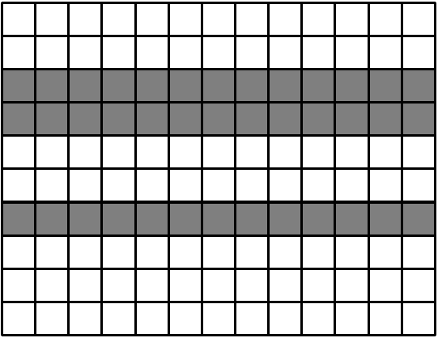
Non-local sparse models for image restoration
(Mairal, Bach, Ponce, Sapiro, Zisserman, ICCV’09)
Sparsity vs Joint sparsity
min ∑ [∑ 1/2 | x_{j} – D®_{ij} |_{F}²] + ¸ |A_{i}|_{p,q}
D2 C
A₁,...,A_{n}
i j2S_{i}
|A|_{p,q}= ∑_{1≤i≤k} |®^{i}|_{q}^{p} (p,q) = (1,2) or (0,1)

Slide 23
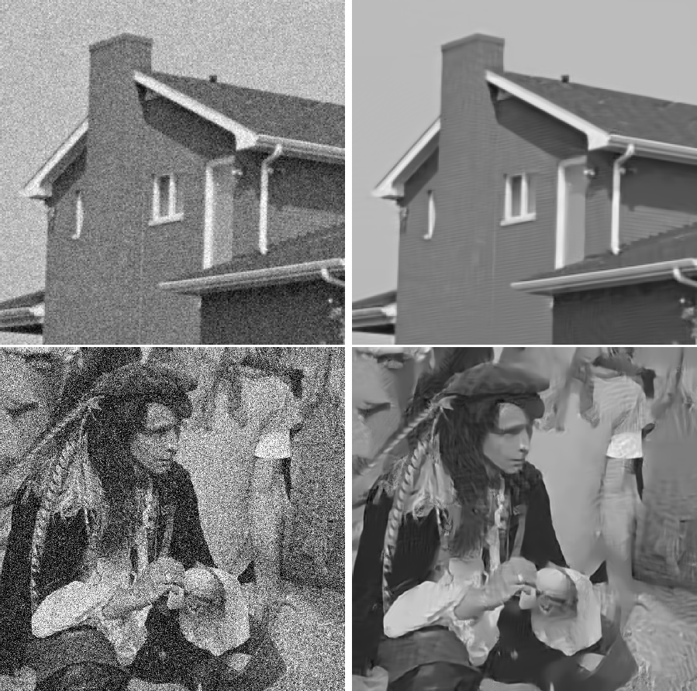
Notes:
Denoising avec du bruit synthetique. Noter qu’on retrouve la structure de briques. Meilleure methode sur les images standard habituelles (Lena etc.). SC et lSC sont des versions simplifiees de la methode ou on n’apprend pas le dictionnaire (SC) ou on l’apprend mais on ne fais pas de groupes (LSC).

Slide 24
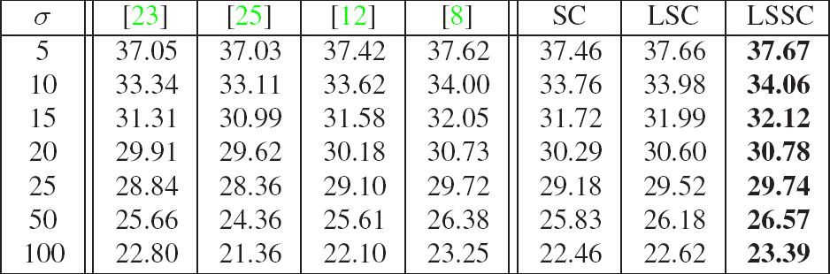
PSNR comparison between our method (LSSC) and Portilla et al.’03 [23];
Roth & Black’05 [25]; Elad& Aharon’06 [12]; and Dabov et al.’07 [8].
Notes:
Denoising avec du bruit synthetique. Noter qu’on retrouve la structure de briques. Meilleure methode sur les images standard habituelles (Lena etc.). SC et lSC sont des versions simplifiees de la methode ou on n’apprend pas le dictionnaire (SC) ou on l’apprend mais on ne fais pas de groupes (LSC).

Slide 25
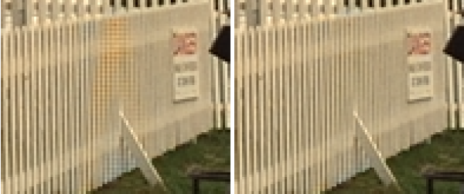
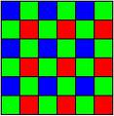
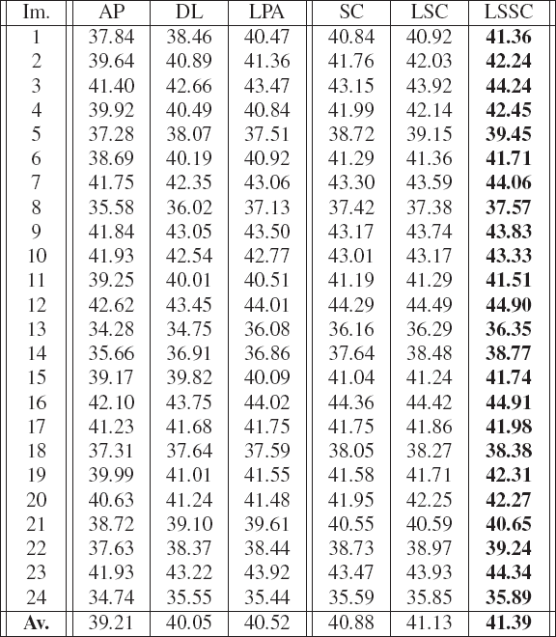
Demosaicking experiments
LSC
LSSC
Bayer pattern
……………………………………………...……………
PSNR comparison between our method (LSSC) and Gunturk et al.’02 [AP];
Zhang & Wu’05 [DL]; and Paliy et al.’07 [LPA] on the Kodak PhotoCD data.
Notes:
Meilleurs resultats sur les donnees standard. LSC (qui est deja tres bon) donne comme les autres methodes standard des artefacts de couleur sur la barriere). LSSC n’a pas ces problemes.

Slide 26
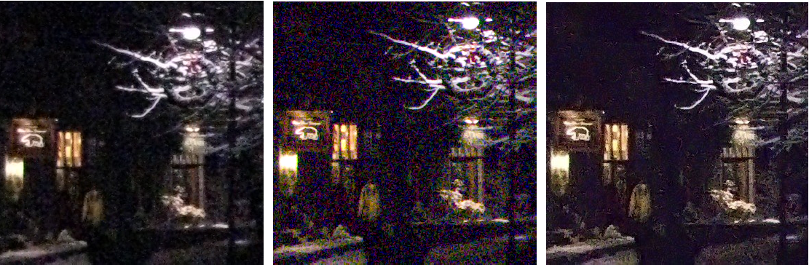
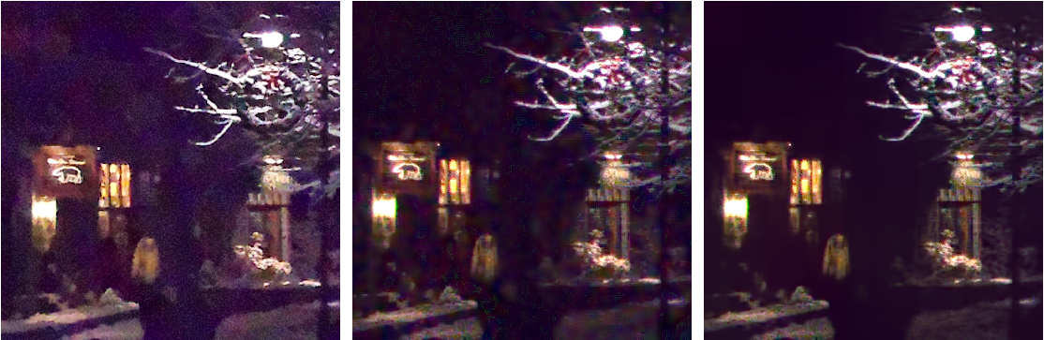
Real noise (Canon Powershot G9, 1600 ISO)
Raw Jpeg
Adobe Camera Raw
Noiseware
DXO
LSC
LSSC

Slide 27
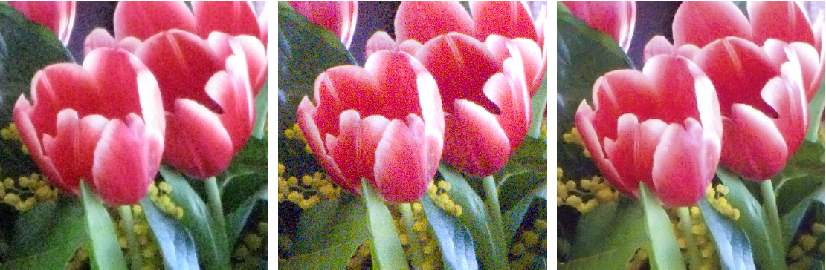
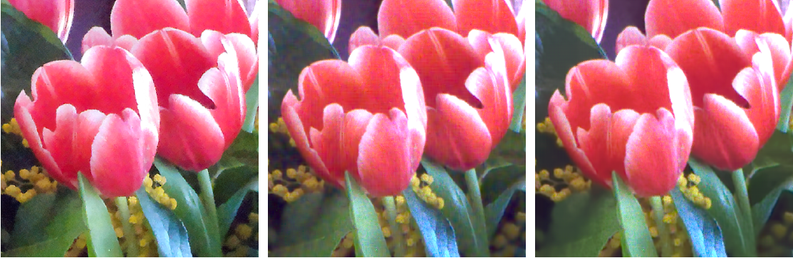
Real noise (Canon Powershot G9, 1600 ISO)
Raw Jpeg
Adobe Camera Raw
Noiseware
DXO
LSC
LSSC

Slide 28
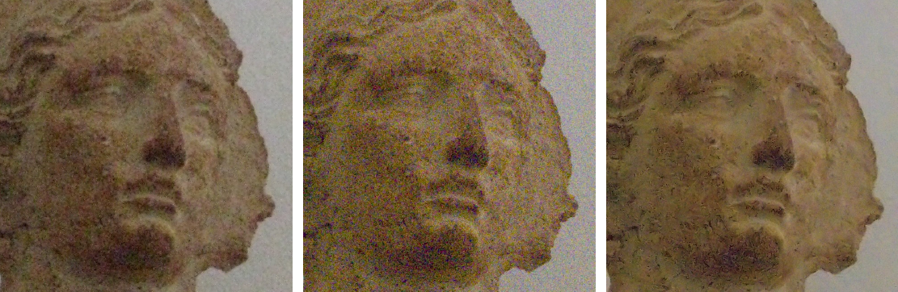
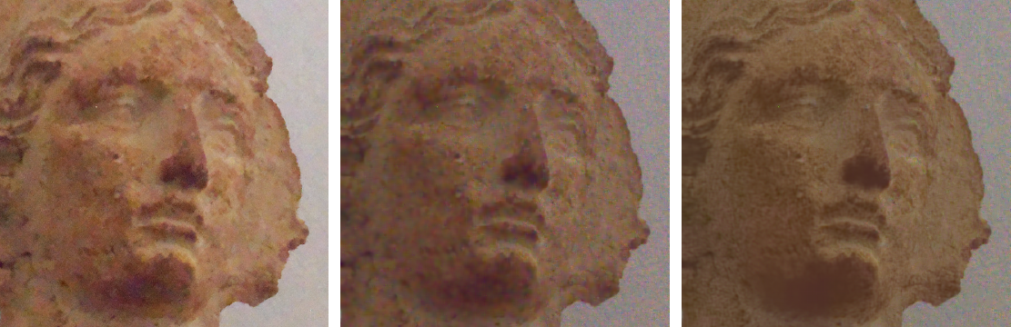
Real noise (Canon Powershot G9, 1600 ISO)
Raw Jpeg
Adobe Camera Raw
Noiseware
DXO
LSC
LSSC

Slide 29
Learning discriminative dictionaries
with L constraints
(Mairal, Bach, Ponce, Sapiro, Zisserman, CVPR’08)
0
α*(x,D) = Argmin | x - Dα |₂² s.t. |α|₀ ≤ L
R*(x,D) = | x – Dα*|₂²
Reconstruction (MOD: Engan, Aase, Husoy’99;
K-SVD: Aharon, Elad, Bruckstein’06):
min ∑_{l} R*(x_{l},D)
Discrimination:
min ∑_{i,l} C_{i}^{λ} [R*(x_{l},D₁),…,R*(x_{l},D_{n})] + λγ R*(x_{l},D_{i})
(Both MOD and K-SVD versions with truncated Newton iterations.)
α
Orthogonal matching pursuit
(Mallat & Zhang’93, Tropp’04)
D
D₁,…,D_{n}
Notes:
Trucs de Julien, version l_0. Comment aller du reconstructif au discriminatif.

Slide 30
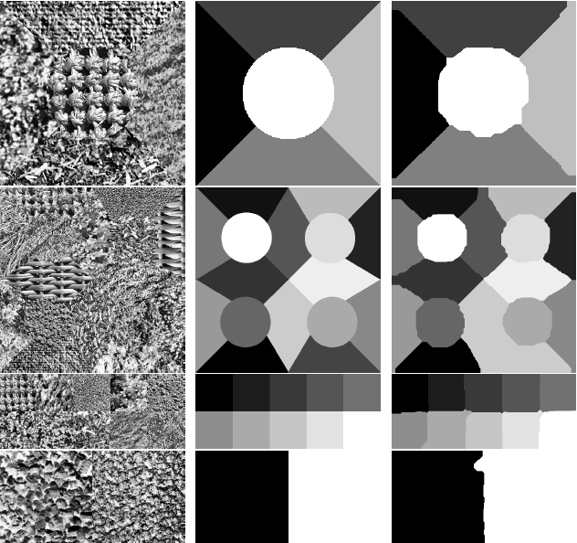
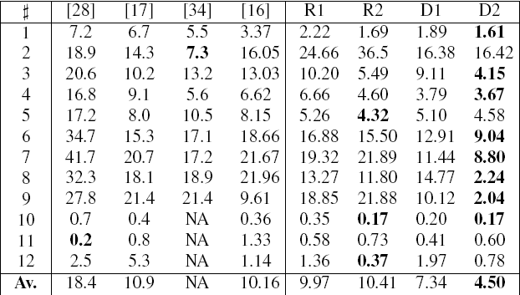
Texture classification results

Slide 31
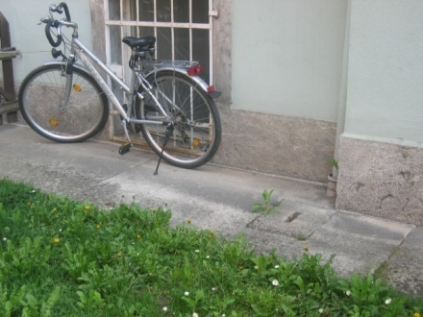
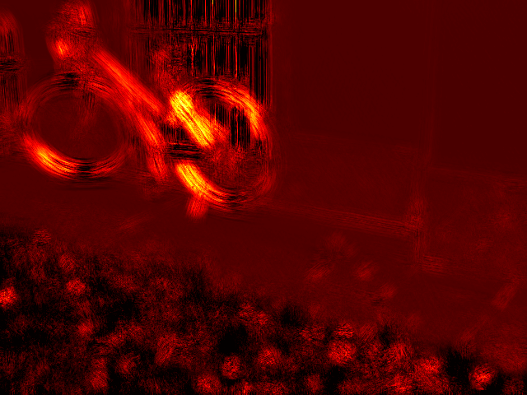
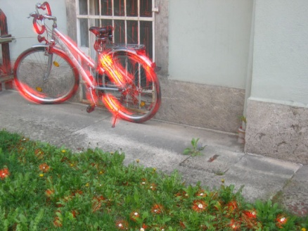
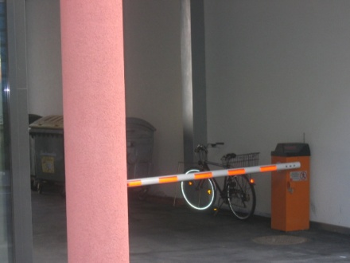
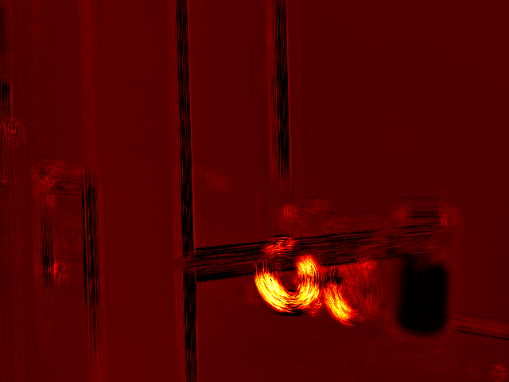
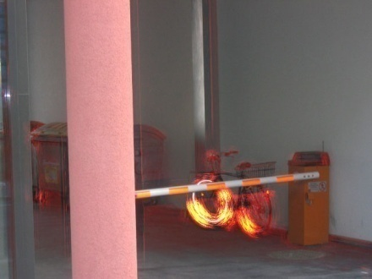
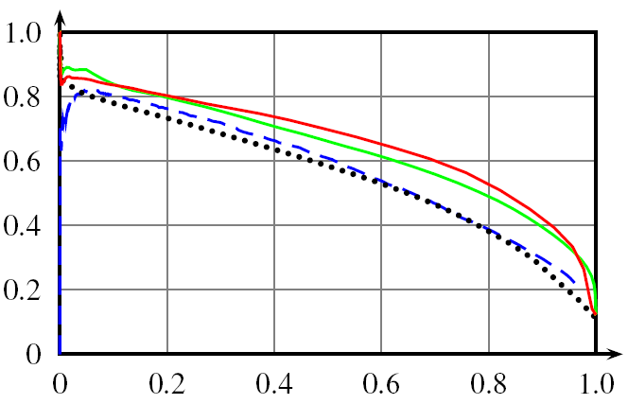
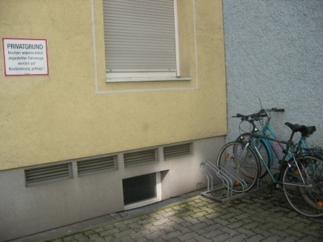
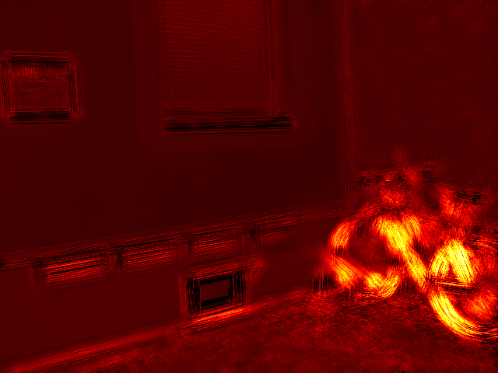
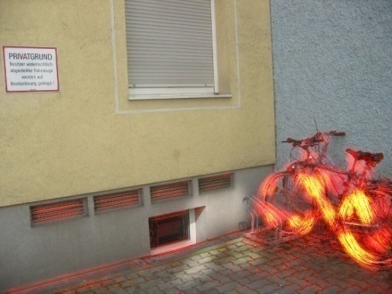
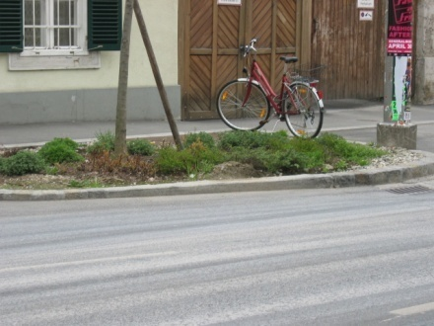
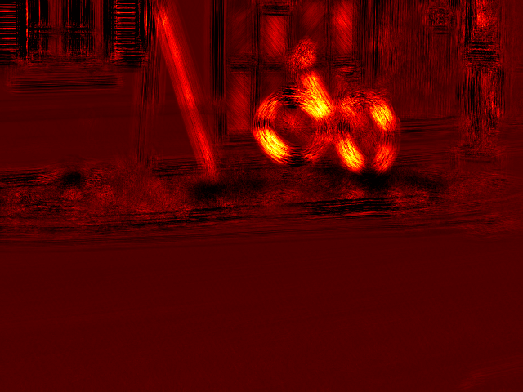
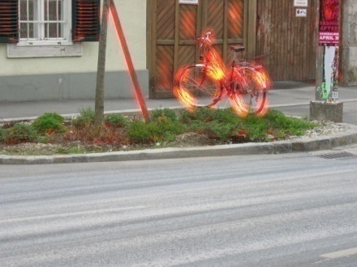
Pixel-level classification results
Qualitative results, Graz 02 data
Quantitative results
Comparaison with Pantofaru et al. (2006)
and Tuytelaars & Schmid (2007).
Notes:
On apprend a classifier les pixels de velo a partir d’images contenant des velos (mais ou on ne sait pas ou ils sont) et d’images n’en contenant pas. Resultats sur une image test.

Slide 32
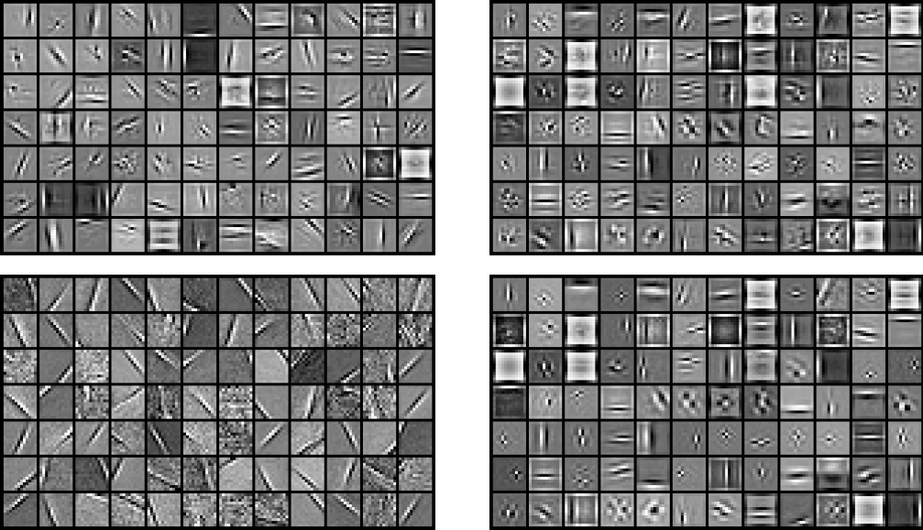
Reconstructive vs discriminative dictionaries
Reconstructive
Discriminative
Bicycle
Background

Slide 33
Learning discriminative dictionaries
with L constraints
(Mairal, Leordeanu, Bach, Hebert, Ponce, ECCV’08)
1
α*(x,D) = Argmin | x - Dα |₂² s.t. |α|₁ ≤ L
R*(x,D) = | x – Dα*|₂²
Reconstruction (Lee, Battle, Rajat, Ng’07):
min ∑_{l} R*(x_{l},D)
Discrimination:
min ∑_{i,l}C_{i}^{λ} [R*(x_{l},D₁),…,R*(x_{l},D_{n})] + λγ R*(x_{l},D_{i})
(Partial dictionary update with Newtown iterations on the dual problem; partial fast sparse coding with projected gradient descent.)
α
Lasso: Convex optimization
(LARS: Efron et al.’04)
D
D₁,…,D_{n}
Notes:
Version l1. Nouveaux algorithmes efficaces pour la reconstruction et la discrimination.

Slide 34
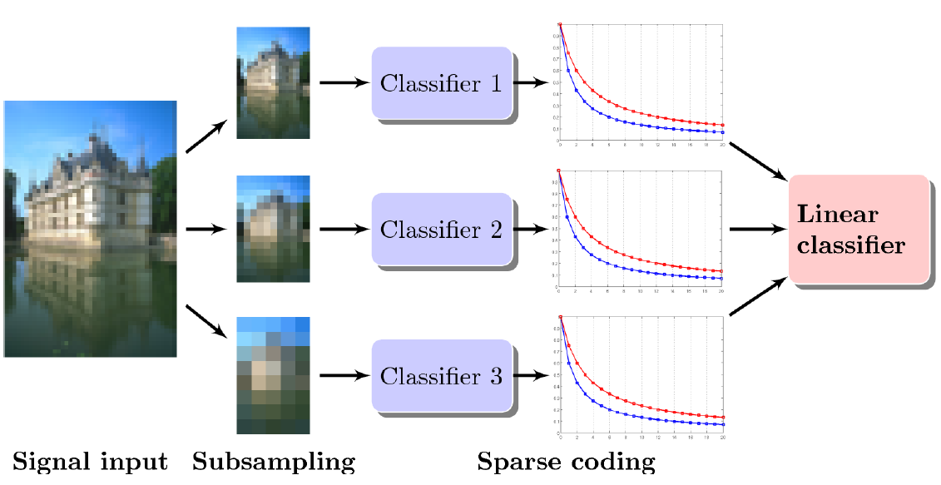
Patch classification with
learned dictionaries

Slide 35
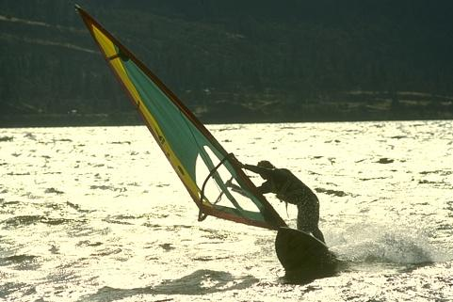
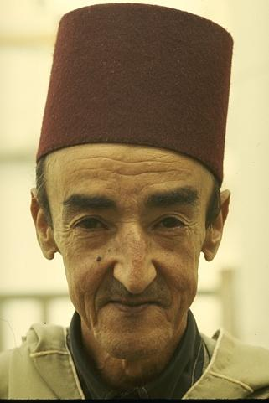
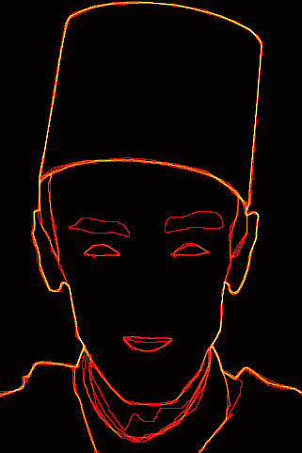



Edge detection results
Quantitative results on the Berkeley segmentation dataset and benchmark (Martin et al., ICCV’01)
Rank | Score | Algorithm
0 | 0.79 | Human labeling
1 | 0.70 | (Maire et al., 2008)
2 | 0.67 | (Aerbelaez, 2006)
3 | 0.66 | (Dollar et al., 2006)
3 | 0.66 | Us – no post-processing
4 | 0.65 | (Martin et al., 2001)
5 | 0.57 | Color gradient
6 | 0.43 | Random
Notes:
Apprentissage d’un detecteur de contours.

Slide 36


Input edges Bike edges Bottle edges People edges
Pascal 07 data
Us + L’07
L’07
Comparaison with Leordeanu et al. (2007)
on Pascal’07 benchmark. Mean error rate
reduction: 33%.
Notes:
Detecteurs de contours specialises pour des categories donnees.

Slide 37
Task-driven dictionary learning
(Mairal, Bach, Ponce, 2010)
min _{W,D} f (W,D) = E_{x,y} [L(y, W, α*( x, D ))] + ν|W|_{F}²
with α*(x,D) = Argmin |x - Dα|₂² + λ|α|₁ + μ|α|₂²
(Mairal et al.’08; Bradley & Bagnell’09; Boureau et al.’10; Yang et al.’10)
α
Applications: Regression, classification, compressed
sensing.
Extensions: Learning linear transforms of the
input data, semi-supervised learning.
Proposition: Under mild assumptions, the function f
is differentiable, and its gradient can be written
in closed form as an expectation.
Algorithm: Stochastic gradient descent.

Slide 38


Slide 39


Slide 40











Authentic
Fake
(Mairal, Bach, Ponce, 2010)
Data courtesy of James Hughes & Daniel Rockmore

Slide 41

Authentic
Fake
Fake
Data courtesy of James Hughes & Daniel Rockmore

Slide 42

Authentic
Fake
Authentic
Data courtesy of James Hughes & Daniel Rockmore

Slide 43
A common architecture for image classification
Filtering
SIFT at keypoints
dense gradients
dense SIFT
Coding
vector quantization
vector quantization
sparse coding
Pooling
whole image, mean
coarse grid, mean
spatial pyramid, max
Idea: Replace k-means by sparse coding (Yang et al.,
CVPR’09; Boureau et al., CVPR’10, ICML’10; Yang et
al., CVPR’10).

Slide 44



Learning dictionaries for image classification (Boureau, LeCun, Bach, Ponce, CVPR’10)
Single - feature
Scenes, supervised
dictionary learning
[1024]
[2048]

Slide 45


Non-blind deblurring (Couzinie-Devy, Mairal, Bach, Ponce, 2010)

Slide 46




(Fergus et al., 2006)
Non-uniform blind
deblurring
(Whyte et al., CVPR’10)
!! Short detour !!
(Us)

Slide 47
Non-uniform blind
deblurring
(Whyte et al., CVPR’10)

Slide 48

Digital Zoom

Slide 49
(Fattal, 2007)

Slide 50
(Glasner et al., 2009)

Slide 51
(Couzinie-Devy et al., 2010)

Slide 52




(Fattal, 2007)
(Glasner et al., 2009)
(Couzinie-Devy et al., 2010)

Slide 53
(Fattal, 2007)
(Glasner et al., 2009)
(Couzinie-Devy et al., 2010)

Slide 54
(Fattal, 2007)
(Glasner et al., 2009)
(Couzinie-Devy et al., 2010)

Slide 55

Inverse halftoning
(Mairal, Bach, Ponce, 2010)

Slide 56

Inverse halftoning
(Mairal, Bach, Ponce, 2010)

Slide 57


Slide 58


Slide 59



Slide 60

PSNR comparison between our method and Kite et al.’00 [FIHT2];
Neelamini et al.’09 [WInHD]; Foi et al.’04 [LPA-ICI]; and Dabov
et al.’06 [SA-DCT].

Slide 61


Slide 62


Slide 63
Epitomic dictionaries
(Benoit, Mairal, Bach, Ponce, 2010)
Traditional
Epitomic
Epitomes: (Jojic, Frey, Kannan, 2003)
Related ideas: (Aharon & Elad, 2007; Hyvarinen & Hoyer, 2001; Kavukcuoglu et al., 2009; Zeiler et al., 2010)

Slide 64

Proximal methods for sparse hierarchical dictionary learning
(Jenatton, Mairal, Obozinski, Bach, ICML’10)

Slide 65

Proximal methods for sparse hierarchical dictionary learning
(Jenatton, Mairal, Obozinski, Bach, ICML’10)

Slide 66


Network flow algorithms for structured sparsity
(Mairal, Jenatton, Obozinski, Bach, NIPS’11)

Slide 67
SPArse Modeling software (SPAMS)
http://www.di.ens.fr/willow/SPAMS/
Tutorials on sparse coding and dictionary learning for image analysis
ICCV’09: www.di.ens.fr/~mairal/tutorial_iccv09/
NIPS’09: www.di.ens.fr/~fbach/nips2009tutorial/
CVPR’10: www.di.ens.fr/~mairal/tutorial_cvpr2010/
Notes:
Les deux focus sont la partie 3D et la partie apprentissage. Le reste est presente assez brievement.

Slide 68


