Slide 1
Instance-level recognition II.
Reconnaissance d’objets et vision artificielle 2010
Josef Sivic
http://www.di.ens.fr/~josef
INRIA, WILLOW, ENS/INRIA/CNRS UMR 8548
Laboratoire d’Informatique, Ecole Normale Supérieure, Paris
With slides from: O. Chum, K. Grauman, S. Lazebnik, B. Leibe, D. Lowe, J. Philbin, J. Ponce, D. Nister, C. Schmid, N. Snavely, A. Zisserman

Slide 2
Outline – the rest of the lecture
Part 1. Matching and recognition with local features
Correspondence
Semi-local and global geometric relations
Robust estimation – RANSAC and Hough Transform
Part 2. Going large-scale
Approximate nearest neighbour matching
Bag-of-visual-words representation
Efficient visual search and extensions
Applications

Slide 3
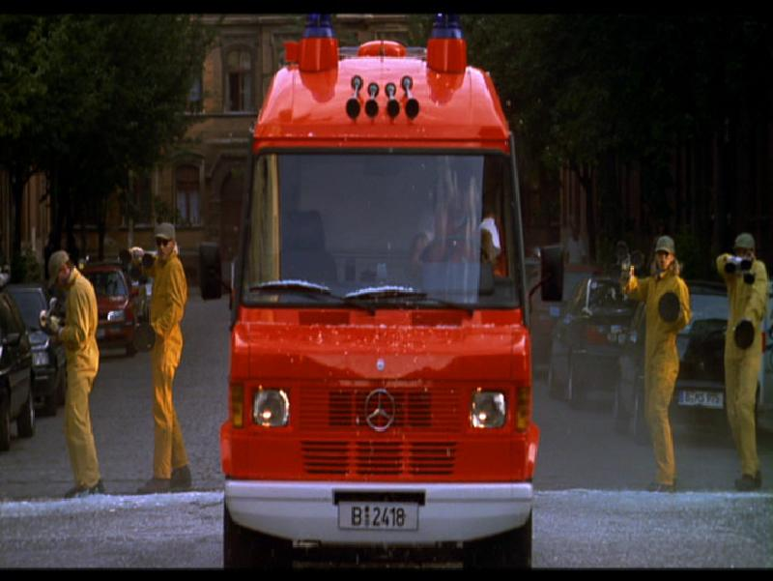
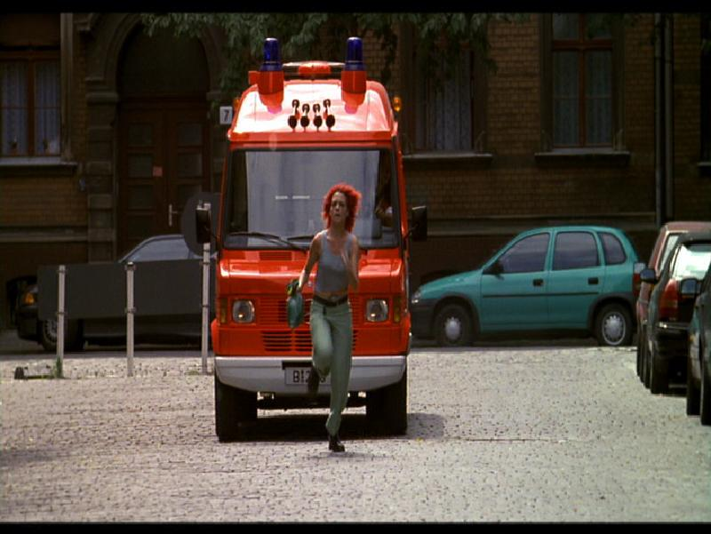
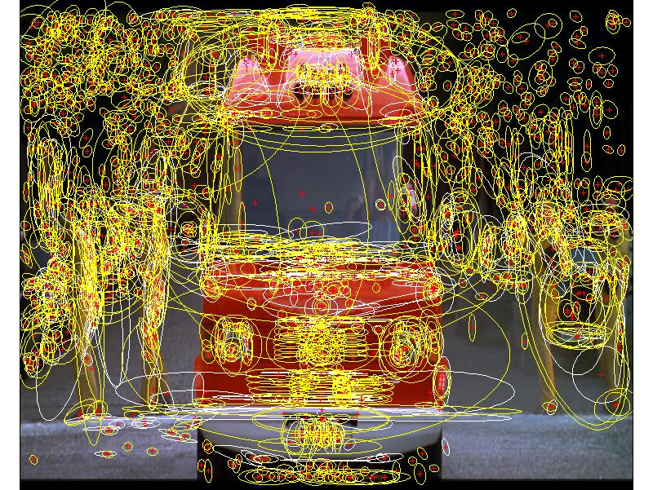
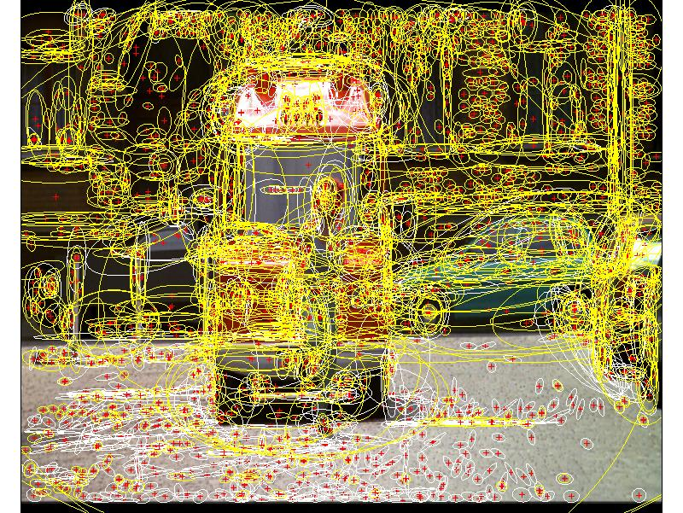
Example II: Two images again
1000+ descriptors per image

Slide 4
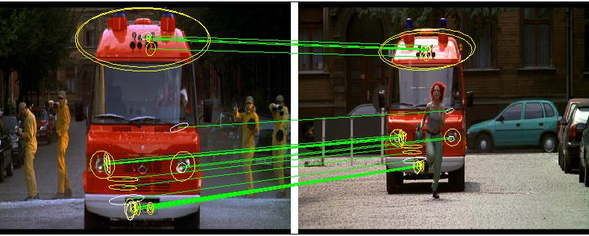
Match regions between frames using SIFT descriptors and spatial consistency
Multiple regions overcome problem of partial occlusion

Slide 5
Approach - review
Establish tentative (or putative) correspondence based on local appearance of individual features (now)
2. Verify matches based on semi-local / global geometric relations (You have just seen this).

Slide 6
What about multiple images?
So far, we have seen successful matching of a query image to a single target image using local features.
How to generalize this strategy to multiple target images with reasonable complexity?
  10, 10², 10³, …, 10⁷, … 10¹⁰ images?

Slide 7

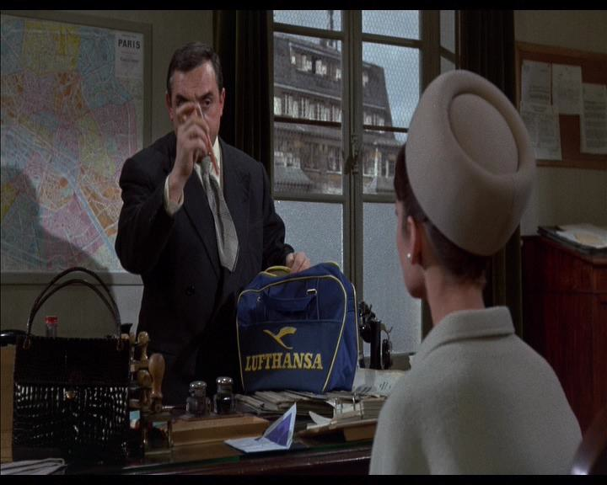
Example: Visual search in an entire feature length movie
Visually defined query
“Find this bag”
“Charade” [Donen, 1963]
Demo:
http://www.robots.ox.ac.uk/~vgg/research/vgoogle/index.html

Slide 8
History of “large scale” visual search with local regions
Schmid and Mohr ’97 – 1k images
Sivic and Zisserman’03 – 5k images
Nister and Stewenius’06 – 50k images (1M)
Philbin et al.’07 – 100k images
Chum et al.’07 + Jegou et al.’07 – 1M images
Chum et al.’08 – 5M images
Jegou et al. ’09 – 10M images
All on a single machine in ~ 1 second!

Slide 9
Two strategies
1. Efficient approximate nearest neighbour search on local feature descriptors.
2. Quantize descriptors into a “visual vocabulary” and use efficient techniques from text retrieval.
(Bag-of-words representation)

Slide 10
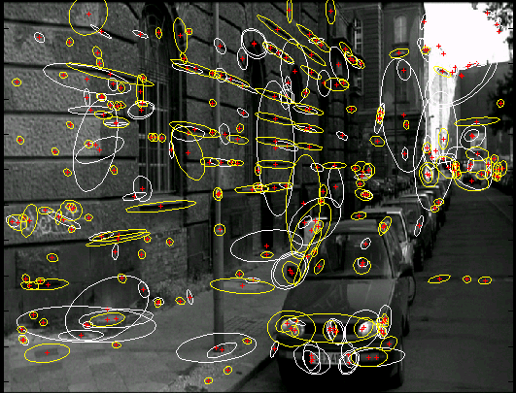
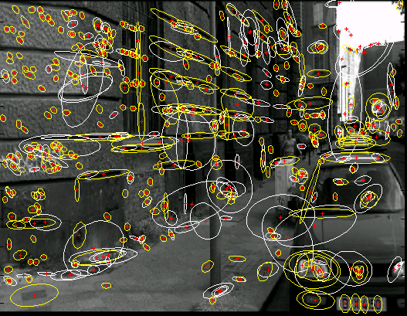
Strategy I: Efficient approximate NN search
Local features
invariant descriptor vectors
Images
invariant descriptor vectors
Compute local features in each image independently (Part 1)
“Label” each feature by a descriptor vector based on its intensity (Part 1)
Finding corresponding features is transformed to finding nearest neighbour vectors
Rank matched images by number of (tentatively) corresponding regions
Verify top ranked images based on spatial consistency (Part 2)

Slide 11


Finding nearest neighbour vectors
Establish correspondences between object model image and images in the database by nearest neighbour matching on SIFT vectors
Model image
128D descriptor space
Image database
Solve following problem for all feature vectors, , in the query image:
where, , are features from all the database images.

Slide 12
Quick look at the complexity of the NN-search
N … images
M … regions per image (~1000)
D … dimension of the descriptor (~128)
Exhaustive linear search: O(M NMD)
Example:
Matching two images (N=1), each having 1000 SIFT descriptors
Nearest neighbors search: 0.4 s (2 GHz CPU, implemenation in C)
Memory footprint: 1000 * 128 = 128kB / image
# of images
CPU time
Memory req.
N = 1,000 … ~7min (~100MB)
N = 10,000 … ~1h7min (~ 1GB)
…
N = 10⁷ ~115 days (~ 1TB)
…
All images on Facebook:
N = 10¹⁰ … ~300 years (~ 1PB)

Slide 13
Nearest-neighbor matching
Solve following problem for all feature vectors, x_{j}, in the query image:
where x_{i} are features in database images.
Nearest-neighbour matching is the major computational bottleneck
  Linear search performs dn operations for n features in the database and d dimensions
  No exact methods are faster than linear search for d>10
  Approximate methods can be much faster, but at the cost of missing some correct matches. Failure rate gets worse for large datasets.

Slide 14
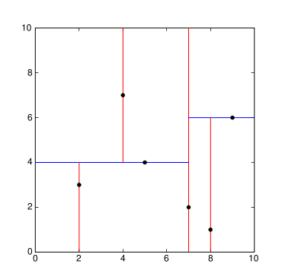
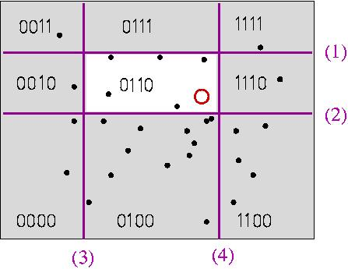
Indexing local features: approximate nearest neighbor search
Best-Bin First (BBF), a variant of k-d trees that uses priority queue to examine most promising branches first [Beis & Lowe, CVPR 1997]
Locality-Sensitive Hashing (LSH), a randomized hashing technique using hash functions that map similar points to the same bin, with high probability [Indyk & Motwani, 1998]
14
K. Grauman, B. Leibe
Notes:
14

Slide 15
K-d tree
K-d tree is a binary tree data structure for organizing a set of points in a K-dimensional space.
Each internal node is associated with an axis aligned hyper-plane splitting its associated points into two sub-trees.
Dimensions with high variance are chosen first.
Position of the splitting hyper-plane is chosen as the mean/median of the projected points – balanced tree.
l₁
4
l₁
6
l₂
l₃
7
8
l₄
l₅
l₇
l₆
l₂
5
3
9
10
l₈
2
5
4
11
l₁₀
8
l₉
1
2
11
1
3
9
10
6
7
Images: Anna Atramentov

Slide 16
K-d tree construction
Simple 2D example
4
l₁
6
l₉
l₅
7
l₁
l₆
l₂
5
8
l₃
l₂
l₃
3
9
l₁₀
10
l₈
l₇
l₄
l₅
l₇
l₆
1
l₄
2
11
l₈
2
5
4
11
l₁₀
8
l₉
1
3
9
10
6
7
Slide credit: Anna Atramentov

Slide 17
KD-tree: Properties
Binary tree of depth O(log(n))
Total nodes: (2n -1) (n-1 internal and n leaves)
Construction time: O(n d log(n))
Memory requirements:
  nonleaf node – (dim, threshold)
  Leaf node: data id
Need to also store the original data

Slide 18
K-d tree query
4
l₁
6
l₉
l₅
7
l₁
q
l₆
l₂
5
8
l₃
l₂
l₃
3
9
l₁₀
10
l₈
l₇
l₄
l₅
l₇
l₆
1
l₄
2
11
l₈
2
5
4
11
l₁₀
8
l₉
1
3
9
10
6
7
Slide credit: Anna Atramentov

Slide 19
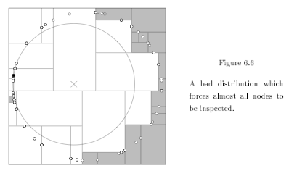
K-d tree: Backtracking
Backtracking is necessary as the true nearest neighbor may not lie in the query cell.
But in some cases, almost all cells need to be inspected.
Figure: A. Moore

Slide 20
Solution: Approximate nearest neighbor K-d tree
Key ideas:
Search k-d tree bins in order of distance from query
Requires use of a priority queue
Limit the number of neighbouring k-d tree bins to explore: only approximate NN is found
Reduce the boundary effects by randomization

Slide 21
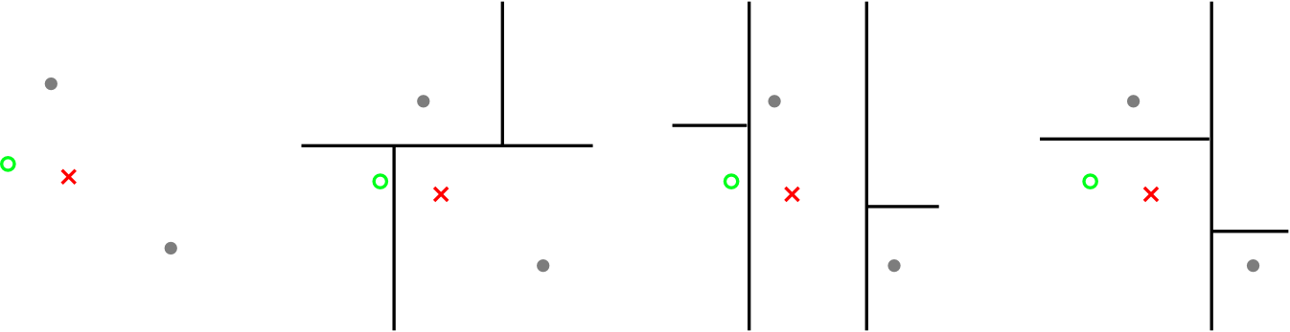
Randomized K-d trees
How to choose the dimension to split and the splitting point?
    Pick dimension with the highest variance
    Split at the mean/median
Multiple randomized trees increase the chances of finding nearby points
True nearest neighbour
Query point
True nearest neighbour found?
No
No
Yes

Slide 22
Approximate NN search using a randomized forest of K-d trees: Algorithm summary
1. Descent all (typically 8) trees to the leaf node
2. Search k-d tree bins in order of distance from query
  Distance between the query and the bin is defined as the minimum distance between the query and any point on the bin boundary
  Requires the use of a priority queue:
    During lookup an entry is added to the priority queue about the option not taken
    For multiple trees, the queue is shared among the trees
  Limit the number of neighbouring K-d tree bins to explore (parameter of the algorithm, typically set to 512)

Slide 23
Experimental evaluation for SIFT matching
http://www.cs.ubc.ca/~lowe/papers/09muja.pdf

Slide 24
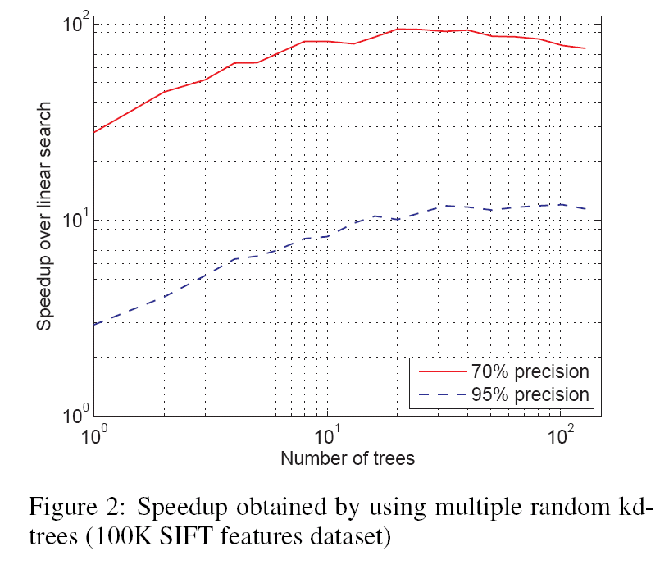
Randomized K-d trees
Performance w.r.t. the number of trees
d=128, n=100K
Precision: percentage of true nearest neighbours found

Slide 25
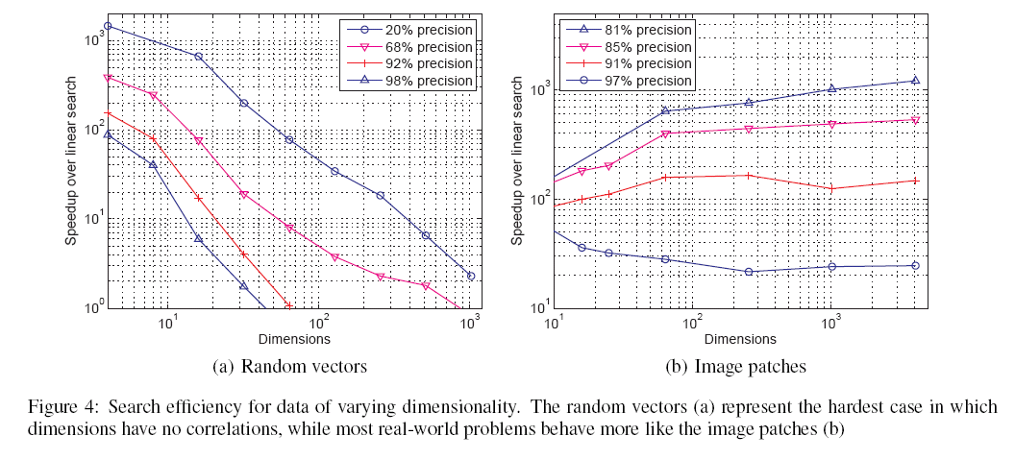
Randomized K-d trees
Performance w.r.t. the number of dimensions

Slide 26
Randomized K-d trees: discussion
Find approximate nearest neighbor in O(logN) time, where N is the number of data points.
Increased memory requirements: needs to store multiple (~8) trees
Good performance in practice for recognition problems (NN-search for SIFT descriptors and image patches).
Code available online:
http://people.cs.ubc.ca/~mariusm/index.php/FLANN/FLANN

Slide 27
Variation: K-means tree [Muja&Lowe, 2009]
Partition of the space is determined by recursive application of k-means clustering.
Cell boundaries are not axis aligned, but given by the set of cluster centers.
Also called “tree structured vector quantization”.
Finding nearest neighbor to a query point involves recursively finding nearest cluster center.
Look-up complexity O(logN)
Also used for vocabulary quantization (see later) [Nister&Stewenius’06]

Slide 28
Example
28
K. Grauman, B. Leibe
Figure credit: David Nister
3-nary tree construction:

Slide 29
Example
29
K. Grauman, B. Leibe
Figure credit: David Nister
Query look-up:

Slide 30
Indexing local features: approximate nearest neighbor search
Best-Bin First (BBF), a variant of k-d trees that uses priority queue to examine most promising branches first [Beis & Lowe, CVPR 1997]
Locality-Sensitive Hashing (LSH), a randomized hashing technique using hash functions that map similar points to the same bin, with high probability [Indyk & Motwani, 1998]
30
K. Grauman, B. Leibe
Notes:
30

Slide 31
Locality Sensitive Hashing (LSH)
Idea: construct hash functions g: R^{d}→Z^{k} such that
for any points p,q:
If ||p-q|| ≤ r, then Pr[g(p)=g(q)] is “high” or “not-so-small”
If ||p-q|| > cr, then Pr[g(p)=g(q)] is “small”
Example of g: linear projections
g(p)=<h₁(p),h₂(p),…,h_{k}(p)>, where h_{X,b}(p)=⎣(p*X+b)/w⎦
⎣.⎦ is the “floor” operator.
X_{i} are sampled from a Gaussian.
w is the width of each quantization bin.
b is sampled from uniform distr. [0,w].
[Datar-Immorlica-Indyk-Mirrokni’04]
Notes:
w … scalar to scale to projection
Projections X, are random, where X_i is sampled from a Gaussian distribution.

Slide 32
Locality Sensitive Hashing (LSH)
Choose a random projection
Project points
Points close in the original space remain close under the projection
Unfortunately, converse not true
Answer: use multiple quantized projections which define a high-dimensional “grid”
Slide: Philbin, Chum, Isard, Zissrman

Slide 33
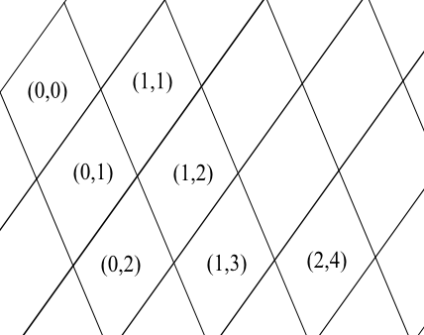
Locality Sensitive Hashing (LSH)
Cell contents can be efficiently indexed using a hash table
Repeat to avoid quantization errors near the cell boundaries
Point that shares at least one cell = potential candidate
Compute distance to all candidates
Slide: Philbin, Chum, Isard, Zissrman

Slide 34
LSH: discussion
In theory, query time is O(kL), where k is the number of projections and L is the number of hash tables, i.e. independent of the number of points, N.
In practice, LSH has high memory requirements as large number of projections/hash tables are needed.
Code and more materials available online:
http://www.mit.edu/~andoni/LSH/
Hashing functions could be also data-dependent (PCA) or learnt from labeled point pairs (close/far).
Y. Weiss, A. Torralba, and R. Fergus, “Spectral hashing,” in NIPS, 2008.
R. Salakhutdinov and G. Hinton, “Semantic Hashing,” ACM SIGIR, 2007.
See also:
http://cobweb.ecn.purdue.edu/~malcolm/yahoo Slaney2008(LSHTutorialDraft).pdf
http://www.sanjivk.com/EECS6898/ApproxNearestNeighbors_2.pdf

Slide 35
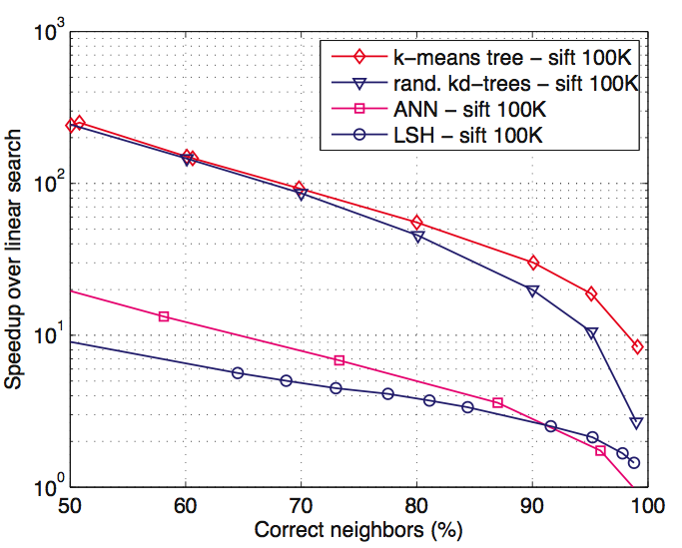
Comparison of approximate NN-search methods
Dataset: 100K SIFT descriptors
Code for all methods available online, see Muja&Lowe’09
Figure: Muja&Lowe’09
Notes:
ANN – based on a single KD-tree, Arya et al. 1998
LSH – Andoni’06

Slide 36
Approximate nearest neighbour search (references)
J. L. Bentley. Multidimensional binary search trees used for associative searching. Comm. ACM, 18(9), 1975.
Freidman, J. H., Bentley, J. L., and Finkel, R. A. An algorithm for finding best matches in logarithmic expected time. ACM Trans. Math. Softw., 3:209–226, 1977.
Arya, S., Mount, D. M., Netanyahu, N. S., Silverman, R., and Wu, A. Y. An optimal algorithm for approximate nearest neighbor searching in fixed dimensions. Journal of the ACM, 45:891–923, 1998.
C. Silpa-Anan and R. Hartley. Optimised KD-trees for fast image descriptor matching. In CVPR, 2008.
M. Muja and D. G. Lowe. Fast approximate nearest neighbors with automatic algorithm configuration. In VISAPP, 2009.
P. Indyk and R. Motwani, “Approximate nearest neighbors: towards removing the curse of dimensionality,” in Proc. of 30th ACM Symposium on Theory of Computing, 1998
G. Shakhnarovich, P. Viola, and T. Darrell, “Fast pose estimation with parameter-sensitive hashing,” in Proc. of the IEEE International Conference on Computer Vision, 2003.
R. Salakhutdinov and G. Hinton, “Semantic Hashing,” ACM SIGIR, 2007.
Y. Weiss, A. Torralba, and R. Fergus, “Spectral hashing,” in NIPS, 2008.

Slide 37
ANN - search (references continued)
O. Chum, J. Philbin, and A. Zisserman. Near duplicate image detection: min-hash and tf-idf weighting. BMVC., 2008.
M. Raginsky and S. Lazebnik, “Locality-Sensitive Binary Codes from Shift-Invariant Kernels,” in Proc. of Advances in neural information processing systems, 2009.
B. Kulis and K. Grauman, “Kernelized locality-sensitive hashing for scalable image search,” Proc. of the IEEE International Conference on Computer Vision, 2009.
J. Wang, S. Kumar, and S.-F. Chang, “Semi-supervised hashing for scalable image retrieval,” in IEEE Computer Society Conference on Computer Vision and Pattern Recognition (CVPR), 2010.
J. Wang, S. Kumar, and S.-F. Chang, “Sequential projection learning for hashing with compact codes,” in Proceedings of the 27th International Conference on Machine Learning, 2010.

