Slide 1
Instance-level recognition II.
Reconnaissance d’objets et vision artificielle 2010
Josef Sivic
http://www.di.ens.fr/~josef
INRIA, WILLOW, ENS/INRIA/CNRS UMR 8548
Laboratoire d’Informatique, Ecole Normale Supérieure, Paris
With slides from: O. Chum, K. Grauman, S. Lazebnik, B. Leibe, D. Lowe, J. Philbin, J. Ponce, D. Nister, C. Schmid, N. Snavely, A. Zisserman

Slide 2
Announcements
Class web-page:
http://www.di.ens.fr/willow/teaching/recvis10/
Assignment 1 is due next Tuesday, Oct 19th 2010!
Assignment 2 out: Stitching photo-mosaics
http://www.di.ens.fr/willow/teaching/recvis10/assignment2/
Matlab tutorial – Fri 15/10 13:30-15:00
Location: 23 Avenue d’Italie.
http://www.di.ens.fr/willow/contact.php
Notes:
Monday 4pm
Friday 13:30

Slide 3
Instance-level recognition
Last time:
Local invariant features (last lecture – C.Schmid)
Today:
Camera geometry – review (J. Ponce)
Correspondence, matching and recognition with local features, efficient visual search (J. Sivic)
Next week:
Very large scale visual indexing – (C. Schmid)

Slide 4
Outline – the rest of the lecture
Part 1. Image matching and recognition with local features
Correspondence
Semi-local and global geometric relations
Robust estimation – RANSAC and Hough Transform
Part 2. Going large-scale
Approximate nearest neighbour matching
Bag-of-visual-words representation
Efficient visual search and extensions
Applications

Slide 5
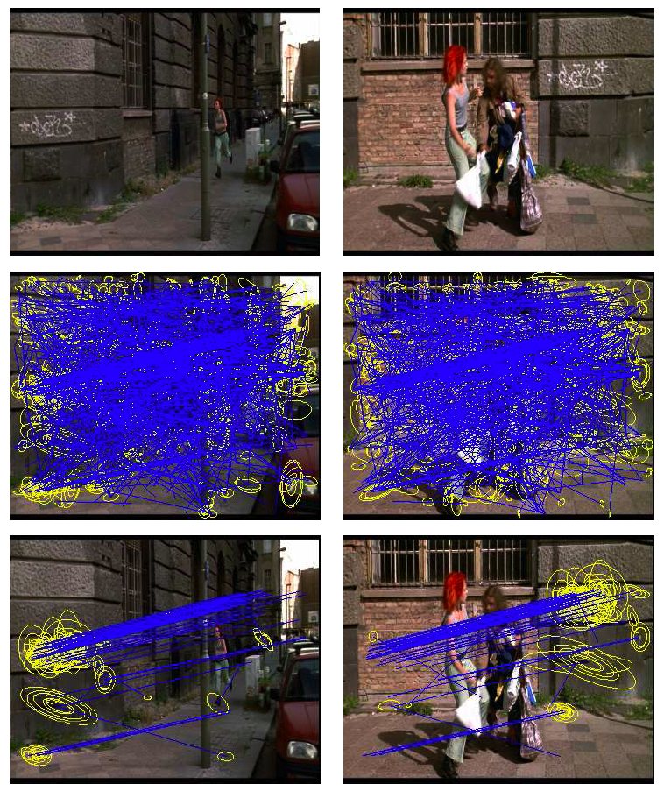
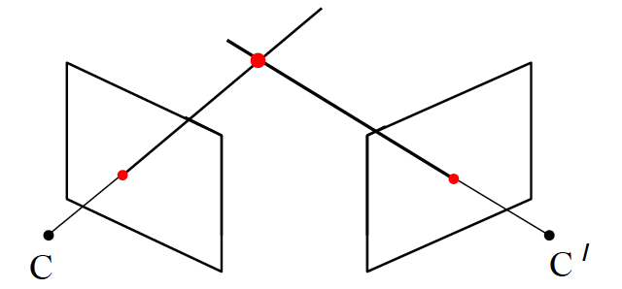
Image matching and recognition with local features
The goal: establish correspondence between two or more images
Image points x and x’ are in correspondence if they are projections of the same 3D scene point X.
Images courtesy A. Zisserman

Slide 6
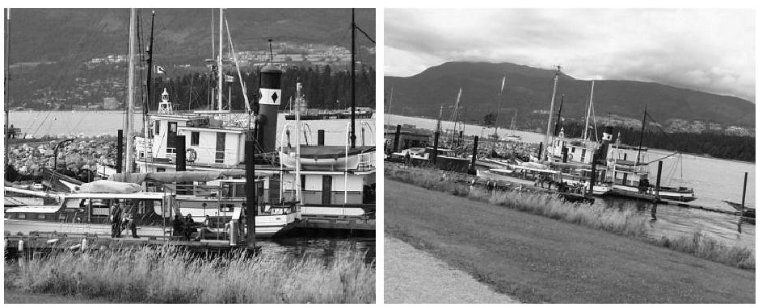
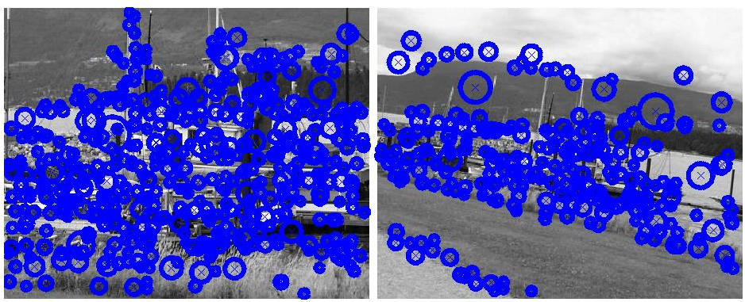
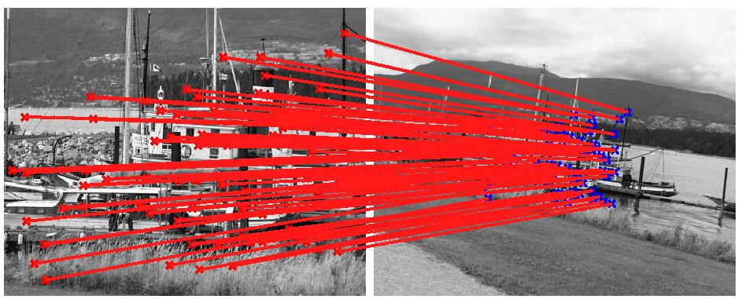
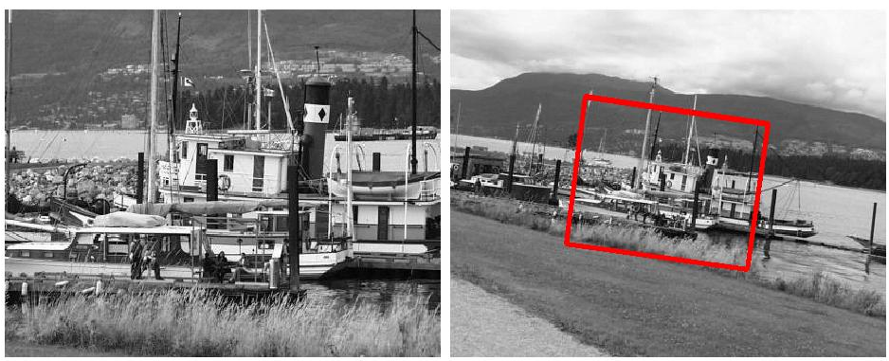
Example I: Wide baseline matching
  Establish correspondence between two (or more) images.
  Useful in visual geometry: Camera calibration, 3D reconstruction, Structure and motion estimation, …
Scale/affine – invariant regions: SIFT, Harris-Laplace, etc.

Slide 7
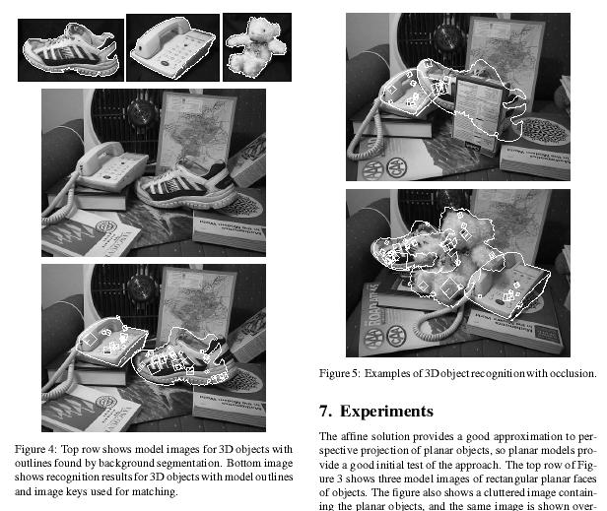
Example II: Object recognition
Establish correspondence between the target image and (multiple) images in the model database.
Model database
Target image
[D. Lowe, 1999]
Notes:
Typically object is deemed recognized if a minimal number of correspondences is established or certain area is of the object is covered.

Slide 8
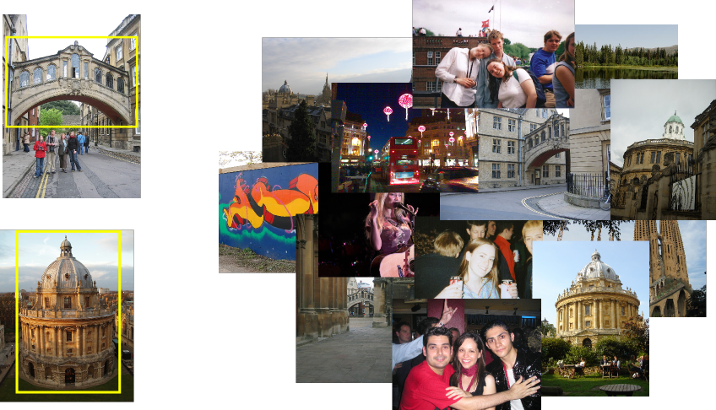
Example III: Visual search
Given a query image, find images depicting the same place / object in a large unordered image collection.
Find these landmarks
...in these images and 1M more

Slide 9
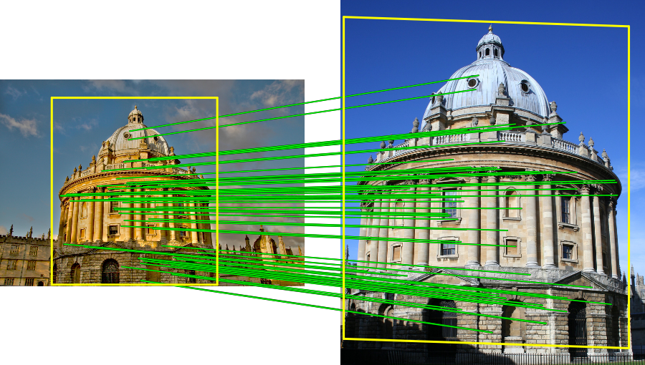
Establish correspondence between the query image and all images from the database depicting the same object / scene.
Query image
Database image(s)
Notes:
Again, the object is deemed matched if at least certain number of correspondences is established.

Slide 10
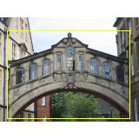
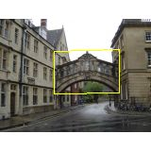
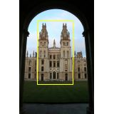
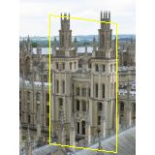
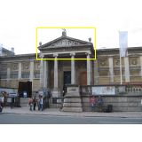
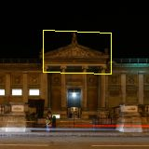
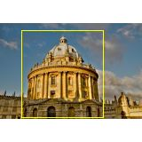
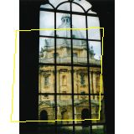
Why is it difficult?
Want to establish correspondence despite possibly large changes in scale, viewpoint, lighting and partial occlusion
Scale
Viewpoint
Lighting
Occlusion
… and the image collection can be very large (e.g. 1M images)

Slide 11
Approach
Pre-processing (last lecture):
Detect local features.
Extract descriptor for each feature.
Matching:
1. Establish tentative (putative) correspondences based on local appearance of individual features (their descriptors).
2. Verify matches based on semi-local / global geometric relations.
Notes:
3: Features are tentatively matched if they locally look similar.

Slide 12
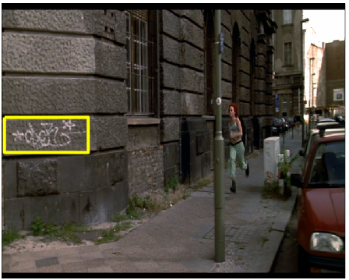
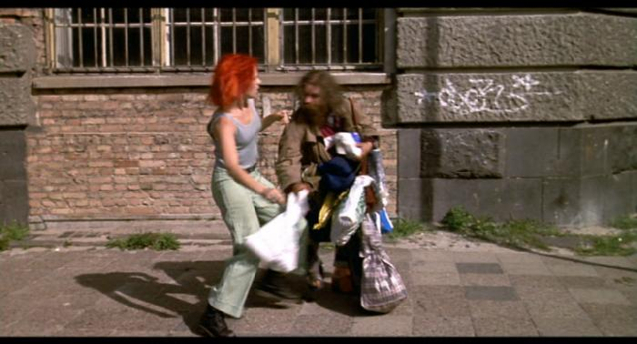
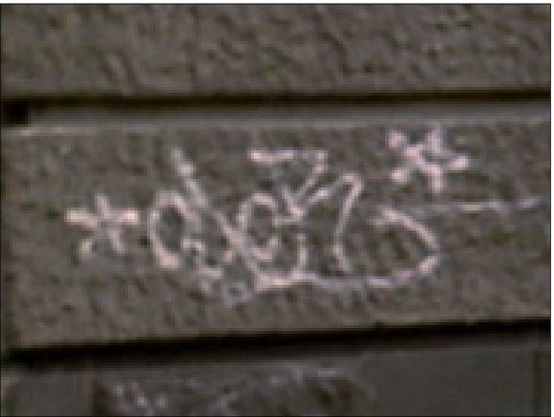
Example I: Two images -“Where is the Graffiti?”
object

Slide 13


Step 1. Establish tentative correspondence
Establish tentative correspondences between object model image and target image by nearest neighbour matching on SIFT vectors
Model (query) image
128D descriptor space
Target image
Need to solve some variant of the “nearest neighbor problem” for all feature vectors, , in the query image:
where, , are features in the target image.
Can take a long time if many target images are considered.

Slide 14
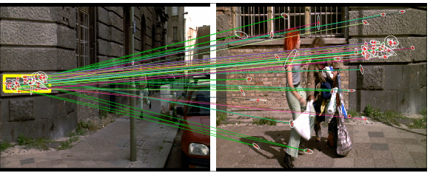
Problem with matching on local descriptors alone
too much individual invariance
each region can affine deform independently (by different amounts)
Locally appearance can be ambiguous
Solution: use semi-local and global spatial relations to verify matches.

Slide 15
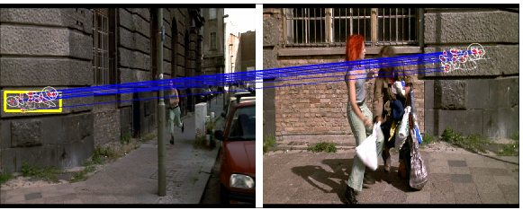
Example I: Two images -“Where is the Graffiti?”
Initial matches
Nearest-neighbor search based on appearance descriptors alone.
After spatial verification

Slide 16
Step 2: Spatial verification (now)
Semi-local constraints
Constraints on spatially close-by matches
2. Global geometric relations
Require a consistent global relationship between all matches

Slide 17
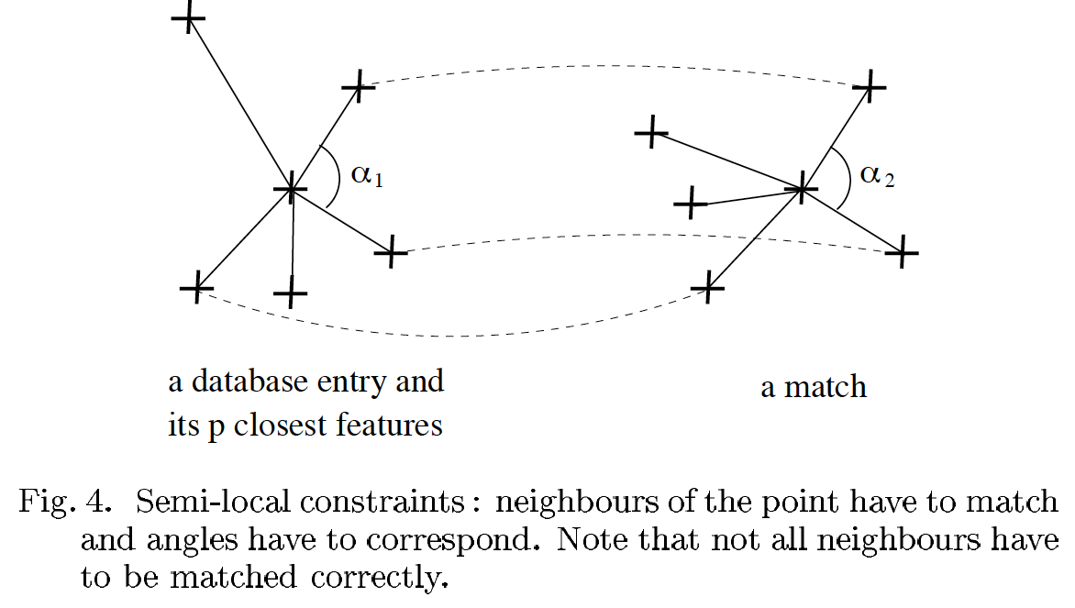
Semi-local constraints: Example I. – neighbourhood consensus
[Schmid&Mohr, PAMI 1997]

Slide 18
Semi-local constraints:
Example I. – neighbourhood consensus
Original images
Tentative matches
[Schaffalitzky & Zisserman, CIVR 2004]
After neighbourhood consensus

Slide 19
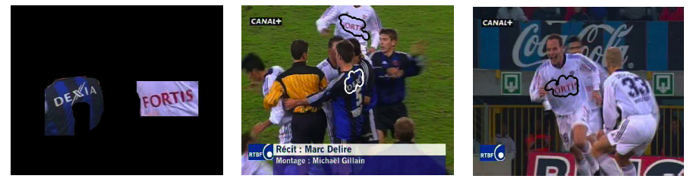
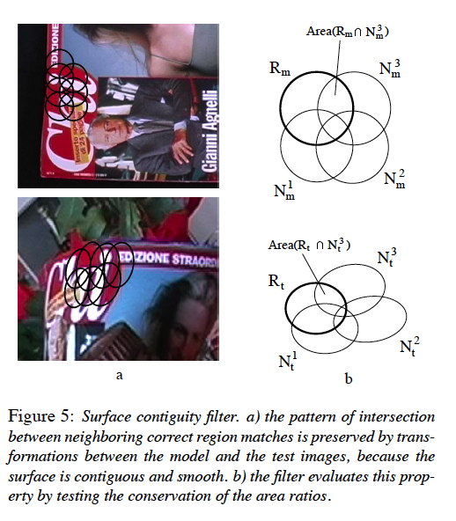
Semi-local constraints: Example II.
Model image
Matched image
[Ferrari et al., IJCV 2005]
Matched image

Slide 20
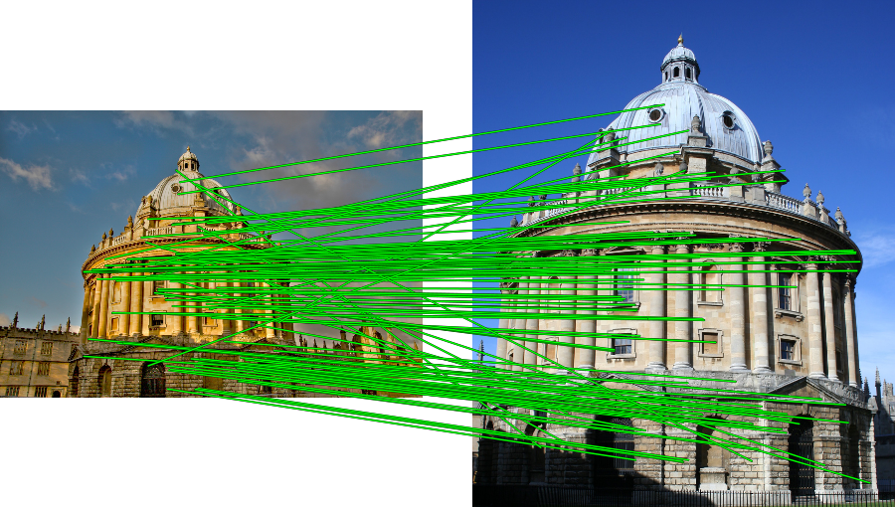
Geometric verification with global constraints
All matches must be consistent with a global geometric relation / transformation.
Need to simultaneously (i) estimate the geometric relation / transformation and (ii) the set of consistent matches
Tentative matches
Matches consistent with an affine transformation

Slide 21
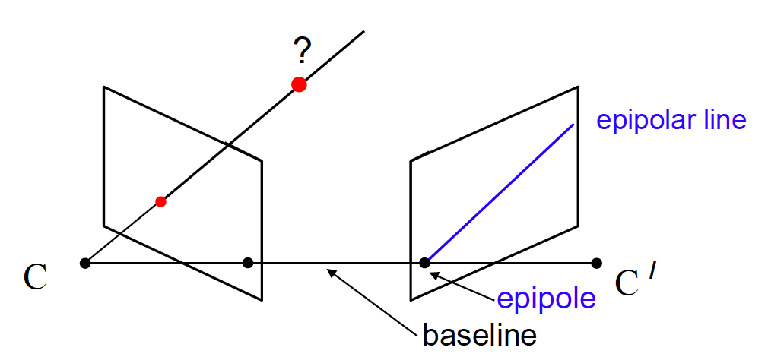
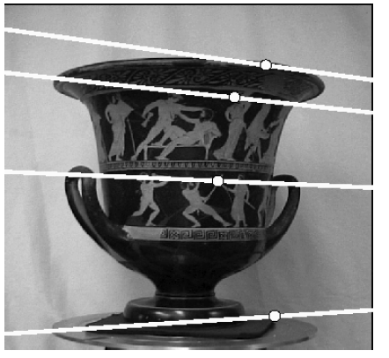
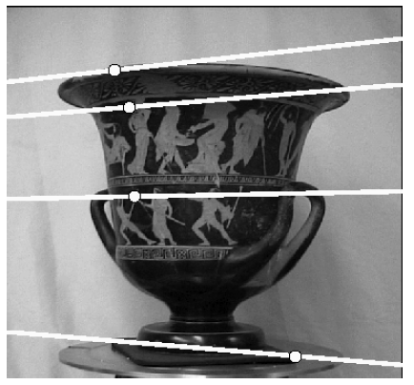
Epipolar geometry (not considered here)
In general, two views of a 3D scene are related by the epipolar constraint.
A point in one view “generates” an epipolar line in the other view
The corresponding point lies on this line.
Slide credit: A. Zisserman

Slide 22
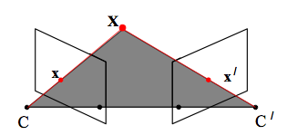

Epipolar geometry (not considered here)
Algebraically, the epipolar constraint can be expressed as
where
x, x’ are homogeneous coordinates (3-vectors) of corresponding image points.
F is a 3x3, rank 2 homogeneous matrix with 7 degrees of freedom, called the fundamental matrix.
Slide credit: A. Zisserman
Notes:
Each point correspondence gives one constraint. F has 9 entries, but is defined up to scale, e.g. 8 correspondences are needed for a linear solution. 7 could be used by using the constraint that F has rank 2.

Slide 23
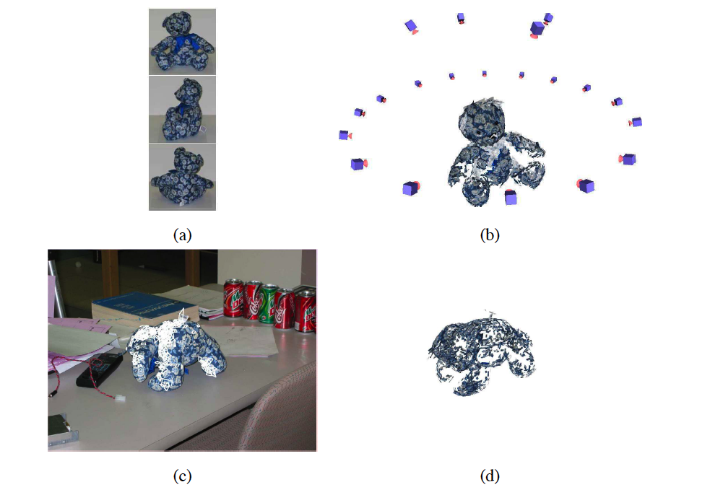
3D constraint: example (not considered here)
Matches must be consistent with a 3D model
3 (out of 20) images used to build the 3D model
Recovered 3D model
Object recognized in a previously unseen pose
Recovered pose
[Lazebnik, Rothganger, Schmid, Ponce, CVPR’03]

Slide 24
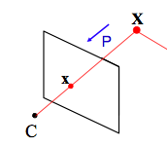

3D constraint: example (not considered here)
With a given 3D model (set of known X’s) and a set of measured image points x, the goal is to find find camera matrix P and a set of geometrically consistent correspondences x X.
Notes:
In general Each point gives two independent constraints. P has 12 entries and 11 parameters, i.e. at least 5.5 correspondences are reqruied to compute P exactly.

Slide 25
2D transformation models
Similarity
(translation,
scale, rotation)
Affine
Projective
(homography)

Slide 26
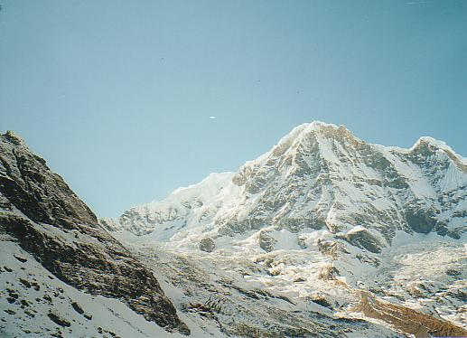
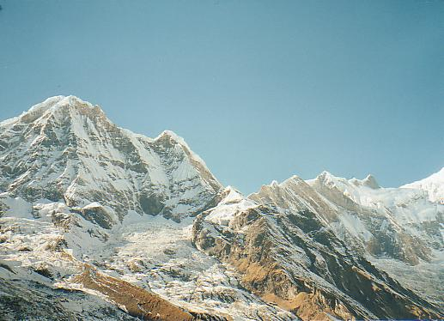
Estimating 2D geometric relations - outline

Slide 27
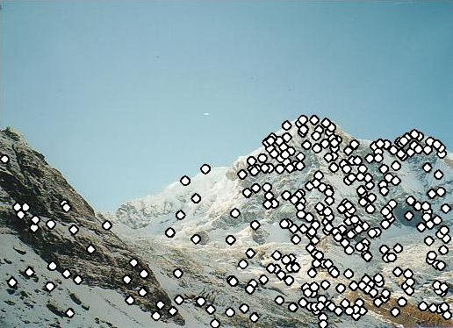
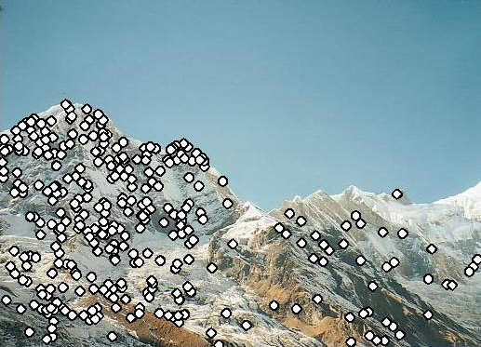
Estimating 2D geometric relations - outline
Extract features

Slide 28
Estimating 2D geometric relations - outline
Extract features
Compute putative matches

Slide 29
Estimating 2D geometric relations - outline
Extract features
Compute putative matches
Identify outliers

Slide 30
Estimating 2D geometric relations - outline
Extract features
Compute putative matches
Identify outliers
Estimate transformation from inliers (valid matches)

Slide 31
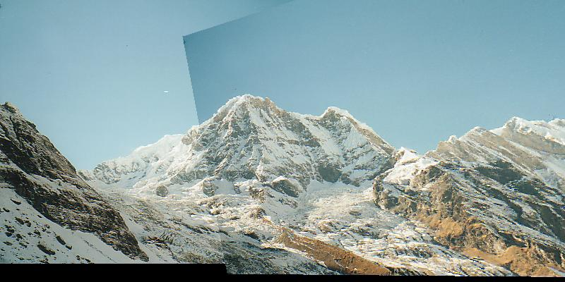
Estimating 2D geometric relations - outline
Extract features
Compute putative matches
Identify outliers
Estimate transformation from inliers (valid matches)

Slide 32
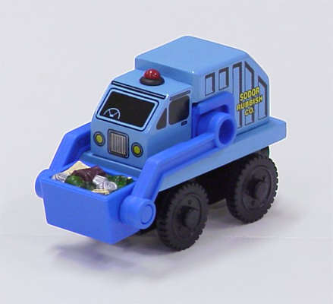
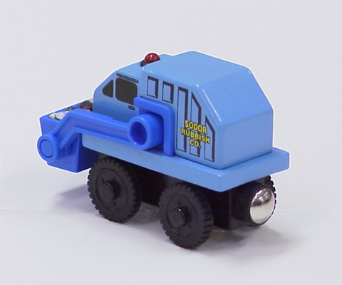
Example: estimating 2D affine transformation
Simple fitting procedure (linear least squares)
Approximates viewpoint changes for roughly planar objects and roughly orthographic cameras
Can be used to initialize fitting for more complex models

Slide 33
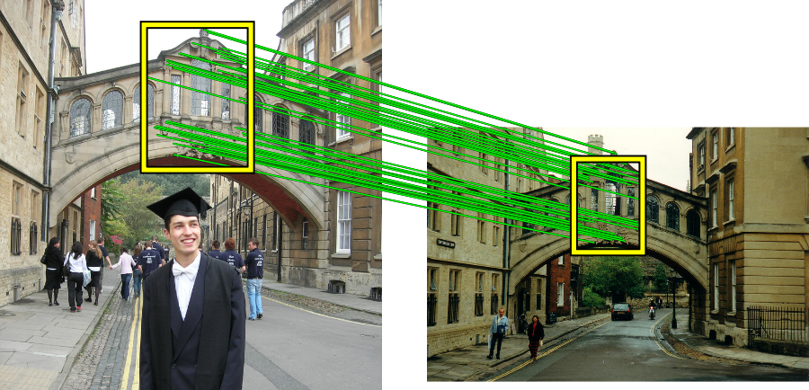
Example: estimating 2D affine transformation
Simple fitting procedure (linear least squares)
Approximates viewpoint changes for roughly planar objects and roughly orthographic cameras
Can be used to initialize fitting for more complex models
Matches consistent with an affine transformation

Slide 34
Fitting an affine transformation
Assume we know the correspondences, how do we get the transformation?

Slide 35
Fitting an affine transformation
Linear system with six unknowns
Each match gives us two linearly independent equations: need at least three to solve for the transformation parameters

Slide 36
Dealing with outliers
The set of putative matches may contain a high percentage (e.g. 90%) of outliers
How do we fit a geometric transformation to a small subset of all possible matches?
Possible strategies:
  RANSAC
  Hough transform

Slide 37
Strategy 1: RANSAC
RANSAC loop (Fischler & Bolles, 1981):
Randomly select a seed group of matches
Compute transformation from seed group
Find inliers to this transformation
If the number of inliers is sufficiently large, re-compute least-squares estimate of transformation on all of the inliers
Keep the transformation with the largest number of inliers

Slide 38
Example: Robust line estimation - RANSAC
Fit a line to 2D data containing outliers
There are two problems
a line fit which minimizes perpendicular distance
a classification into inliers (valid points) and outliers
Solution: use robust statistical estimation algorithm RANSAC
(RANdom Sample Consensus) [Fishler & Bolles, 1981]
Slide credit: A. Zisserman

Slide 39
RANSAC robust line estimation
Repeat
  Select random sample of 2 points
  Compute the line through these points
  Measure support (number of points within threshold distance of the line)
Choose the line with the largest number of inliers
  Compute least squares fit of line to inliers (regression)
Slide credit: A. Zisserman

Slide 40
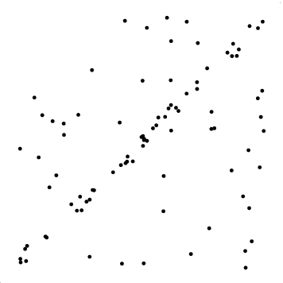
Slide credit: O. Chum

Slide 41
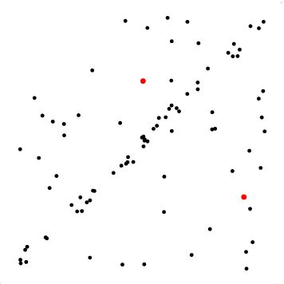
Slide credit: O. Chum

Slide 42
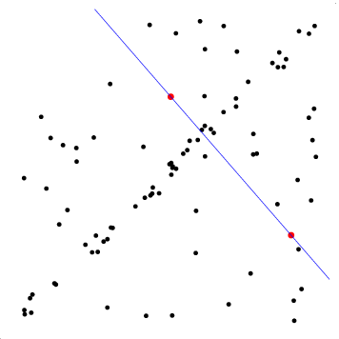
Slide credit: O. Chum

Slide 43
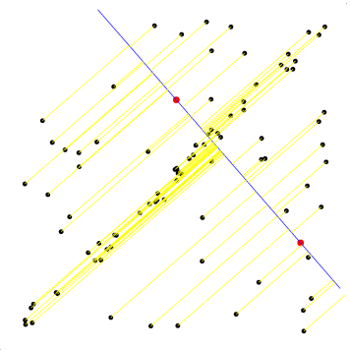
Slide credit: O. Chum

Slide 44
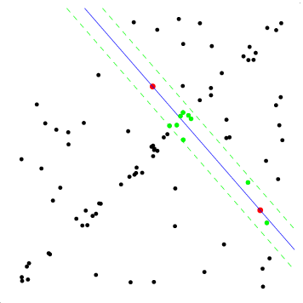
Slide credit: O. Chum

Slide 45
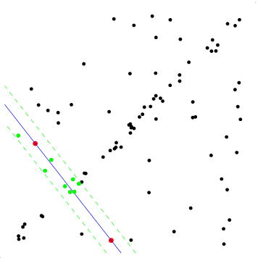
Slide credit: O. Chum

Slide 46
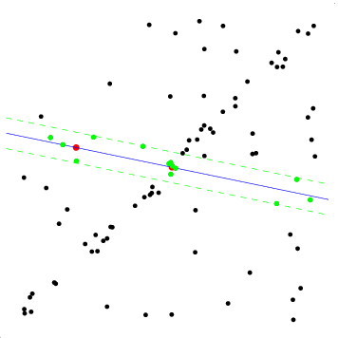
Slide credit: O. Chum

Slide 47
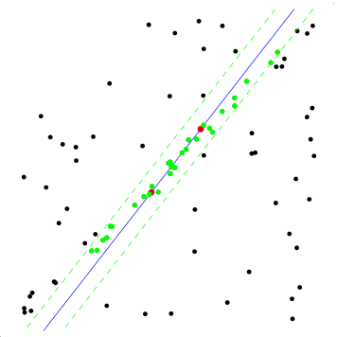
Slide credit: O. Chum

Slide 48
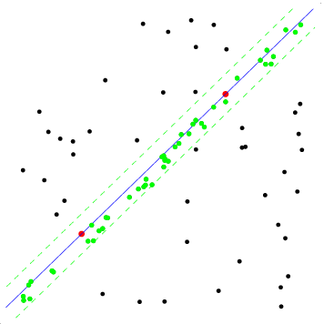
Slide credit: O. Chum

Slide 49
Algorithm summary – RANSAC robust estimation of 2D affine transformation
Repeat
  Select 3 point to point correspondences
  Compute H (2x2 matrix) + t (2x1) vector for translation
  Measure support (number of inliers within threshold distance, i.e. d²_{transfer} < t)
Choose the (H,t) with the largest number of inliers
(Re-estimate (H,t) from all inliers)

Slide 50
How many samples?
Number of samples N
  Choose N so that, with probability p, at least one random sample is free from outliers
  e.g.:
    p=0.99
    outlier ratio: e
Probability a randomly picked point is an inlier
Probability of all points in a sample (of size s) are inliers
Source: M. Pollefeys

Slide 51
How many samples?
Number of samples N
  Choose N so that, with probability p, at least one random sample is free from outliers
  e.g.:
    p=0.99
    outlier ratio: e
Probability that all N samples (of size s) are corrupted (contain an outlier)
 | proportion of outliers e
s | 5% | 10% | 20% | 30% | 40% | 50% | 90%
1 | 2 | 2 | 3 | 4 | 5 | 6 | 43
2 | 2 | 3 | 5 | 7 | 11 | 17 | 458
3 | 3 | 4 | 7 | 11 | 19 | 35 | 4603
4 | 3 | 5 | 9 | 17 | 34 | 72 | 4.6e4
5 | 4 | 6 | 12 | 26 | 57 | 146 | 4.6e5
6 | 4 | 7 | 16 | 37 | 97 | 293 | 4.6e6
7 | 4 | 8 | 20 | 54 | 163 | 588 | 4.6e7
8 | 5 | 9 | 26 | 78 | 272 | 1177 | 4.6e8
Probability of at least one point in a sample (of size s) is an outlier
Source: M. Pollefeys

Slide 52
Example: line fitting
p = 0.99
s = ?
e = ?
N = ?
Source: M. Pollefeys

Slide 53
Example: line fitting
p = 0.99
s = 2
e = 2/10 = 0.2
N = 5
 | proportion of outliers e
s | 5% | 10% | 20% | 30% | 40% | 50% | 90%
1 | 2 | 2 | 3 | 4 | 5 | 6 | 43
2 | 2 | 3 | 5 | 7 | 11 | 17 | 458
3 | 3 | 4 | 7 | 11 | 19 | 35 | 4603
4 | 3 | 5 | 9 | 17 | 34 | 72 | 4.6e4
5 | 4 | 6 | 12 | 26 | 57 | 146 | 4.6e5
6 | 4 | 7 | 16 | 37 | 97 | 293 | 4.6e6
7 | 4 | 8 | 20 | 54 | 163 | 588 | 4.6e7
8 | 5 | 9 | 26 | 78 | 272 | 1177 | 4.6e8
Compare with exhaustively trying all point pairs:
10
2
= 10*9 / 2 = 45
Source: M. Pollefeys

Slide 54
How to reduce the number of samples needed?
1. Reduce the proportion of outliers.
2. Reduce the sample size
  use simpler model (e.g. similarity instead of affine tnf.)
  use local information (e.g. a region to region correspondence is equivalent to (up to) 3 point to point correspondences).
Number of samples N
 | proportion of outliers e
s | 5% | 10% | 20% | 30% | 40% | 50% | 90%
1 | 2 | 2 | 3 | 4 | 5 | 6 | 43
2 | 2 | 3 | 5 | 7 | 11 | 17 | 458
3 | 3 | 4 | 7 | 11 | 19 | 35 | 4603
4 | 3 | 5 | 9 | 17 | 34 | 72 | 4.6e4
5 | 4 | 6 | 12 | 26 | 57 | 146 | 4.6e5
6 | 4 | 7 | 16 | 37 | 97 | 293 | 4.6e6
7 | 4 | 8 | 20 | 54 | 163 | 588 | 4.6e7
8 | 5 | 9 | 26 | 78 | 272 | 1177 | 4.6e8
Region to region correspondence

Slide 55
RANSAC (references)
M. Fischler and R. Bolles, “Random Sample Consensus: A Paradigm for Model Fitting with Applications to Image Analysis and Automated Cartography,” Comm. ACM, 1981
R. Hartley and A. Zisserman, Multiple View Geometry in Computer Vision, 2nd ed., 2004.
Extensions:
B. Tordoff and D. Murray, “Guided Sampling and Consensus for Motion Estimation, ECCV’03
D. Nister, “Preemptive RANSAC for Live Structure and Motion Estimation, ICCV’03
Chum, O.; Matas, J. and Obdrzalek, S.: Enhancing RANSAC by Generalized Model Optimization, ACCV’04
Chum, O.; and Matas, J.: Matching with PROSAC - Progressive Sample Consensus , CVPR 2005
Philbin, J., Chum, O., Isard, M., Sivic, J. and Zisserman, A.: Object retrieval with large vocabularies and fast spatial matching, CVPR’07
Chum, O. and Matas. J.: Optimal Randomized RANSAC, PAMI’08

Slide 56
Strategy 2: Hough Transform
Origin: Detection of straight lines in cluttered images
Can be generalized to arbitrary shapes
Can extract feature groupings from cluttered images in linear time.
Illustrate on extracting sets of local features consistent with a similarity transformation.

Slide 57
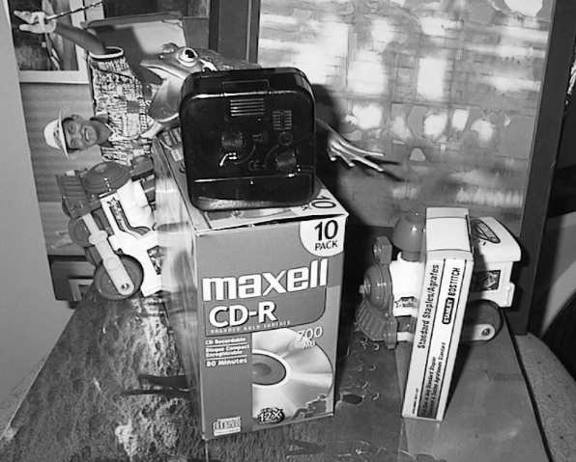
Hough transform for object recognition
Suppose our features are scale- and rotation-covariant
  Then a single feature match provides an alignment hypothesis (translation, scale, orientation)
Target image
model
David G. Lowe. “Distinctive image features from scale-invariant keypoints”, IJCV 60 (2), pp. 91-110, 2004.

Slide 58
Hough transform for object recognition
Suppose our features are scale- and rotation-covariant
  Then a single feature match provides an alignment hypothesis (translation, scale, orientation)
  Of course, a hypothesis obtained from a single match is unreliable
  Solution: Coarsely quantize the transformation space. Let each match vote for its hypothesis in the quantized space.
model
David G. Lowe. “Distinctive image features from scale-invariant keypoints”, IJCV 60 (2), pp. 91-110, 2004.

Slide 59
Basic algorithm outline
H: 4D-accumulator array
(only 2-d shown here)
Initialize accumulator H
to all zeros
For each tentative match
compute transformation
hypothesis: tx, ty, s, θ
H(tx,ty,s,θ) = H(tx,ty,s,θ) + 1
end
end
Find all bins (tx,ty,s,θ) where H(tx,ty,s,θ) has at least three votes
Correct matches will consistently vote for the same transformation while mismatches will spread votes.
Cost: Linear scan through the matches (step 2), followed by a linear scan through the accumulator (step 3).
tx
ty

Slide 60
Hough transform details (D. Lowe’s system)
Training phase: For each model feature, record 2D location, scale, and orientation of model (relative to normalized feature frame)
Test phase: Let each match between a test and a model feature vote in a 4D Hough space
  Use broad bin sizes of 30 degrees for orientation, a factor of 2 for scale, and 0.25 times image size for location
  Vote for two closest bins in each dimension
Find all bins with at least three votes and perform geometric verification
  Estimate least squares affine transformation
  Use stricter thresholds on transformation residual
  Search for additional features that agree with the alignment

Slide 61
Hough transform in object recognition (references)
P.V.C. Hough, Machine Analysis of Bubble Chamber Pictures, Proc. Int. Conf. High Energy Accelerators and Instrumentation, 1959
D. Lowe, “Distinctive image features from scale-invariant keypoints”, IJCV 60 (2), 2004.
H. Jegou, M. Douze, C. Schmid, Hamming embedding and weak geometric consistency for large scale image search, ECCV’2008
Extensions (object category detection):
B. Leibe, A. Leonardis, and B. Schiele., Combined Object Categorization and Segmentation with an Implicit Shape Model, in ECCV'04 Workshop on Statistical Learning in Computer Vision, Prague, May 2004.
S. Maji and J. Malik, Object Detection Using a Max-Margin Hough Tranform, CVPR’2009
Lehmann, B. Leibe, L. Van Gool. Fast PRISM: Branch and Bound Hough Transform for Object Class Detection, IJCV (to appear), 2010.
O. Barinova, V. Lempitsky, P. Kohli, On the Detection of Multiple Object Instances using Hough Transforms, CVPR, 2010

Slide 62
Comparison
Hough Transform
Advantages
  Can handle high percentage of outliers (>95%)
  Extracts groupings from clutter in linear time
Disadvantages
  Quantization issues
  Only practical for small number of dimensions (up to 4)
Improvements available
  Probabilistic Extensions
  Continuous Voting Space
  Can be generalized to arbitrary shapes and objects
RANSAC
Advantages
  General method suited to large range of problems
  Easy to implement
  “Independent” of number of dimensions
Disadvantages
  Basic version only handles moderate number of outliers (<50%)
Many variants available, e.g.
  PROSAC: Progressive RANSAC [Chum05]
  Preemptive RANSAC [Nister05]
[Leibe08]

Slide 63
Outline – the rest of the lecture
Part 1.
Correspondence
Semi-local and global geometric relations
Robust estimation – RANSAC and Hough Transform
Part 2.
Approximate nearest neighbour matching
Bag-of-visual-words representation
Efficient visual search and extensions
Applications

