Slide 1
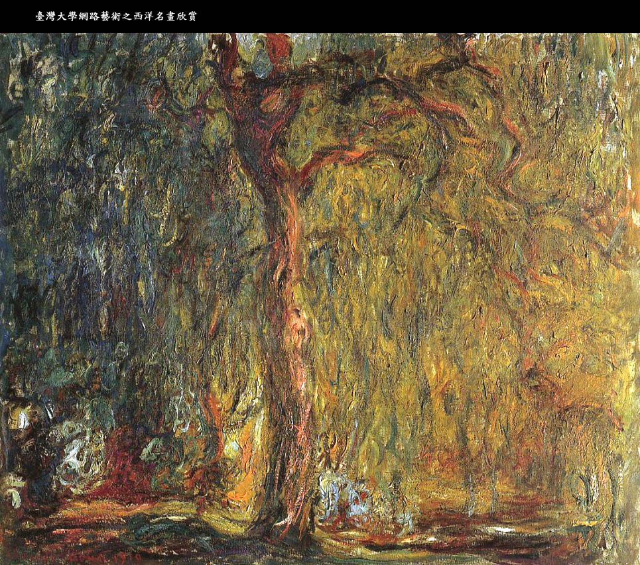

Slide 2
Reconnaissance d’objets
et vision artificielle
Josef Sivic (josef.sivic@ens.fr)
http://www.di.ens.fr/~josef
INRIA - Equipe-projet WILLOW
ENS/INRIA/CNRS UMR 8548
Laboratoire d’Informatique
Ecole Normale Supérieure, Paris

Slide 3
The rest of the class today
Overview of course assignments and the final project (J. Sivic)
Overview of research at WILLOW and internship possibilities (I. Laptev)

Slide 4
Course assignments
http://www.di.ens.fr/willow/teaching/recvis10/

Slide 5
Course assignments
http://www.di.ens.fr/willow/teaching/recvis10/

Slide 6
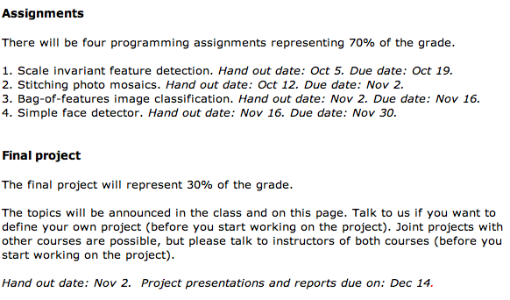

Slide 7
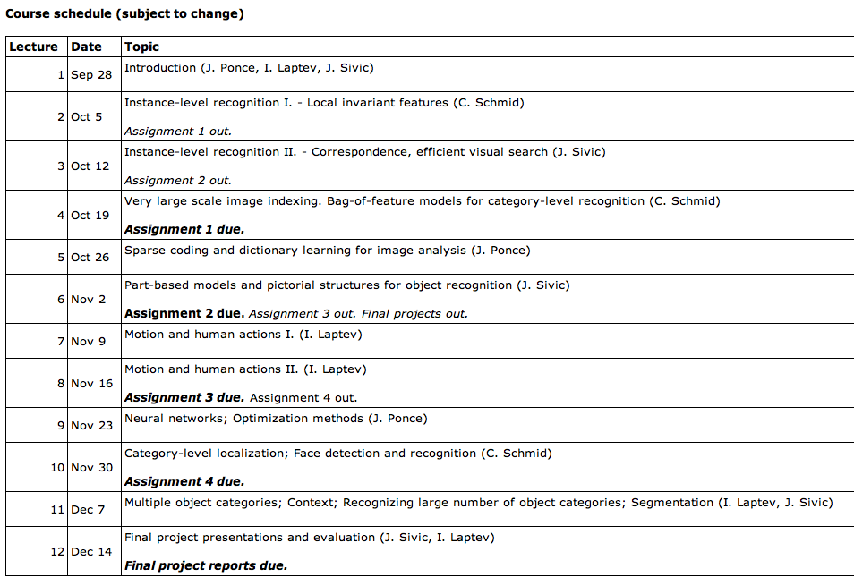

Slide 8
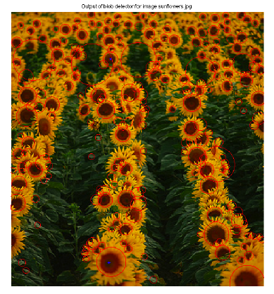
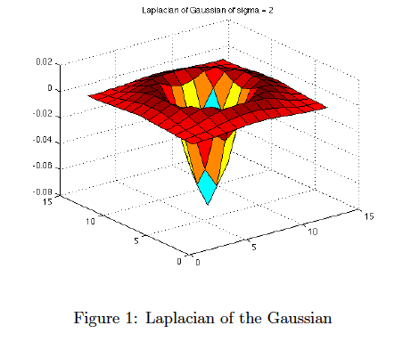
A1: Scale-invariant feature detection

Slide 9
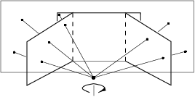
A2: Stitching photo mosaics
The goal of the assignment is to automatically stitch images acquired by a panning camera into a mosaic.

Slide 10
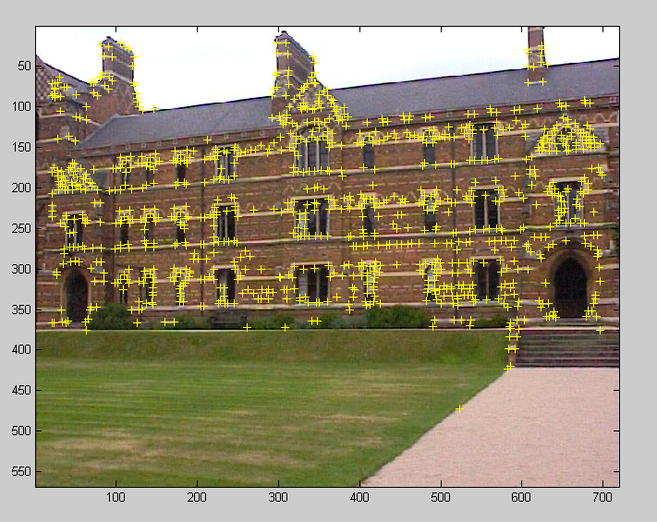
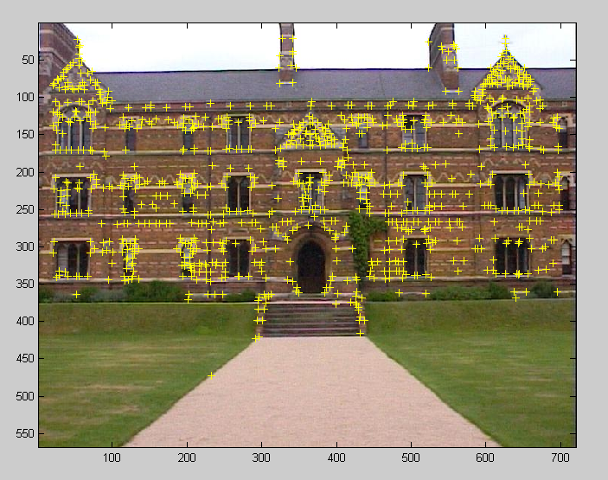
A2: Stitching photo mosaics
1. Detect feature points (Assignment 1)
2. Match feature points and estimate planar homography between images
3. Warp and composite images into a common reference frame

Slide 11
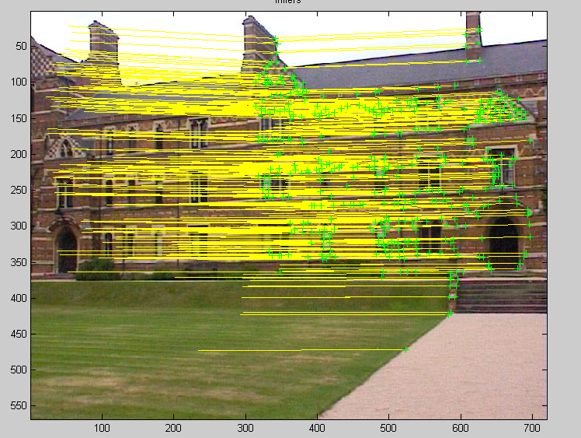
A2: Stitching photo mosaics
1. Detect feature points (Assignment 1)
2. Match feature points and estimate planar homography between images
3. Warp and composite images into a common reference frame

Slide 12
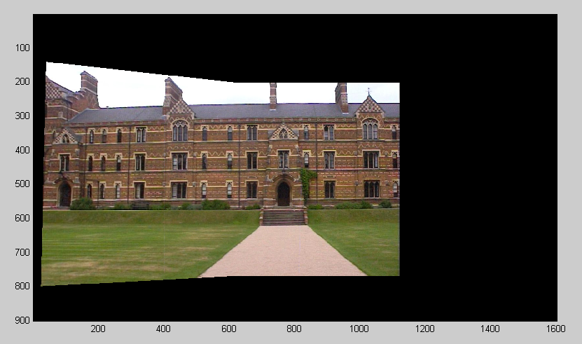
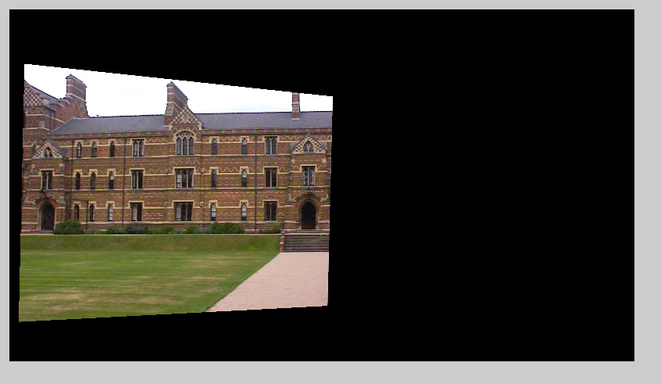
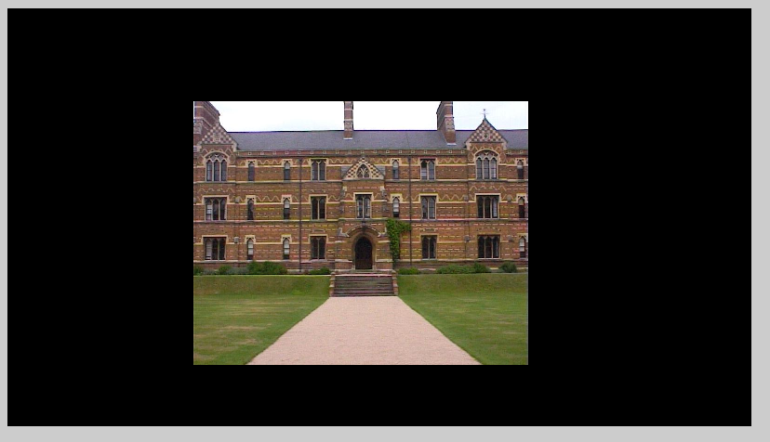
A2: Stitching photo mosaics
1. Detect feature points (Assignment 1)
2. Match feature points and estimate planar homography between images
3. Warp and composite images into a common reference frame

Slide 13
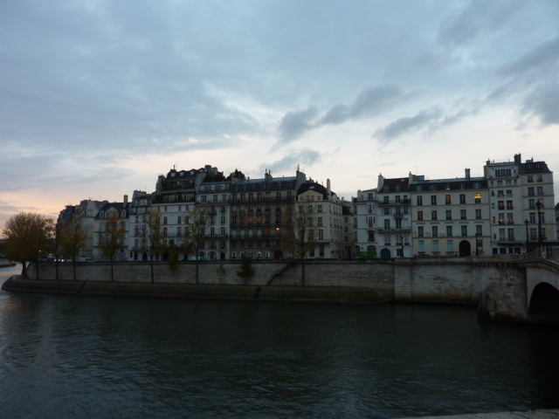
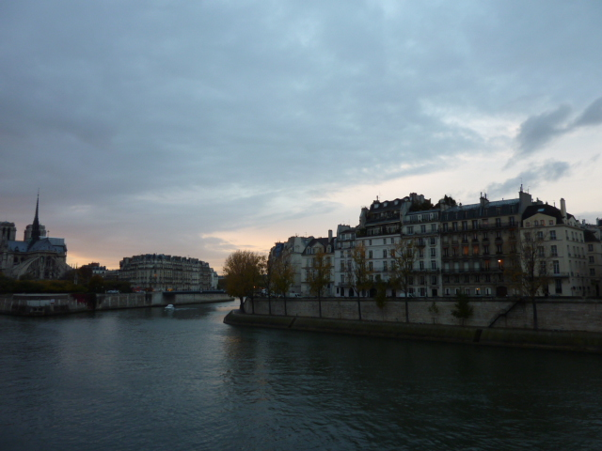
A2: Stitching photo mosaics
Stitch your own images!
Images courtesy: Jose Lezama

Slide 14
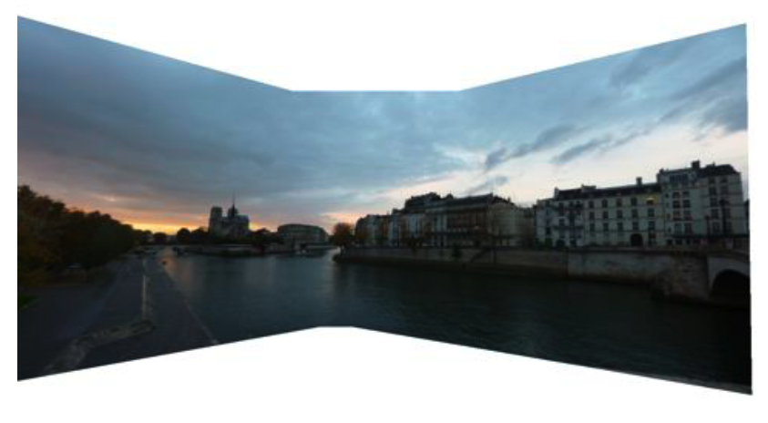
A2: Stitching photo mosaics
Stitch your own images!
Images courtesy: Jose Lezama

Slide 15
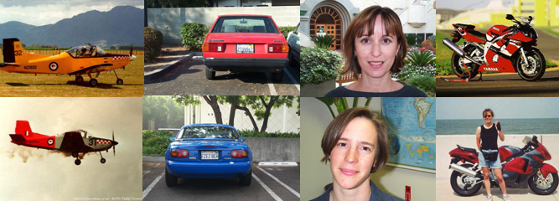
A3: Bag-of-features image classification
The goal of this assignment is to implement a category-level image classifier to perform four-class image classification into “airplanes”, “motorbikes”, “faces” and “cars” categories.
Training and test images will be provided.
The goal is to achieve at least 90% accuracy and compare performance with a baseline image representation.
Training images
Test images

Slide 16
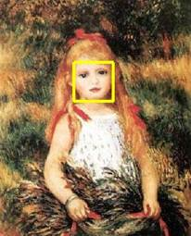
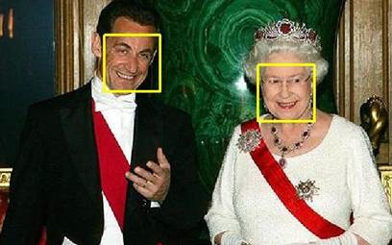
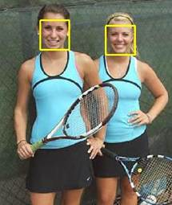
A4: Simple face detector
You will develop a simple “window-scanning” face detector and analyze its performance on real images.
The detector will be based on a linear Support Vector Machine classifier.
Training and test images will be provided.

Slide 17
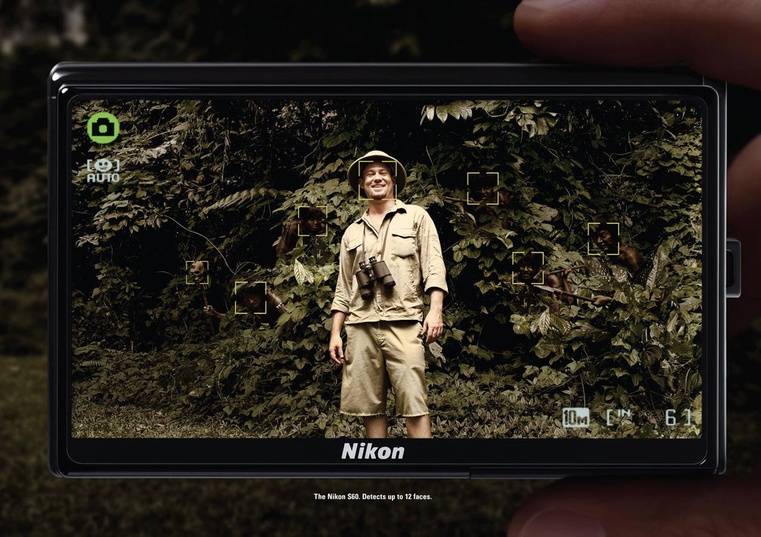

Slide 18
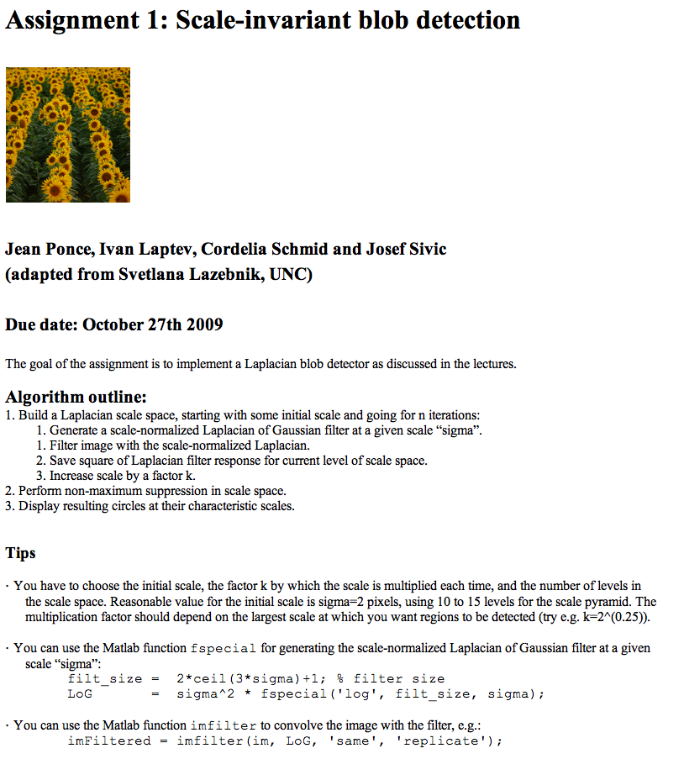
Assignments
Assignments will be implemented in Matlab
We provide a comprehensive starting package including (1) detailed instructions, (2) usually some starting code and (3) datasets for each assignment.

Slide 20
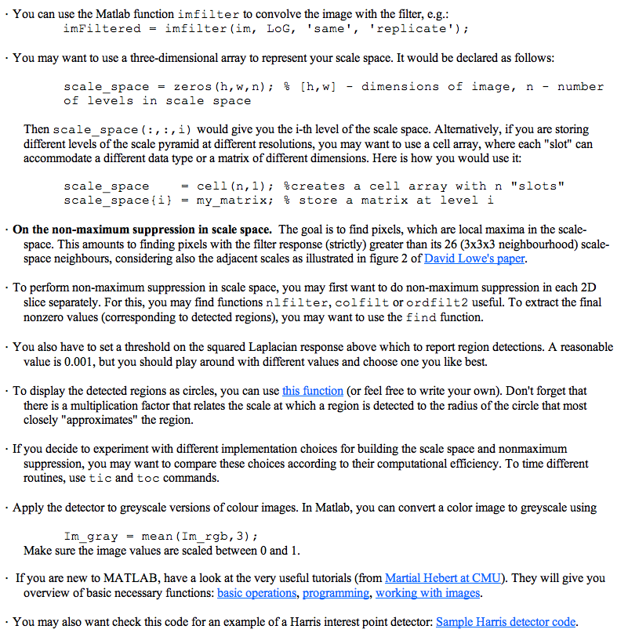

Slide 21
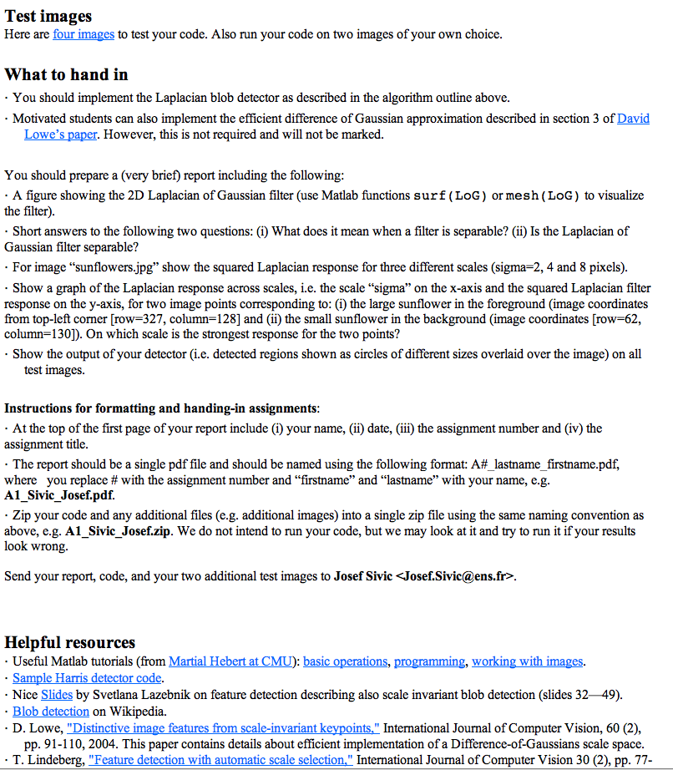

Slide 23
Final projects
The final project will represent 30% of the grade.
The topics will be announced in the class and on the course page.
Talk to us if you want to define your own project (before you start working on the project).
Joint projects with other courses are possible, but please talk to instructors of
both courses (before you start working on the project).
You are encouraged to work alone but you can also form groups of two or three people. Each group will submit a single final report. Reports will be in a standard conference format submission and max 3 pages long.
Hand out date: Nov 2.
Project presentations (~10mins per group) and reports due on: Dec 14.

Slide 24
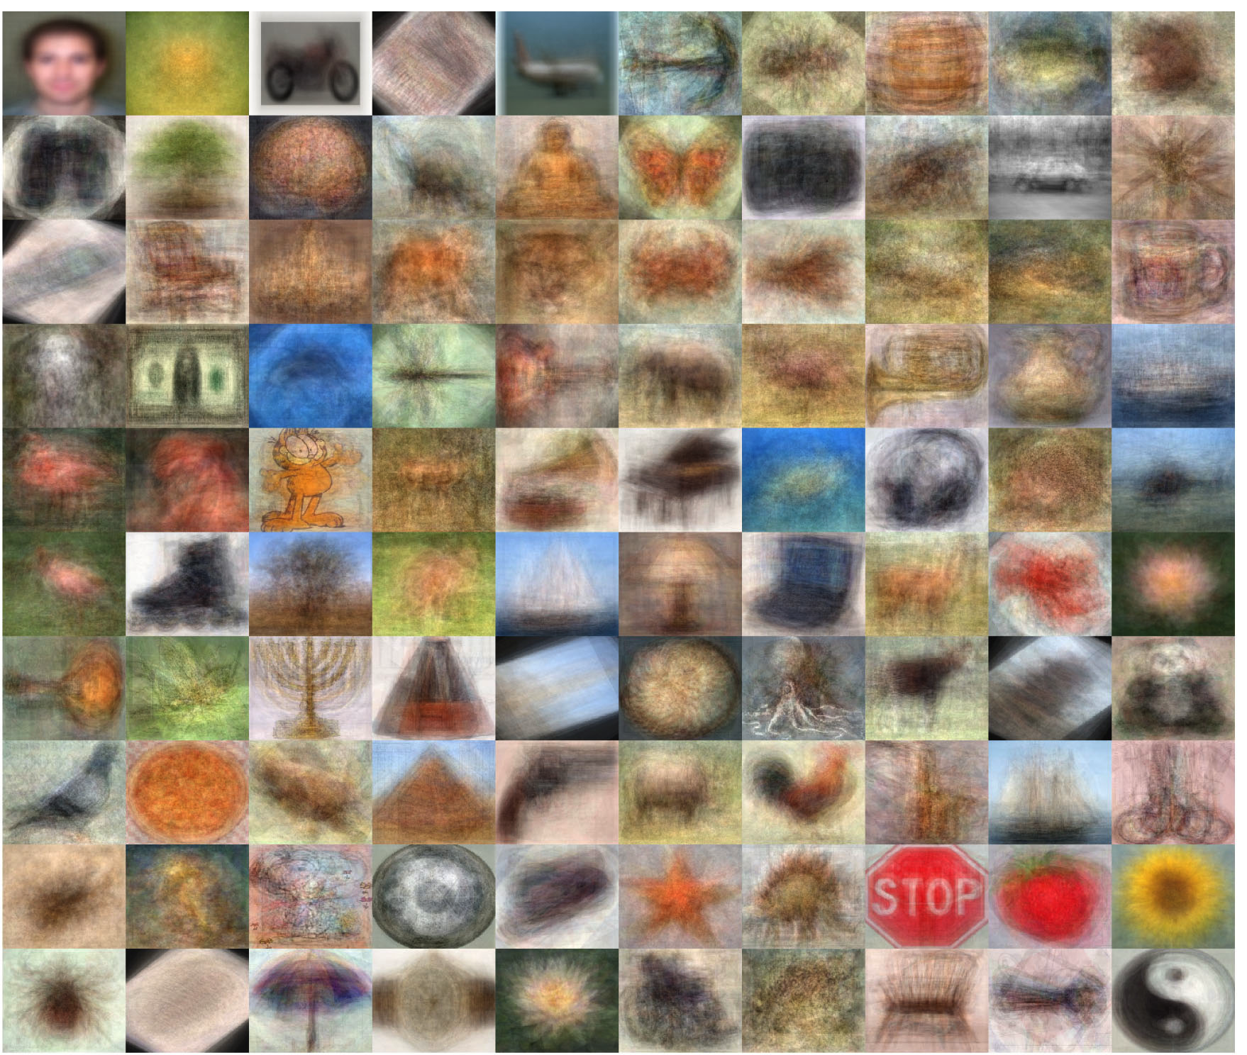
Final projects
Two suggested topics building on assignments 3 and 4:
1. Image classification of 100 object classes.

Slide 25
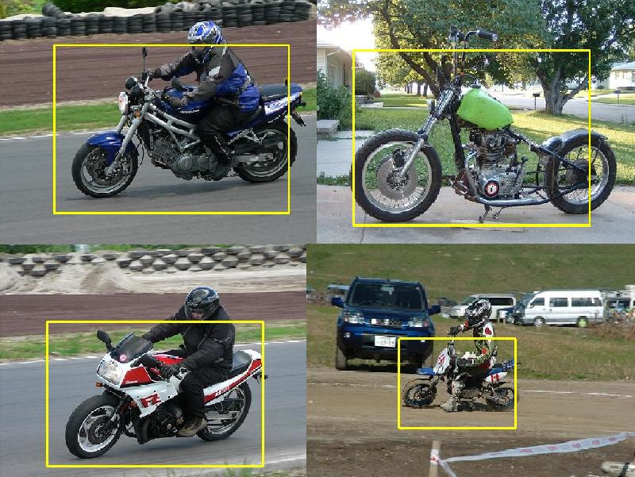
Final projects
Two suggested topics building on assignments 3 and 4:
2. Object detection and localization

Slide 26
Any questions?

Slide 27
