Slide 1
Instance-level recognition III.
Visual search: extensions and applications
Reconnaissance d’objets et vision artificielle 2010
Josef Sivic
http://www.di.ens.fr/~josef
INRIA, WILLOW, ENS/INRIA/CNRS UMR 8548
Laboratoire d’Informatique, Ecole Normale Supérieure, Paris
With slides from: O. Chum, K. Grauman, S. Lazebnik, B. Leibe, D. Lowe, J. Philbin, J. Ponce, D. Nister, C. Schmid, N. Snavely, A. Zisserman

Slide 2
Announcements
Class web-page:
http://www.di.ens.fr/willow/teaching/recvis10/
Email list: Please add your name and email.
Assignment 1 deadline was extended to
Next Tuesday, Nov 2nd 2010!
Assignment 2: Stitching photo-mosaics
http://www.di.ens.fr/willow/teaching/recvis10/assignment2/
is due next Tuesday, Nov 2nd 2010

Slide 3
Lecture plan
Lecture 2:
Local invariant features (C.Schmid)
Lecture 3:
Camera geometry – review (J. Ponce)
Correspondence, matching and recognition with local features, efficient visual search (J. Sivic)
Lecture 4: (C. Schmid):
Very large scale visual indexing
Bag-of-feature models for category-level recognition
Lecture 5 (today):
Sparse coding and dictionary learning (J. Ponce)
Visual search – extensions and applications (J. Sivic)
Category-level localization (J. Sivic)

Slide 4
1. Review: Large-scale recognition with local features

Slide 5
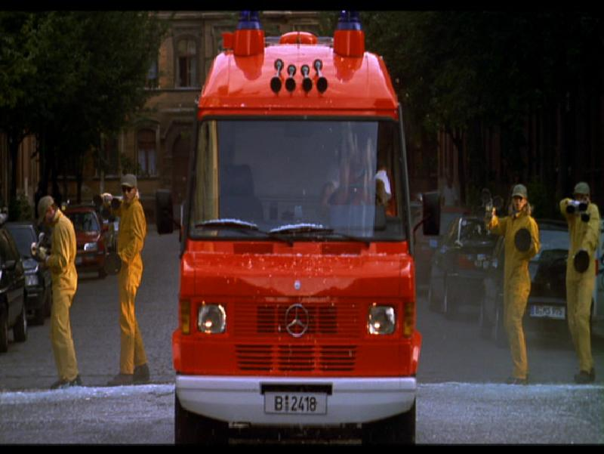
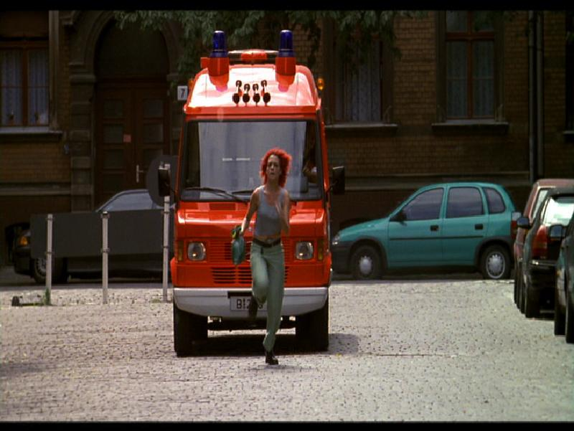
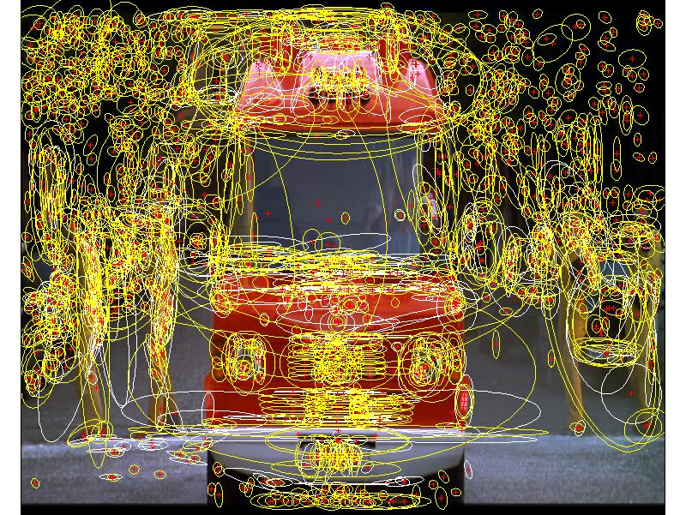
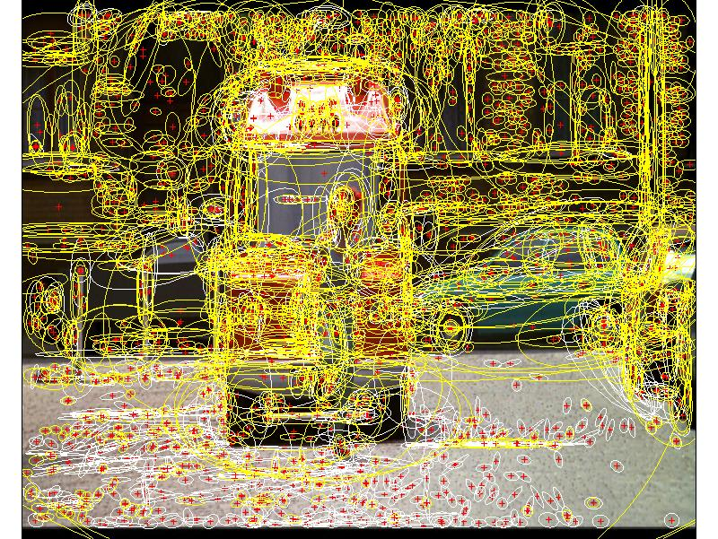
Review: recognition with local features
1000+ descriptors per image

Slide 6
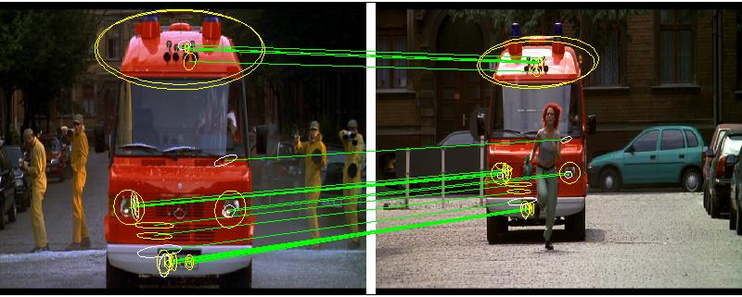
Match regions between frames using SIFT descriptors and spatial consistency
Multiple regions overcome problem of partial occlusion

Slide 7
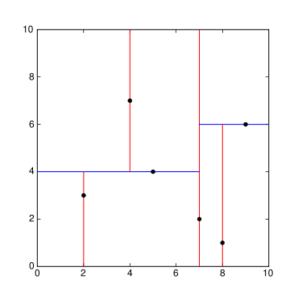
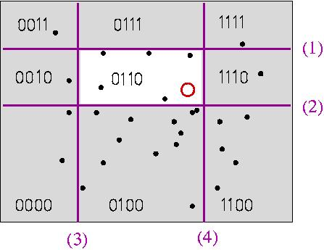
Fast descriptor search
Complexity
  O(nd) for n features and d dimensions
  Linear in the number of features / images
Speed up individual descriptor vector search
  kd-trees (k dim. tree), approximate nearest neighbor search
  K-means tree
  Locality sensitive hashing (LSH)
kd-tree decomposition
K-means tree
Locality sensitive hashing (LSH)

Slide 8
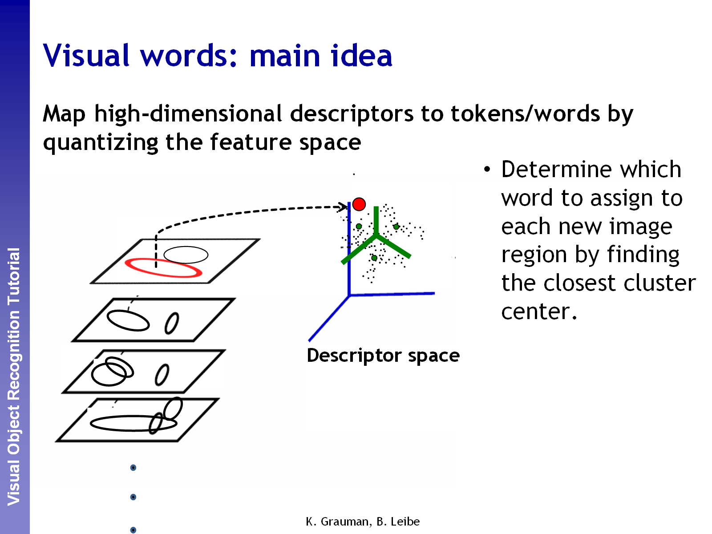

Slide 9
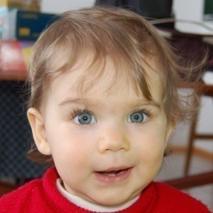
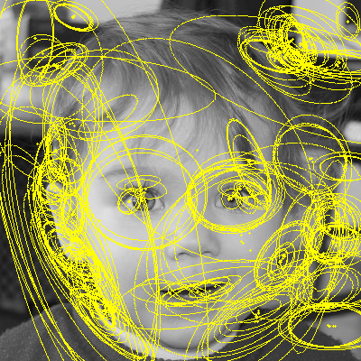
Bag-of-features / Bag-of-visual-words [Sivic&Zisserman’03]
Query
image
Set of SIFT
descriptors
centroids
(visual words)
sparse frequency vector
Harris-Hessian-Laplace
regions + SIFT descriptors
Bag-of-features
processing
+tf-idf weighting
“visual words”:
  1 “word” (index) per local descriptor
  only images ids in inverted file
  => 8 GB fits!
Inverted
file
querying
Re-ranked
list
Geometric
verification
ranked image
short-list
[Chum & al. 2007]

Slide 10
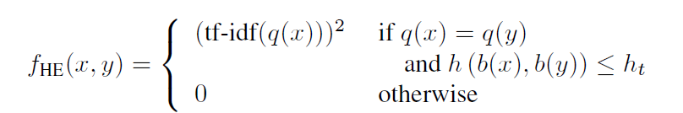
Beyond visual words: Hamming Embedding
[Jegou et al. ECCV’08]
Representation of a descriptor x
  Vector-quantized to q(x) as in standard BOF
  + short binary vector b(x) for an additional localization in the Voronoi cell
Two descriptors x and y match iff
where h(a,b) Hamming distance

Slide 11
Recent approaches for very large scale indexing
centroids
(visual words)
Query
image
Set of SIFT
descriptors
sparse frequency vector
Hessian-Affine
regions + SIFT descriptors
Bag-of-features
processing
+tf-idf weighting
Vector
compression
Vector
search
Re-ranked
list
Geometric
verification
ranked image
short-list

Slide 12
VLAD : vector of locally aggregated descriptors
Simplification of Fisher kernels
Learning: a vector quantizer (k-means)
  output: k centroids (visual words): c₁,…,c_{i},…c_{k}
  centroid c_{i} has dimension d
For a given image
  assign each descriptor to closest center c_{i}
  accumulate (sum) descriptors per cell
v_{i} := v_{i} + (x - c_{i})
VLAD (dimension D = k x d)
The vector is L2-normalized
x
c_{i}

Slide 13
Visual search using local regions (references)
C. Schmid, R. Mohr, Local Greyvalue Invariants for Image Retrieval, PAMI, 1997
J. Sivic, A. Zisserman, Text retrieval approach to object matching in videos, ICCV, 2003
D. Nister, H. Stewenius, Scalable Recognition with a Vocabulary Tree, CVPR, 2006.
J. Philbin, O. Chum, M. Isard, J. Sivic, A. Zisserman, Object retrieval with large vocabularies and fast spatial matching, CVPR, 2007
O. Chum, J. Philbin, M. Isard, J. Sivic, A. Zisserman, Total Recall: Automatic Query Expansion with a Generative Feature Model for Object Retrieval, ICCV, 2007
H. Jegou, M. Douze, C. Schmid, Hamming embedding and weak geometric consistency for large scale image search, ECCV’2008
O. Chum, M. Perdoch, J. Matas: Geometric min-Hashing: Finding a (Thick) Needle in a Haystack, CVPR 2009
H. Jégou, M. Douze and C. Schmid, On the burstiness of visual elements, CVPR, 2009
H. Jégou, M. Douze, C. Schmid and P. Pérez, Aggregating local descriptors into a compact image representation, CVPR’2010

Slide 14
Efficient visual search for objects and places
Oxford Buildings Search - demo
http://www.robots.ox.ac.uk/~vgg/research/oxbuildings/index.html

Slide 15
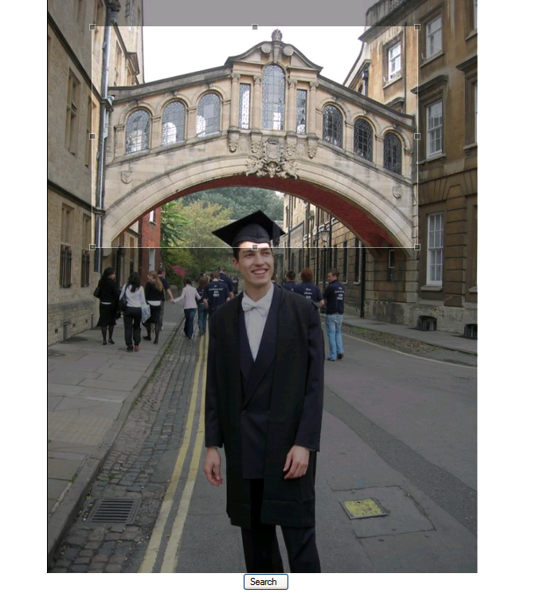
Example

Slide 16
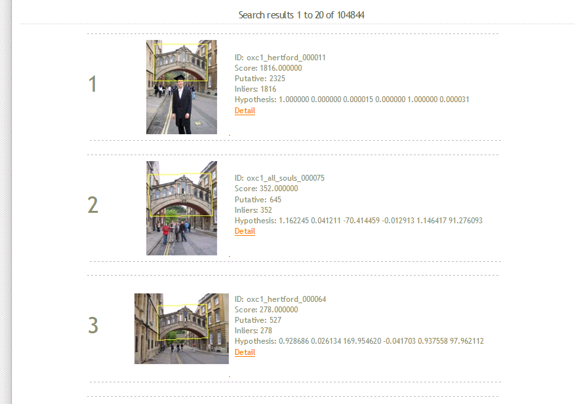

Slide 17
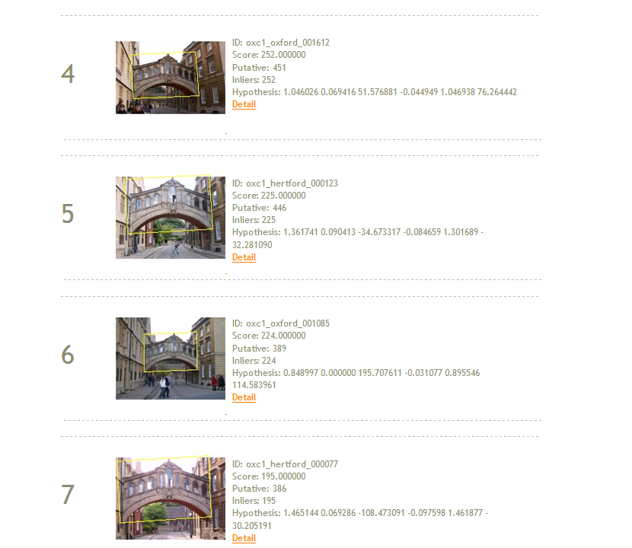

Slide 18
2. Visual search - extensions
Query expansion
Pre-computing matching graph
Overcoming quantization errors
Retrieval in structured databases

Slide 19
Query Expansion in text
In text :
  Reissue top n responses as queries
  Pseudo/blind relevance feedback
  Danger of topic drift
In vision:
  Reissue spatially verified image regions as queries

Slide 20
Query Expansion: Text
Original query: Hubble Telescope Achievements
Query expansion: Select top 20 terms from top 20 documents according to tf-idf
Added terms:
Telescope, hubble, space, nasa, ultraviolet, shuttle, mirror, telescopes, earth, discovery, orbit, flaw, scientists, launch, stars, universe, mirrors, light, optical, species
Example from: Jimmy Lin, University of Maryland

Slide 21
Automatic query expansion
Visual word representations of two images of the same object may differ (due to e.g. detection/quantization noise) resulting in missed returns
Initial returns may be used to add new relevant visual words to the query
Strong spatial model prevents ‘drift’ by discarding false positives
[Chum, Philbin, Sivic, Isard, Zisserman, ICCV’07]

Slide 22
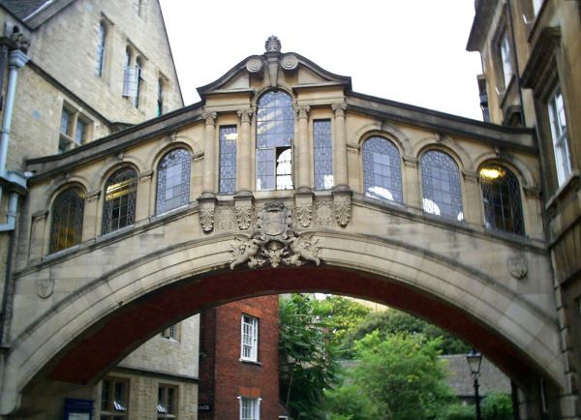
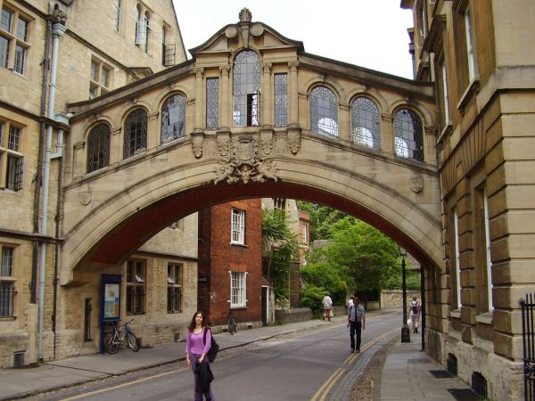
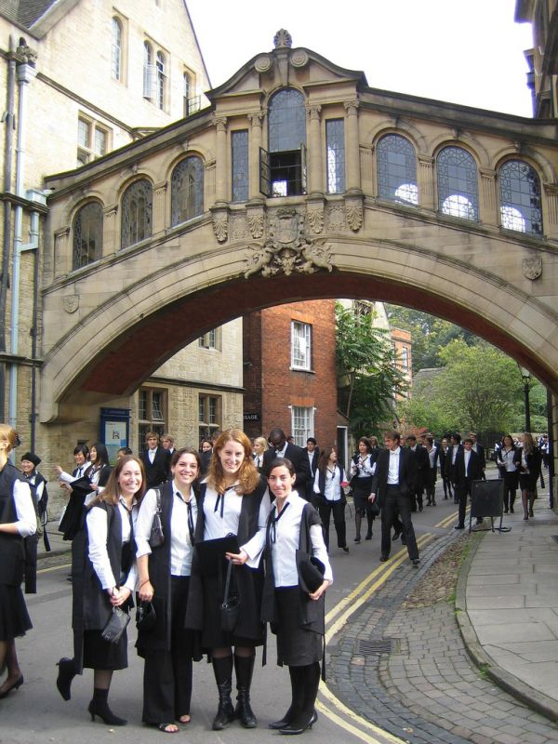
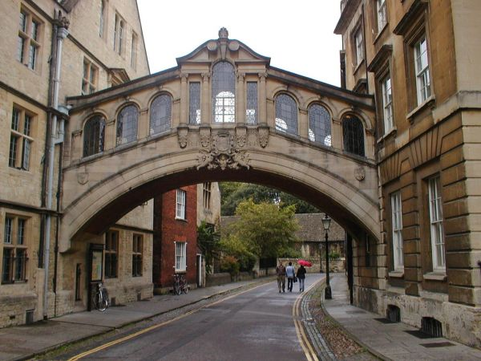
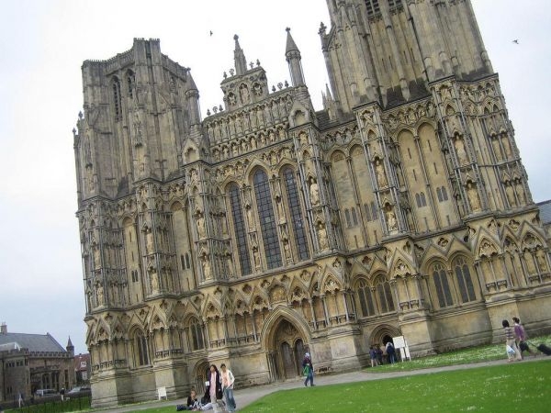
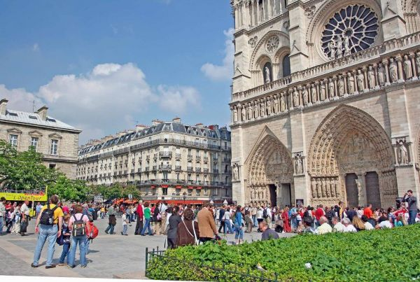
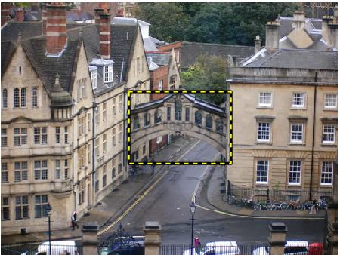
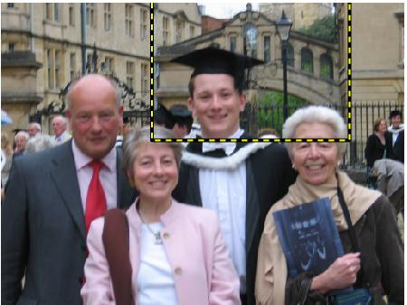
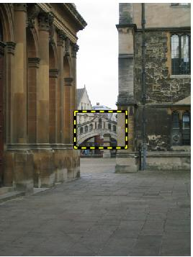
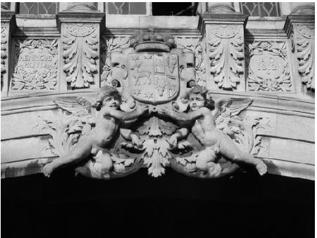
Visual query expansion - overview
1. Original query
2. Initial retrieval set
…
3. Spatial verification
4. New enhanced query
5. Additional retrieved images

Slide 23
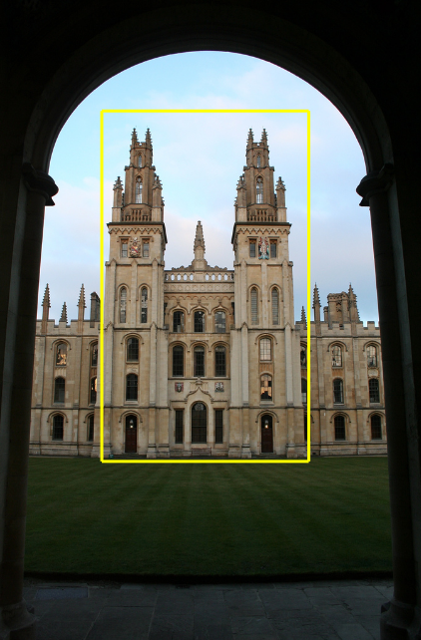
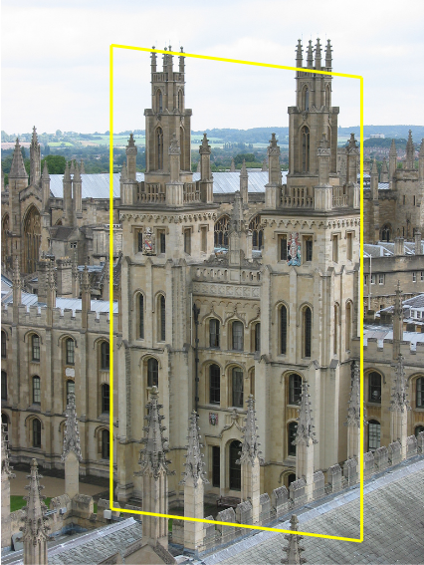
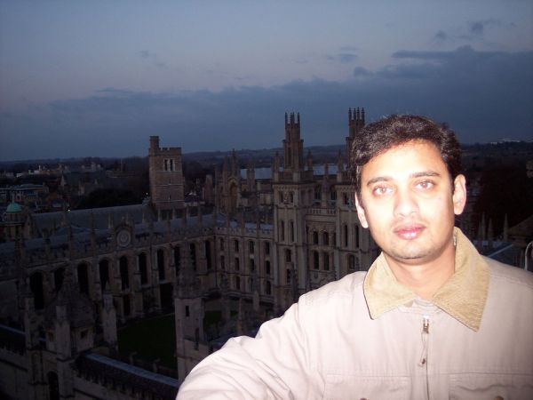
Query Expansion
Query Image
Originally retrieved image
Originally not retrieved

Slide 24
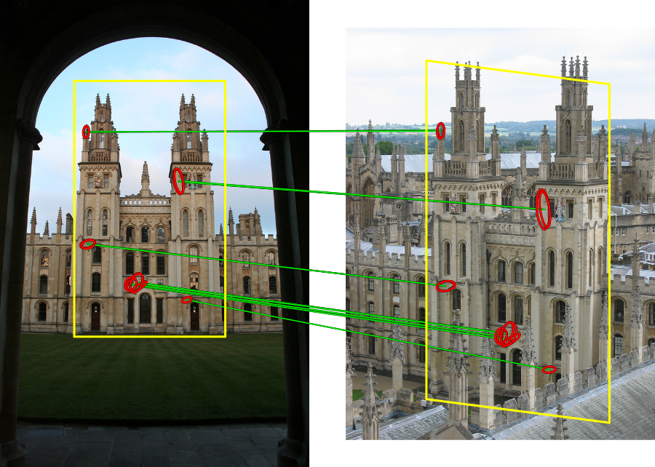
Query Expansion

Slide 25
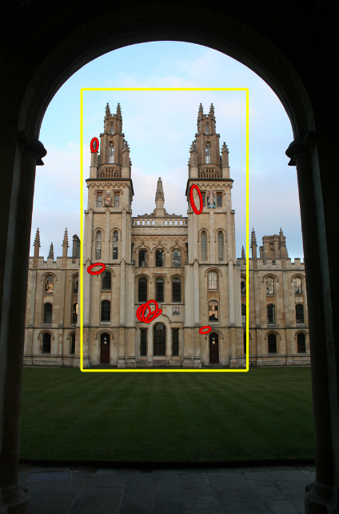
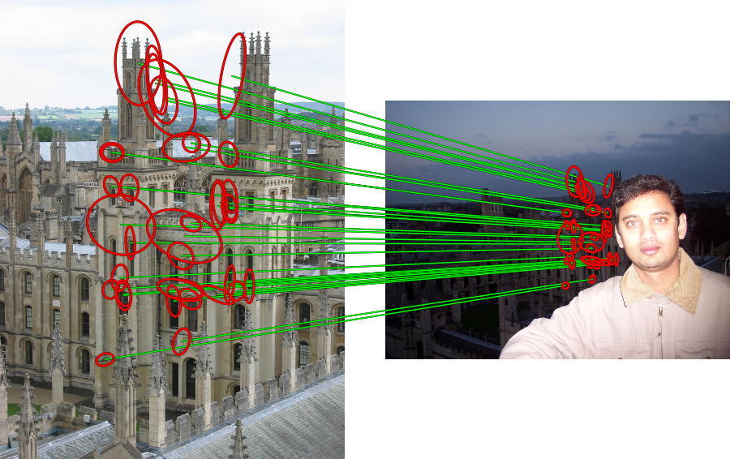
Query Expansion

Slide 26
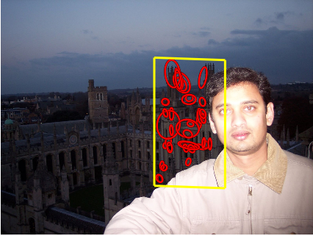
Query Expansion

Slide 27
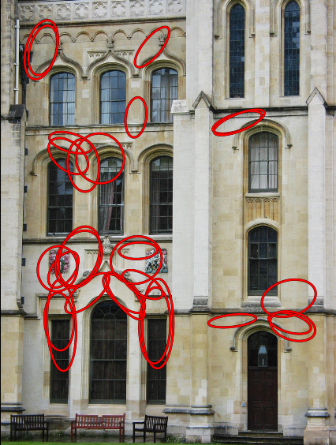
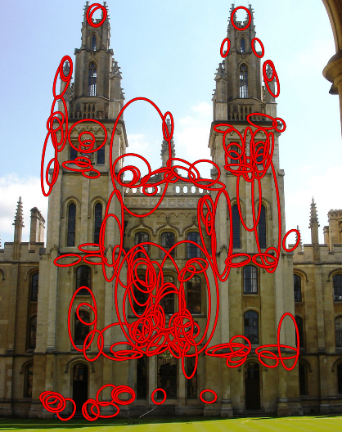
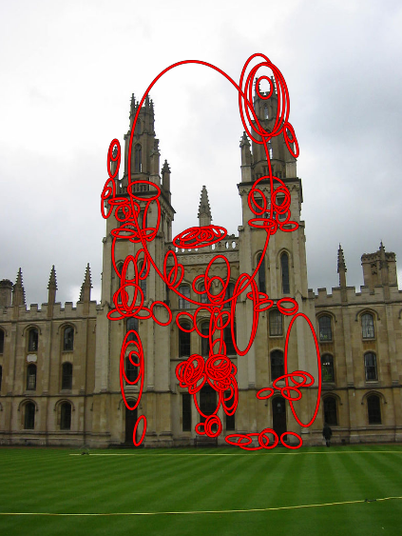
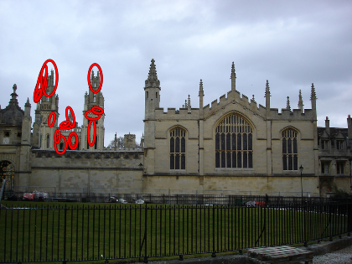
Query Expansion
Query Image
Spatially verified retrievals with matching regions overlaid
…
New expanded query
New expanded query is formed as
  the average of visual word vectors of spatially verified returns
  only inliers are considered
  regions are back-projected to the original query image

Slide 28
Efficient visual search for objects and places
Oxford Buildings Search - demo
http://www.robots.ox.ac.uk/~vgg/research/oxbuildings/index.html

Slide 29
Query Expansion
Query image
Originally retrieved
Retrieved only
after expansion

Slide 30
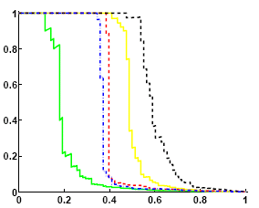
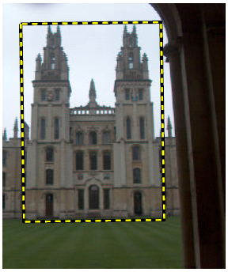
Original results (good)
Prec.
Query
image
Rec.
Expanded results (better)
Prec.
Rec.

Slide 31
Pre-compute query expansion?
Query expansion works well, however, at an additional cost at the query time.
Can we offline pre-process the database and pre-compute the query expansion?
Solution: Compute and build a matching graph.

Slide 32
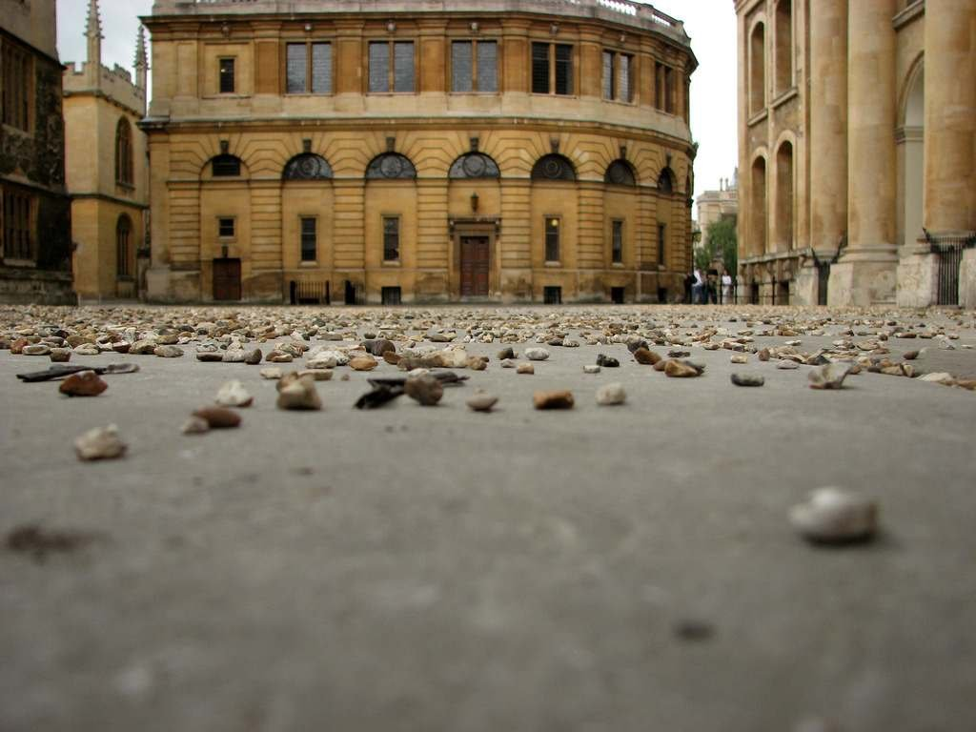
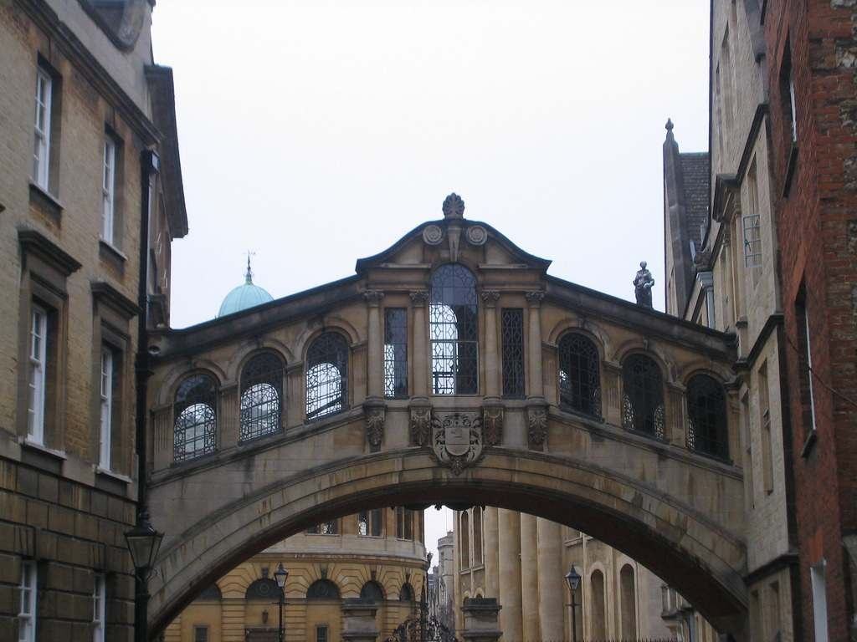
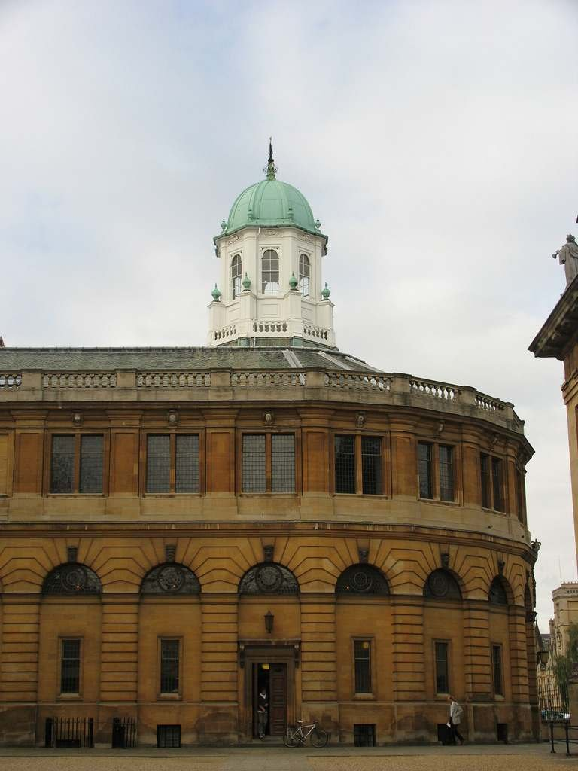
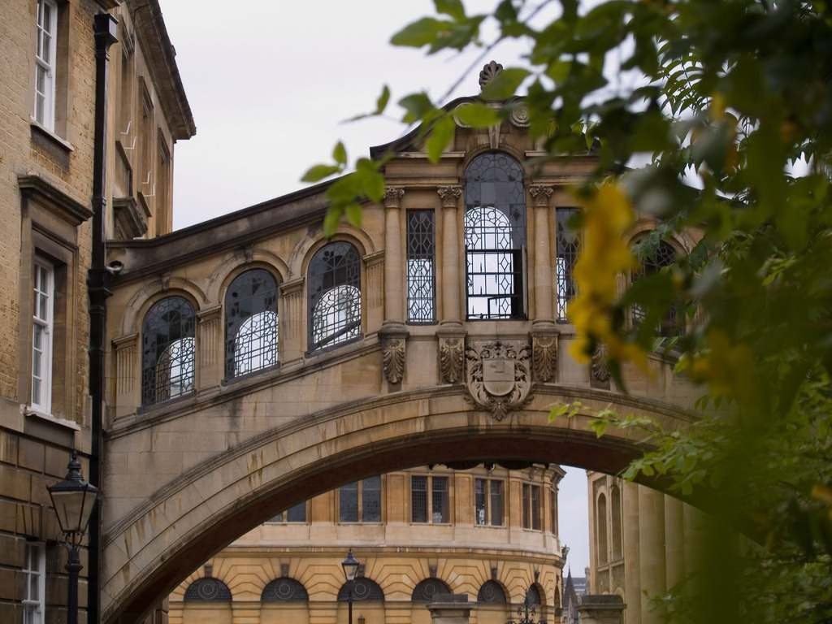
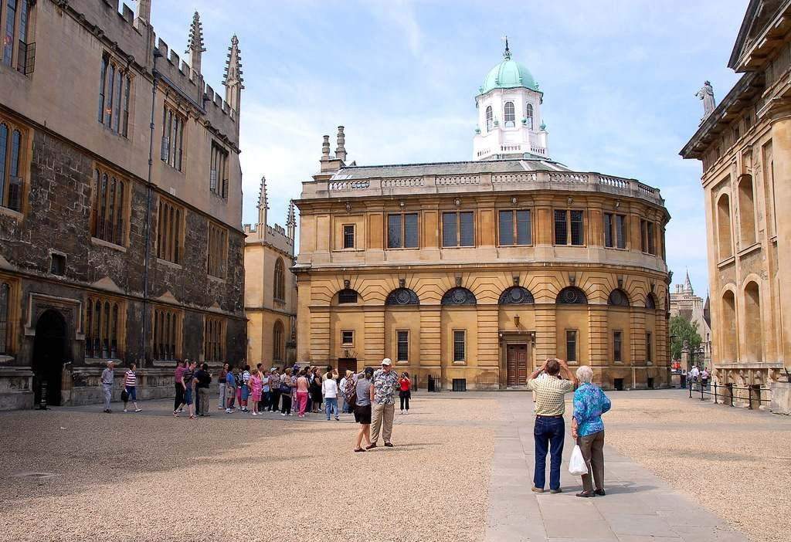
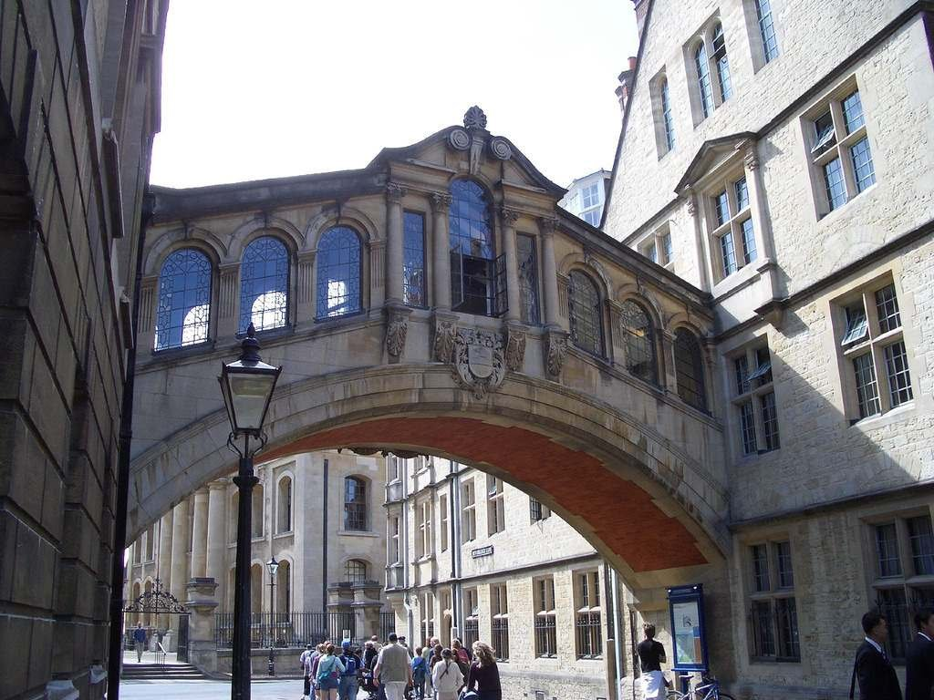
Matching graph
Build a ‘matching graph’ over all the images in the dataset
Each image is a node and a link represents two images having some object in common
Instead of expanding the query, traverse links of this graph
[Chum et al. 2008, Philbin et al. IJCV 2010, Turcot and Lowe 2009]

Slide 33
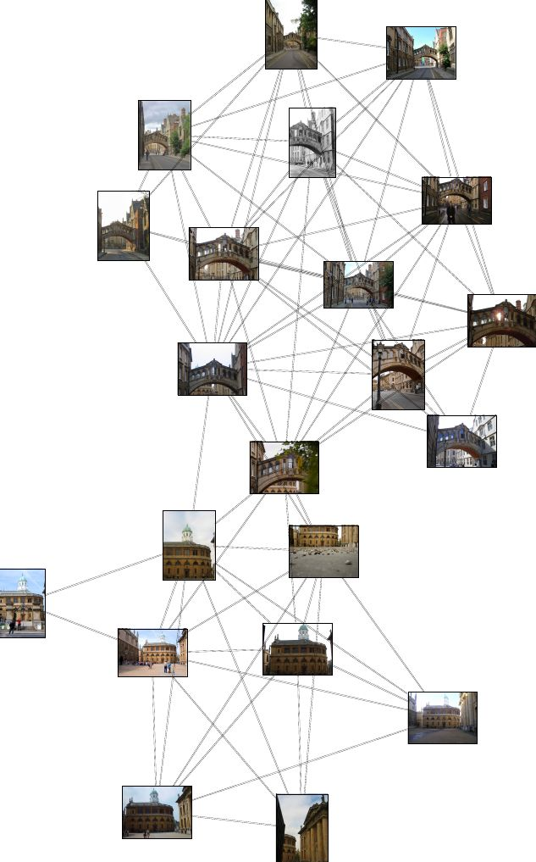
Example:

Slide 34



Quantization errors
Typically, quantization has a significant impact on the final performance of the system [Sivic03,Nister06,Philbin07]
Quantization errors split features that should be grouped together and confuse features that should be separated
Voronoi
cells

Slide 35
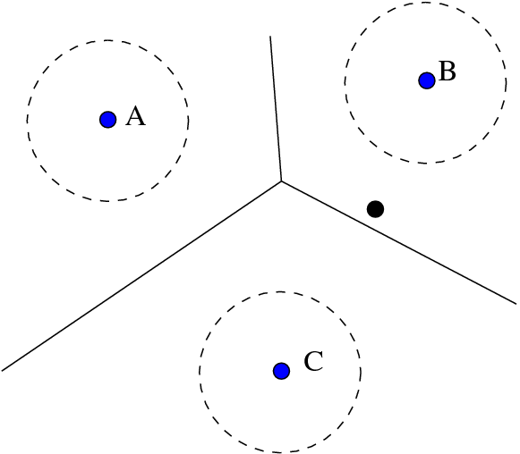
Overcoming quantization errors
Query expansion. [Chum et al. 2007]
Soft-assignment. [Philbin et al. 2008]
Hamming embedding / VLAD [Jegou&Schmid ’08, ‘10]
B: 1.0
Hard Assignment
A: 0.1
B: 0.5
C: 0.4
Soft Assignment
Overcome errors given a quantization.
Have cost in terms of space and/or time complexity at query-time

Slide 36


Descriptor learning for efficient retrieval
The aim of this work is to reduce these errors at source, by learning a projection function that actively reduces this error:
can be linear or non-linear and we can choose keep the descriptor dimensionality the same or reduce it
After this projection, use the same visual words architecture
[Philbin, Isard, Sivic, Zisserman, ECCV 2010]

Slide 37
Descriptor learning for efficient retrieval
No additional query-time cost over BOW
For particular object retrieval, we can leverage the spatial consistency between object instances to automatically generate large amounts of training data (matched / non matched point pairs)
Confusion and splitting
No confusion or splitting

Slide 38

Descriptor learning for efficient retrieval
Choose form of :
  Can be linear:
  Or non-linear (DBN-style formulation):
Non-linear model gives better results.

Slide 39
Learning
Function is non-linear, non-convex
We can’t expect to find the global optimum
…but this doesn’t mean we shouldn’t use non-convex models!
We use pseudo-second order method called Stochastic Meta Descent (SMD) [Bray04]
Can fully train over 3M point pairs (50 epochs) in ~24 hours on one machine

Slide 40
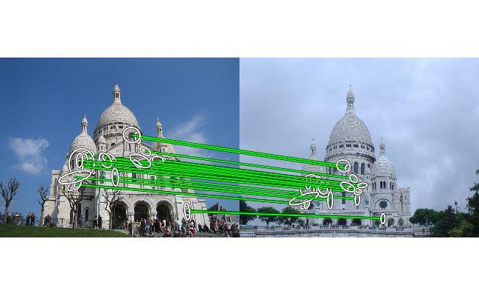
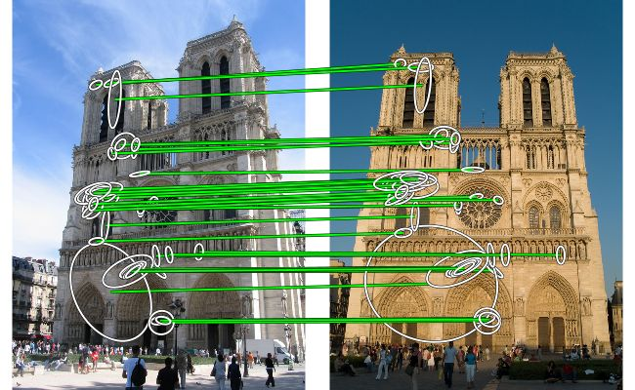
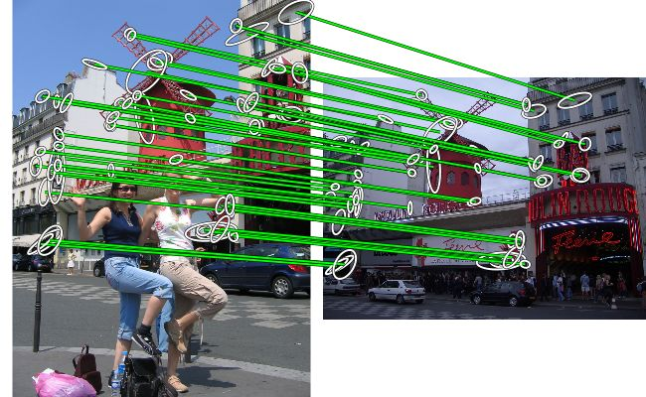
Results: Spatial Verification
26 inliers
38 inliers
49 inliers
Quantized 128-D SIFT descriptors (K=1M)

Slide 41
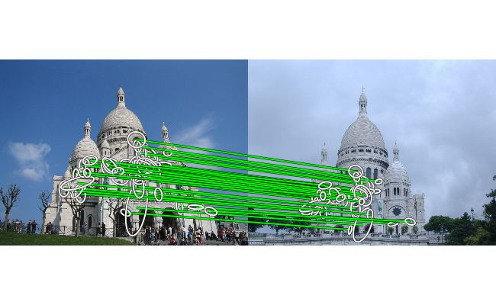
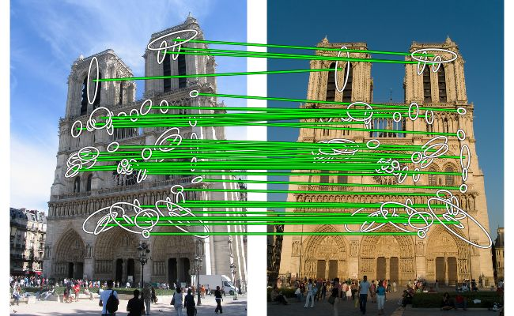

Results: Spatial Verification
26 inliers
48 inliers
38 inliers
61 inliers
49 inliers
114 inliers
Quantized 128-D SIFT descriptors (K=1M)
Raw 128-D SIFT

Slide 42



Results: Spatial Verification
26 inliers
37 inliers
48 inliers
38 inliers
56 inliers
61 inliers
49 inliers
64 inliers
114 inliers
Quantized 128-D SIFT descriptors (K=1M)
Quantized 32-D learnt descriptors (K=1M)
Raw 128-D SIFT

Slide 43
Results: Baseline to State of the Art
Mean
Average Precision
1. Baseline Method K = 10K
0.389
2. Large Vocabulary K=1M
0.618
3. Spatial Re-ranking
0.653
4. Soft Assignment (SA)
Learnt descriptors
0.731
0.707
5. Query Expansion (QE)
0.801
6. SA & QE
0.825

Slide 44














Place recognition: retrieval in a structured (on a map) database
Query
Optimized image database
Best match
Image database
Image indexing
with spatial verification
Query Expansion
(Panoramio,
Flickr, … )
Confuser
Suppression
Only negative training data
(from geotags)

Slide 45






Correctly recognized examples
45

Slide 46

More correctly recognized examples

Slide 47

Quantitative evaluation
200 challenging test queries downloaded from Panoramio
~17,000 geotagged images downloaded from Google Street View

Slide 48
Other recent work
Learning a vocabulary to overcome quantization errors
[Mikulik et al. ECCV 2010]
Large scale image clustering [Chum et al. CVPR 2009, Philbin et al. IJCV 2010, Li et al., ECCV 2008]
Very large scale retrieval -- towards 1 billion images
[Jegou et al. CVPR 2010] Last lecture!
Matching in structured datasets (3D landmarks or street-view images)
[Knopp et al. ECCV 2010, Zamir&Shah ECCV 2010, Li et al. ECCV 2010, Baatz et al. ECCV 2010 ]

Slide 49

What objects/scenes local regions do not work on?

Slide 50

What objects/scenes local regions do not work on?
E.g. texture-less objects, objects defined by shape, deformable objects, wiry objects.

Slide 51
3. Example applications of large scale visual search and matching

Slide 52
Sony Aibo (Evolution Robotics)
SIFT usage
  Recognize
  docking station
  Communicate
  with visual cards
Other uses
  Place recognition
  Loop closure in SLAM
52
K. Grauman, B. Leibe
Slide credit: David Lowe

Slide 53



Application: Internet-based inpainting
Photo-editing using images of the same place
[Whyte, Sivic and Zisserman, 2009]

Slide 54


Mobile tourist guide
Aachen Cathedral
Mobile tourist guide
Self-localization
Object/building recognition
Photo/video augmentation
54
[Quack, Leibe, Van Gool, CIVR’08]
B. Leibe

Slide 55

Web Demo: Movie Poster Recognition
50’000 movie
posters indexed
Query-by-image
from mobile phone
available in Switzer-
land
http://www.kooaba.com/en/products_engine.html#
55
K. Grauman, B. Leibe

Slide 56





Image Auto-Annotation
Moulin Rouge
Old Town Square (Prague)
Tour Montparnasse
Colosseum
Viktualienmarkt
Maypole
Left: Wikipedia image
Right: closest match from Flickr
[Quack CIVR’08]
56
K. Grauman, B. Leibe

Slide 57

Visual search in your pocket

Slide 58


Slide 59
Building Rome in a Day – or – matching and 3D reconstruction in large unstructured datasets.
Goal: Build a 3D model of a city from
a large collection of images downloaded from the Internet
Use a cluster with 500 CPU cores.
Building Rome in a Day, Sameer Agarwal, Noah Snavely, Ian Simon, Steven M. Seitz and Richard Szeliski,
International Conference on Computer Vision, 2009
http://grail.cs.washington.edu/rome/

Slide 60




15,464
37,383
76,389
Slide: N. Snavely

Slide 61

Reproduced with permission of Yahoo! Inc. © 2005 by Yahoo! Inc.
YAHOO! and the YAHOO! logo are trademarks of Yahoo! Inc.
Slide: N. Snavely
Notes:
10/26/10
61

Slide 62



Photo Tourism overview
Photo Explorer
Scene reconstruction
Input photographs
Relative camera positions and orientations
Point cloud
Sparse correspondence
Slide: N. Snavely
[Note: change to Trevi for consistency]
Notes:
Our system takes as input an unordered set of photos, either from an Internet search or from a large personal collection. We assume the photos are largely from the same static scene.
The first step of our system is to apply a computer vision techniques to reconstruct the geometry of the scene. The output of this procedure is the relative positions and orientation for the cameras used to take a connected set of the photographs, as well as a point cloud representing the geometry of the scene, and a sparse set of correspondences between the photos.
This information is then loaded into our interactive photo explorer tool.

Slide 63
Photo Tourism overview
Photo Explorer
Scene reconstruction
Input photographs
Slide: N. Snavely
[Note: change to Trevi for consistency]

Slide 64
Scene reconstruction
Automatically estimate
  position, orientation, and focal length of cameras
  3D positions of feature points
Feature detection
Incremental structure from motion
Feature matching
Correspondence estimation
Slide: N. Snavely

Slide 65


Feature detection
Detect features using SIFT [Lowe, IJCV 2004]
Slide: N. Snavely

Slide 66
















Feature detection
Detect features using SIFT [Lowe, IJCV 2004]
Slide: N. Snavely

Slide 67
Feature detection
Detect features using SIFT [Lowe, IJCV 2004]
Slide: N. Snavely

Slide 68

Feature matching
Complexity of matching:
From Agarwal et al. “Building Rome in a Day”, ICCV’09

Slide 69
Feature matching
Obtain candidate pairs of images to match using visual vocabulary matching based on k-means tree
Figure: N. Snavely
Notes:
Next, we match features across each pair of photos using approximate nearest neighbor matching.

Slide 70
Feature matching
Match features between candidate pairs using K-d trees built on SIFT descriptors.
Figure: N. Snavely

Slide 71
Feature matching
Refine matching using RANSAC [Fischler & Bolles 1987] to estimate fundamental matrices between pairs
Slide: N. Snavely
Notes:
The matches are refined by using RANSAC, which is a robust model-fitting technique, to estimate a fundamental matrix between each pair of matching images and keeping only matches consistent with that fundamental matrix.
We then link connected components of pairwise feature matches together to form correspondences across multiple images.
Once we have correspondences, we run structure from motion to recover the camera and scene geometry. Structure from motion solves the following problem:

Slide 72
Structure from motion (R. Keriven’s class)
p₄
p₁
p₃
minimize
p₂
f (R, T, P)
p₅
p₇
p₆
Camera 1
Camera 3
R₁,t₁
R₃,t₃
Camera 2
R₂,t₂
Slide: N. Snavely

Slide 73

Example of the final 3D point cloud and cameras
57,845 downloaded images, 11,868 registered images. This video: 4,619 images.

