Slide 1
Reconnaissance d’objets
et vision artificielle
http://www.di.ens.fr/willow/teaching/recvis09
Lecture 7
A bit more on neural nets
Optimization methods
Part-based object models

Slide 2
Convolutional Nets
Yann LeCun
The Courant Institute of Mathematical Sciences
New York University
http://yann.lecun.com

Slide 3
An Old Idea for Local Shift Invariance
[Hubel & Wiesel 1962]:
  simple cells detect local features
  complex cells “pool” the outputs of simple cells within a retinotopic neighborhood.
“Simple cells”
“Complex cells”
pooling subsampling
Convolutions
Retinotopic Feature Maps

Slide 4
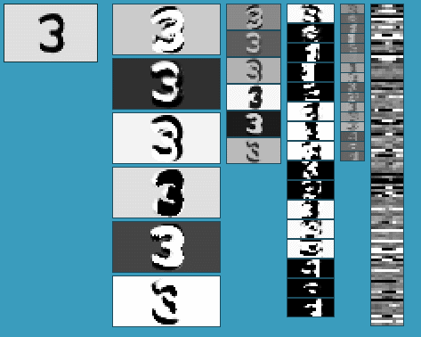
The Multistage Hubel-Wiesel Architecture
Building a complete artificial vision system:
  Stack multiple stages of simple cells / complex cells layers
  Higher stages compute more global, more invariant features
  Stick a classification layer on top
  [Fukushima 1971-1982]
    neocognitron
  [LeCun 1988-2007]
    convolutional net
  [Poggio 2002-2006]
    HMAX
  [Ullman 2002-2006]
    fragment hierarchy
  [Lowe 2006]
    HMAX
QUESTION: How do we find (or learn) the filters?

Slide 5
Convolutional Net Architecture
Layer 3
12@10x10
Layer 5
100@1x1
Layer 1
6@28x28
Layer 2
6@14x14
Layer 4
12@5x5
input
1@32x32
Layer 6: 10
10
5x5
convolution
2x2
pooling/
subsampling
5x5
convolution
2x2
pooling/
subsampling
5x5
convolution
Convolutional net for handwriting recognition (400,000 synapses)‏
Convolutional layers (simple cells): all units in a feature plane share the same weights
Pooling/subsampling layers (complex cells): for invariance to small distortions.
Supervised gradient-descent learning using back-propagation
The entire network is trained end-to-end. All the layers are trained simultaneously.

Slide 6
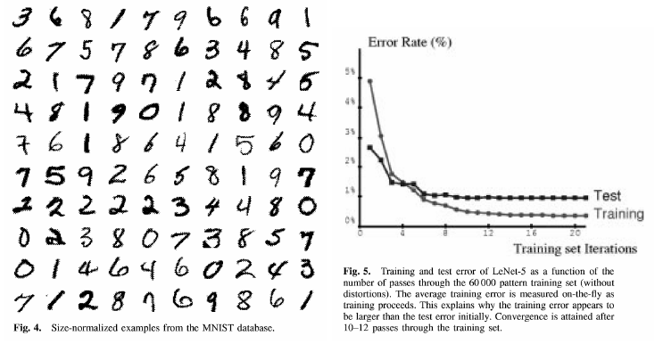
MNIST Handwritten Digit Dataset
Handwritten Digit Dataset MNIST: 60,000 training samples, 10,000 test samples

Slide 7
Results on MNIST Handwritten Digits

Slide 8
Some Results on MNIST (from raw images: no preprocessing)‏
Note: some groups have obtained good results with various amounts of preprocessing
such as deskewing (e.g. 0.56% using an SVM with smart kernels [deCoste and Schoelkopf])‏
hand-designed feature representations (e.g. 0.63% with “shape context” and nearest neighbor [Belongie]

Slide 9
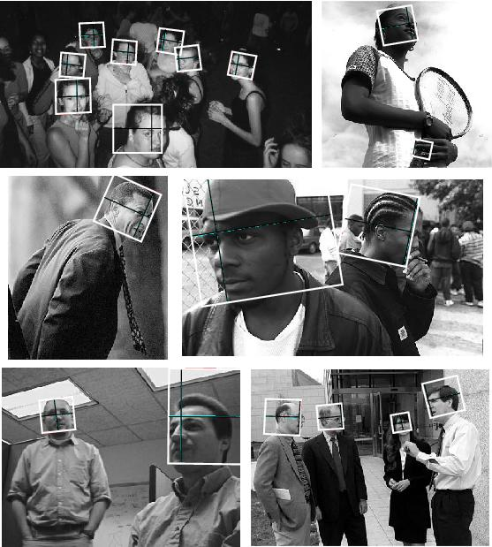
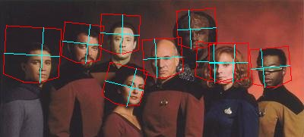
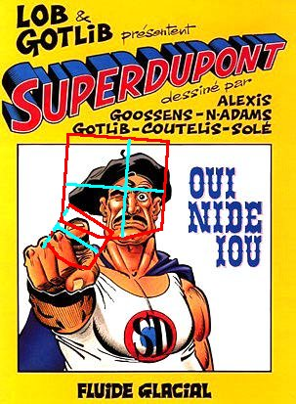
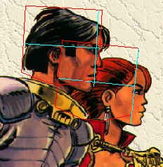
Face Detection and Pose Estimation: Results

Slide 10
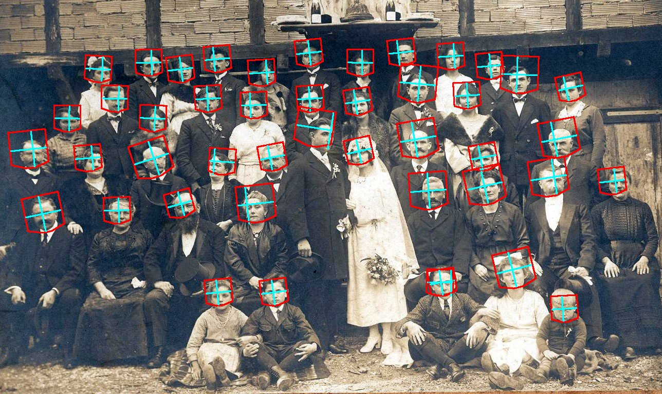
Face Detection with a Convolutional Net

Slide 11
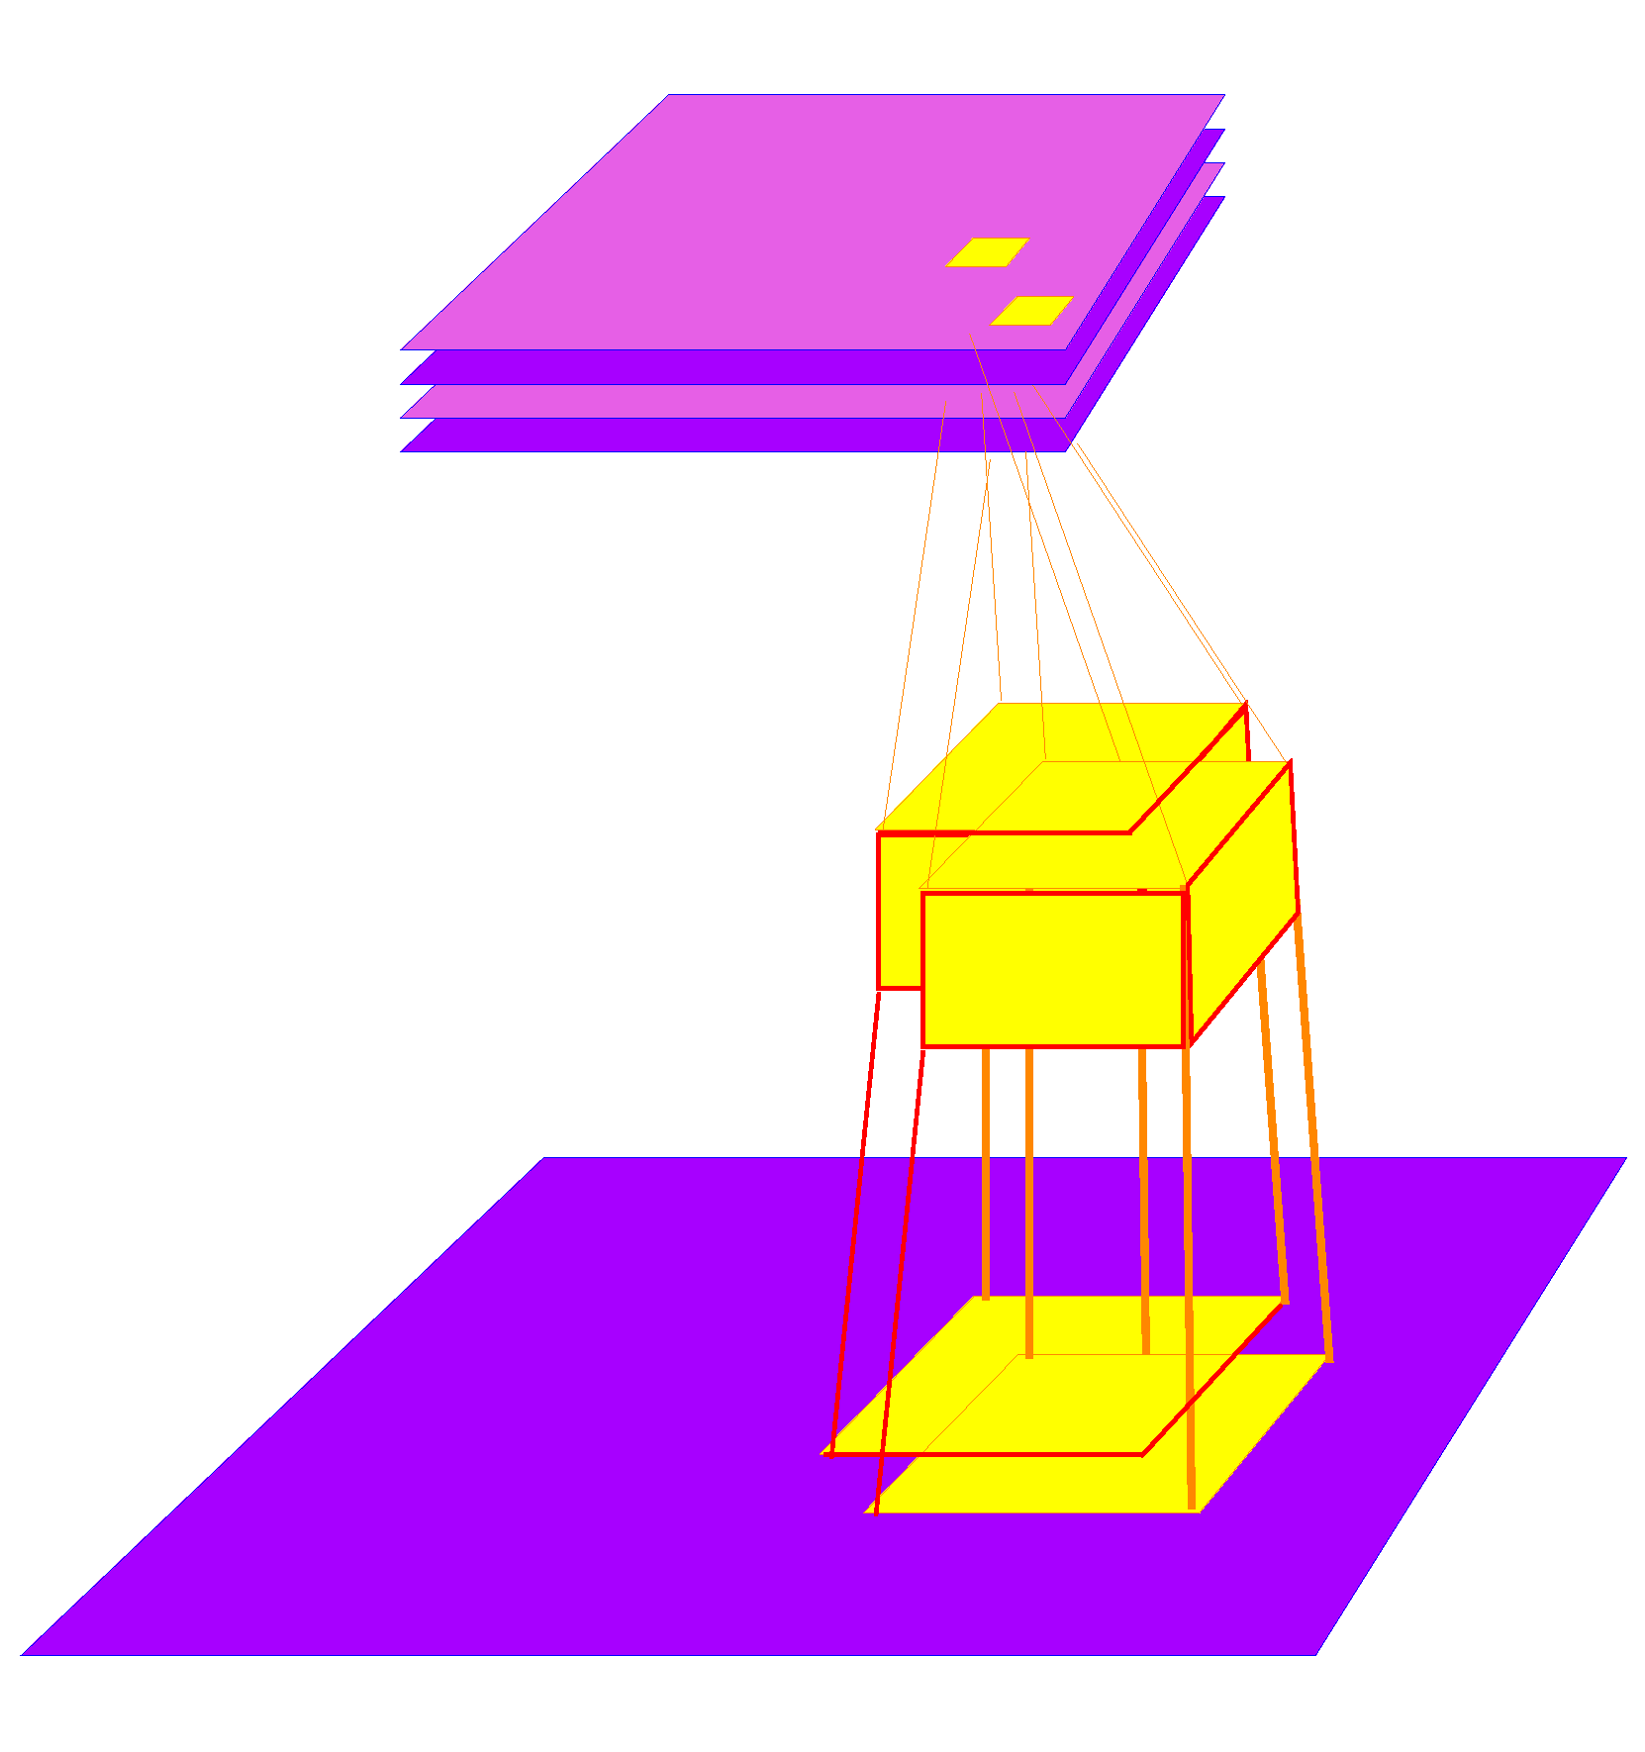
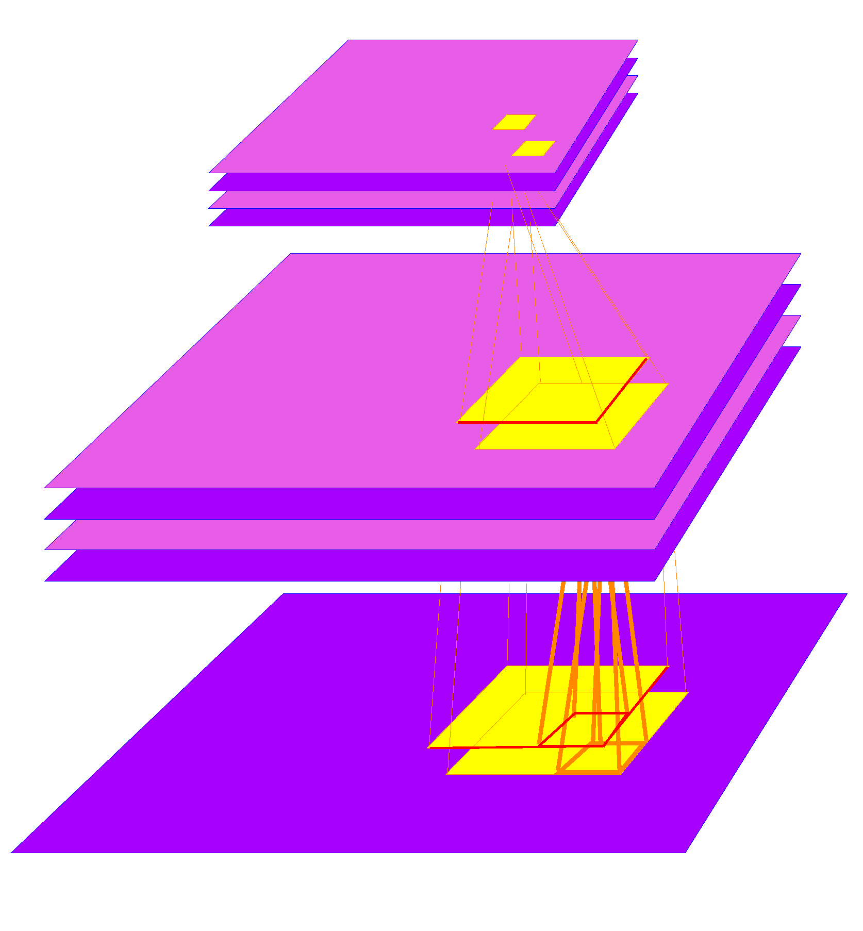
Applying a ConvNet on Sliding Windows is Very Cheap!
output: 3x3
96x96
input:120x120
Traditional Detectors/Classifiers must be applied to every location on a large input image, at multiple scales.
Convolutional nets can replicated over large images very cheaply.
The network is applied to multiple scales spaced by 1.5.

Slide 12
Building a Detector/Recognizer:
Replicated Convolutional Nets
Computational cost for replicated convolutional net:
  96x96 -> 4.6 million multiply-accumulate operations
  120x120 -> 8.3 million multiply-accumulate operations
  240x240 -> 47.5 million multiply-accumulate operations
  480x480 -> 232 million multiply-accumulate operations
Computational cost for a non-convolutional detector of the same size, applied every 12 pixels:
  96x96 -> 4.6 million multiply-accumulate operations
  120x120 -> 42.0 million multiply-accumulate operations
  240x240 -> 788.0 million multiply-accumulate operations
  480x480 -> 5,083 million multiply-accumulate operations
96x96 window
12 pixel shift
84x84 overlap

Slide 13
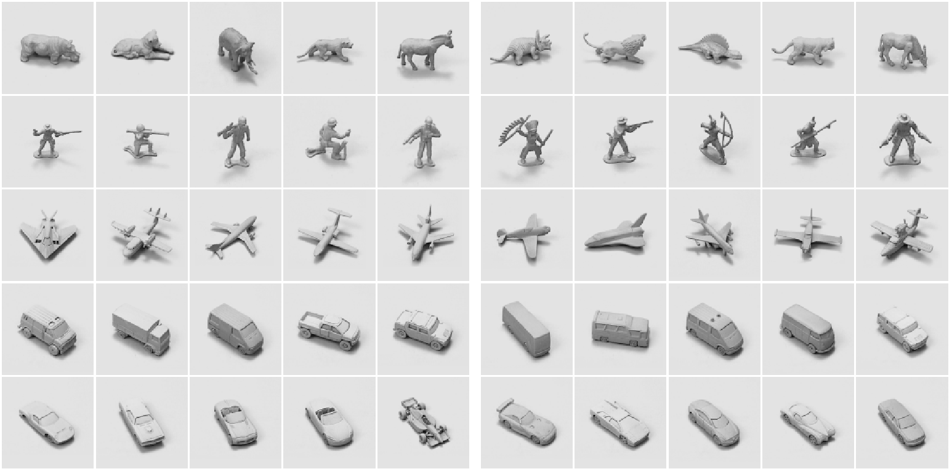
Generic Object Detection and Recognition
with Invariance to Pose and Illumination
50 toys belonging to 5 categories: animal, human figure, airplane, truck, car
10 instance per category: 5 instances used for training, 5 instances for testing
Raw dataset: 972 stereo pair of each object instance. 48,600 image pairs total.
For each instance:
18 azimuths
  0 to 350 degrees every 20 degrees
9 elevations
  30 to 70 degrees from horizontal every 5 degrees
6 illuminations
  on/off combinations of 4 lights
  2 cameras (stereo)‏
7.5 cm apart
  40 cm from the object
Training instances
Test instances

Slide 14
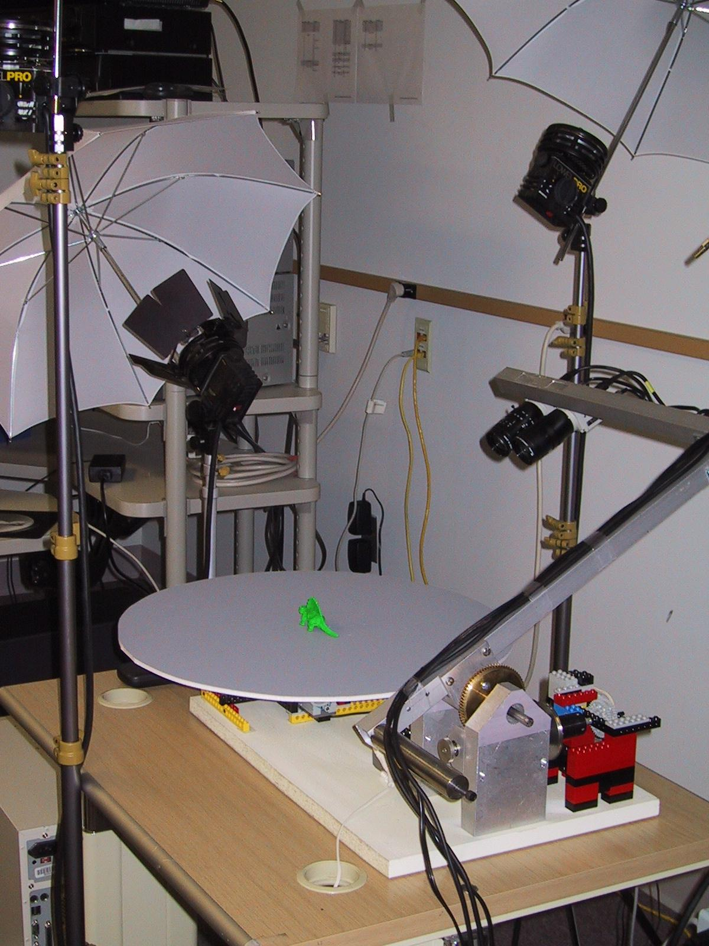
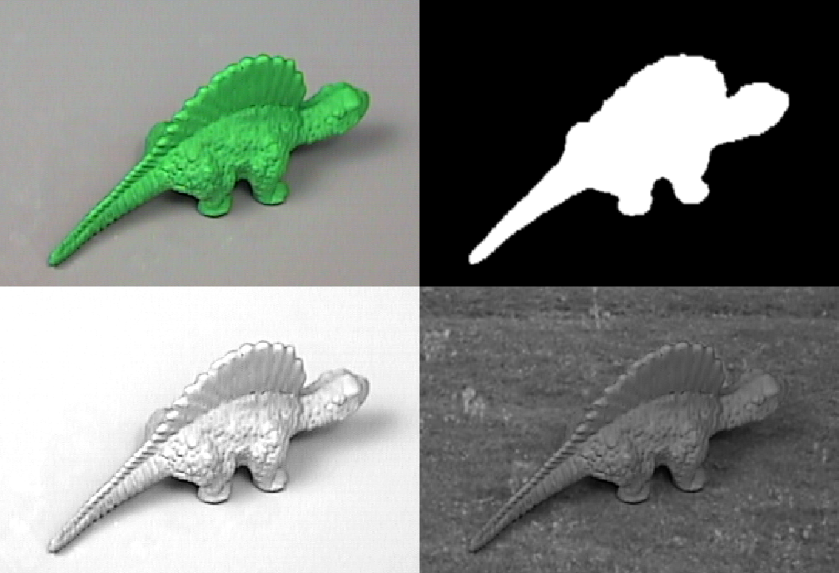
Data Collection, Sample Generation
Image capture setup
Objects are painted green so that:
- all features other than shape are removed
- objects can be segmented, transformed,
and composited onto various backgrounds
Original image
Object mask
Shadow factor
Composite image

Slide 15
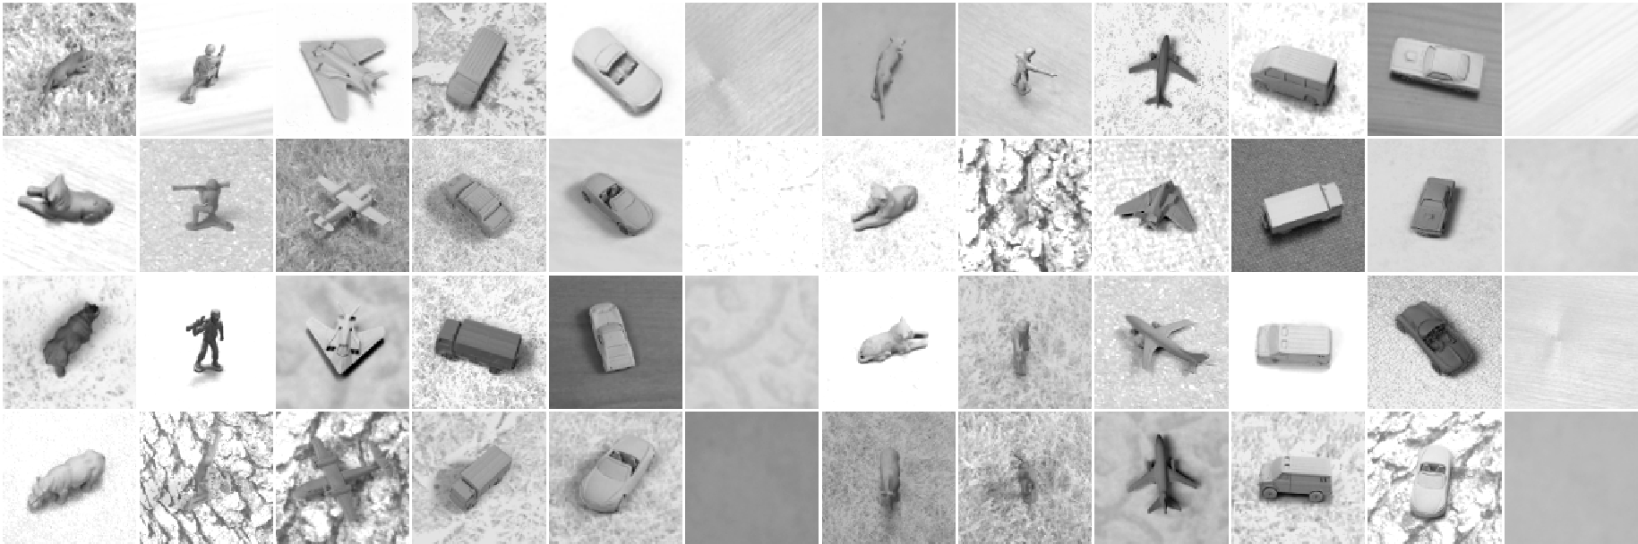
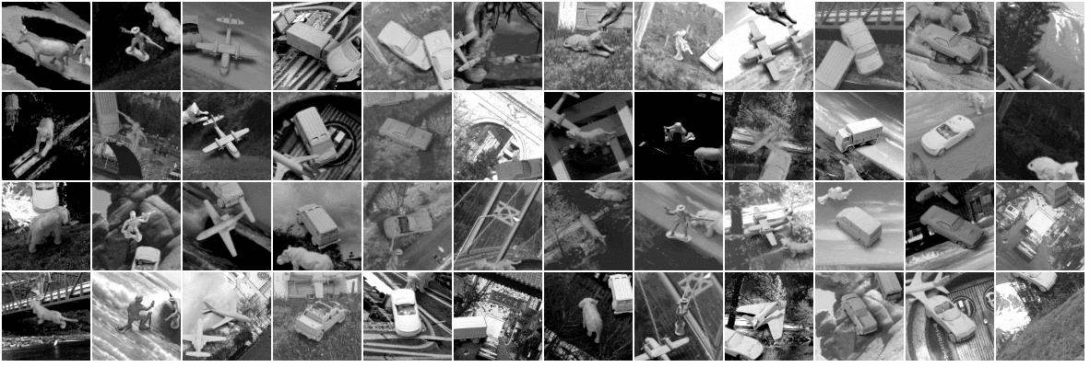
Textured and Cluttered Datasets

Slide 16
Convolutional Network
Layer 3
24@18x18
Layer 6
Fully
connected
(500 weights)‏
Layer 4
24@6x6
Stereo
input
2@96x96
Layer 1
8@92x92
Layer 5
100
Layer 2
8@23x23
5
4x4
subsampling
6x6
convolution
(96 kernels)‏
5x5
convolution
(16 kernels)‏
6x6
convolution
(2400 kernels)‏
3x3
subsampling
90,857 free parameters, 3,901,162 connections.
The architecture alternates convolutional layers (feature detectors) and subsampling layers (local feature pooling for invariance to small distortions).
The entire network is trained end-to-end (all the layers are trained simultaneously).
A gradient-based algorithm is used to minimize a supervised loss function.

Slide 17
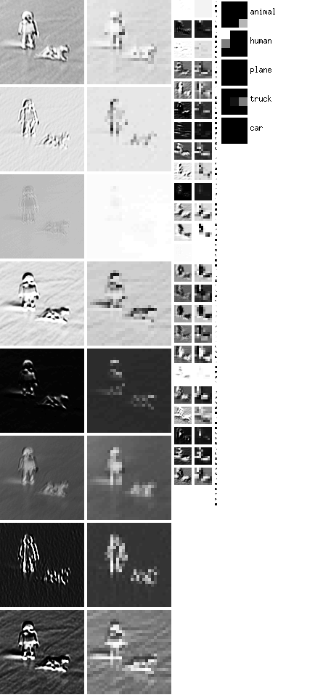
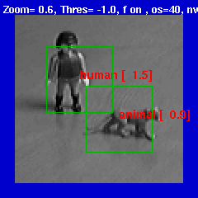
Alternated Convolutions and Subsampling
“Simple cells”
“Complex cells”
Averaging subsampling
Multiple convolutions
Local features are extracted everywhere.
averaging/subsampling layer builds robustness to variations in feature locations.
Hubel/Wiesel'62, Fukushima'71, LeCun'89, Riesenhuber & Poggio'02, Ullman'02,....

Slide 18

Normalized-Uniform Set: Error Rates
Linear Classifier on raw stereo images: 30.2% error.
K-Nearest-Neighbors on raw stereo images: 18.4% error.
K-Nearest-Neighbors on PCA-95: 16.6% error.
Pairwise SVM on 96x96 stereo images: 11.6% error
Pairwise SVM on 95 Principal Components: 13.3% error.
Convolutional Net on 96x96 stereo images: 5.8% error.
Training instances
Test instances

Slide 19
Jittered-Cluttered Dataset
Jittered-Cluttered Dataset:
291,600 tereo pairs for training, 58,320 for testing
Objects are jittered: position, scale, in-plane rotation, contrast, brightness, backgrounds, distractor objects,...
Input dimension: 98x98x2 (approx 18,000)‏

Slide 20
Experiment 2: Jittered-Cluttered Dataset
291,600 training samples, 58,320 test samples
SVM with Gaussian kernel 43.3% error
Convolutional Net with binocular input: 7.8% error
Convolutional Net + SVM on top: 5.9% error
Convolutional Net with monocular input: 20.8% error
Smaller mono net (DEMO): 26.0% error
Dataset available from http://www.cs.nyu.edu/~yann

Slide 21
What's wrong with K-NN and SVMs?
K-NN and SVM with Gaussian kernels are based on matching global templates
Both are “shallow” architectures
There is now way to learn invariant recognition tasks with such naïve architectures (unless we use an impractically large number of templates).
Output
The number of necessary templates grows exponentially with the number of dimensions of variations.
Global templates are in trouble when the variations include: category, instance shape, configuration (for articulated object), position, azimuth, elevation, scale, illumination, texture, albedo, in-plane rotation, background luminance, background texture, background clutter, .....
Linear
Combinations
Features (similarities)‏
Global Template Matchers
(each training sample is a template
Input

Slide 22
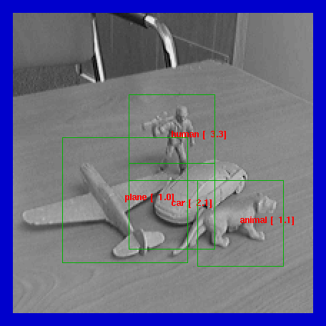
Examples (Monocular Mode)‏

Slide 23
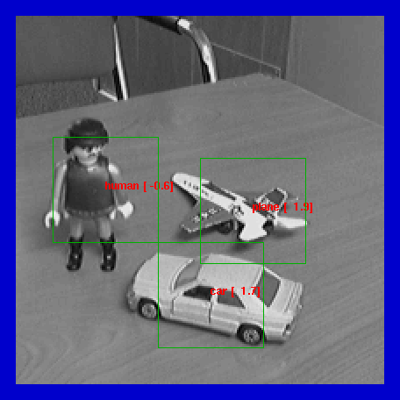
Examples (Monocular Mode)‏

Slide 24
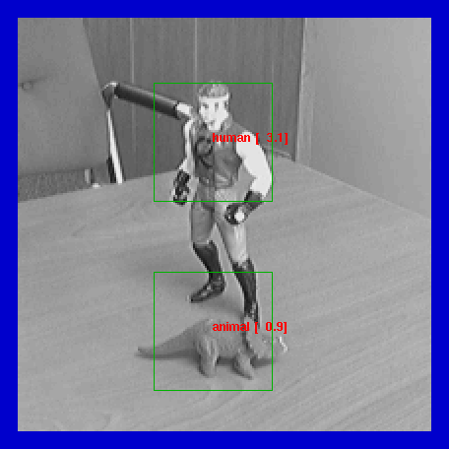
Examples (Monocular Mode)‏

Slide 25
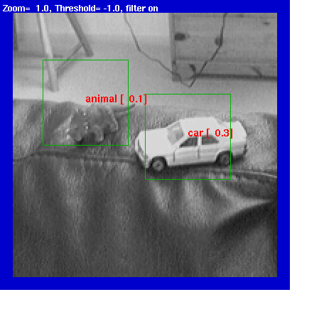
Examples (Monocular Mode)‏

Slide 26
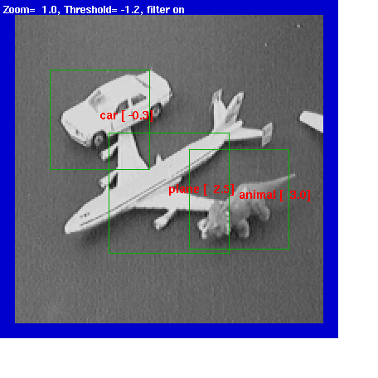
Examples (Monocular Mode)‏

Slide 27
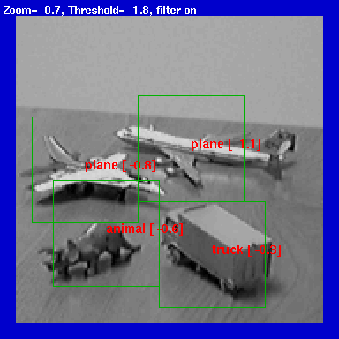
Examples (Monocular Mode)‏

Slide 28
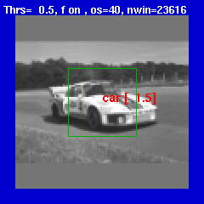
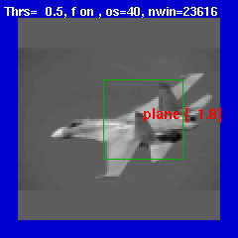
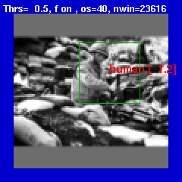
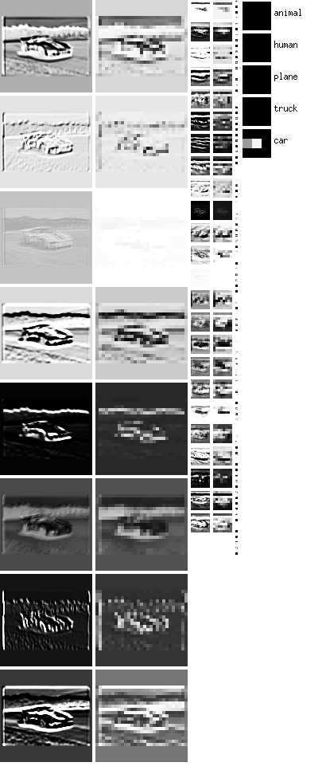
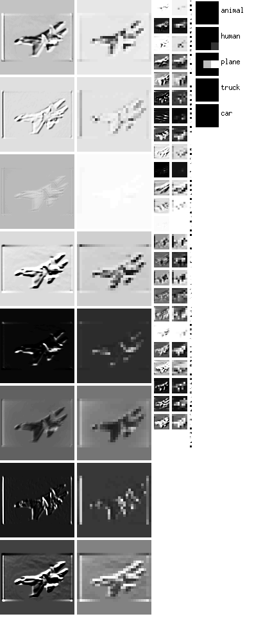
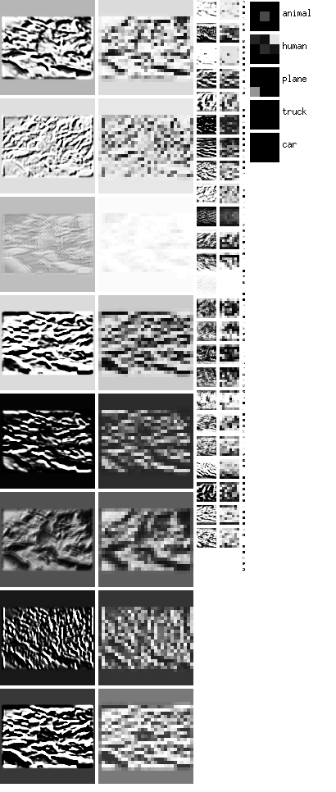
Natural Images (Monocular Mode)‏

Slide 29
Supervised Convolutional Nets: Pros and Cons
Convolutional nets can be trained to perform a wide variety of visual tasks.
  Global supervised gradient descent can produce parsimonious architectures
BUT: they require lots of labeled training samples
  60,000 samples for handwriting
  120,000 samples for face detection
  25,000 to 350,000 for object recognition
Since low-level features tend to be non task specific, we should be able to learn them unsupervised.
Hinton has shown that layer-by-layer unsupervised “pre-training” can be used to initialize “deep” architectures
  [Hinton & Shalakhutdinov, Science 2006]
Can we use this idea to reduce the number of necessary labeled examples.

Slide 30
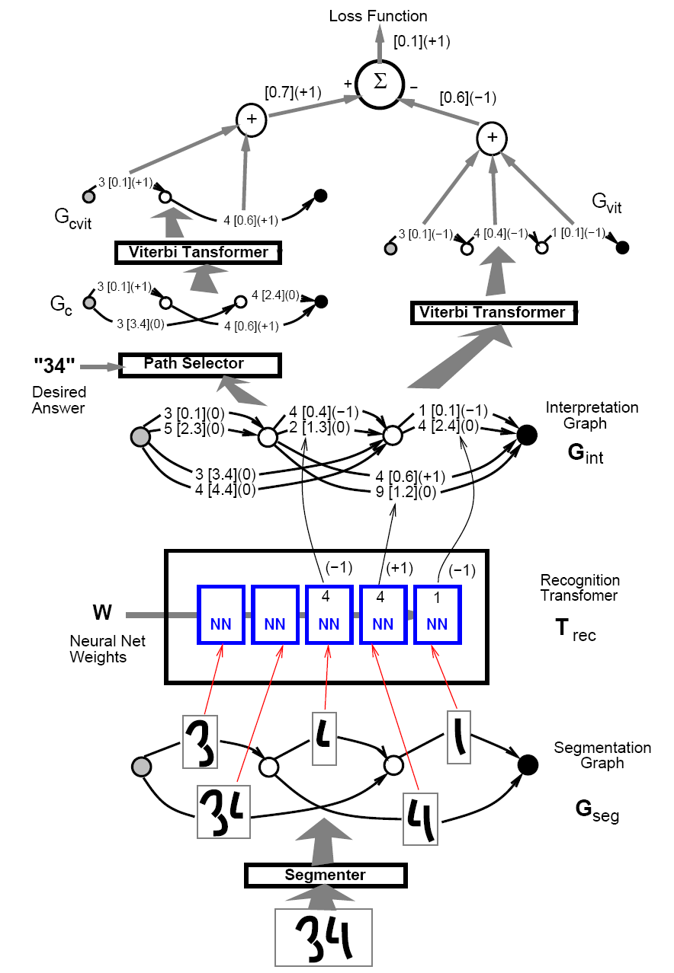

Slide 31

or
How can bad optimization be good
in large-scale settings
See http://leon.bottou.org/slides/largescale/lstut.pdf

Slide 32
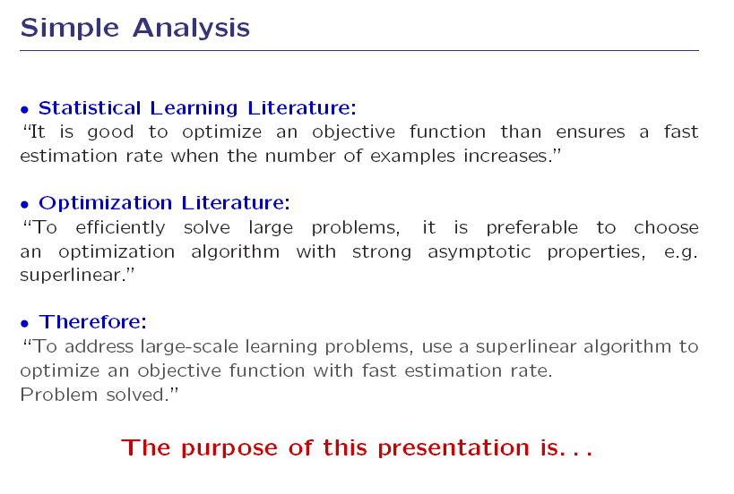

Slide 33
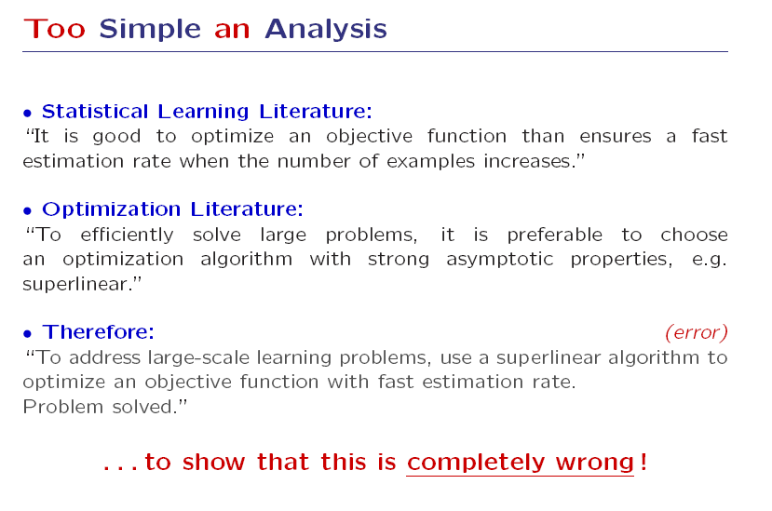

Slide 34
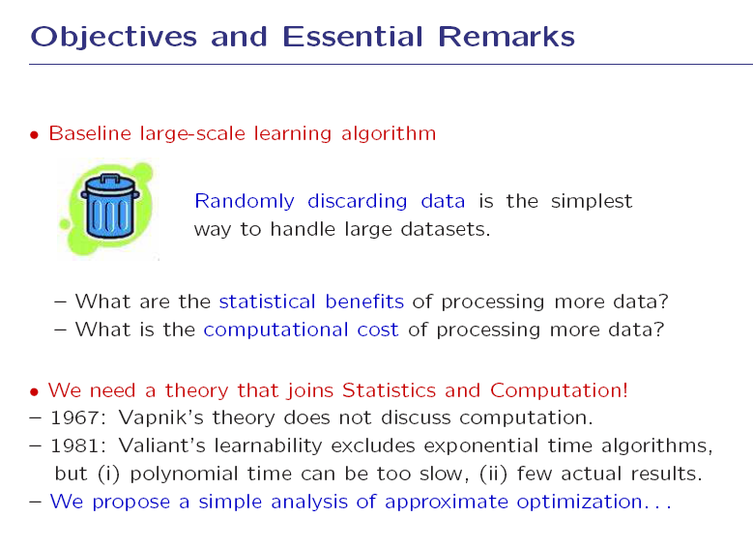

Slide 35
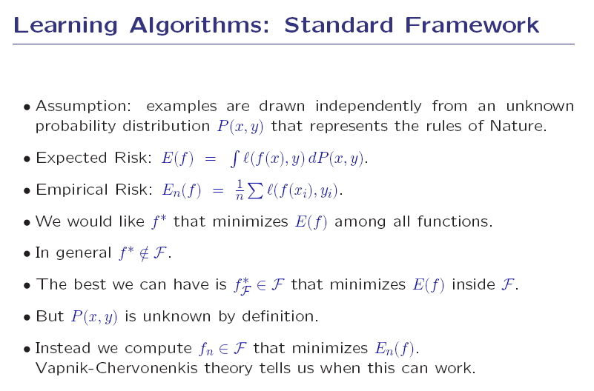

Slide 36
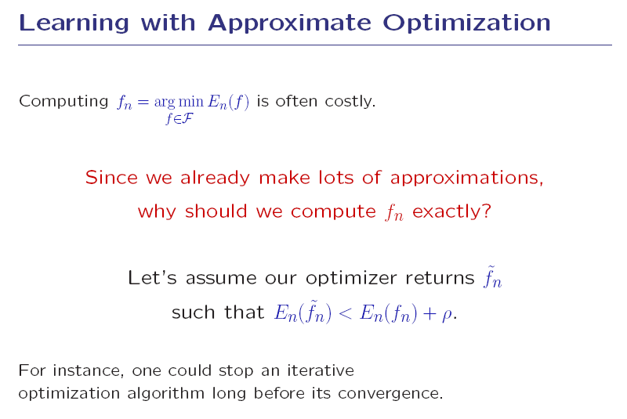

Slide 37
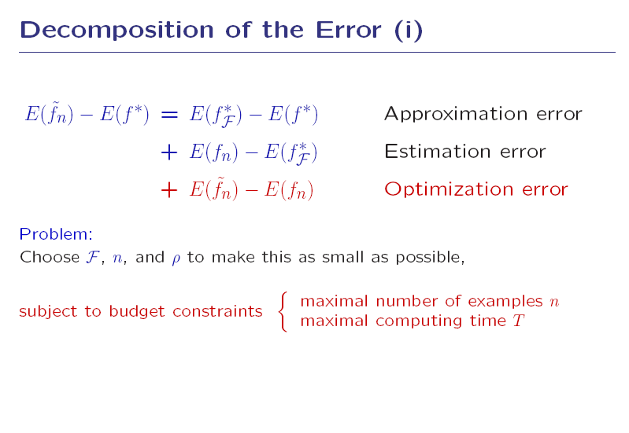

Slide 38
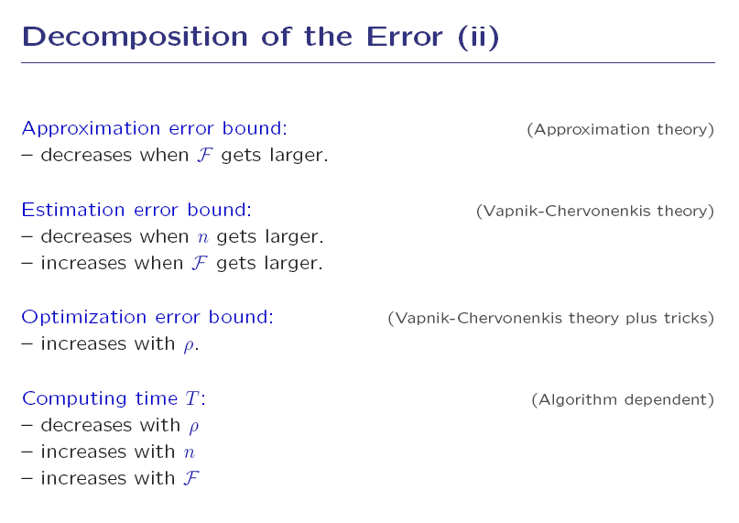

Slide 39
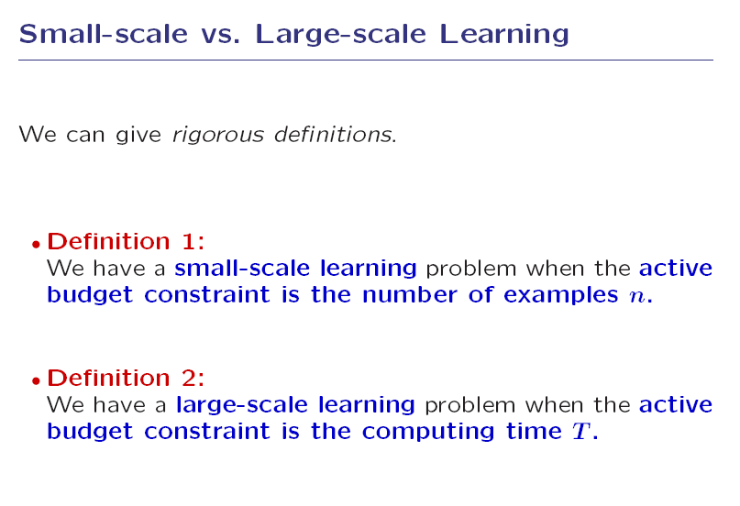

Slide 40
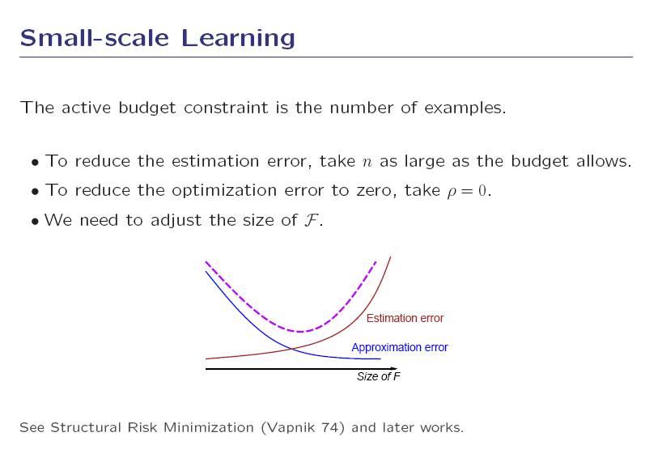

Slide 41
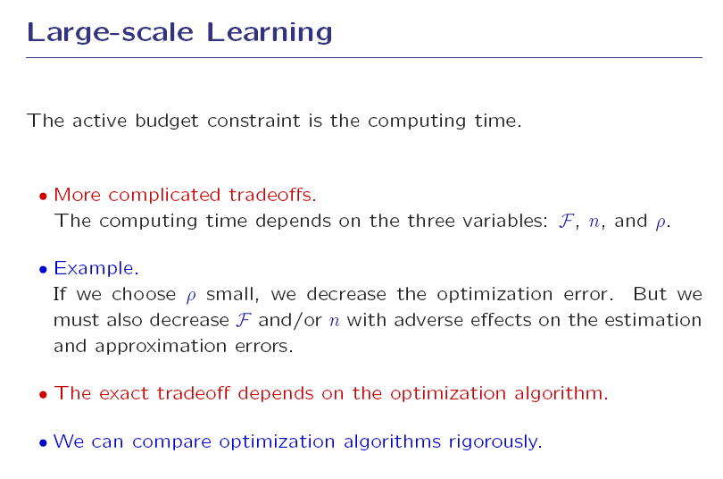

Slide 42
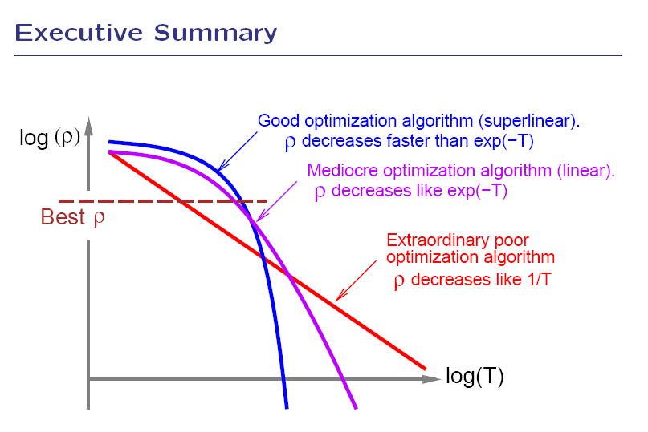

Slide 43
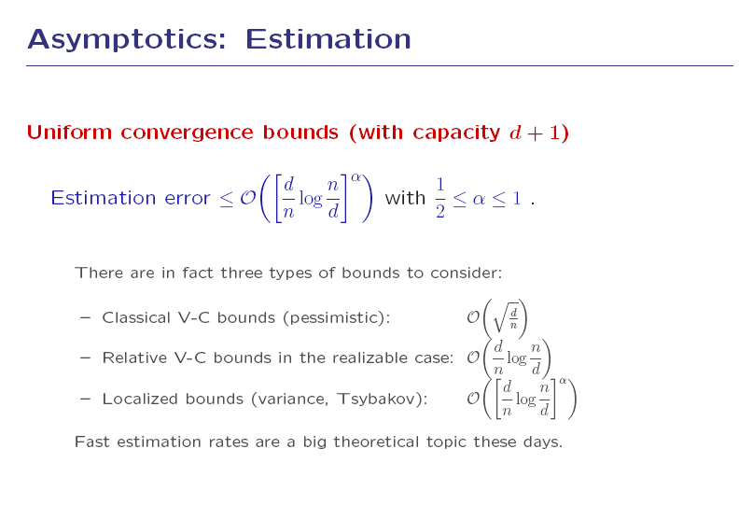

Slide 44
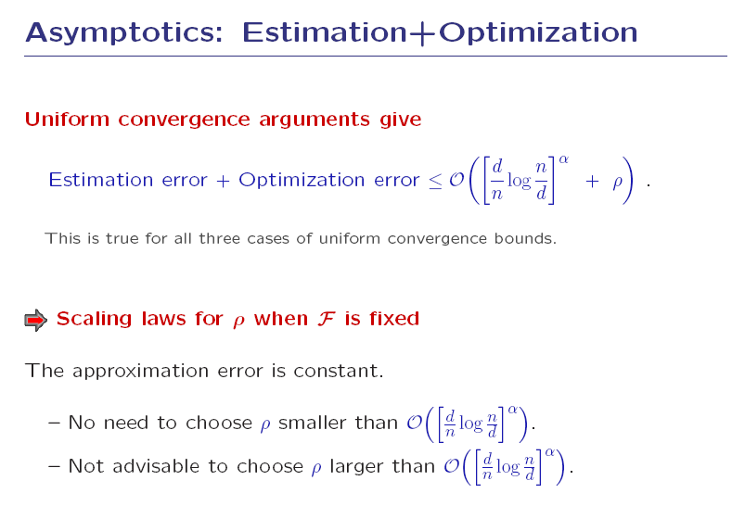
statistical estimation rate

Slide 45
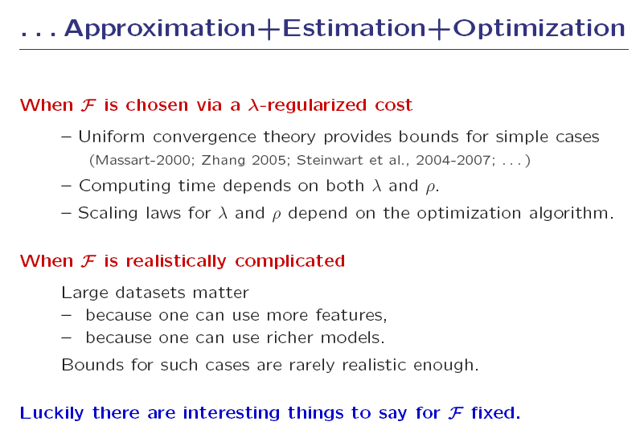

Slide 46
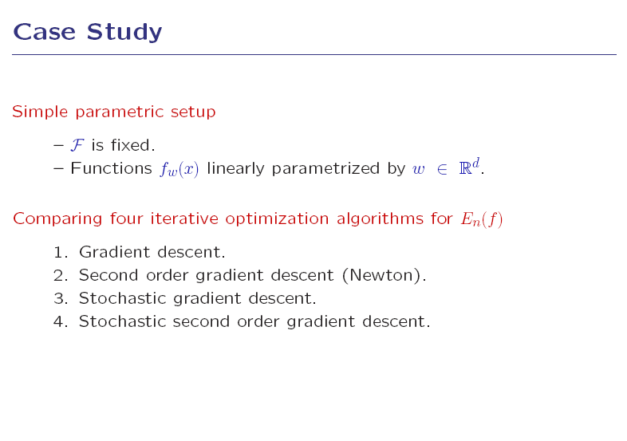

Slide 47
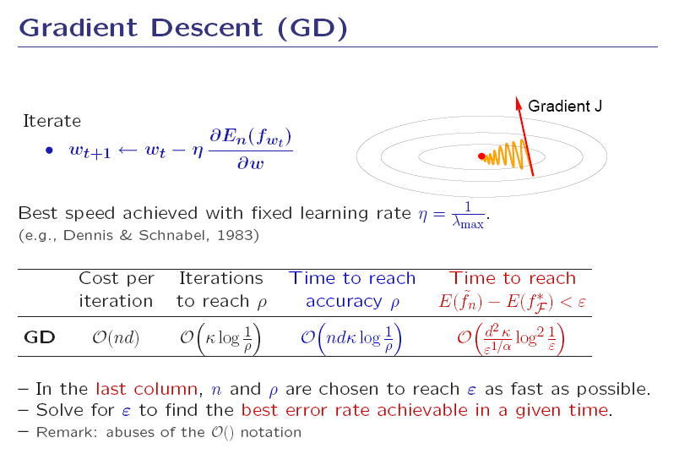

Slide 48
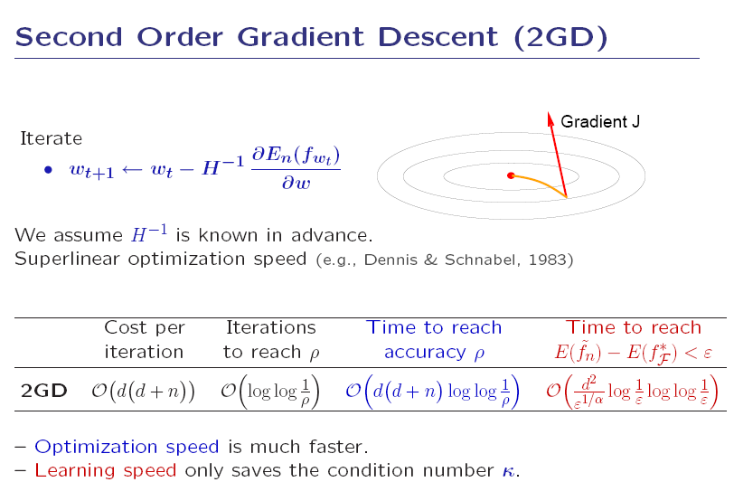

Slide 49
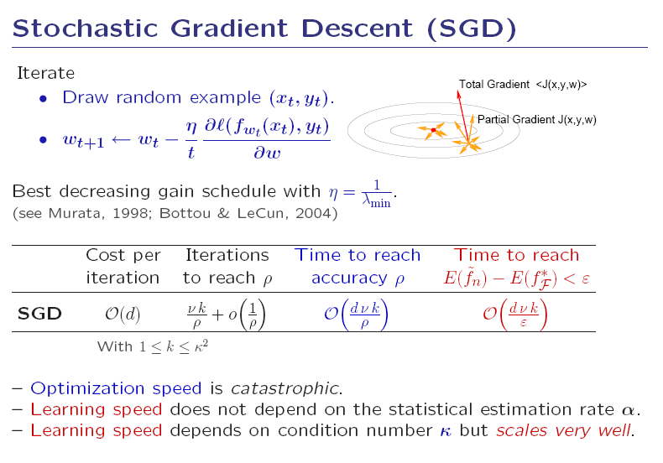

Slide 50
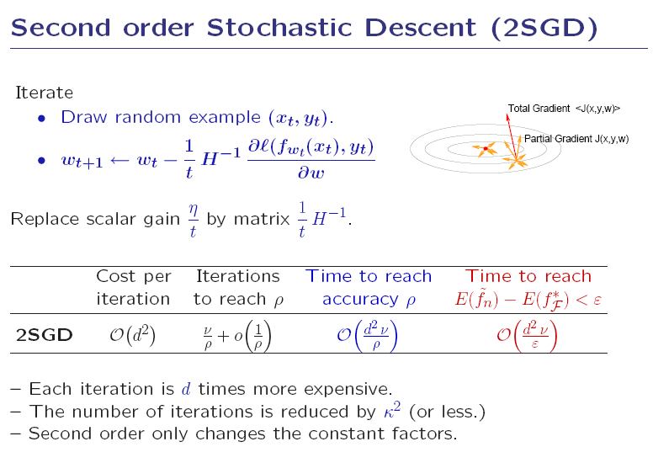

Slide 51
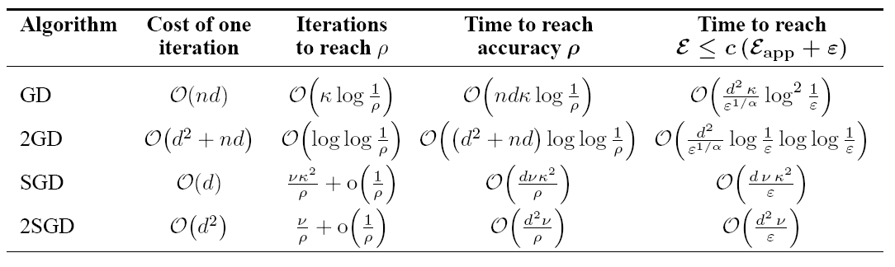
Summary

Slide 52
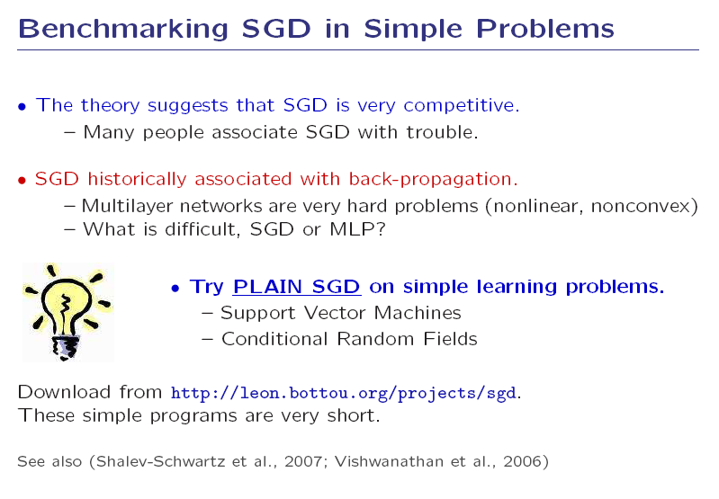

Slide 53


Slide 54


Slide 55


Slide 56

Generative part-based models
Fischler & Elschlager’73
Many slides adapted from Svetlana Lazebnik, Fei-Fei Li, Rob Fergus, and Antonio Torralba

Slide 57
Bayesian approach
Model: P_{µ} ( f | c)
Learn the model by maximizing the likelihood of the training data
max_{µ} ∑_{κ=1}^{n} log P_{µ} ( f_{k} | c)
Recognize using Bayes rule
  P_{µ} ( c | f ) = P_{µ} ( f | c) P(c) / P(f)

Slide 58




R. Fergus, P. Perona and A. Zisserman, Object Class Recognition by Unsupervised Scale-Invariant Learning, CVPR 2003
Notes:
Globally different, but have portions in common

Slide 59
Probabilistic model
Part
descriptors
Part
locations
Candidate parts

Slide 60
Probabilistic model
h: assignment of features to parts
Part 1
Part 3
Part 2

Slide 61
Probabilistic model
h: assignment of features to parts
Part 1
Part 3
Part 2

Slide 62
Probabilistic model
Distribution
over patch
descriptors
High-dimensional appearance space

Slide 63
Probabilistic model
Distribution
over joint
part positions
2D image space

Slide 64
Results: Faces
Face
shape
model
Patch
appearance
model
Recognition
results

Slide 65
Results: Motorbikes and airplanes

Slide 66


Note: The Fergus part-based model is very rigid
(Schmid & Mohr, 1996)
(Lowe, 1999)
(Fergus, Perona & Zisserman, 2003)

Slide 67






Model Learning as Multi-Image Segmentation
(Lazebnik, Scmid, Ponce, BMVC’04)
Practical approach: two-image matching followed by validation
initial pair
validation set
candidate part
Notes:
Our strategy for learning parts is based on establishing direct visual correspondence between training images. Ideally, we would like to simultaneously establish correspondence across the entire training set. However, this multi-dimensional matching problem is intractable. Instead, we initialize the parts by matching pairs of images, and then validate these candidate parts.

Slide 68
Model ≡ loose assembly of parts
Part ≡ rigid assembly of features
(Lazebnik, Ponce, Schmid, ICCV’O5)
(Fergus et al., 2003)

Slide 69



Slide 70



Slide 71



Slide 72

A

Slide 73

A
(Gaston, Grimson, & Lozano-Perez, 1982; Ayache & Faugeras, 1982)
(Faugeras & Hebert, 1983; Huttenlocher, 1987)

Slide 74




Slide 75
Discriminative approach
Model: P_{µ} ( c | f)
Learn the model by maximizing the likelihood of the training data
max_{µ} ∑_{κ=1}^{n} log P_{µ} ( c_{k} | f_{k})
Recognize by maximizing posterior probability of class
  max_{c} P_{µ} ( c | f )

Slide 76















































Complete Object Recognition System (ICCV’05)
Training pairs
Candidate parts
Matching
…
…
…
…
Validation images
Part dictionary
Response scores
Learning
validation images
Validation
Classifier
parts
Test image
Part detection
Testing
response
vector
Decision

Slide 77

UIUC Bird Database
50 training images per class:
  20 initial images (50 largest candidate parts retained);
  30 validation (20 highest-scoring parts retained).
50 test images per class.
100 total.
Overall classification rate: 92.33%
Bag of features (Zhang et al., 2005): 83%

Slide 78
Model ≡ locally rigid assembly of parts
Part ≡ locally rigid assembly of features
A first attempt at handling:
changes in viewpoint
nonrigid shape
noncharacteristic texture
(Kushal, Schmid, Ponce, 2006)

Slide 79







Model ≡ locally rigid assembly of parts
Part ≡ locally rigid assembly of features
base images
validation images
A first attempt at handling:
changes in viewpoint
nonrigid shape
noncharacteristic texture
(Kushal, Schmid, Ponce, 2006)

Slide 80

Model ≡ locally rigid assembly of parts
Part ≡ locally rigid assembly of features
A first attempt at handling:
changes in viewpoint
nonrigid shape
noncharacteristic texture
(Kushal, Schmid, Ponce, 2006)

Slide 81

Model ≡ locally rigid assembly of parts
Part ≡ locally rigid assembly of features
Qualitative experiments on Pascal VOC’07 (Kushal, Schmid, Ponce, 2008)

Slide 82

Model ≡ locally rigid assembly of parts
Part ≡ locally rigid assembly of features
Quantitative experiments on Pascal VOC’07 (Kushal, Schmid, Ponce, 2008)

Slide 83

Color histograms (S&B’91)
Local jets (Florack’93)
Spin images (J&H’99)
Sift (Lowe’99)
Shape contexts (B&M’95)
Texton histograms (L&M’97)
Gist (O&T’05)
Spatial pyramids (LSP’06)
Hog (D&T’06)
Phog (B&Z’07)
Convolutional nets (LC’70)

Slide 84

Locally orderless structure of images (K&vD’99)

Slide 85

Felzwenszalb, McAllester, Ramanan (2007)
[Wins on 6 of the Pascal’07 classes, see Chum
& Zisserman (2007) for the other big winner.]

