Slide 1
Reconnaissance d’objets
et vision artificielle
http://www.di.ens.fr/willow/teaching/recvis09
Lecture 6
Face recognition
Face detection
Neural nets

Slide 2
Attention!
Troisième exercice de programmation du
le 24 novembre
http://www.di.ens.fr/willow/teaching/recvis09/assignment3/

Slide 3
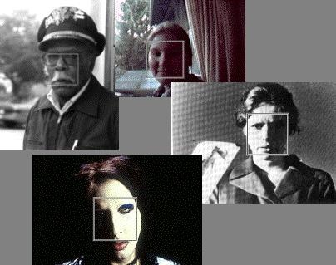
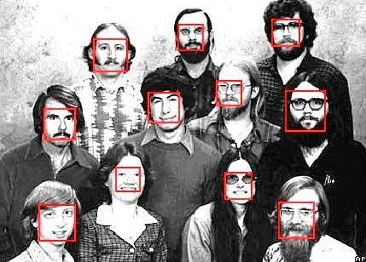
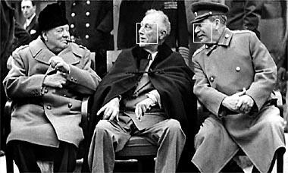
Face detection and recognition
Many slides adapted from S. Lazebnik,
K. Grauman and D. Lowe

Slide 4
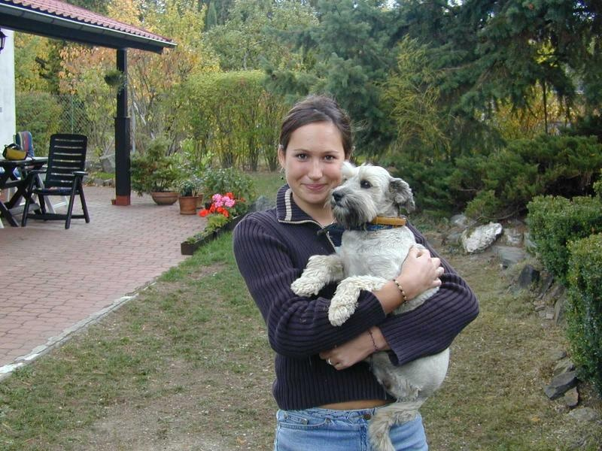
Face detection and recognition
Detection
Recognition
“Sally”

Slide 5
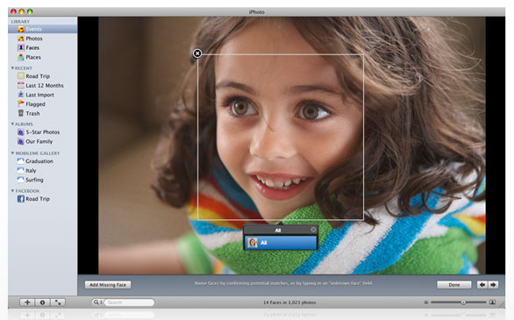
Consumer application: iPhoto 2009
http://www.apple.com/ilife/iphoto/

Slide 6
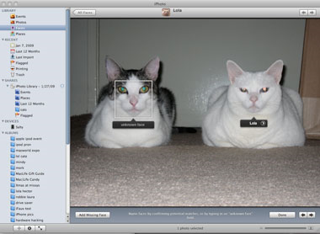
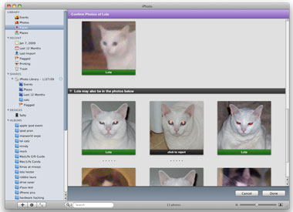
Consumer application: iPhoto 2009
Can be trained to recognize pets!
http://www.maclife.com/article/news/iphotos_faces_recognizes_cats

Slide 7
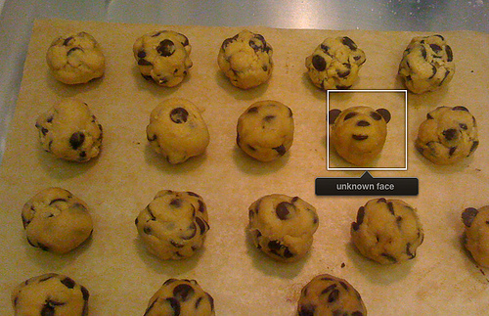
Consumer application: iPhoto 2009
Things iPhoto thinks are faces

Slide 8
History
Early face recognition systems: based on features and distances
Bledsoe (1966), Kanade (1973)
Appearance-based models: eigenfaces
Sirovich & Kirby (1987), Turk & Pentland (1991)
Real-time face detection with boosting
Viola & Jones (2001)

Slide 9
Outline
Face recognition
  Eigenfaces
Face detection
  The Viola & Jones system

Slide 10
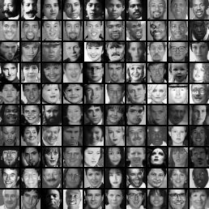
The space of all face images
When viewed as vectors of pixel values, face images are extremely high-dimensional
  100x100 image = 10,000 dimensions
However, relatively few 10,000-dimensional vectors correspond to valid face images
We want to effectively model the subspace of face images

Slide 11
The space of all face images
We want to construct a low-dimensional linear subspace that best explains the variation in the set of face images

Slide 12
Principal Component Analysis
Given: N data points x₁, … ,x_{N} in R^{d}
We want to find a new set of features that are linear combinations of original ones:
u(x_{i}) = u^{T}(x_{i} – µ)
(µ: mean of data points)
What unit vector u in R^{d} captures the most variance of the data?

Slide 13
Principal Component Analysis
Direction that maximizes the variance of the projected data:
N
Projection of data point
N
Covariance matrix of data
The direction that maximizes the variance is the eigenvector associated with the largest eigenvalue of Σ

Slide 14
Eigenfaces: Key idea
Assume that most face images lie on
a low-dimensional subspace determined by the first k (k<d) directions of maximum variance
Use PCA to determine the vectors u₁,…u_{k} that span that subspace:
x ≈ μ + w₁u₁ + w₂u₂ + … + w_{k}u_{k}
Represent each face using its “face space” coordinates (w₁,…w_{k})
Perform nearest-neighbor recognition in “face space”
M. Turk and A. Pentland, Face Recognition using Eigenfaces, CVPR 1991

Slide 15
Eigenfaces example
Training images
x₁,…,x_{N}

Slide 16
Eigenfaces example
Top eigenvectors:
u₁,…u_{k}
Mean: μ

Slide 17
Eigenfaces example
Face x in “face space” coordinates:
=

Slide 18
Eigenfaces example
Face x in “face space” coordinates:
Reconstruction:
=
=
+
^
x
=
µ + w₁u₁ + w₂u₂ + w₃u₃ + w₄u₄ + …

Slide 19
Summary: Recognition with eigenfaces
Process labeled training images:
Find mean µ and covariance matrix Σ
Find k principal components (eigenvectors of Σ) u₁,…u_{k}
Project each training image x_{i} onto subspace spanned by principal components:
(w_{i1},…,w_{ik}) = (u₁^{T}(x_{i} – µ), … , u_{k}^{T}(x_{i} – µ))
Given novel image x:
Project onto subspace:
(w₁,…,w_{k}) = (u₁^{T}(x – µ), … , u_{k}^{T}(x – µ))
Optional: check reconstruction error x – x to determine whether image is really a face
Classify as closest training face in k-dimensional subspace
^

Slide 20
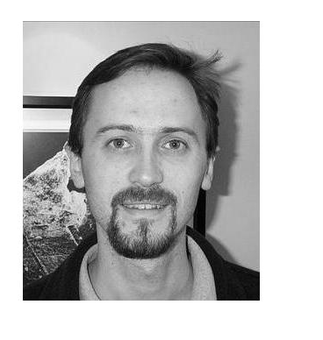
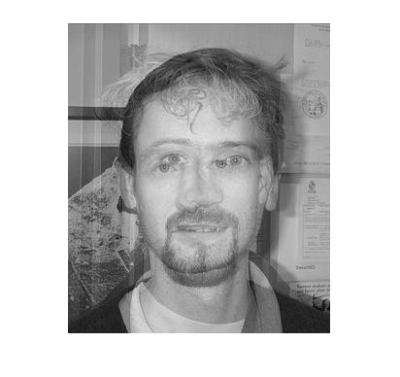
Limitations
Global appearance method: not robust to misalignment, background variation

Slide 21
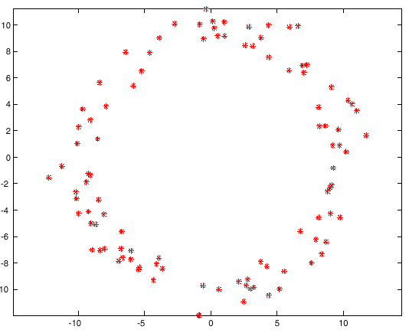
Limitations
PCA assumes that the data has a Gaussian distribution (mean µ, covariance matrix Σ)
The shape of this dataset is not well described by its principal components

Slide 22
Limitations
The direction of maximum variance is not always good for classification

Slide 23
Limitations
The direction of maximum variance is not always good for classification

Slide 24
Alternative (Belhumeur et al., 1997)
Fisherfaces (aka linear discriminant analysis): Use the direction that maximizes the ratio of
between-class scatter and within-class scatter

Slide 25
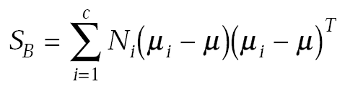
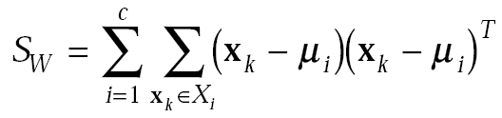
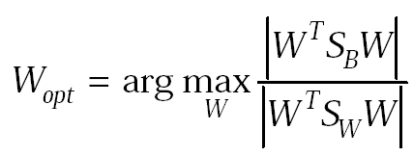
Alternative (Belhumeur et al., 1997)
Fisherfaces (aka linear discriminant analysis): Use the direction that maximizes the ratio of
between-class scatter and within-class scatter
Between-class
scatter
Within-class
scatter
Optimal
direction
Generalized eigenvalue problem

Slide 26
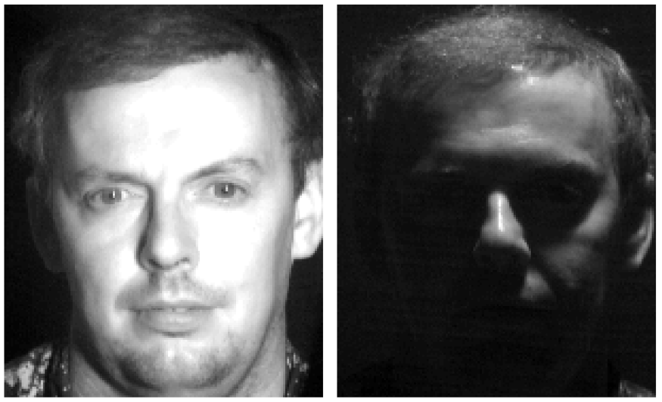

Slide 27
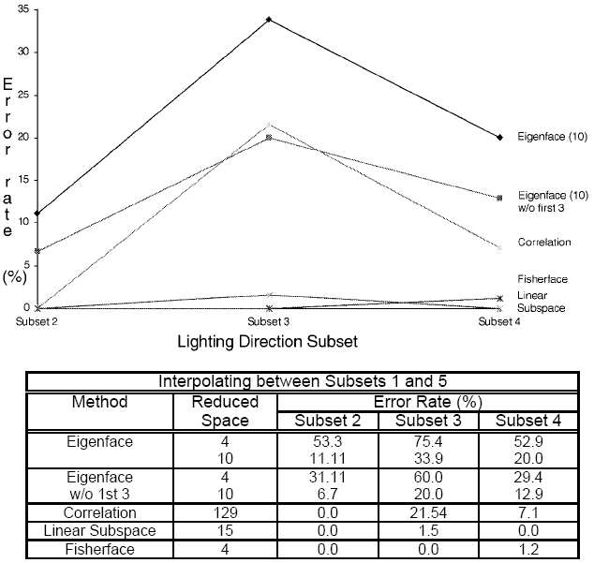
Eigenfaces vs. Fisherfaces: Recognition Using Class Specific Linear Projection (Belhumeur, Hespanha, Kriegman, PAMI 19(7), 1997)

Slide 28
Face detection and recognition
Detection
Recognition
“Sally”

Slide 29
Face detection
Basic idea: slide a window across image and evaluate a face model at every location

Slide 30
Challenges of face detection
Sliding window detector must evaluate tens of thousands of location/scale combinations
  This evaluation must be made as efficient as possible
Faces are rare: 0–10 per image
  At least 1000 times as many non-face windows as face windows
  This means that the false positive rate must be extremely low
  Also, we should try to spend as little time as possible on the non-face windows
Notes:
As I said earlier the classifier is evaluated 50,000
Faces are quite rare…. Perhaps 1 or 2 faces per image
A reasonable goal is to make the false positive rate less than the true positive rate...

Slide 31
The Viola/Jones Face Detector
A “paradigmatic” method for real-time object detection
Training is slow, but detection is very fast
Key ideas
  Integral images for fast feature evaluation
  Boosting for feature selection
  Attentional cascade for fast rejection of non-face windows
P. Viola and M. Jones. Rapid object detection using a boosted cascade of simple features. CVPR 2001.

Slide 32
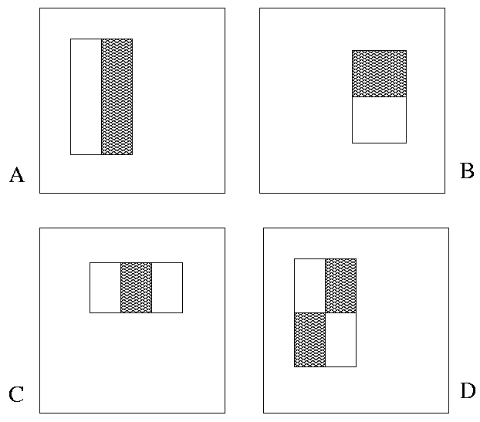
Image Features
“Rectangle filters”
Value =
∑ (pixels in white area) –
∑ (pixels in black area)
Notes:
For real problems results are only as good as the features used...
This is the main piece of ad-hoc (or domain) knowledge
Rather than the pixels, we have selected a very large set of simple functions
Sensitive to edges and other critcal features of the image
** At multiple scales
Since the final classifier is a perceptron it is important that the features be non-linear… otherwise the final classifier will be a simple perceptron.
We introduce a threshold to yield binary features

Slide 33
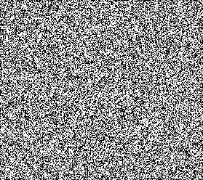



Example
Source
Result

Slide 34
Fast computation with integral images
The integral image computes a value at each pixel (x,y) that is the sum of the pixel values above and to the left of (x,y), inclusive
This can quickly be computed in one pass through the image
(x,y)

Slide 35
Computing the integral image

Slide 36
Computing the integral image
ii(x, y-1)
s(x-1, y)
i(x, y)
Cumulative row sum: s(x, y) = s(x–1, y) + i(x, y)
Integral image: ii(x, y) = ii(x, y−1) + s(x, y)
MATLAB: ii = cumsum(cumsum(double(i)), 2);

Slide 37
Computing sum within a rectangle
Let A,B,C,D be the values of the integral image at the corners of a rectangle
Then the sum of original image values within the rectangle can be computed as:
  sum = A – B – C + D
Only 3 additions are required for any size of rectangle!
  This is now used in many areas of computer vision
D
B
C
A

Slide 38
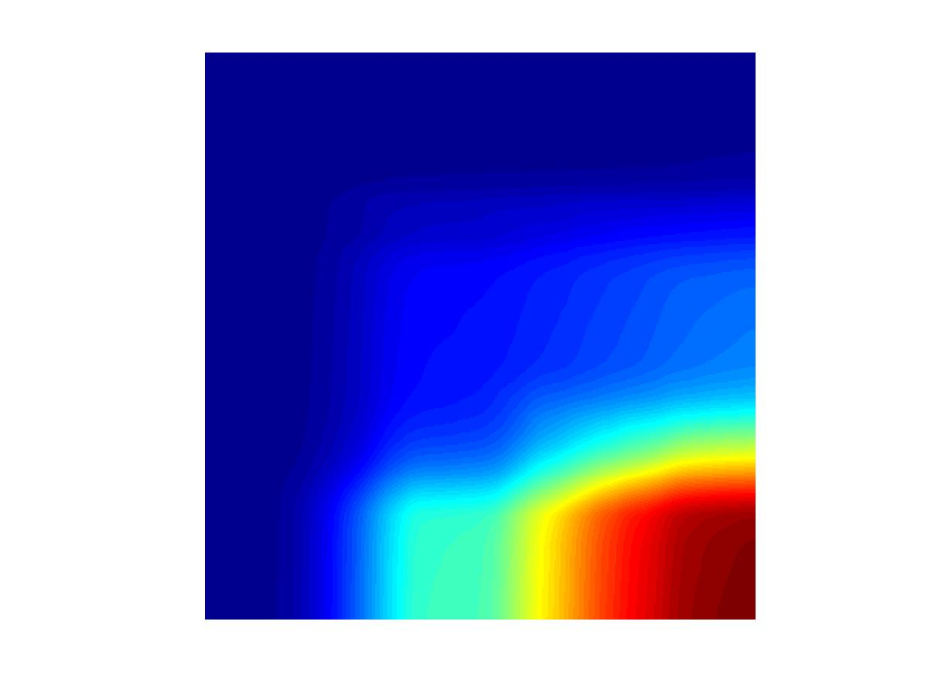
Example
Integral Image
-1
+1
+2
-2
-1
+1
(x,y)
(x,y)

Slide 39
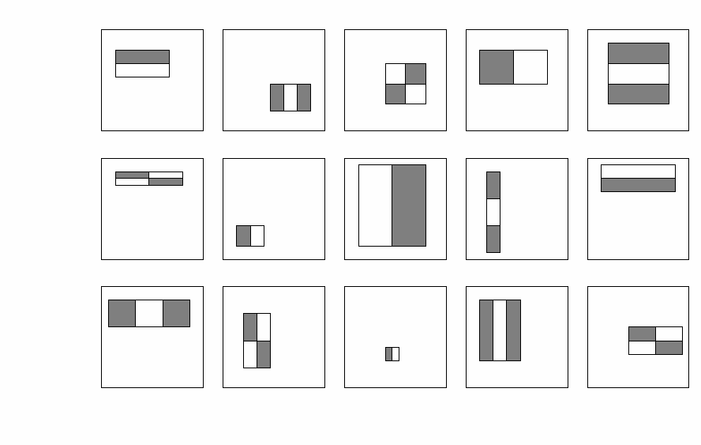
Feature selection
For a 24x24 detection region, the number of possible rectangle features is ~180,000!

Slide 40
Feature selection
For a 24x24 detection region, the number of possible rectangle features is ~180,000!
At test time, it is impractical to evaluate the entire feature set
Can we create a good classifier using just a small subset of all possible features?
How to select such a subset?

Slide 41
Boosting
Boosting is a classification scheme that works by combining weak learners into a more accurate ensemble classifier
Weak learner: classifier with accuracy that need be only better than chance
We can define weak learners based on rectangle features:
value of rectangle feature
parity
threshold
window
Y. Freund and R. Schapire, A short introduction to boosting, Journal of Japanese Society for Artificial Intelligence, 14(5):771-780, September, 1999.

Slide 42
Boosting
Boosting is a classification scheme that works by combining weak classifiers into a more accurate ensemble classifier
Weak classifier: classifier with accuracy that need be only better than chance
We can define weak classifiers based on rectangle features:
Parameters
tuned to minimize
misclassification
error
value of rectangle feature
parity
threshold
window
Y. Freund and R. Schapire, A short introduction to boosting, Journal of Japanese Society for Artificial Intelligence, 14(5):771-780, September, 1999.

Slide 43
Boosting outline
Initially, give equal weight to each training example
Iterative training procedure
  Find best weak classifier for current weighted training set
  Raise the weights of training examples misclassified by current weak learner
Compute final classifier as linear combination of all weak classifiers (weight of each learner is related to its accuracy)
Y. Freund and R. Schapire, A short introduction to boosting, Journal of Japanese Society for Artificial Intelligence, 14(5):771-780, September, 1999.

Slide 44
Boosting
Weak
Classifier 1

Slide 45
Boosting
Weights
Increased

Slide 46
Boosting
Weak
Classifier 2

Slide 47
Boosting
Weights
Increased

Slide 48
Boosting
Weak
Classifier 3

Slide 49
Boosting
Final classifier is
linear combination of weak classifiers

Slide 50
AdaBoost algorithm: more details
Start with equal weights on each data point (i)
For t = 1 …,T
  Select weak classifier with minimum error
  Set
  Reweight examples (boosting) to give misclassified examples more weight
  Add weak classifier with weight
Final
classifier:

Slide 51
Boosting for face detection
For each round of boosting:
  Evaluate each rectangle filter on each example
  Select best threshold for each filter
  Select best filter/threshold combination
  Reweight examples
Computational complexity of learning: O(MNT)
  M filters, N examples, T thresholds

Slide 52
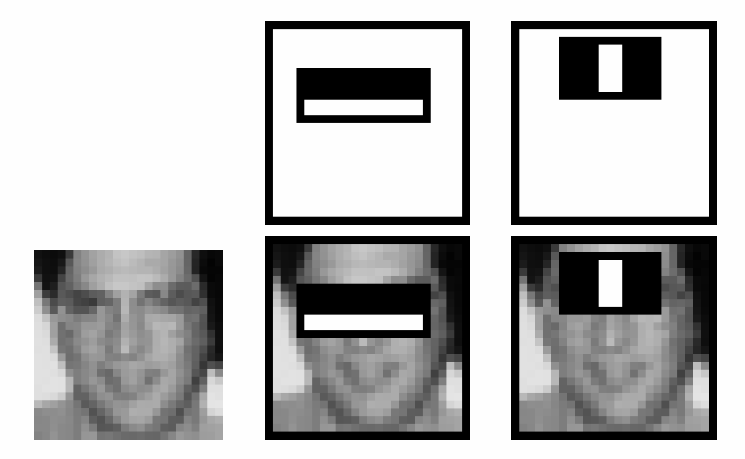
First two features selected by boosting

Slide 53
Cascading classifiers
We start with simple classifiers which reject many of the negative sub-windows while detecting almost all positive sub-windows
Positive results from the first classifier triggers the evaluation of a second (more complex) classifier, and so on
A negative outcome at any point leads to the immediate rejection of the sub-window
T
T
T
IMAGE
SUB-WINDOW
T
FACE
Classifier 1
Classifier 2
Classifier 3
F
F
F
NON-FACE
NON-FACE
NON-FACE

Slide 54
Cascading classifiers
Chain classifiers that are progressively more complex and have lower false positive rates:
Receiver operating characteristic
% False Pos
0
50
vs
false
neg
determined by
50 100
% Detection
T
T
T
IMAGE
SUB-WINDOW
T
FACE
Classifier 1
Classifier 2
Classifier 3
F
F
F
NON-FACE
NON-FACE
NON-FACE
Notes:
In general simple classifiers, while they are more efficient, they are also weaker.
We could define a computational risk hierarchy (in analogy with structural risk minimization)…
A nested set of classifier classes
The training process is reminiscent of boosting…
- previous classifiers reweight the examples used to train subsequent classifiers
The goal of the training process is different
- instead of minimizing errors minimize false positives

Slide 55
Training the cascade
Adjust weak learner threshold to minimize false negatives (as opposed to total classification error)
Each classifier trained on false positives of previous stages
  A single-feature classifier achieves 100% detection rate and about 50% false positive rate
  A five-feature classifier achieves 100% detection rate and 40% false positive rate (20% cumulative)
  A 20-feature classifier achieve 100% detection rate with 10% false positive rate (2% cumulative)
IMAGE
SUB-WINDOW
50%
20%
2%
1 Feature
5 Features
20 Features
FACE
F
F
F
NON-FACE
NON-FACE
NON-FACE

Slide 56
The implemented system
Training Data
  5000 faces
    All frontal, rescaled to
    24x24 pixels
  300 million non-faces
    9500 non-face images
  Faces are normalized
    Scale, translation
Many variations
  Across individuals
  Illumination
  Pose
(Most slides from Paul Viola)
Notes:
This situation with negative examples is actually quite common… where negative examples are free.

Slide 57
System performance
Training time: “weeks” on 466 MHz Sun workstation
38 layers, total of 6061 features
Average of 10 features evaluated per window on test set
“On a 700 Mhz Pentium III processor, the face detector can process a 384 by 288 pixel image in about .067 seconds”
  15 Hz
  15 times faster than previous detector of comparable accuracy (Rowley et al., 1998)

Slide 58
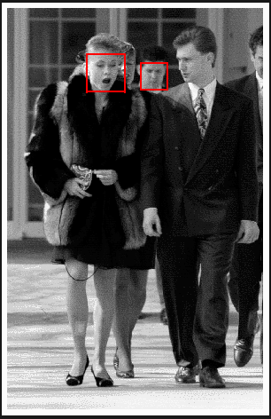
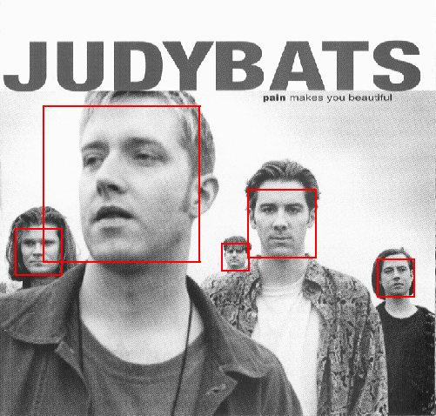
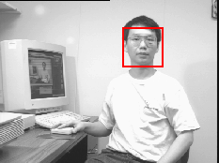
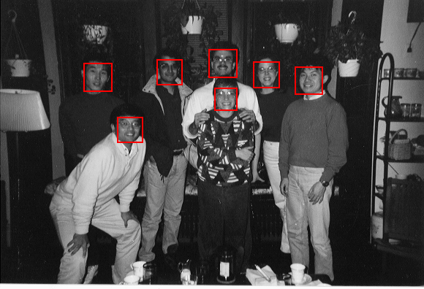
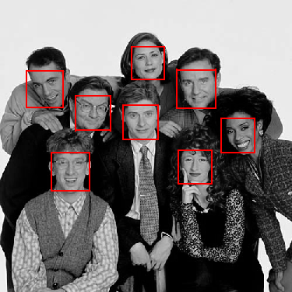
Output of Face Detector on Test Images

Slide 59
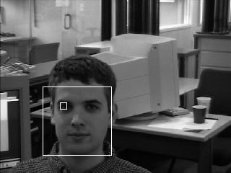
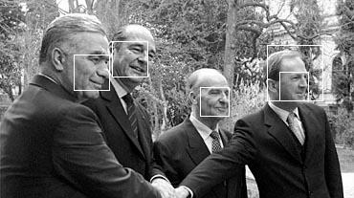
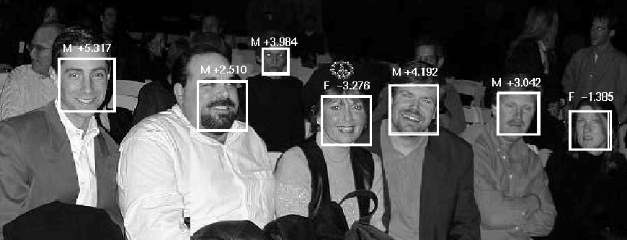
Other detection tasks
Facial Feature Localization
Profile Detection
Male vs.
female

Slide 60
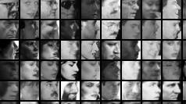
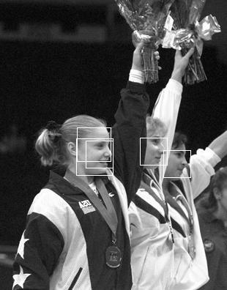
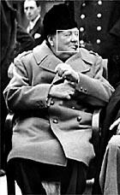
Profile Detection

Slide 61
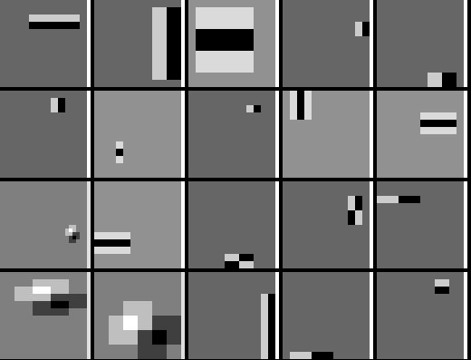
Profile Features

Slide 62
Summary: Viola/Jones detector
Rectangle features
Integral images for fast computation
Boosting for feature selection
Attentional cascade for fast rejection of negative windows

Slide 63
Linear classifiers
Find linear function (hyperplane) to separate positive and negative examples
Which hyperplane
is best?

Slide 64
Support vector machines
Find hyperplane that maximizes the margin between the positive and negative examples
For support, vectors,
Distance between point and hyperplane:
Therefore, the margin is 2 / ||w||
Support vectors
Margin
C. Burges, A Tutorial on Support Vector Machines for Pattern Recognition, Data Mining and Knowledge Discovery, 1998

Slide 65
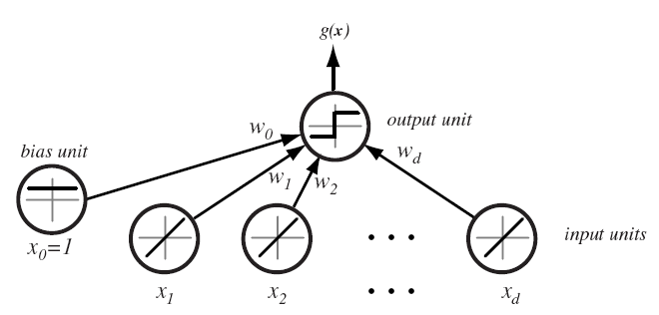
Linear classifiers
The perceptron
(Rosenblatt’57)
What the perceptron can
learn, it will learn using a
simple weight update
rule.

Slide 66
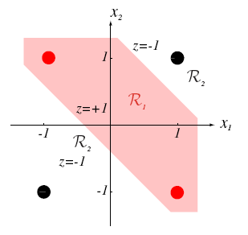
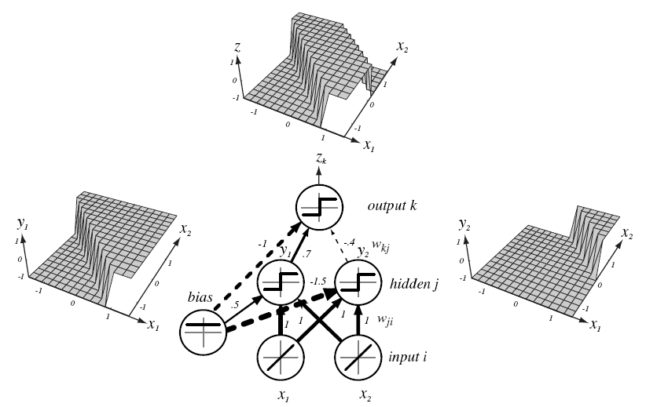
Slide by Duda, Hart, Stork

Slide 67
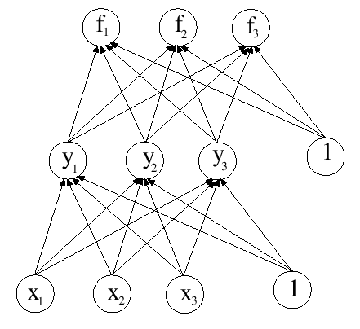
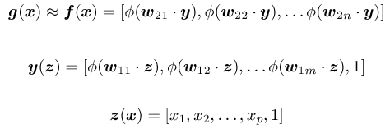
Multi-layer
neural
network
Slide by D.A. Forsyth
Notes:
Here phi is a squashing function; this is figure 22.13. We seek to adjust the w’s to get
the best classifier.

Slide 68
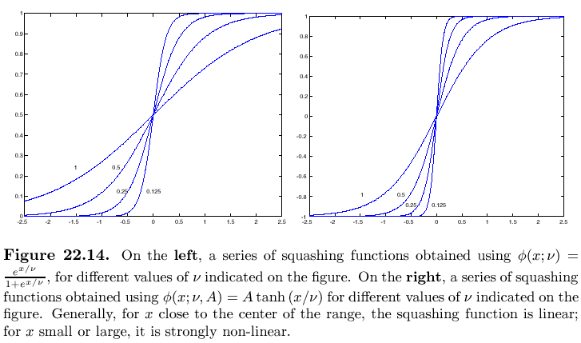
Slides by D.A. Forsyth
Notes:
22.14 - a bunch of different squashing functions

Slide 69
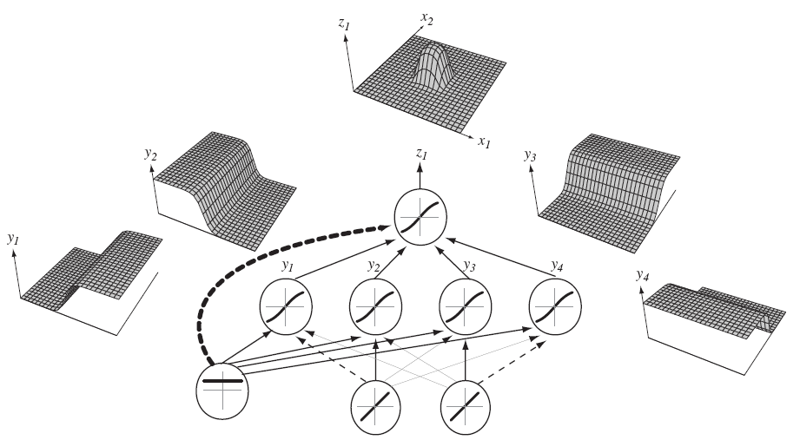
Any function can be learned by a 3-layer
network with enough hidden units
Slide by Duda, Hart, Stork

Slide 70
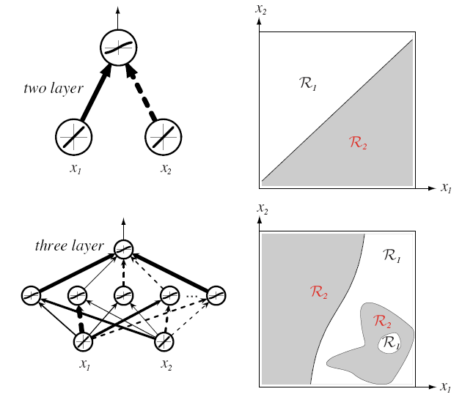
Slide by Duda, Hart, Stork

Slide 71
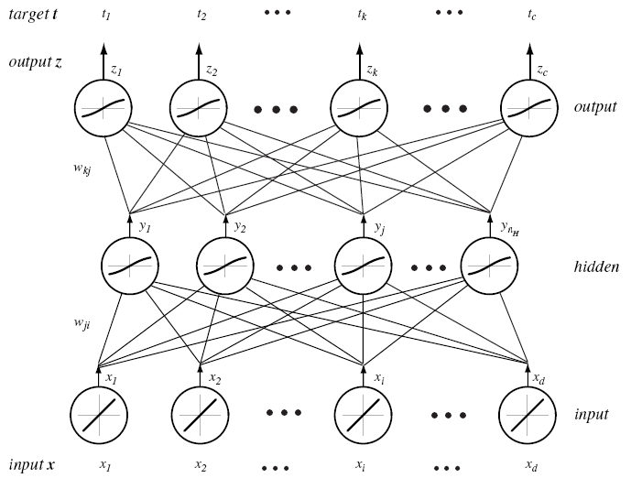
Slide by Duda, Hart, Stork

Slide 72
Gradient-based supervised learning
Parametric prediction function: f (x, w) ! y
Learning: Minimize
Recognition: y = f(x, w)
E = ∑_{i} L (y_{i} ,f (x_{i}, w))
How can we minimize E? ..Gradient descent..

Slide 73
Gradient-based supervised learning II
Gradient descent:
  compute rE=(∂E/∂w₁, … , ∂E/∂w_{n})
  w_{k+1} Ã w_{k} -²rE
Stochastic gradient descent:
  compute rE_{i}
  w_{k+1} Ã w_{k} - ²rE_{i}
  where E_{i} is the energy associated
  with some random training sample i
The stochastic version works much better
in practice.

Slide 74
Gradient-based supervised learning III
Consider a feed-forward system composed
of successive modules:
x_{i} = f_{i} (w_{i}, x_{i-1})
E = L (y , x), with x = x_{n} = f_{n} (w_{n}, x_{n-1})
∂E/∂w_{n} = ∂E/∂x ∂f_{n}/∂w_{n}
∂E/∂x_{n-1} = ∂E/∂x ∂f_{n}/∂x_{n-1}
Backward recursion: backpropagation

Slide 75
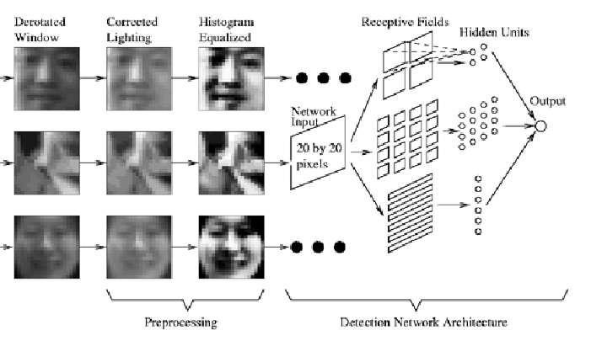
The vertical face-finding part of Rowley, Baluja and Kanade’s system
Figure from “Rotation invariant neural-network based face detection,” H.A. Rowley, S. Baluja and T. Kanade, Proc. Computer Vision and Pattern Recognition, 1998, copyright 1998, IEEE
Slide by D.A. Forsyth

Slide 76
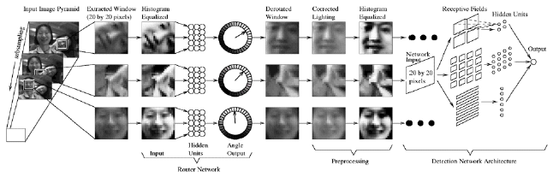
Architecture of the complete system: they use another neural
net to estimate orientation of the face, then rectify it. They
search over scales to find bigger/smaller faces.
Figure from “Rotation invariant neural-network based face detection,” H.A. Rowley, S. Baluja and T. Kanade, Proc. Computer Vision and Pattern Recognition, 1998, copyright 1998, IEEE
Slide by D.A. Forsyth
Notes:
Always worth asking: “why is it better to search over scales than to use bigger templates?”

Slide 77
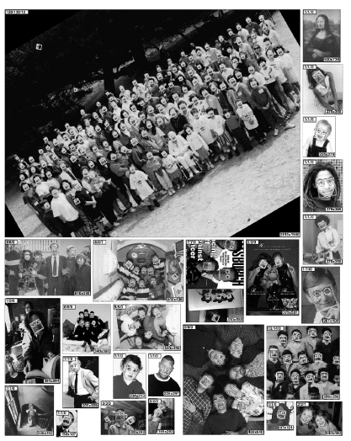
Figure from “Rotation invariant neural-network based face detection,” H.A. Rowley, S. Baluja and T. Kanade, Proc. Computer Vision and Pattern Recognition, 1998, copyright 1998, IEEE
Slide by D.A. Forsyth

Slide 78
Convolutional neural networks
Template matching using NN classifiers seems to work
Natural features are filter outputs
  probably, spots and bars, as in texture
  but why not learn the filter kernels, too?
Slide by D.A. Forsyth

Slide 79
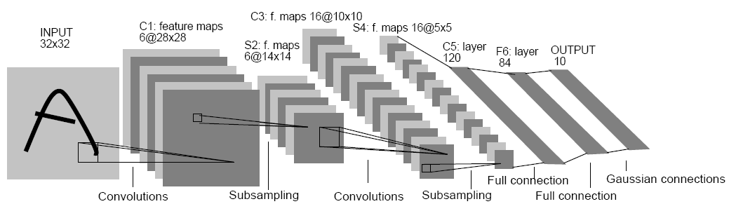
A convolutional neural network, LeNet; the layers filter, subsample, filter,
subsample, and finally classify based on outputs of this process.
Figure from “Gradient-Based Learning Applied to Document Recognition”, Y. Lecun et al Proc. IEEE, 1998 copyright 1998, IEEE
Slide by D.A. Forsyth

Slide 80
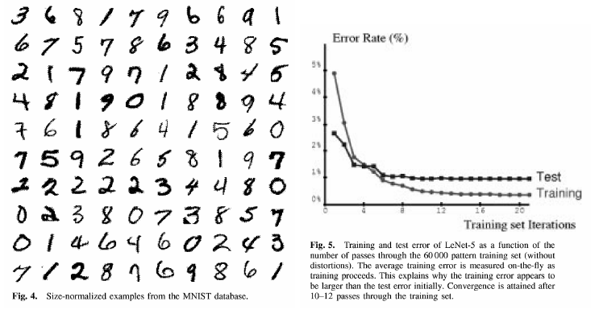
Figure from “Gradient-Based Learning Applied to Document Recognition”, Y. Lecun et al Proc. IEEE, 1998 copyright 1998, IEEE
Slide by D.A. Forsyth
Notes:
22.19

Slide 81
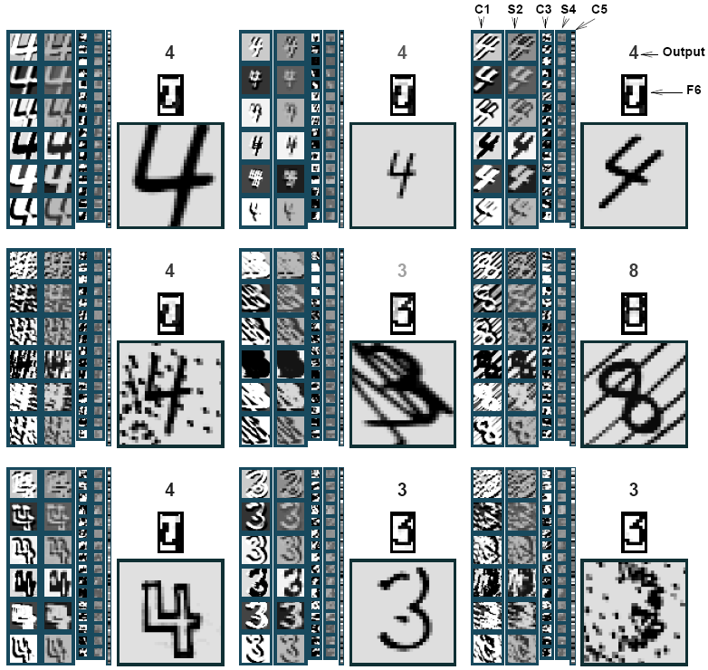

Slide 82
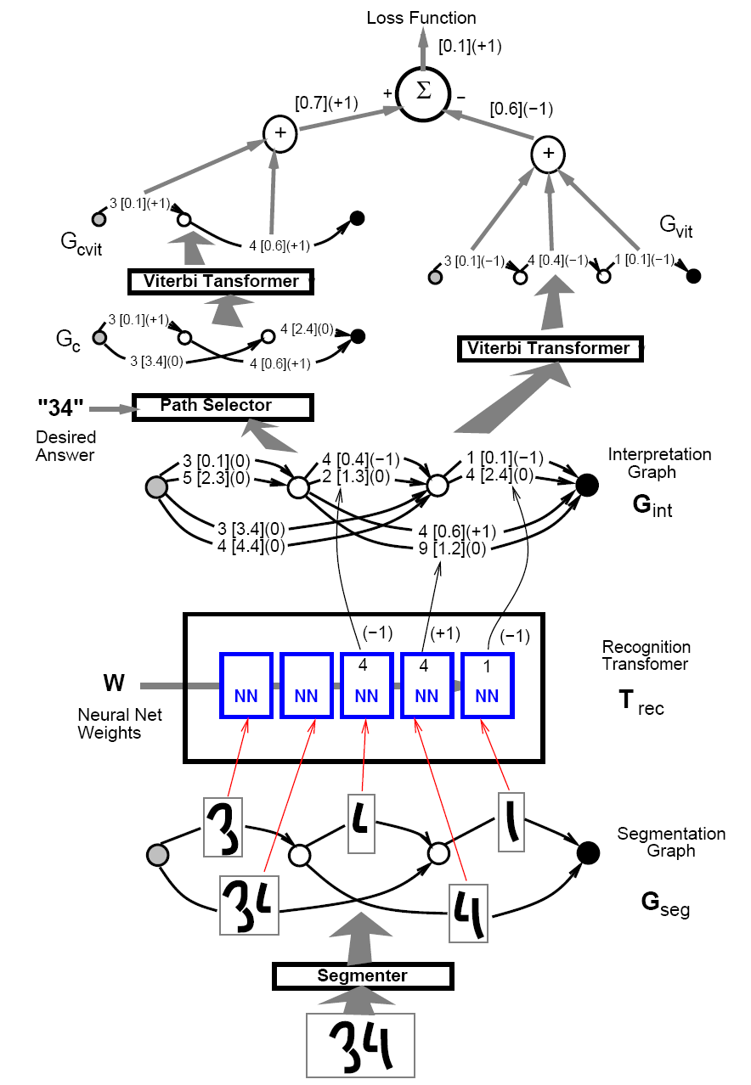

Slide 83

Slide by L. Bottou

Slide 84

Slide by L. Bottou

Slide 85

Slide by L. Bottou

