Slide 1





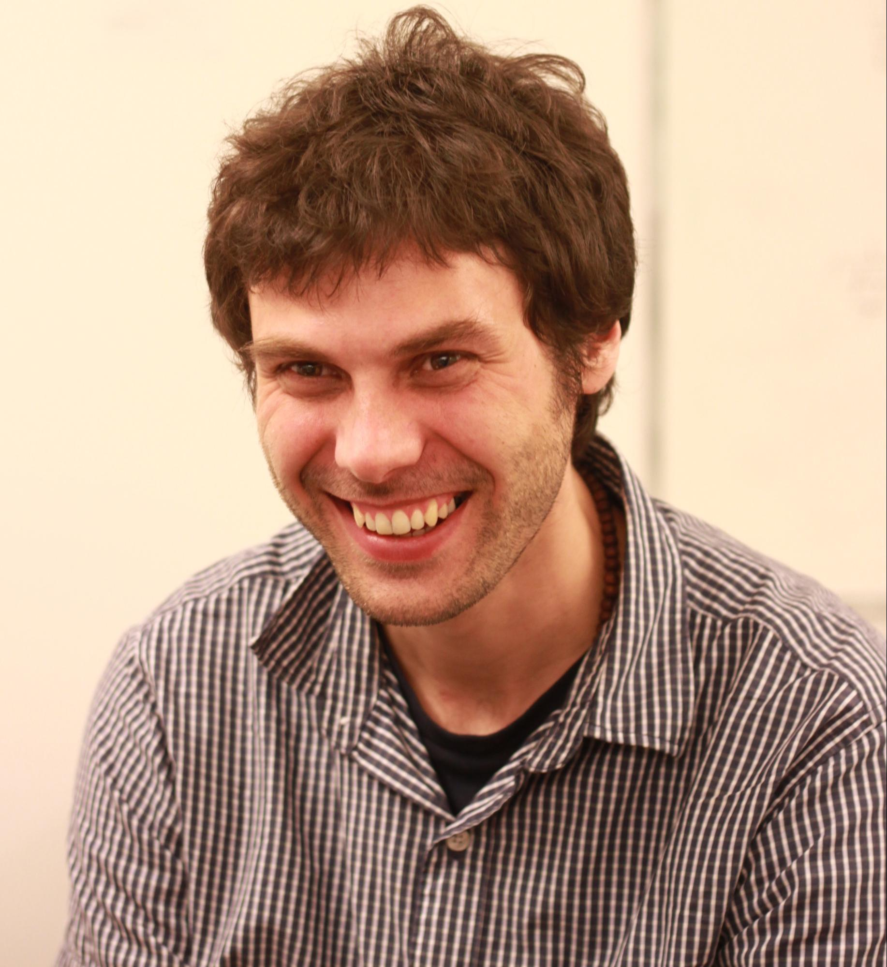
NetVLAD: CNN architecture for weakly supervised place recognition
Relja Arandjelović
P. Gronat
A. Torii
T. Pajdla
J. Sivic

Slide 2
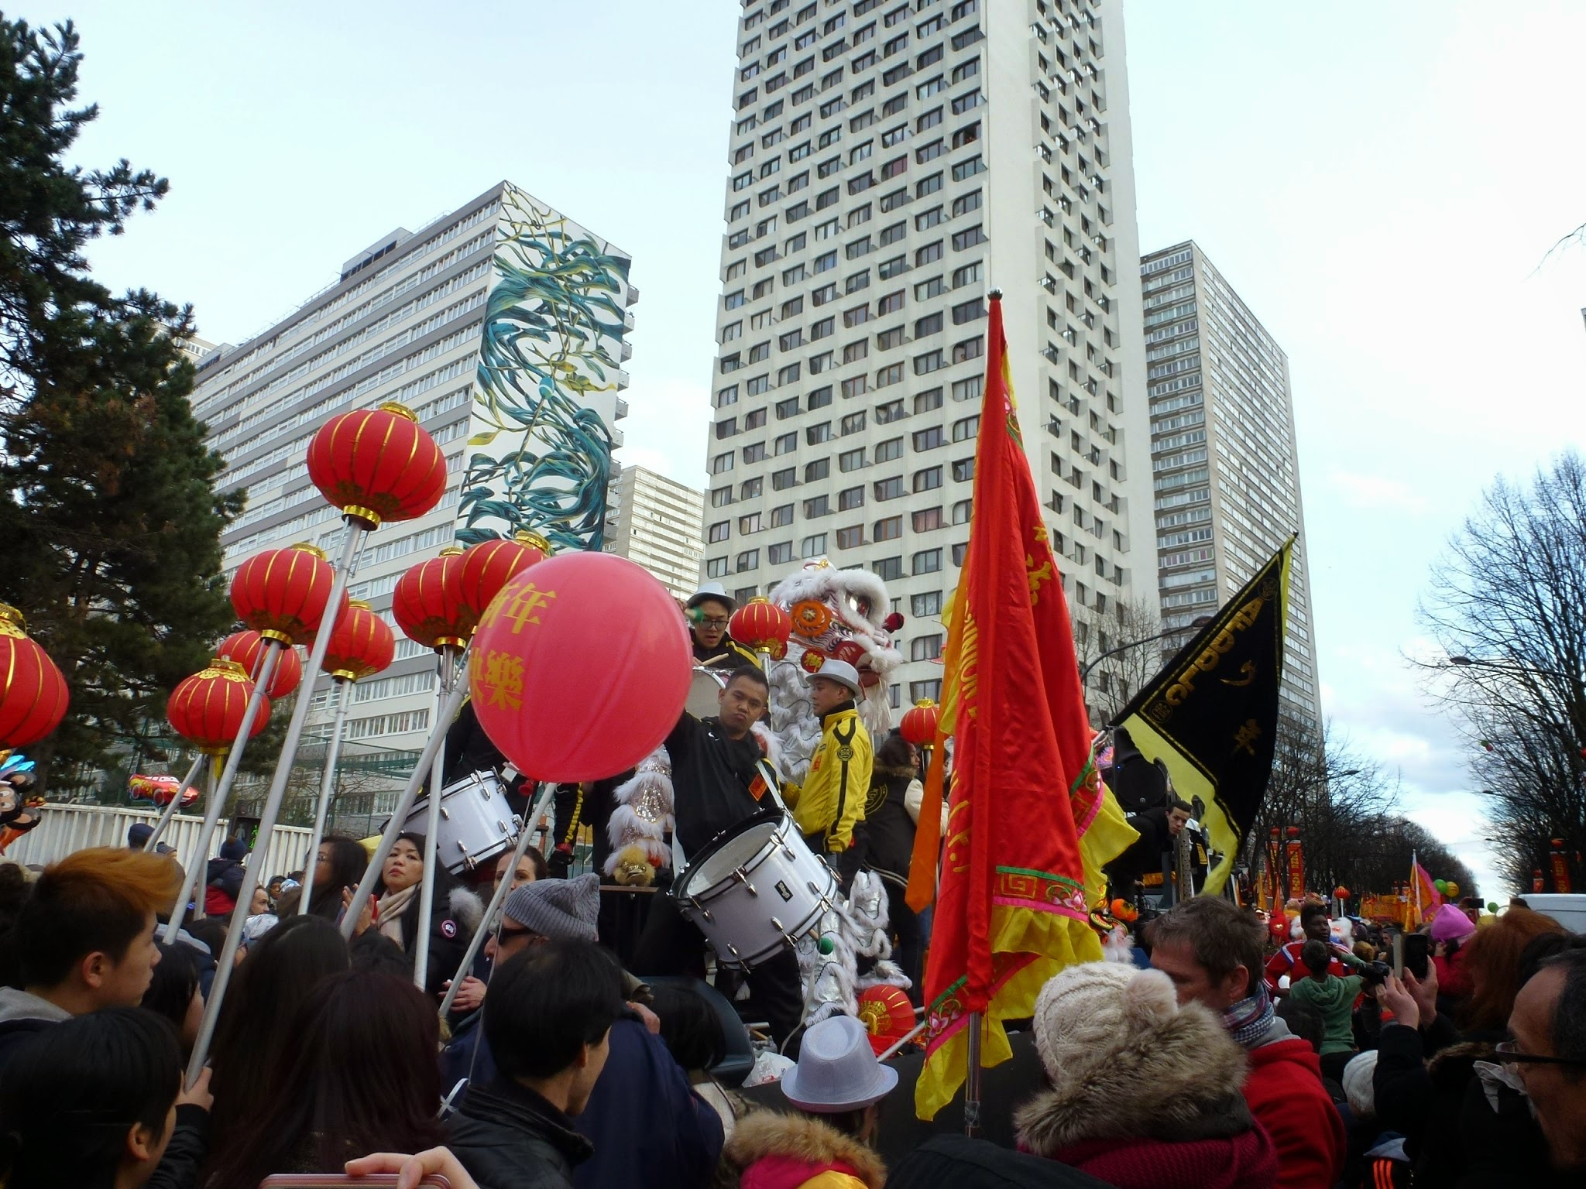

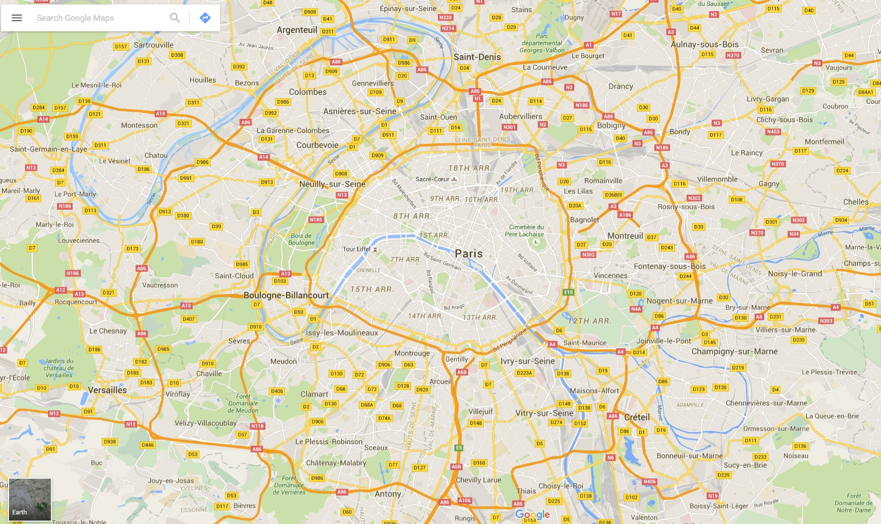

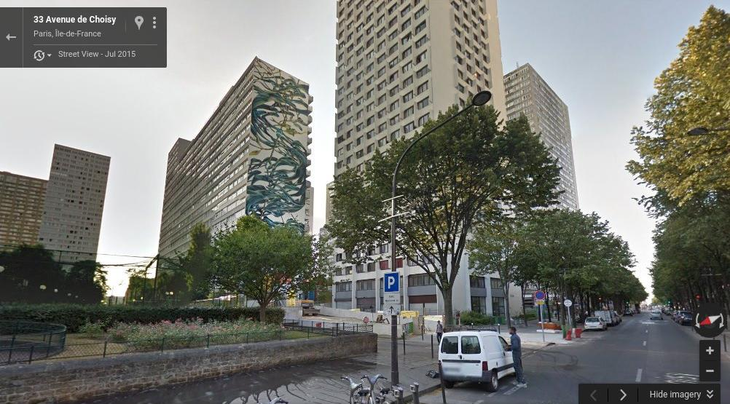
Visual Place Recognition: The goal
Search box
?
+

Slide 3
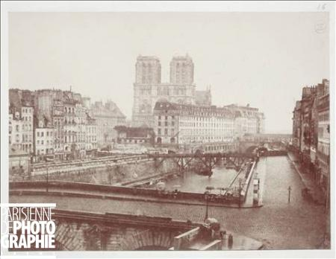
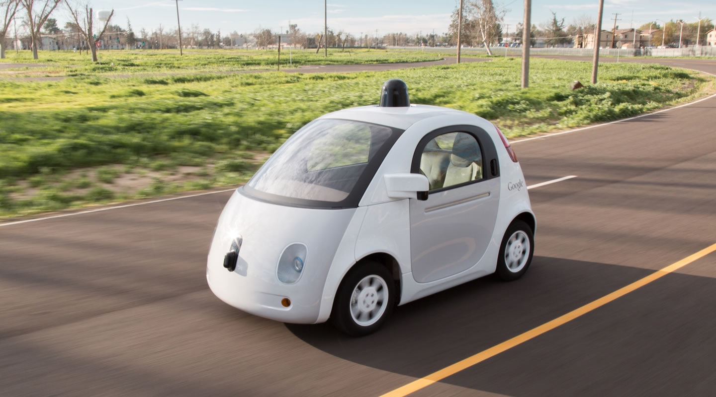
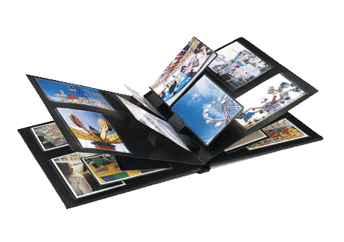
Why is this important? (when we have GPS)
Legacy and historical imagery
Improve accuracy of GPS (augmented reality, navigation in robotics)
1852
Understand personal photo collections

Slide 4
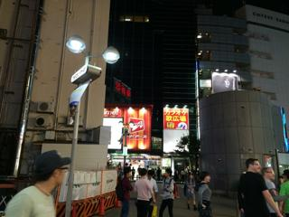
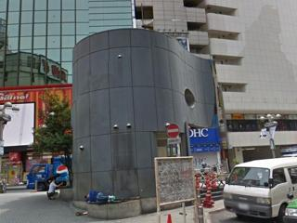
Why is it difficult?
Lighting changes: Different time of day / year
Changes in camera viewpoint
Occluders and ambiguous objects: People, cars, trees, pavement...
Big data: World-scale localization

Slide 5
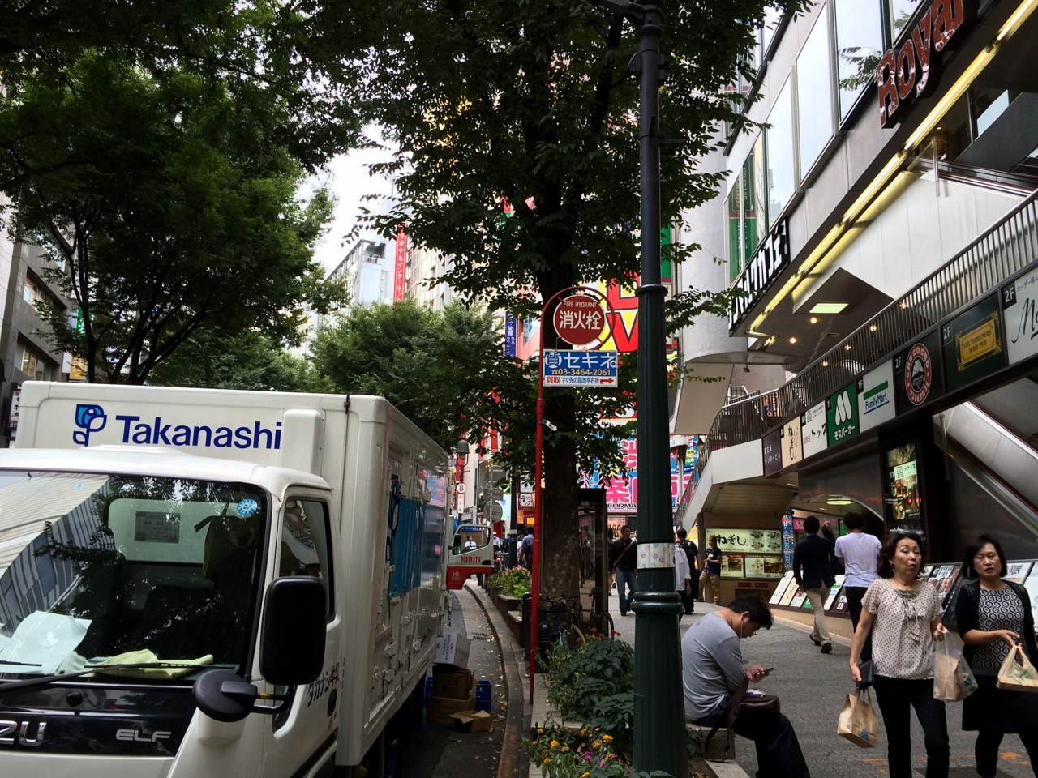
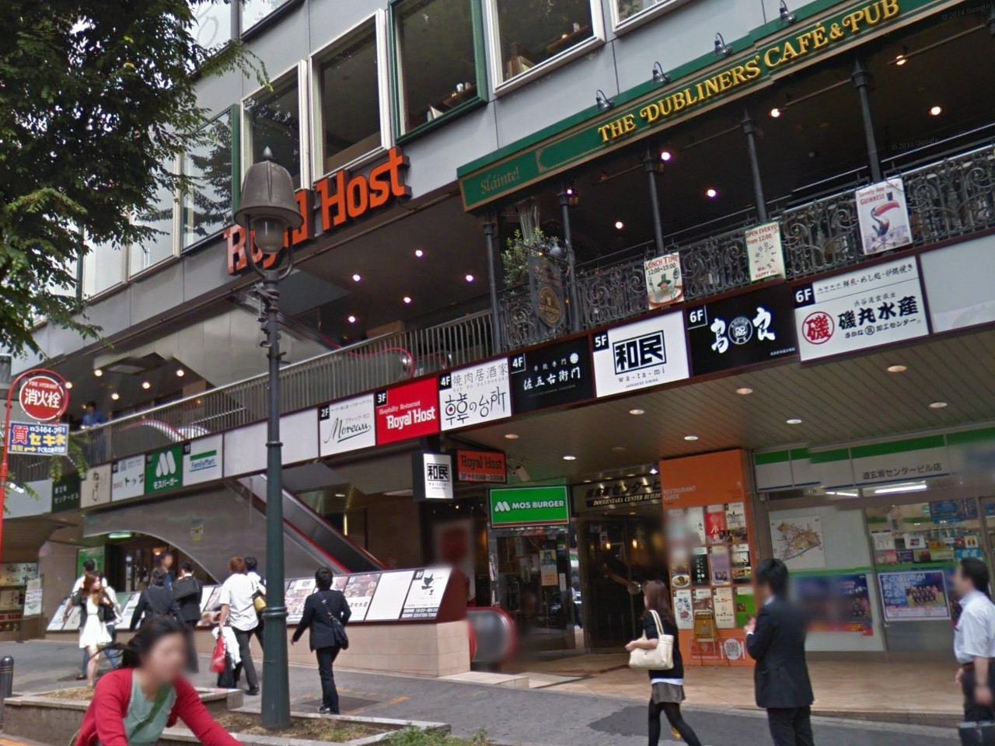
Why is it difficult?
Lighting changes: Different time of day / year
Changes in camera viewpoint
Occluders and ambiguous objects: People, cars, trees, pavement...
Big data: World-scale localization

Slide 6
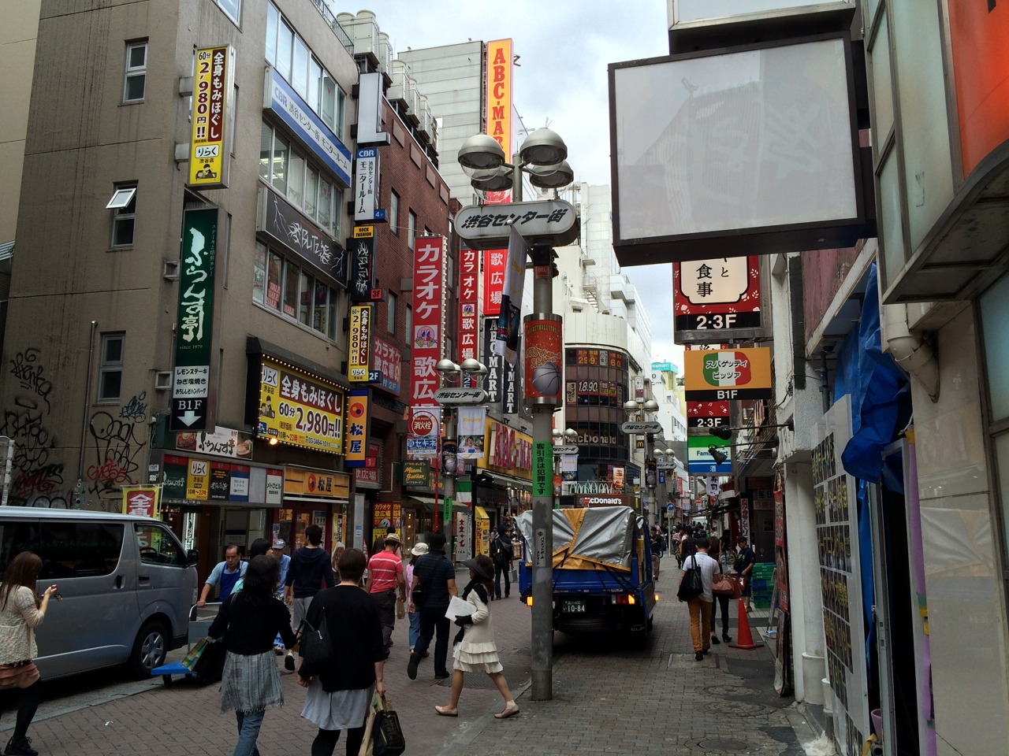
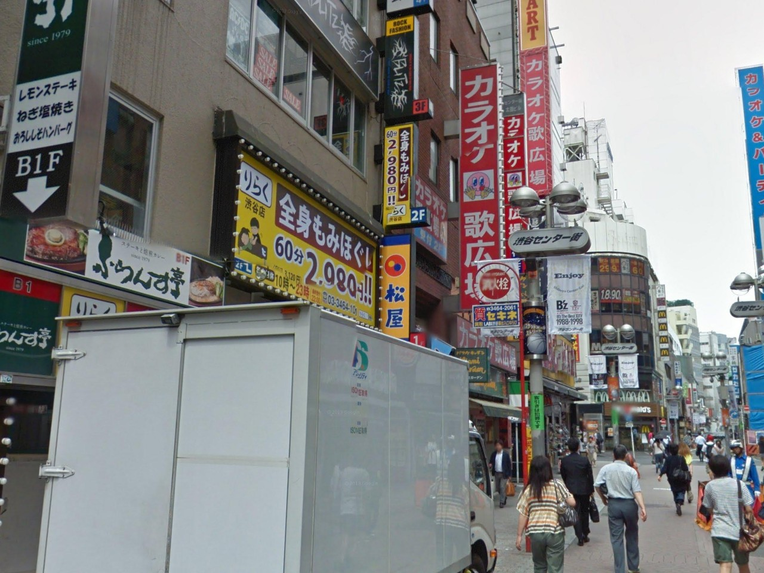
Why is it difficult?
Lighting changes: Different time of day / year
Changes in camera viewpoint
Occluders and ambiguous objects: People, cars, trees, pavement...
Big data: World-scale localization

Slide 7
Why is it difficult?
Lighting changes: Different time of day / year
Changes in camera viewpoint
Occluders and ambiguous objects: Trees, cars, pavement...
Big data: World-scale localization

Slide 8
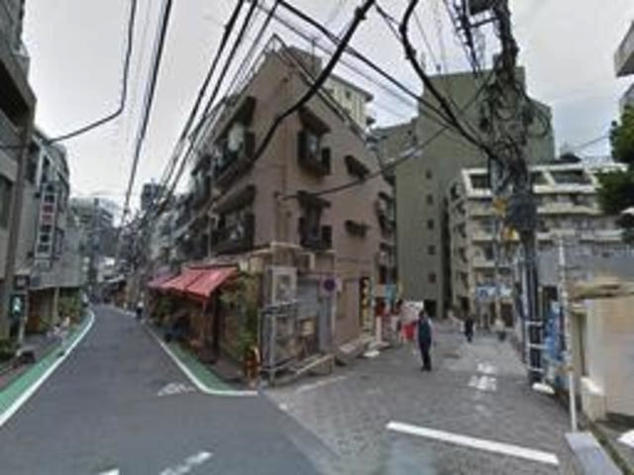
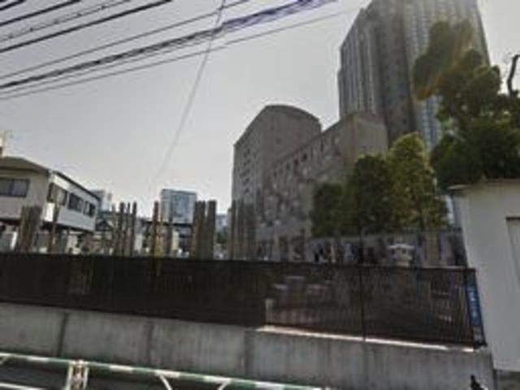
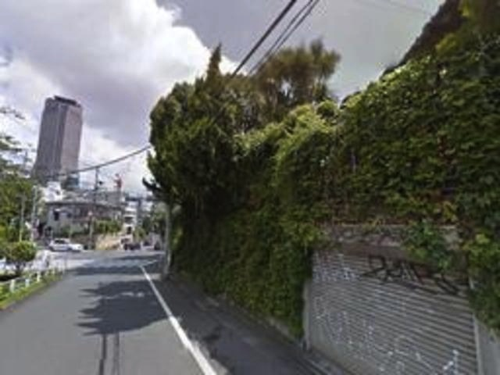
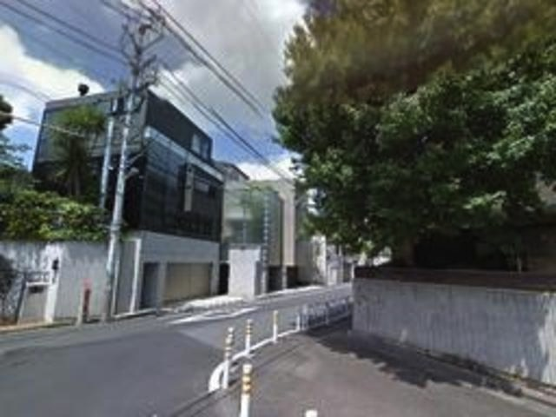
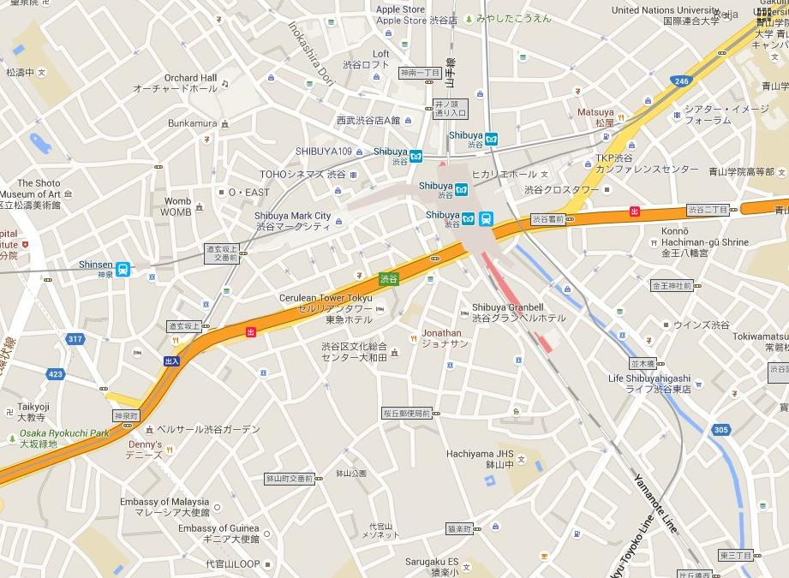
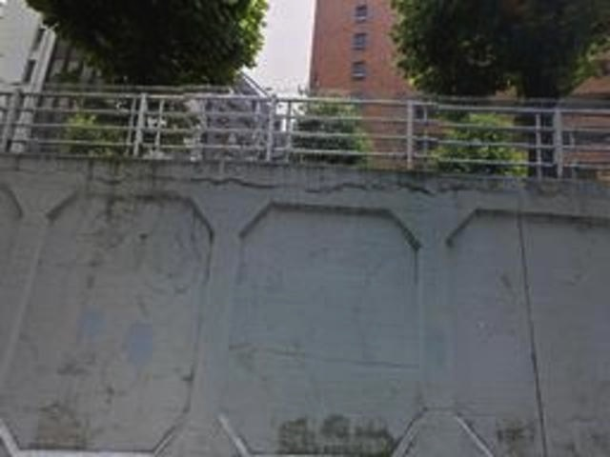
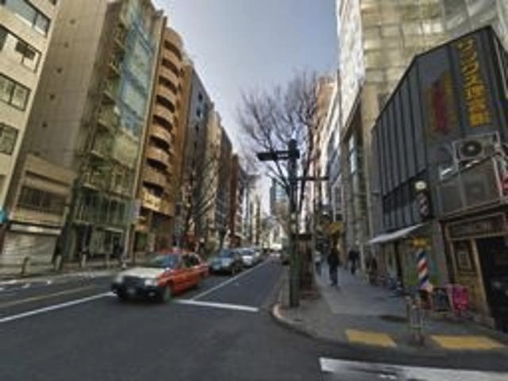
The approach: visual instance recognition
Represent the world by a set of geotagged images

Slide 9
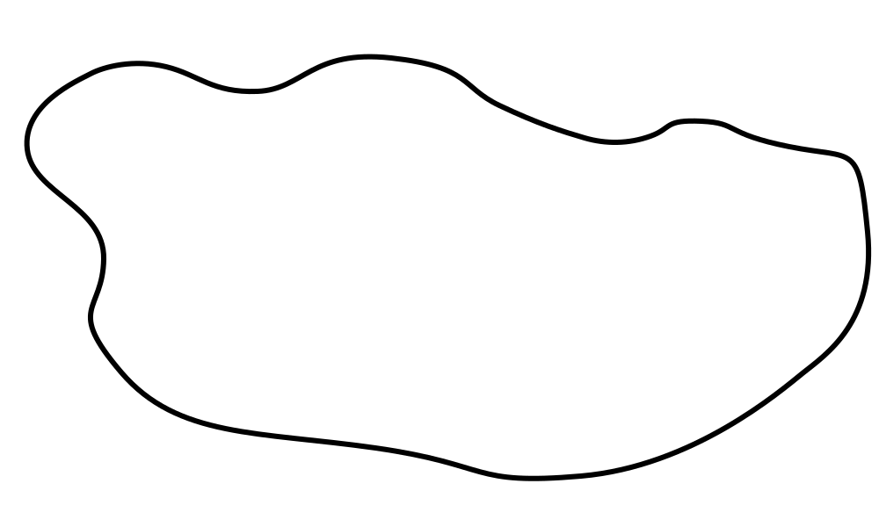
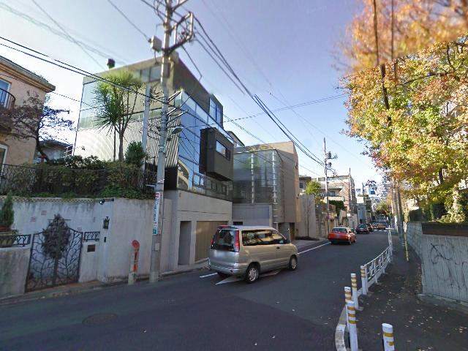
The approach: visual instance recognition
Geotagged image database
Design an “image representation” extractor f(I)
+
f( )
f( )
f( )
+
+
Transfer GPS
f( )
+
f( )
+
+
+
f( )
+
Query
f( )
Image representation space

Slide 10
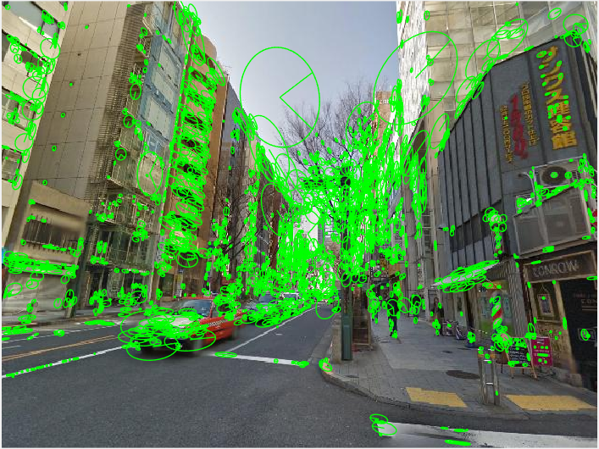
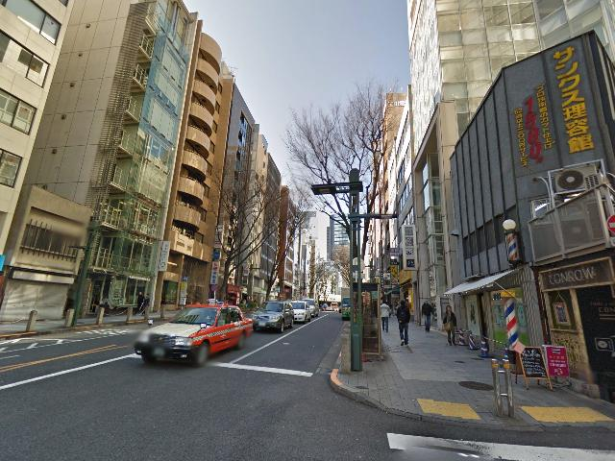
Visual instance recognition:
Local feature based methods still perform best
2
0
0
1
0
1
…
Image I
Extract local features (SIFT)
Aggregate
(BoW, VLAD, FV)
f(I)
Basic pipeline and improvements:
[Sivic & Zisserman 03, Nister & Stewenius 06, Philbin et al. 07, Perronnin & Dance 07, Jegou et al. 08, Jegou et al. 09, Muja & Lowe 08, Jegou et al. 10, Chum et al. 07, Arandjelović & Zisserman 12, Tolias & Jegou 14, Jegou et al. 09, Tolias et al. 13, Turcot & Lowe 09, Arandjelović & Zisserman 13, Delhumeau et al. 14, Jegou & Zisserman 14, …]
Not much learning

Slide 11
Visual instance recognition:
Local feature based methods still perform best
2
0
0
1
0
1
…
Image I
Extract local features (SIFT)
Aggregate
(BoW, VLAD, FV)
f(I)
Learn better local features:
[Cummins & Newman 09, Jegou et al. 07, Knopp et al. 10, Qin et al. 13, Arandjelović & Zisserman 14, Gronat et al. 13, Cao et al. 13, Winder et al. 09, Philbin et al. 10, Simonyan et al. 12, Simo-Serra et al. 14, Paulin et al. 15, Makadia 10, Mikulik et al. 10, Qin et al. 14, …]
All start from either hand-engineered descriptors and/or don’t train for the end-task

Slide 12
Visual instance recognition:
Local feature based methods still perform best
2
0
0
1
0
1
…
Image I
Extract local features (SIFT)
Aggregate
(BoW, VLAD, FV)
f(I)
Replace local features with a pre-trained CNN descriptor:
[Babenko et al. 14, Gong et al. 14, Azizpour et al. 14, Razavian et al. 14, Babenko & Lempitsky 15]
Not trained on the instance recognition task

Slide 13
Can we apply CNNs to place recognition?
Questions:
  What is a good CNN architecture?
  How to get the lots of annotated training data?
  What is the appropriate loss for end-to-end training?

Slide 14
Mimic the state-of-the-art architecture
2
0
0
1
0
1
…
Image I
Extract local features (SIFT)
Aggregate
(BoW, VLAD, FV)
f(I)
Convolutional layers from
AlexNet or VGGNet
Trainable pooling layer
But make it trainable end-to-end

Slide 15
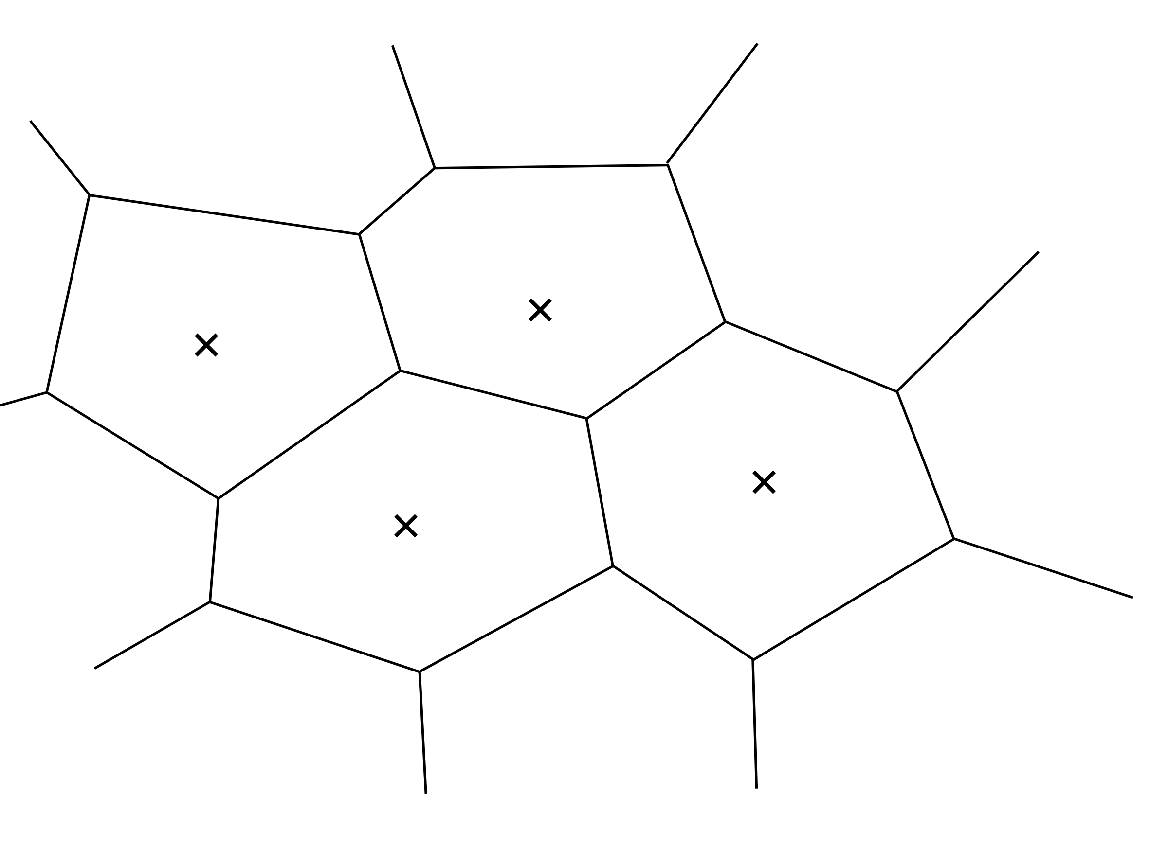


Review: Pooling local descriptors -
Bag-of-Words (BoW)
  0/1 assignment of desc. i to cluster k
$$a_{k}(x_{i})$$
$$x_{i}$$
0
1
0
0
[Sivic and Zisserman 03]

Slide 16

Review: Pooling local descriptors -
Bag-of-Words (BoW)
  0/1 assignment of desc. i to cluster k
$$B\left(k\right)=\sum_{i=1}^{N}{a_{k}(x_{i})}$$
$$a_{k}(x_{i})$$
Sum over all N descriptors in the image
0
1
1
2
B = [ 1, 0, 2, 1, … ]
[Sivic and Zisserman 03]

Slide 17



Review: Vector of Locally Aggregated Descriptors (VLAD)
  0/1 assignment of desc. i to cluster k
$$a_{k}(x_{i})(x_{i}−c_{k})$$
Residual vector
$$x_{i}$$
$$c_{k}$$
[Jégou et al. 10]

Slide 18
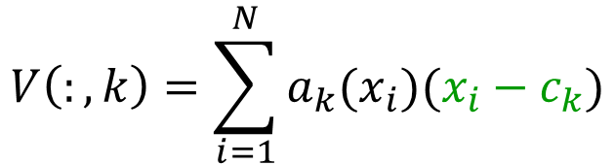
Review: Vector of Locally Aggregated Descriptors (VLAD)
  0/1 assignment of desc. i to cluster k
$$V\left(:,k\right)=\sum_{i=1}^{N}{a_{k}(x_{i})(x_{i}−c_{k})}$$
$$a_{k}(x_{i})(x_{i}−c_{k})$$
Residual vector
Sum over all N descriptors in the image
V = [ , . , , , … ]
[Jégou et al. 10]

Slide 19
NetVLAD: Trainable pooling layer
Convolutional layers from
AlexNet or VGGNet
Trainable pooling layer
Part of the CNN architecture
Trainable end-to-end

Slide 20
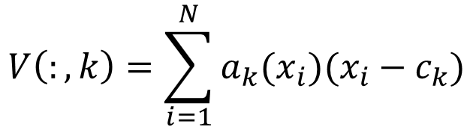
NetVLAD: Trainable pooling layer
  0/1 assignment of desc. i to cluster k
$$V\left(:,k\right)=\sum_{i=1}^{N}{a_{k}(x_{i})(x_{i}−c_{k})}$$
Replace hard-assignment of descriptors to clusters with soft-assignment

Slide 21
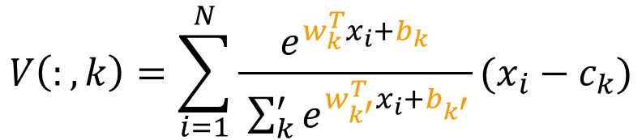
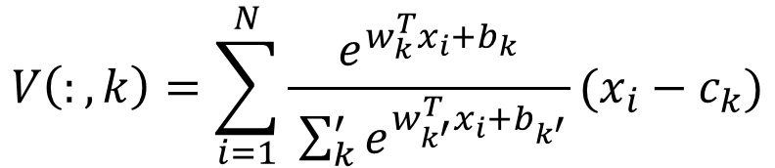
NetVLAD: Trainable pooling layer
  soft assignment of desc. i to cluster k
$$V\left(:,k\right)=\sum_{i=1}^{N}{\frac{e^{w_{k}^{T}x_{i}+b_{k}}}{ \sum_{k}^{′}{e^{w_{k^{′}}^{T}x_{i}+b_{k^{′}}}}}(x_{i}−c_{k})}$$
$$V\left(:,k\right)=\sum_{i=1}^{N}{\frac{e^{w_{k}^{T}x_{i}+b_{k}}}{ \sum_{k}^{′}{e^{w_{k^{′}}^{T}x_{i}+b_{k^{′}}}}}(x_{i}−c_{k})}$$

Slide 22
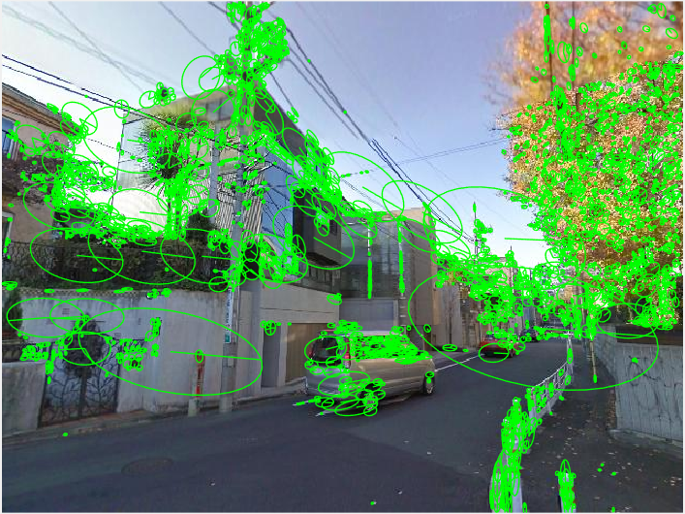
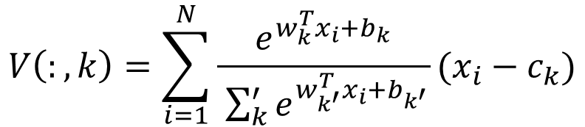

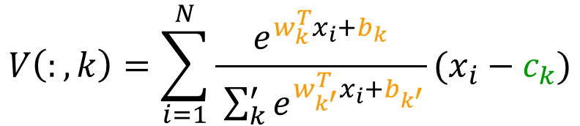
NetVLAD: Trainable pooling layer
Decouple assignment (w_{k} b_{k}) from anchor point c_{k}
$$V\left(:,k\right)=\sum_{i=1}^{N}{\frac{e^{w_{k}^{T}x_{i}+b_{k}}}{ \sum_{k}^{′}{e^{w_{k^{′}}^{T}x_{i}+b_{k^{′}}}}}(x_{i}−c_{k})}$$
$$V\left(:,k\right)=\sum_{i=1}^{N}{\frac{e^{w_{k}^{T}x_{i}+b_{k}}}{ \sum_{k}^{′}{e^{w_{k^{′}}^{T}x_{i}+b_{k^{′}}}}}(x_{i}−c_{k})}$$
$$c_{k}$$

Slide 23

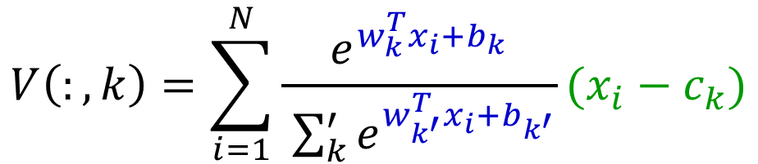
NetVLAD as a trainable layer
  Convolution with filters {w_{k}} and biases {b_{k}}
$$V\left(:,k\right)=\sum_{i=1}^{N}{\frac{e^{w_{k}^{T}x_{i}+b_{k}}}{ \sum_{k}^{′}{e^{w_{k^{′}}^{T}x_{i}+b_{k^{′}}}}}(x_{i}−c_{k})}$$
Soft-max $→\overline{a}$
Residual vector
WxHxD feature map
of last conv. layer

Slide 24
Can we apply CNNs to place recognition?
Questions:
  What is a good CNN architecture?
  How to get the lots of annotated training data?
  What is the appropriate loss for end-to-end training?

Slide 25
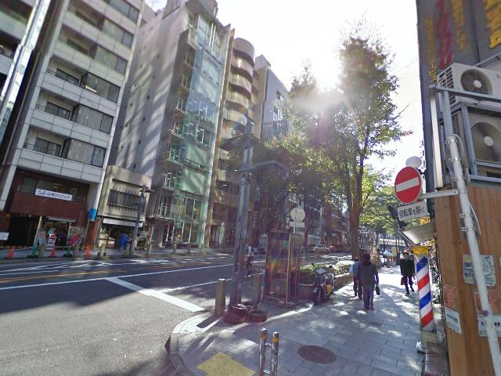
Google Street View Time Machine
  The same locations at different times and seasons

Slide 26
Google Street View Time Machine
  The same locations at different times and seasons

Slide 27
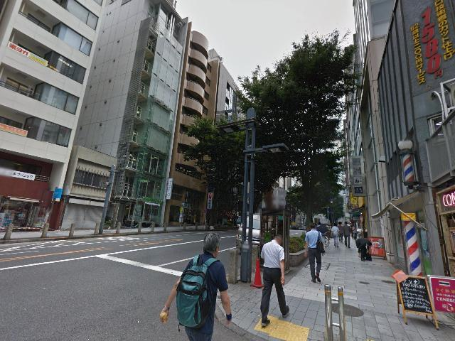
Google Street View Time Machine
  The same locations at different times and seasons

Slide 28
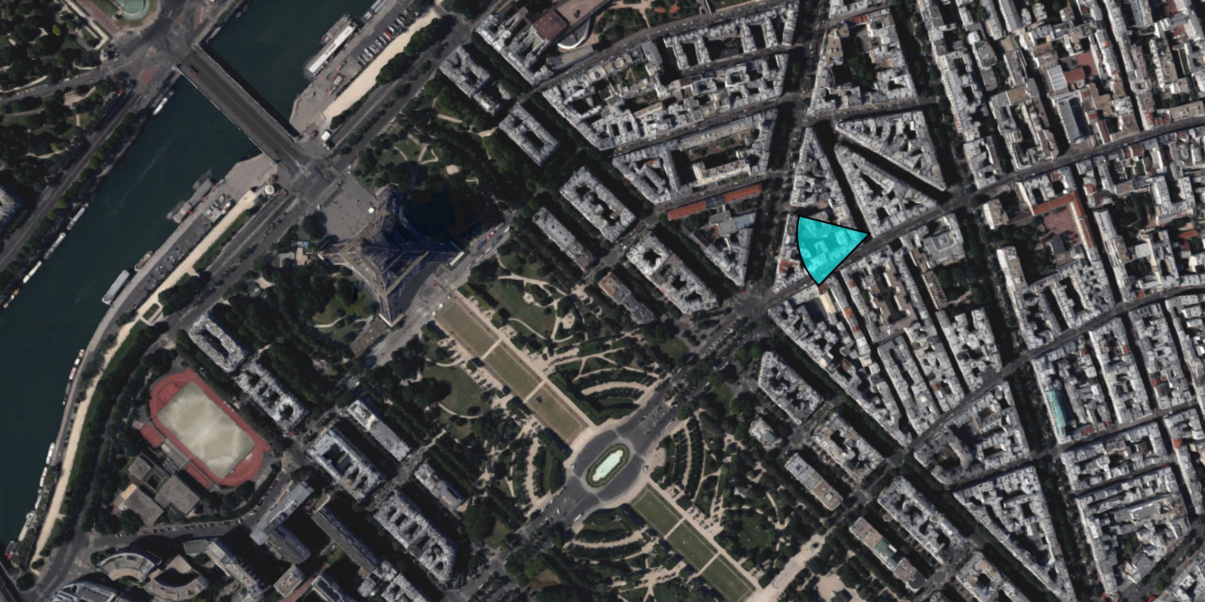
But provides only weak supervision
Query

Slide 29
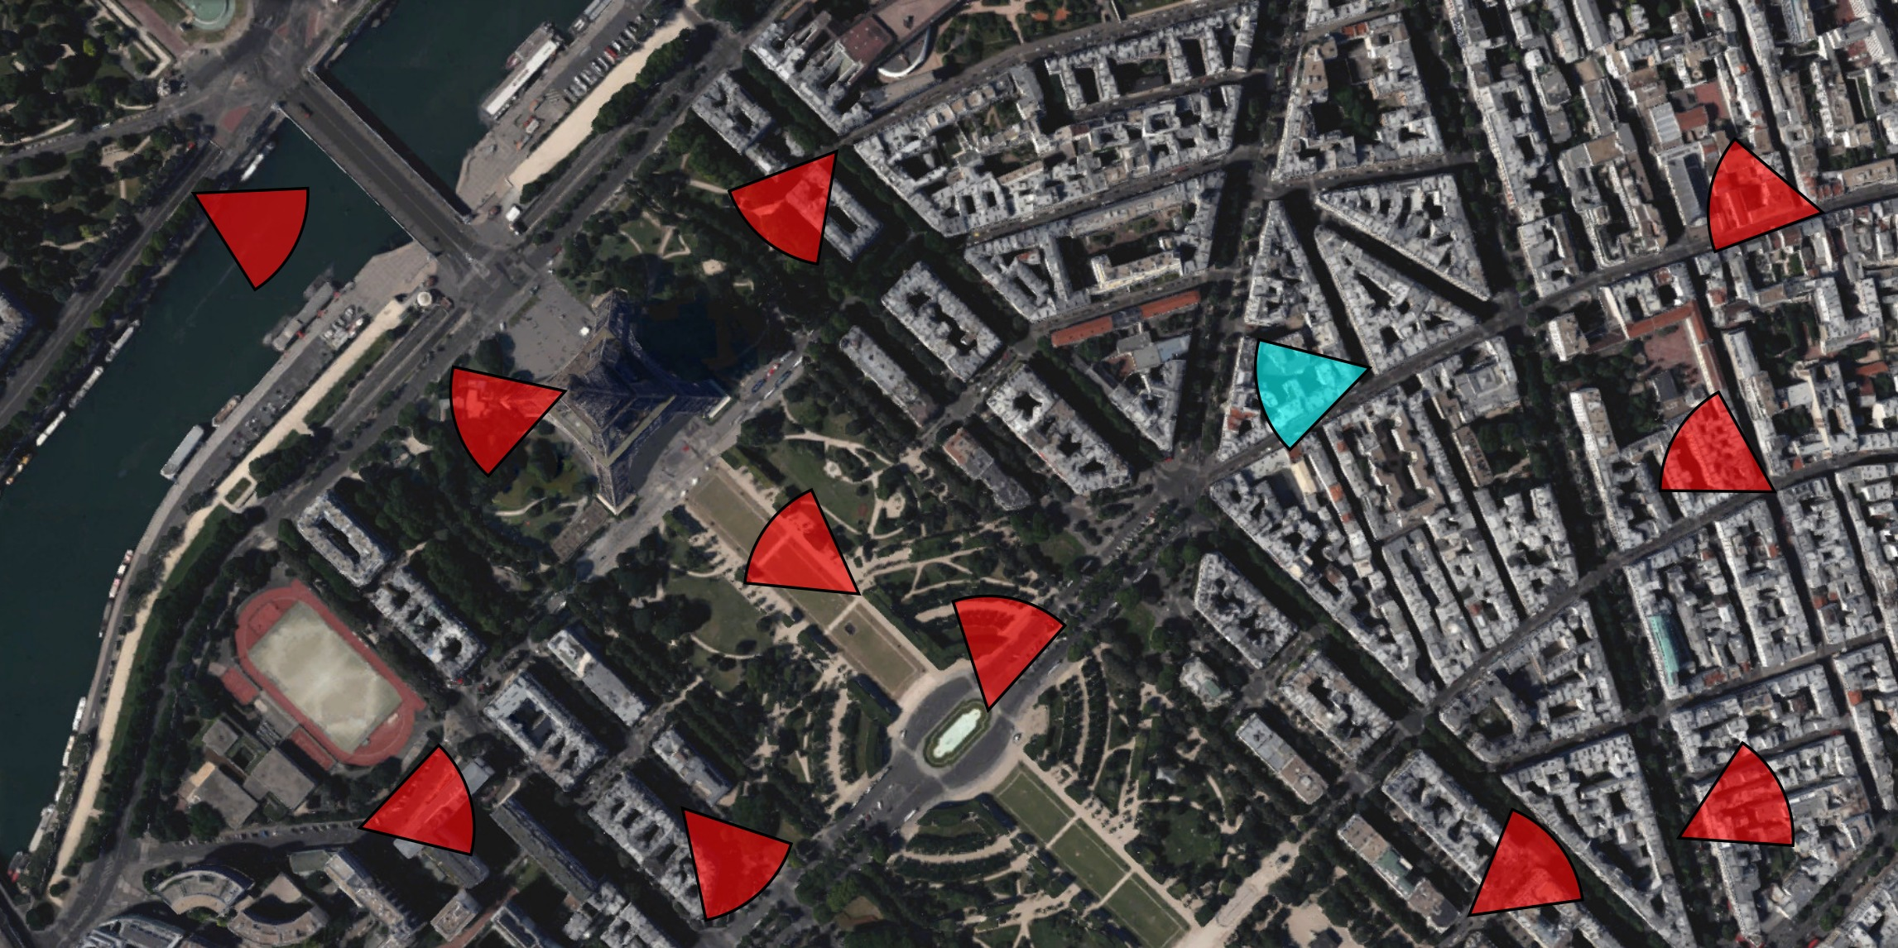
But provides only weak supervision
  Given a query, GPS gives us:
    Definite negatives :
      geographically far from the query
Query

Slide 30
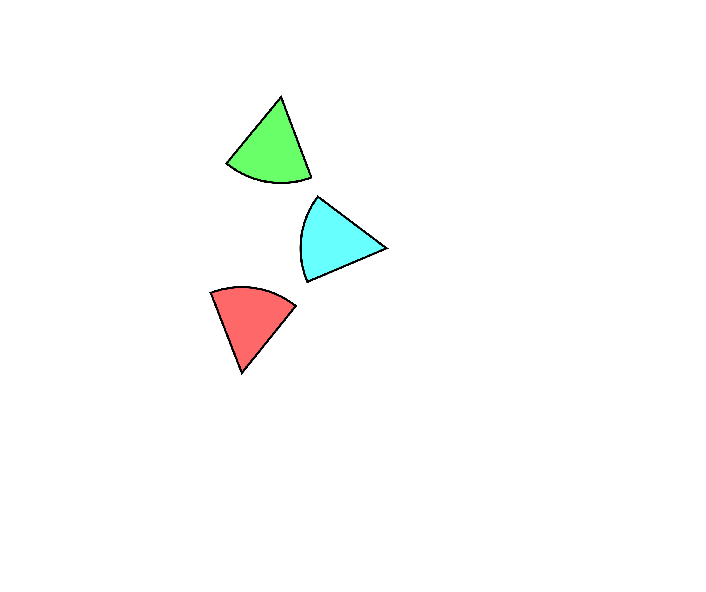
But provides only weak supervision
Query

Slide 31
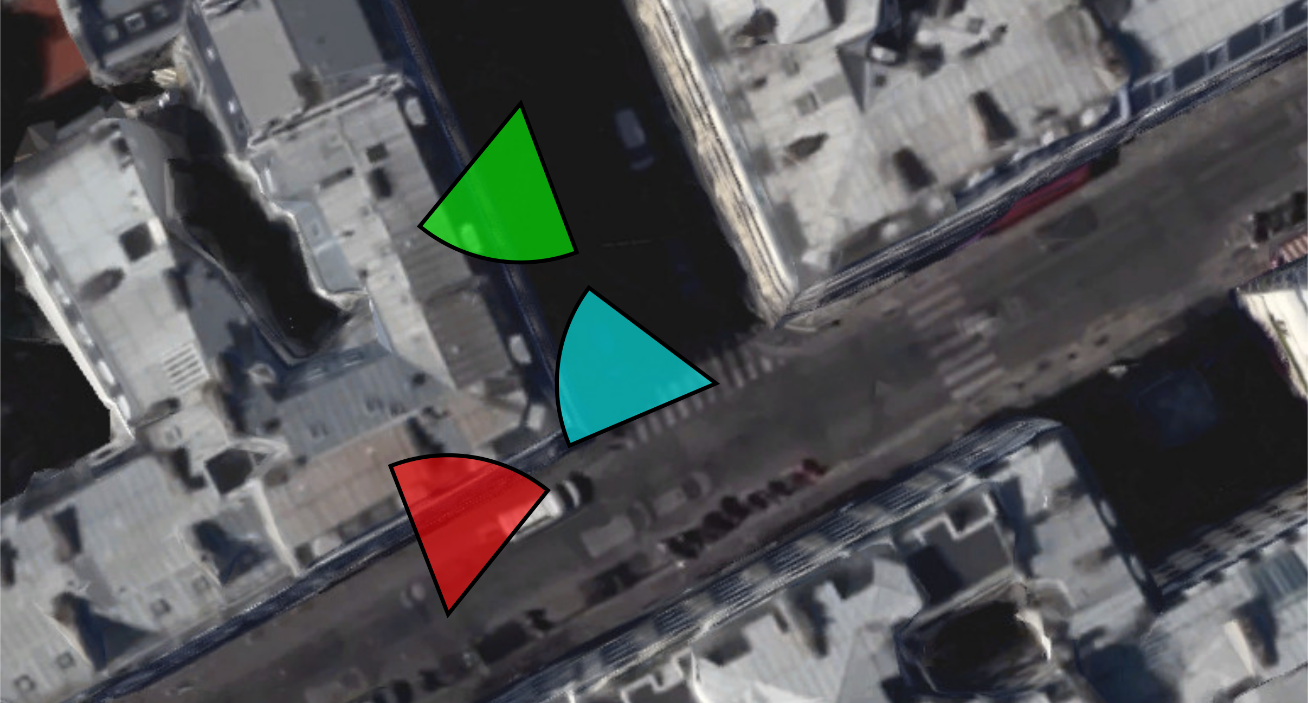
But provides only weak supervision
  Given a query, GPS gives us:
    Potential positives:
      geographically close to the query
Query

Slide 32
Can we apply CNNs to place recognition?
Questions:
  What is a good CNN architecture?
  How to get the lots of annotated training data?
  What is the appropriate loss for end-to-end training?

Slide 33
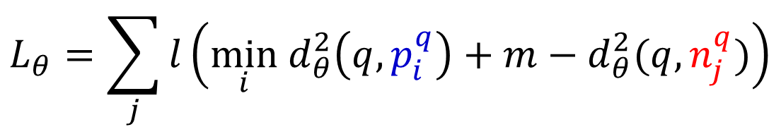
Weakly supervised ranking loss
  Inspired by the triplet loss
  [Schultz and Joachims 04, Weinberger et al. 06, Wang et al. 14, Schroff et al. 15]
  Can be optimized with Stochastic Gradient Descent
  More details at the [poster]
For a tuple (q, {p_{i}^{q}}, {n_{j}^{q}}) :
  hinge loss
  margin
$$L_{θ}=\sum_{j}{l\left(\min_{i}{ d}_{θ}^{2}\left(q,p_{i}^{q}\right)+m−d_{θ}^{2}(q,n_{j}^{q})\right)}$$
Sum over negatives
Distance to the best potential positive
Distance to the negative

Slide 34
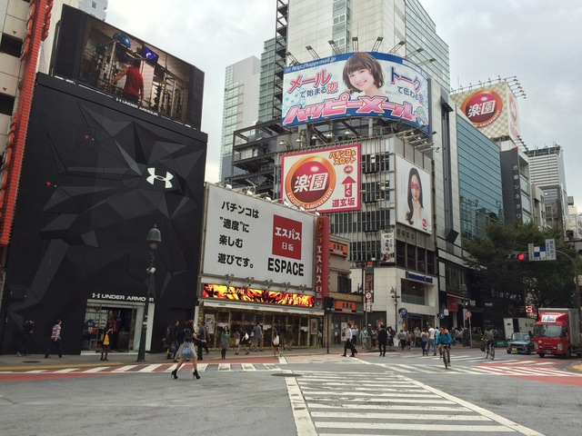
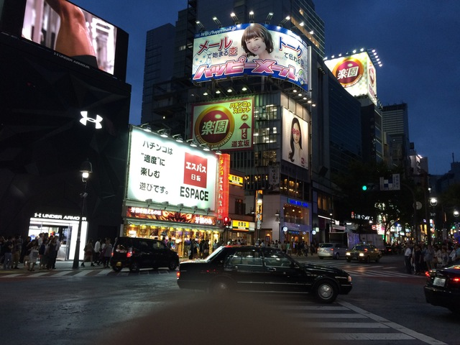
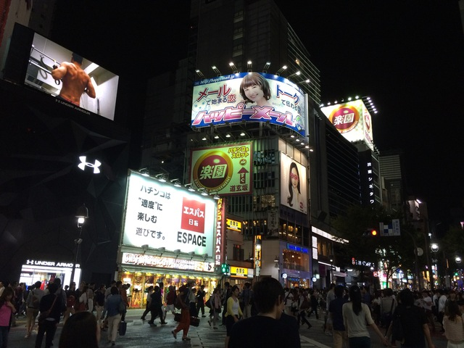
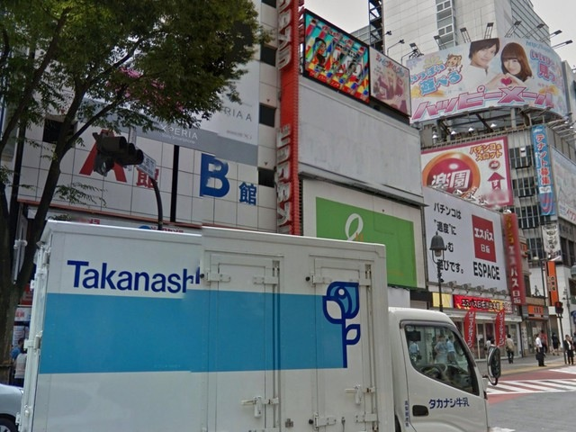
Experiments: Datasets and evaluation protocol
  Pittsburgh [Torii et al. 13]
    Database: 250k images from Street View
    Queries: 24k images from Street View at other times
  Tokyo 24/7 [Torii et al. 15]
    Database: 76k images from Street View
    Queries: 315 images from mobile phone cameras
Day query
Sunset query
Night query
Database image

Slide 35
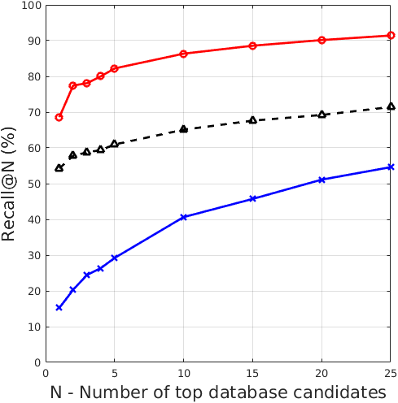
New state-of-the-art result on all datasets
Trained NetVLAD sets the state-of-the-art by a large margin
Ours: Trained NetVLAD
RootSIFT+VLAD+whitening
[Torii et al. CVPR’15]
Off-the-shelf Max pooling
[Razavian et al. ICLR’15]
 | recall@5
Previous state-of-the-art | 60.9%
Trained NetVLAD | 82.2%
Relative improvement | 35.0%

Slide 36
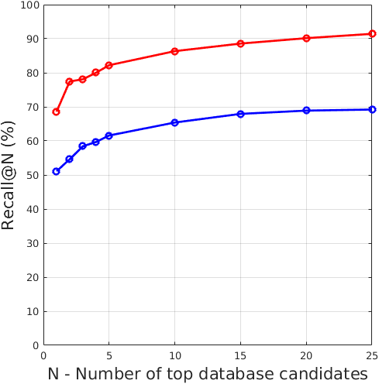
End-to-end training vs off-the-shelf
Training is crucial
Ours: Trained NetVLAD
Off-the-shelf VLAD
 | recall@5
Off-the-shelf VLAD | 61.6%
Trained NetVLAD | 82.2%
Relative improvement | 33.4%

Slide 37
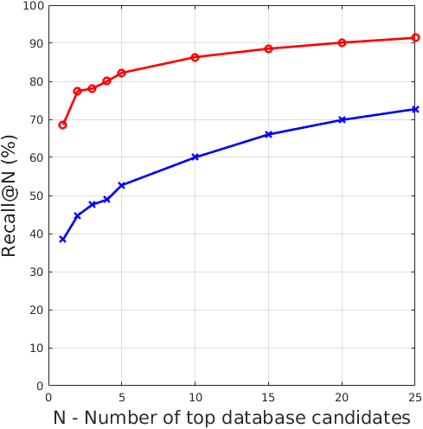
NetVLAD vs Max
NetVLAD clearly beats Max pooling
Ours: Trained NetVLAD
Ours: Trained Max pooling
 | recall@5
Off-the-shelf VLAD | 52.7%
Trained NetVLAD | 82.2%
Relative improvement | 56.0%

Slide 38
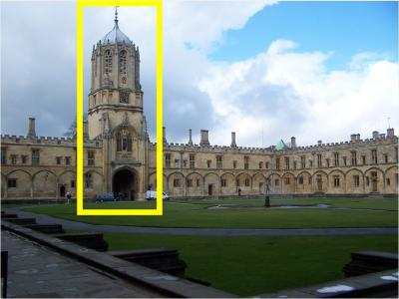
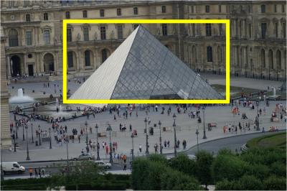

Results on standard retrieval benchmarks
Test our network on a related task: specific image/object retrieval
Sets the new state-of-the-art for compact image representations (256-D) on all 3 datasets
Method | Oxford 5k (full) | Oxford 5k (crop) | Paris 6k (full) | Paris 6k (crop) | Holidays (original) | Holidays (rotated)
Jégou and Zisserman CVPR14 |  | 47.2 |  |  | 65.7 | 65.7
Gordo et al. CVPR12 |  |  |  |  | 78.3
Razavian et al. ICLR15 | 53.3 |  | 67.0 |  | 74.2
Babenko and Lempitsky ICCV15 | 58.9 | 53.1 |  |  |  | 80.2
NetVLAD off-the-shelf | 53.4 | 55.5 | 64.3 | 67.7 | 82.1 | 86.0
NetVLAD trained | 62.5 | 63.5 | 72.0 | 73.5 | 79.9 | 84.3
Ours
[Radenović et al. arXiv 16, Gordo et al. arXiv 16]

Slide 39



Conclusions
State-of-the-art on place recognition and
image retrieval benchmarks
Trainable NetVLAD pooling layer
Street View Time Machine
Weakly supervised ranking loss [poster]
$$L_{θ}=\sum_{j}{l\left(\min_{i}{ d}_{θ}^{2}\left(q,p_{i}^{q}\right)+m−d_{θ}^{2}(q,n_{j}^{q})\right)}$$
Code and trained networks available online:
http://www.di.ens.fr/willow/research/netvlad/ (the link is in the paper)

Slide 40

The end: Qualitative results
Code and trained networks available online:
http://www.di.ens.fr/willow/research/netvlad/ (the link is in the paper)
Query
Top result
Green: Correct
Red: Incorrect

Slide 41






































Example
Potential positives
Definite negatives
Query
The best matching positive

Slide 42


NetVLAD behaviour with dimensionality reduction
NetVLAD (-o-) clearly beats Max (x) at reduced dimensionality as well:
  Much better performance at the same dimensionality (512-D)
  Similar performance at 2-4x more compact representation
Pitts250k
Tokyo 24/7 all

Slide 43
Which layers should be trained?
Effects of training only down to a certain layer; base network: AlexNet
Lowest trained layer | Max pooling |  |  | NetVLAD pooling
 | rec@1 | rec@5 | rec@10 | rec@1 | rec@5 | rec@10
None (off-the-shelf) | 33.5 | 57.3 | 68.4 | 54.5 | 69.8 | 76.1
NetVLAD |  |  |  | 80.5 | 91.8 | 95.2
conv5 | 63.8 | 83.8 | 89.0 | 84.1 | 94.6 | 95.5
conv4 | 62.1 | 83.6 | 89.2 | 85.1 | 94.4 | 96.1
conv3 | 69.8 | 86.7 | 90.3 | 85.5 | 94.6 | 96.5
conv2 | 69.1 | 87.6 | 91.5 | 84.5 | 94.6 | 96.6
conv1 | 68.5 | 86.2 | 90.8 | 84.2 | 94.7 | 96.1
Subset of the Pittsburgh dataset
Largest improvement due to the top layer (conv5 / NetVLAD)
Training lower levels gives further improvements
Some overfitting below conv2

Slide 44
















What has been learnt?
Input
image
AlexNet
ours
AlexNet
off-shelf
Places205
off-shelf
[Zeiler and Fergus 14]

Slide 45
















What has been learnt?
Input
image
AlexNet
ours
AlexNet
off-shelf
Places205
off-shelf
[Zeiler and Fergus 14]

