Slide 1
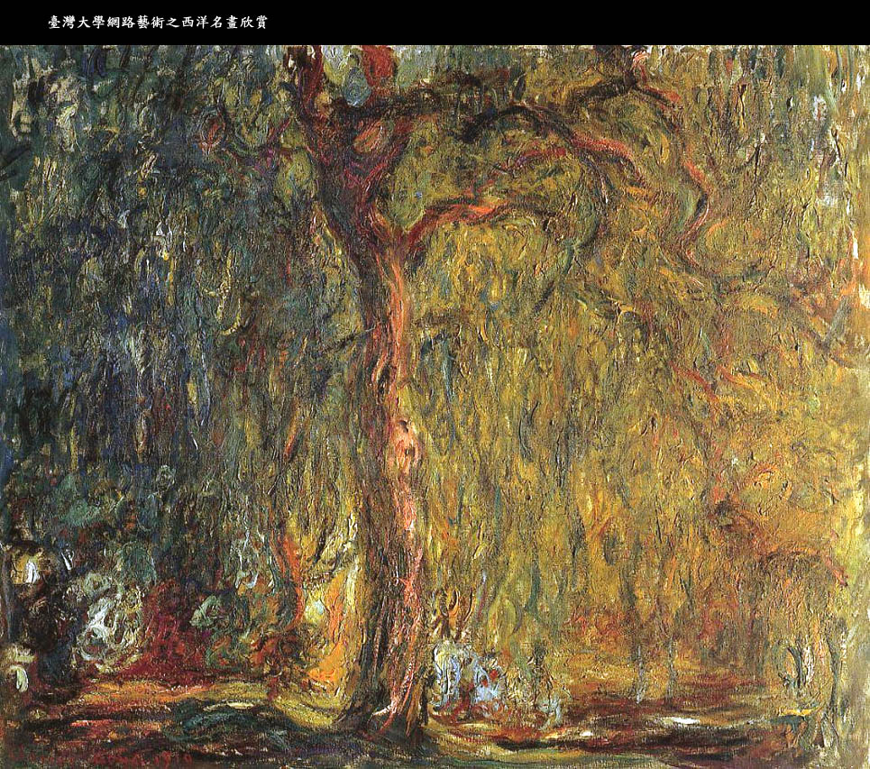

Slide 2
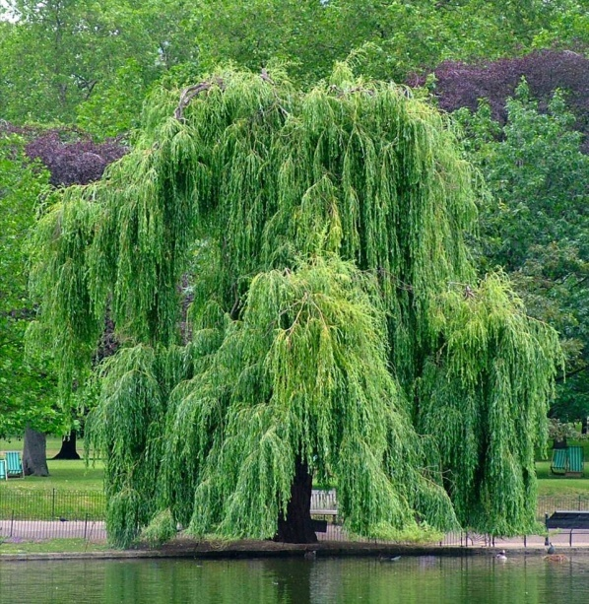
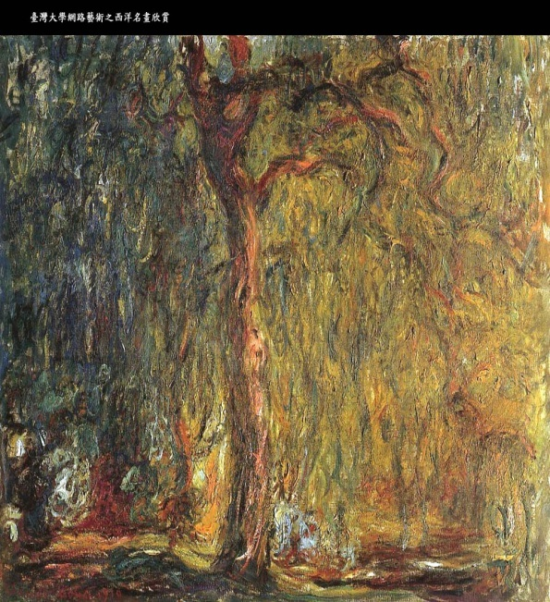



WILLOW
Models of visual
object recognition and
scene understanding
Jean Ponce (ponce@di.ens.fr)
http://www.di.ens.fr/willow
LIENS, UMR 8548
Ecole normale supérieure, Paris

Slide 3
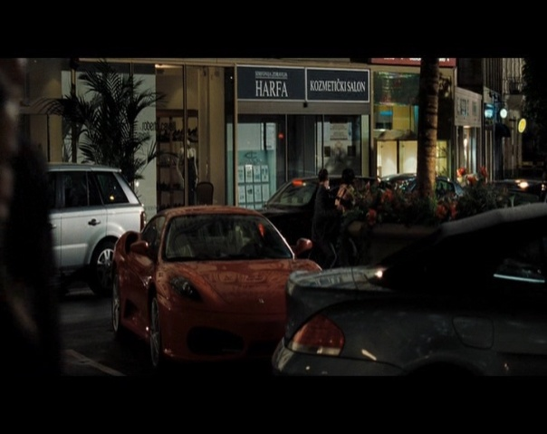

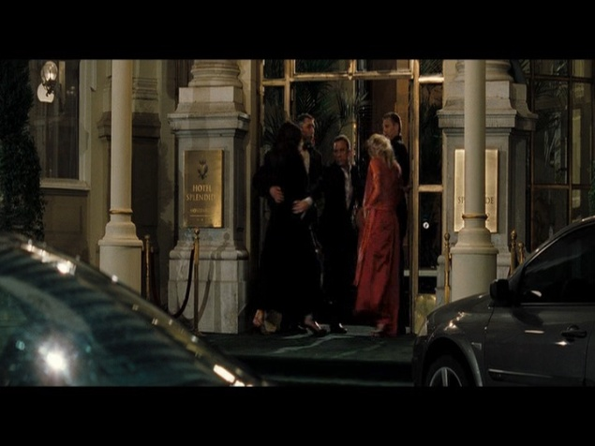
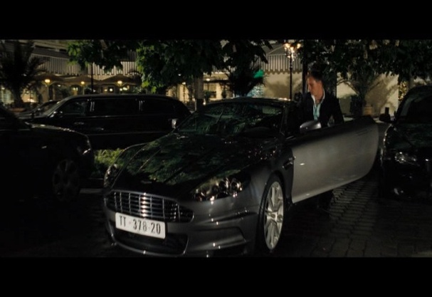
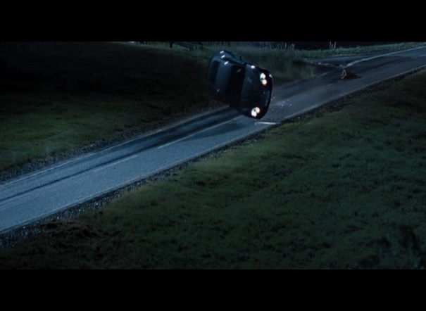
Visual scene understanding
(Courtesy Ivan Laptev, VISTA)
outdoors
indoors
outdoors
exit through a door
house
person
car
kidnapping
drinking
building
person
glass
people
car
car
candle
car
street
outdoors
car enter
Objects:
  cars, glasses, people, etc…
Actions:
  drinking, running, door exit, car enter, etc…
person
car
street
constraints
countryside
person
Scene categories:
  indoors, outdoors, street scene, etc…
Geometry:
  Street, wall, field, stair, etc…
car
car crash
road
field

Slide 4
Tenet:
  Image interpretation ≠ statistical pattern matching.
  Representational issues must be addressed.
Scientific challenges:
  3D object and scene modeling, analysis, and retrieval
  Category-level object and scene recognition
  Human activity capture and classification
  Machine learning
Applications:
  Film post production and special effects
  Quantitative image analysis in archaeology,
  anthropology, and cultural heritage preservation
  Video annotation, interpretation, and retrieval
  Others in an opportunistic manner

Slide 5

WILLOW
LIENS: ENS/INRIA/CNRS UMR 8548
PhD students:
L. Benoît
Y. Boureau
F. Couzinie-Devy
O. Duchenne
L. Février
T. Hocking
R. Jenatton
A. Joulin
A. Lefèvre
J. Mairal
M. Sturzel
O. Whyte
Visiting professors:
F. Durand (MIT)
Faculty:
J. Ponce
S. Arlot
J.-Y. Audibert
F. Bach
I. Laptev
J. Sivic
A. Zisserman (Oxford/ENS - EADS)
Post-docs:
B. Russell
J. van Gemert
N. Cherniavsky
T. Cour
G. Obozinski
Notes:
5
Hui: Nanyang Tech., U. Singapore, Jan: U. Amsterdam, Guillaume: UC Berkeley, Timothee: UPenn, Neva: U. Washington.

Slide 6
Outline
Rationale and objectives
3D object and scene modeling, analysis, and retrieval
Category-level object and scene recognition
Machine learning
Human activity capture and classification
Projects and partnerships

Slide 7
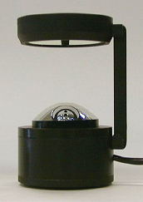
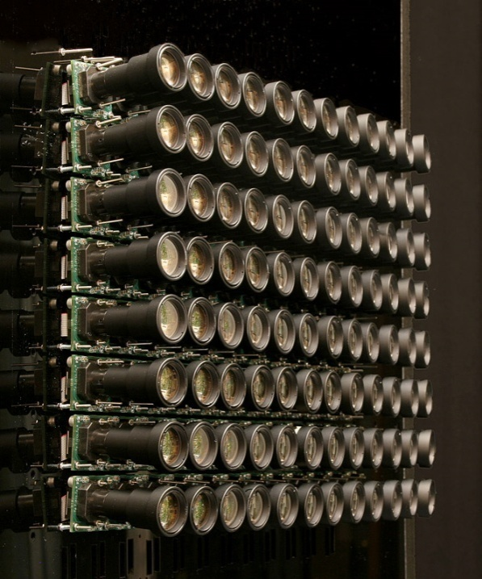
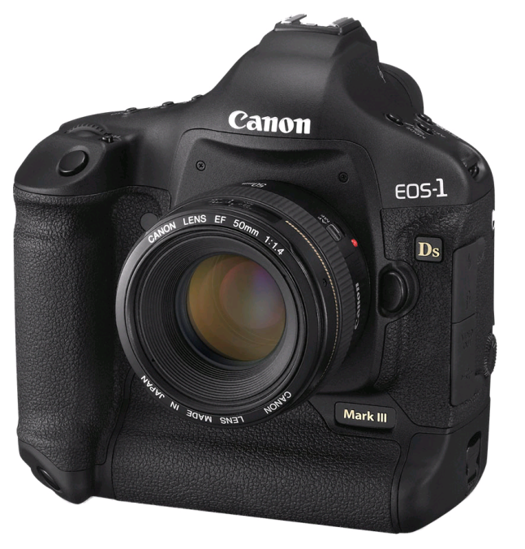
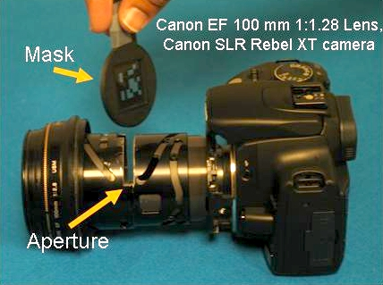
What is a camera?
(Ponce, CVPR’09)
© S. Nayar, CU
© M. Levoy, Stanford
(Pajdla, 2002)
(Seitz and Kim, 2002)
( Yu and McMillan, 2004)
© R. Raskar, MIT
Notes:
7

Slide 8
What is a camera?
(Ponce, CVPR’09)
x
ξ
c
y
r
x
Notes:
8

Slide 9
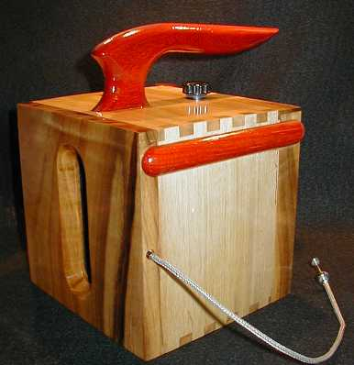
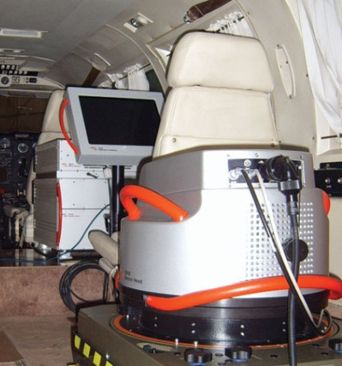
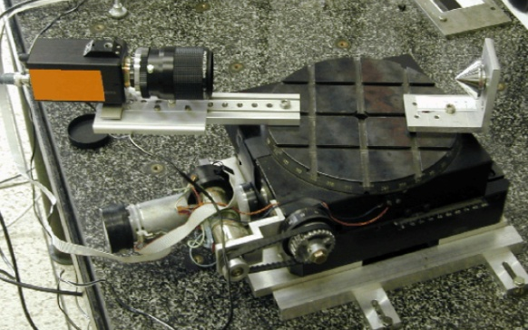
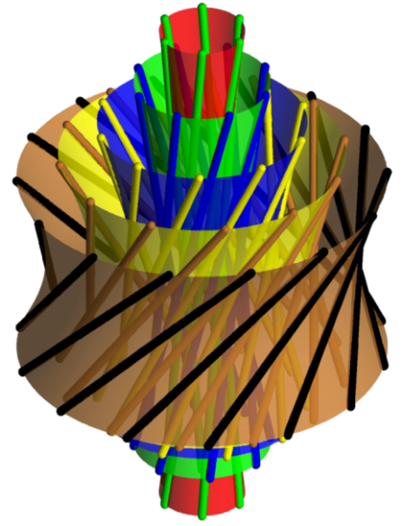
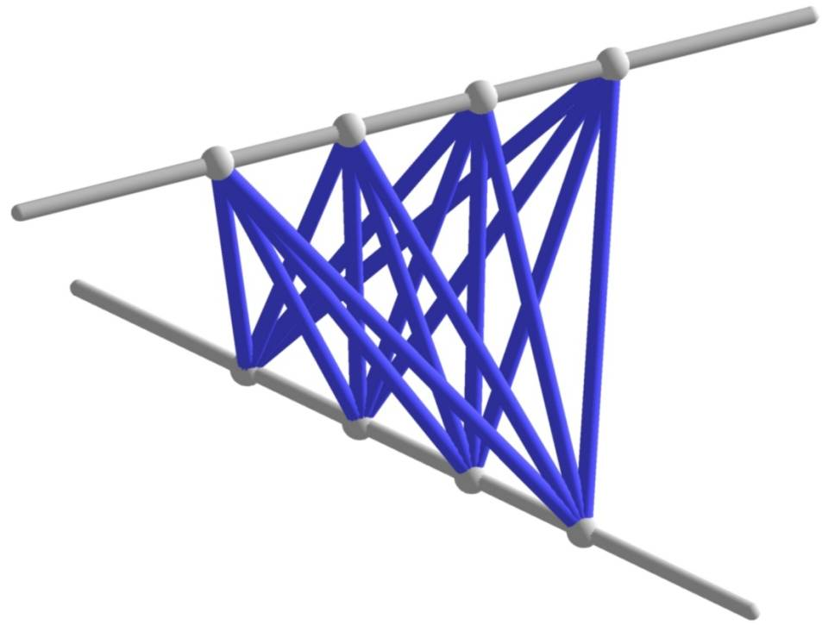
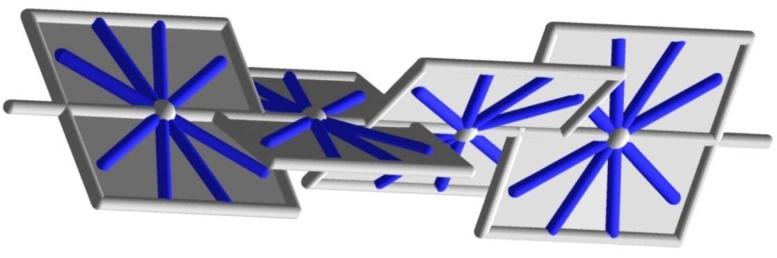
Nondegenerate linear
congruences
© E. Molzcan
© Leica
x
r
© T. Pajdla, CTU
y
ξ
ξ
r
y
x
??
(Veblen & Young, 1910; Pottman and Wallner, 2001). Illustrations © H. Havlicek, VUT.

Slide 10
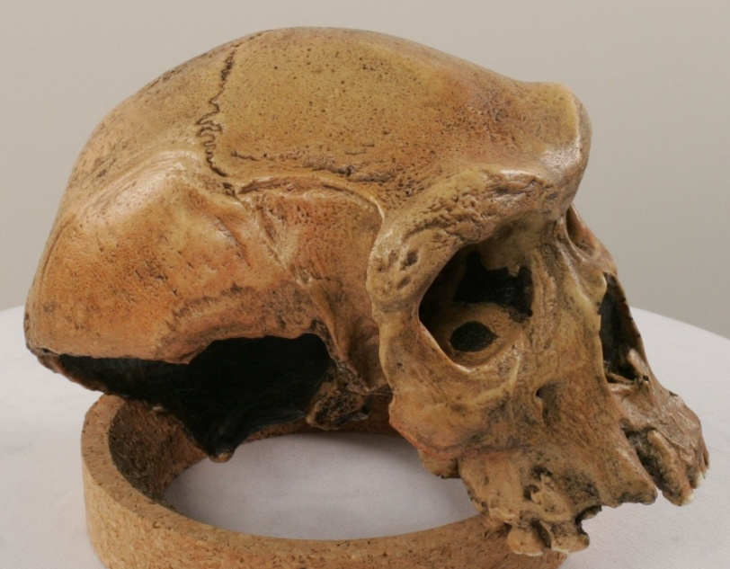
High-fidelity multi-view stereopsis
(Furukawa and Ponce, CVPR’07)
http://www.cs.washington.edu/homes/furukawa/research/pmvs/index.html
Data courtesy of S. Leigh, UIUC Anthropology Department. See for example (Hernandez and Schmitt, 2004; Strecha et al., 2006) for related work.

Slide 11
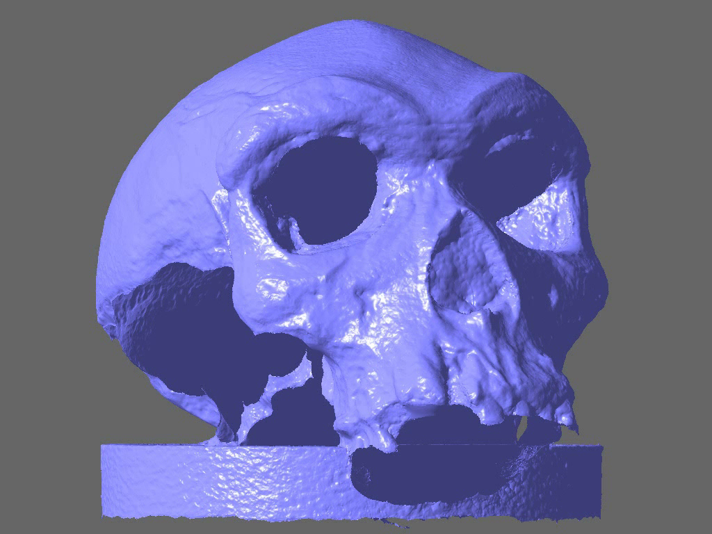

Slide 12
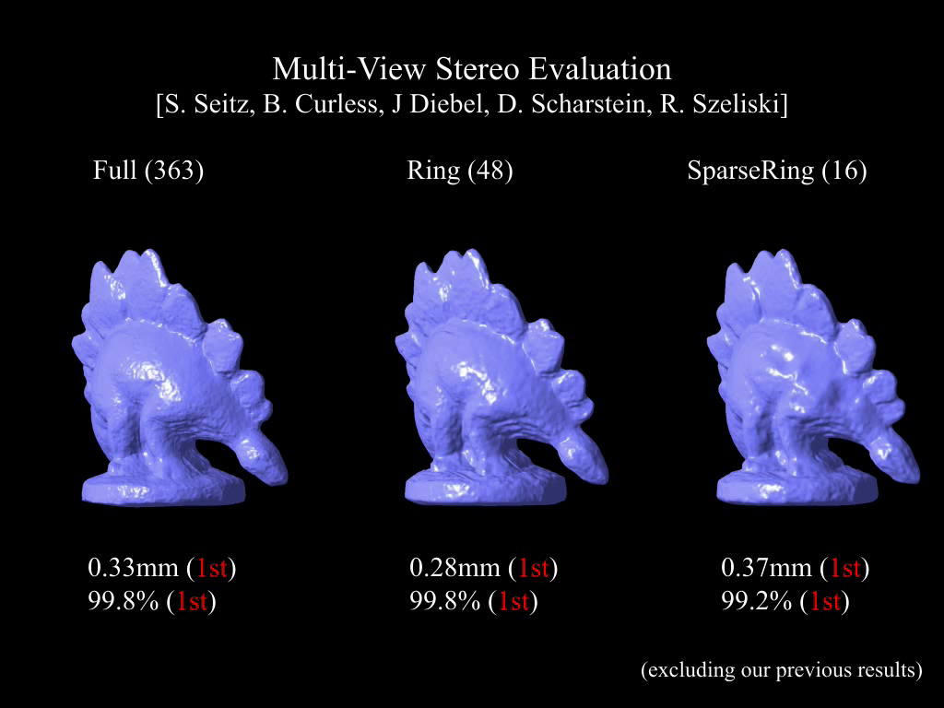

Slide 13



Toward markerless motion capture
(Furukawa & Ponce, CVPR’08)
Data courtesy of Ryan White and David Forsyth,
UIUC (8 synchronized input videos).
(Edwards et al.’98; Carceroni & Kutulakos’02)
(Zhang et al.’04; Pons et al.’07; MOVA’07)

Slide 14
Notes:
14

Slide 15
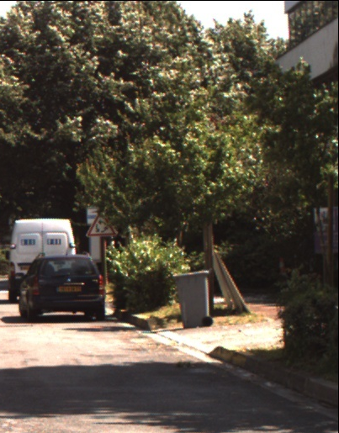
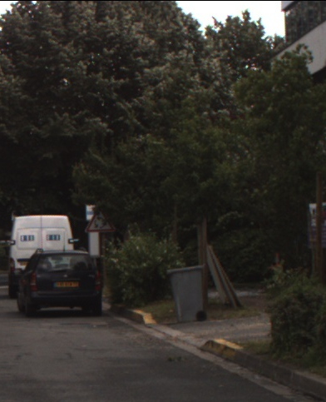
Challenge: Illumination – What is wrong with the shadows?

Slide 16
Outline
Rationale and objectives
3D object and scene modeling, analysis, and retrieval
Category-level object and scene recognition
Machine learning
Human activity capture and classification
Projects and partnerships

Slide 17
Model ≡ locally rigid assembly of parts
Part ≡ locally rigid assembly of features
(Fergus et al., 2003)
A first attempt at handling:
changes in viewpoint
nonrigid shape
noncharacteristic texture
(Kushal, Schmid, Ponce, CVPR’07)

Slide 18
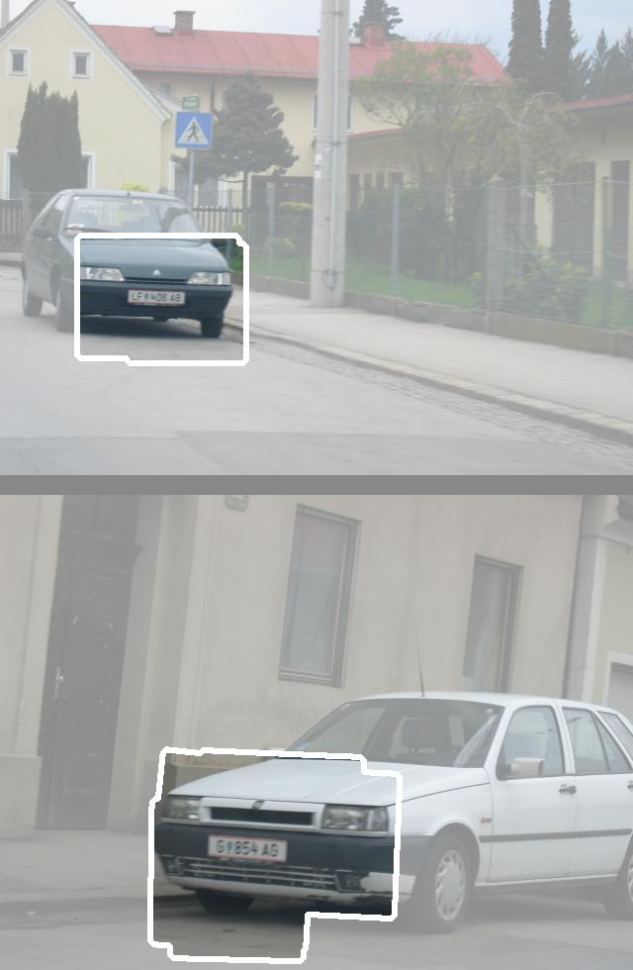
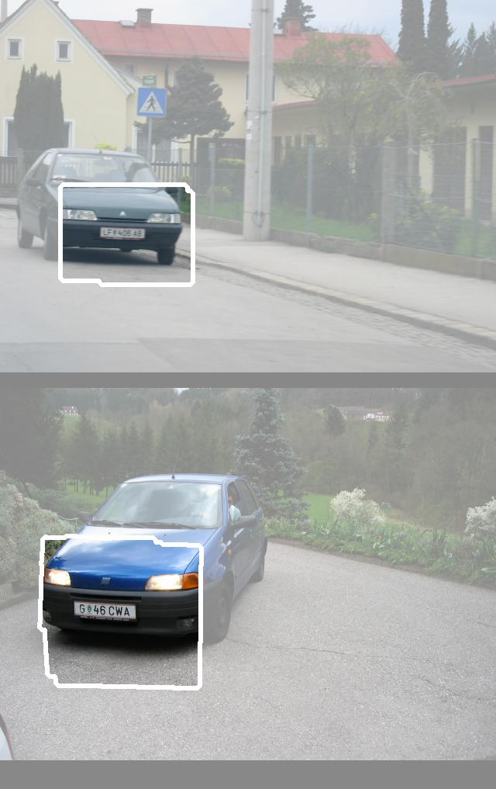
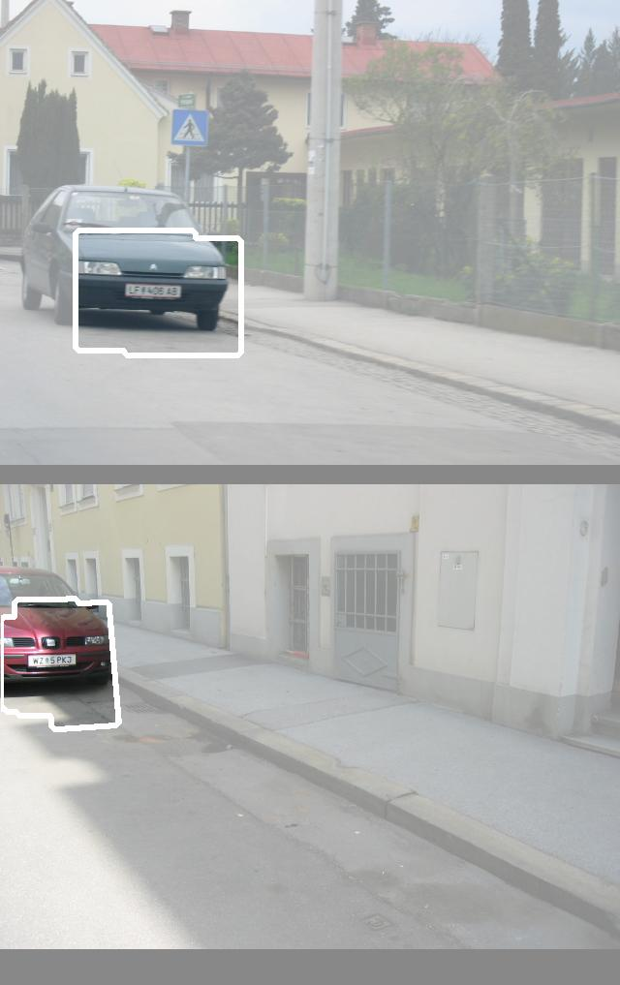
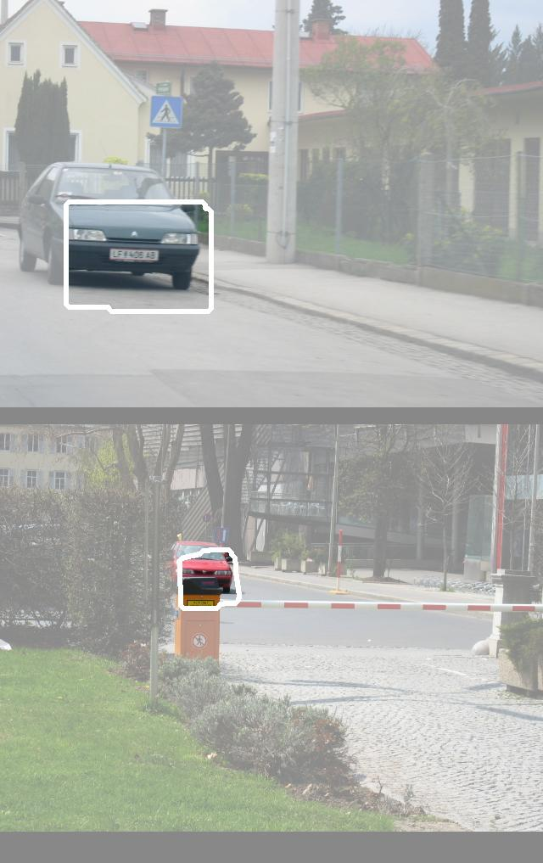
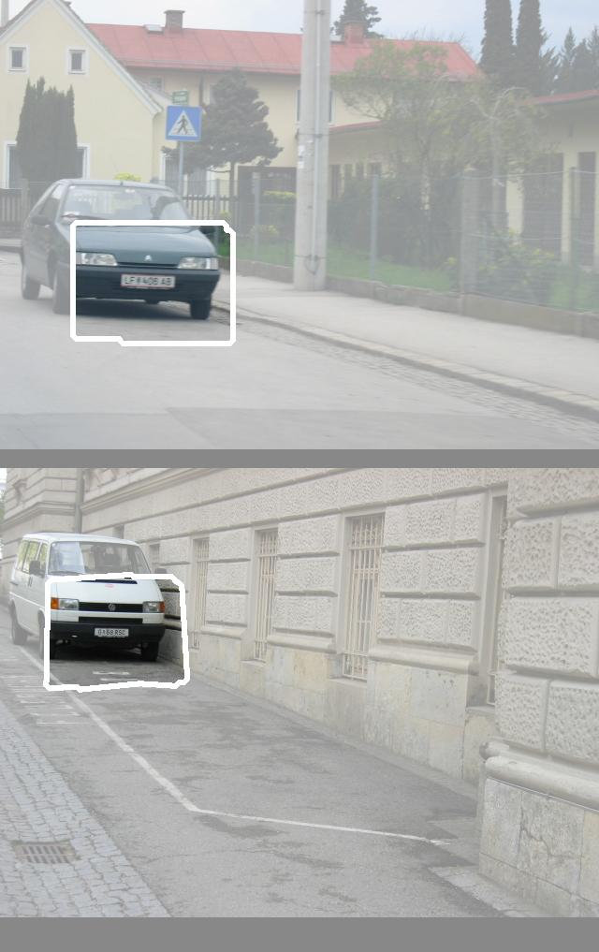
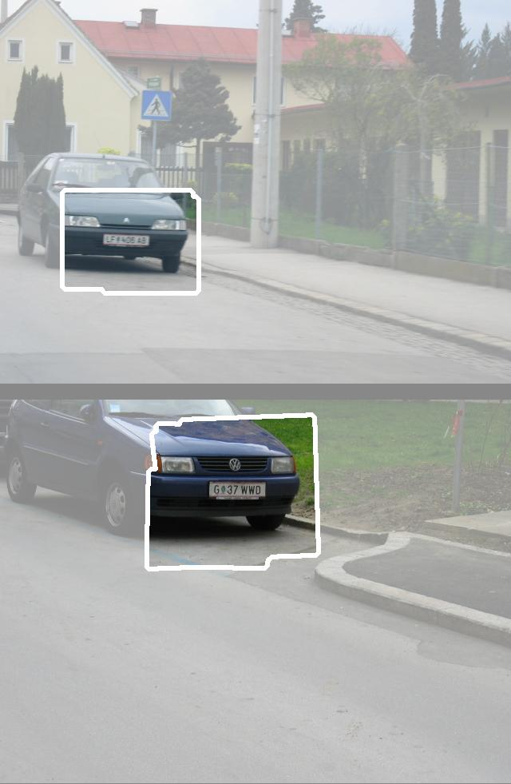
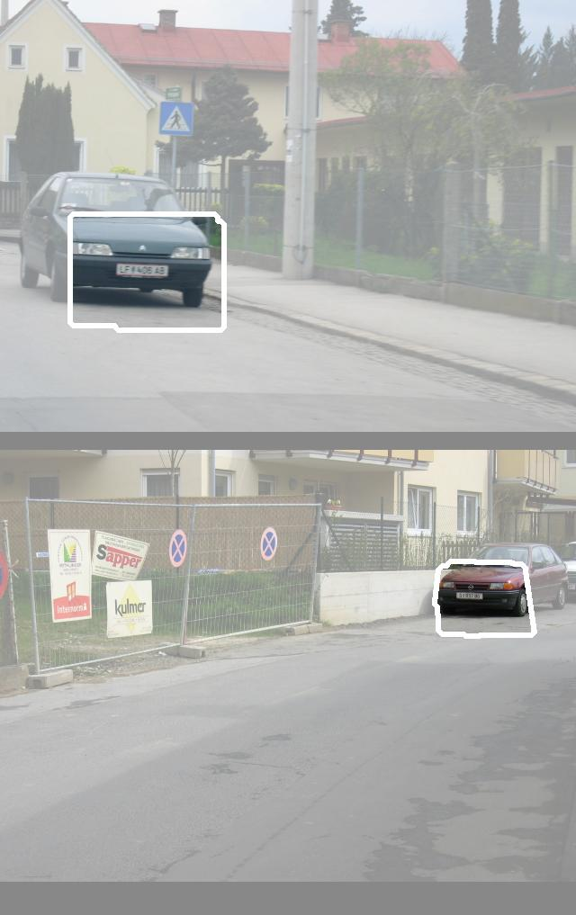
Model ≡ locally rigid assembly of parts
Part ≡ locally rigid assembly of features
base images
validation images
A first attempt at handling:
changes in viewpoint
nonrigid shape
noncharacteristic texture
(Kushal, Schmid, Ponce, CVPR’07)

Slide 19
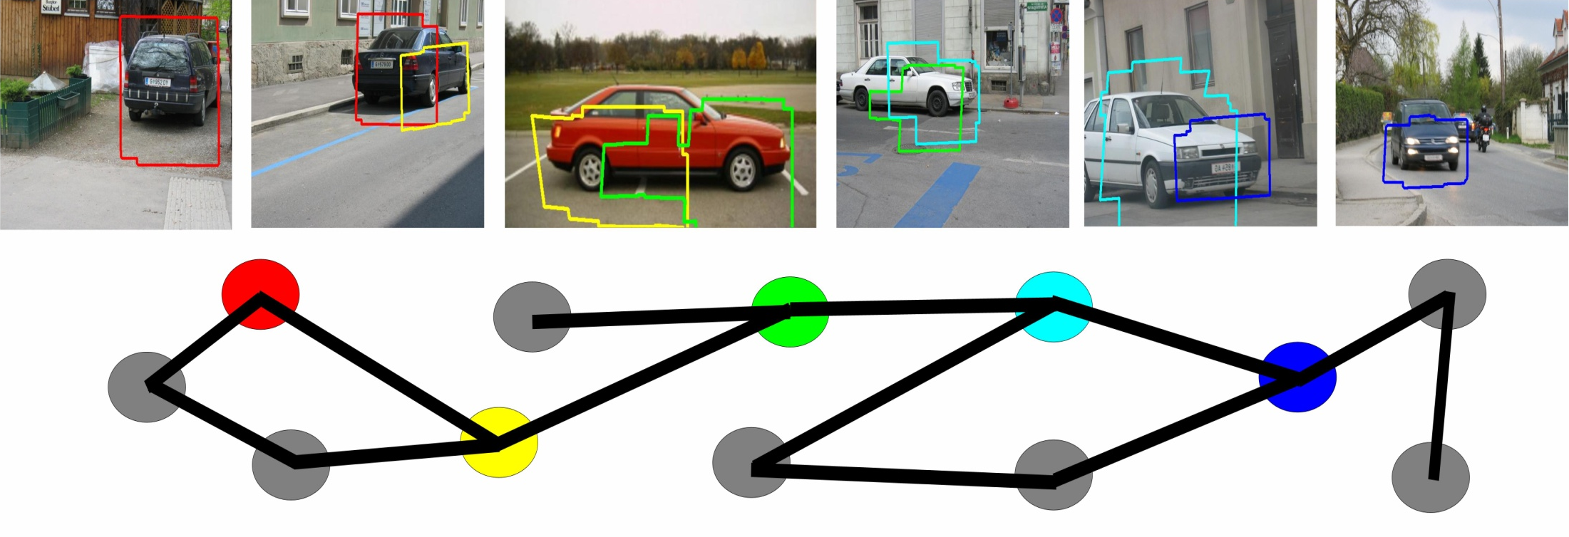
Model ≡ locally rigid assembly of parts
Part ≡ locally rigid assembly of features
A first attempt at handling:
changes in viewpoint
nonrigid shape
noncharacteristic texture
(Kushal, Schmid, Ponce, CVPR’07)

Slide 20
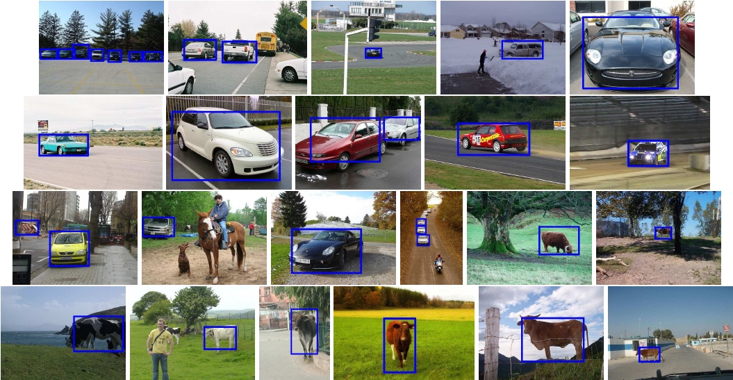
Model ≡ locally rigid assembly of parts
Part ≡ locally rigid assembly of features
Qualitative experiments on Pascal VOC’07 (Kushal, Schmid, Ponce, 2008)

Slide 21

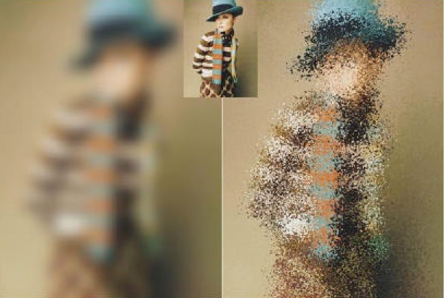
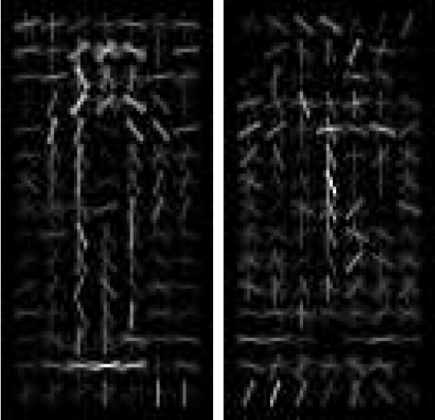
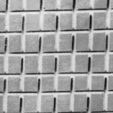
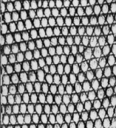
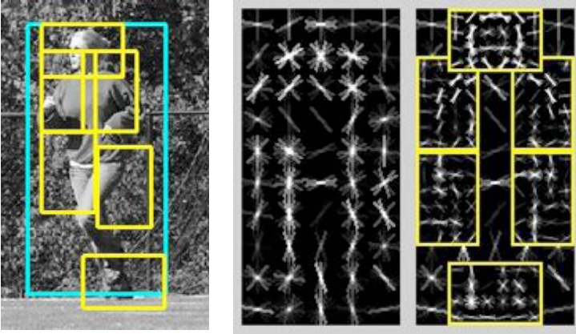
Beyond (locally) orderless image models
(Swain & Ballard’91; Lazebnik, Schmid,
Ponce’03; Sivic & Zisserman,’03;
Csurka et al.’04; Zhang et al.’06)
(Koenderink & Van Doorn’99; Dalal
& Triggs’06; Lazebnik, Schmid,
Ponce’06; Chum & Zisserman’07)
??
(Felzwenszalb, McAllester, Ramanan’07)

Slide 22
Outline
Rationale and objectives
3D object and scene modeling, analysis, and retrieval
Category-level object and scene recognition
Machine learning
Human activity capture and classification
Projects and partnerships

Slide 23
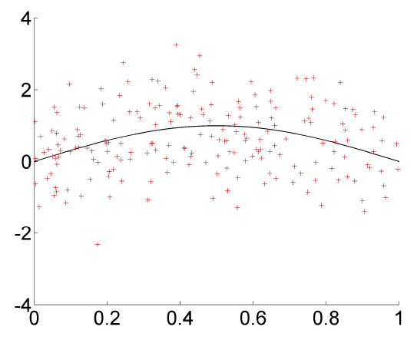
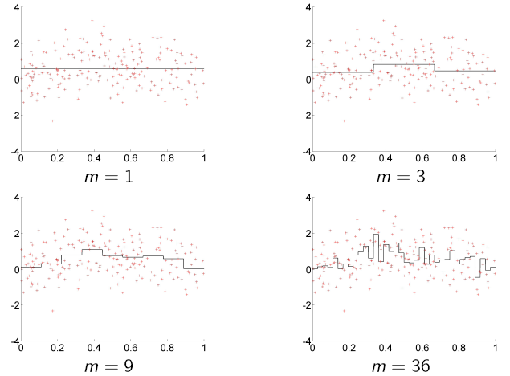
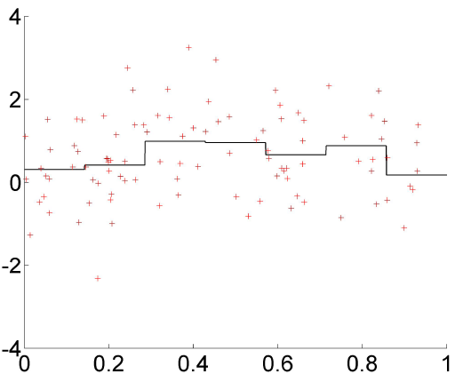
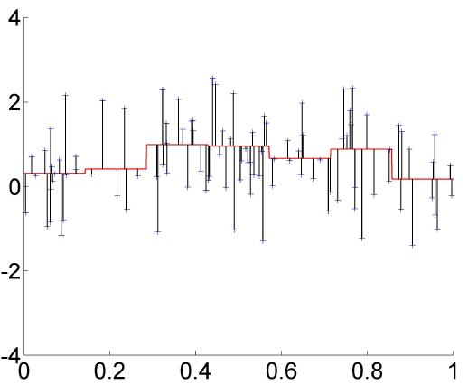
Resampling and optimal model selection
(Arlot, 2008)
Training
Validation

Slide 24
Resampling and optimal model selection
(Arlot, 2008)
Theorem: Under reasonable assumptions, we
have, with high probability:
  L( s, s_{v}) ≥ (1 + ∙) min_{m} L( s, s_{m} ),
  L(s , s_{pv}) ≤ (1 +ε_{n}) min_{m} L( s, s_{m} ).

Slide 25
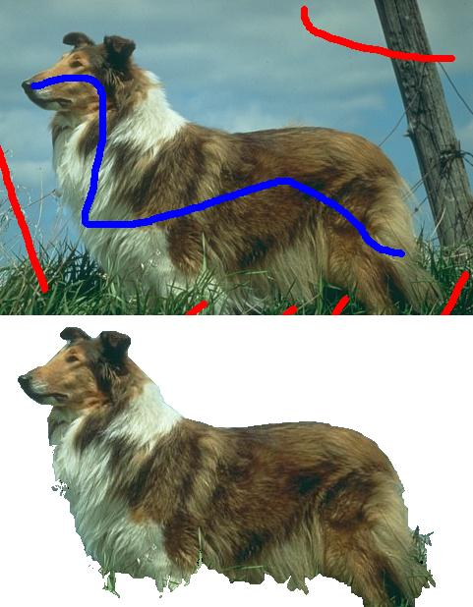
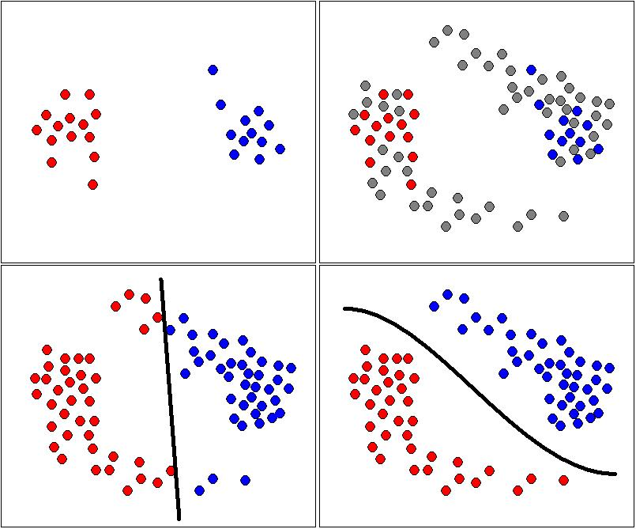
Interactive segmentation
as transductive learning
(Duchenne, Audibert, Ponce, Kériven, Ségonne, CVPR’08)

Slide 26
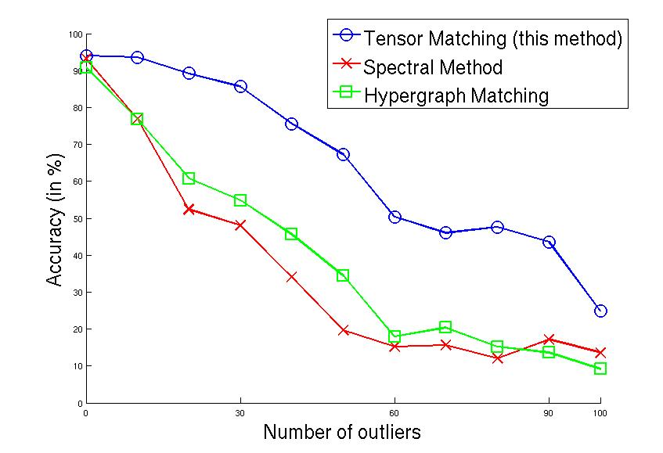
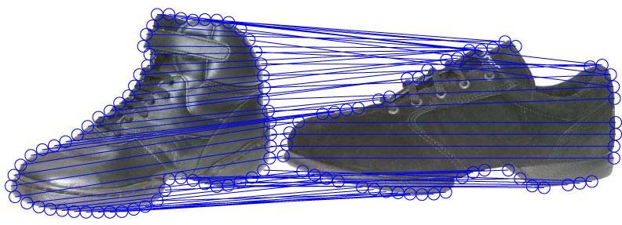
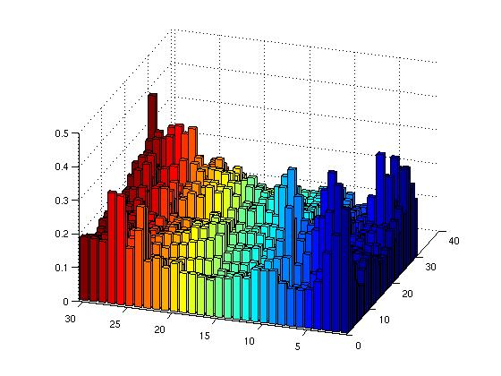
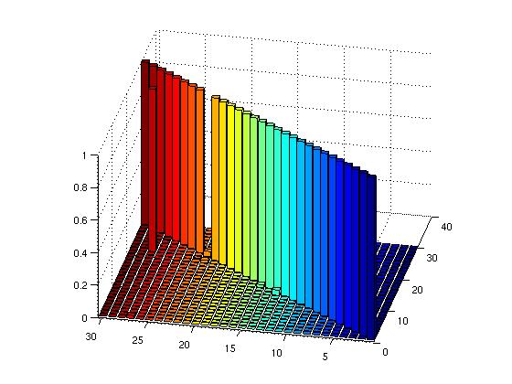
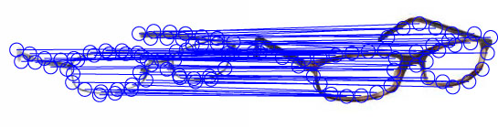
Tensorial methods for
higher-order
graph matching
(Duchenne, Bach, Kweon, Ponce, 2009)
SM: Leordeanu & Hebert (2005)
HM: Zass & Shashua (2008)
L₂
L₁

Slide 27
Discriminative dictionaries for
local image analysis
(Mairal, Bach, Ponce, Sapiro, Zisserman, CVPR’08)
α*(x,D) = Argmin | x - Dα |₂² s.t. |α|₀ ≤ L
R*(x,D) = | x – Dα*|₂²
Reconstruction (MOD: Engan, Aase, Husoy’99;
K-SVD: Aharon, Elad, Bruckstein’06):
min ∑_{l} R*(x_{l},D)
Discrimination:
min ∑_{i,l} C_{i}^{λ} [R*(x_{l},D₁),…,R*(x_{l},D_{n})] + λγ R*(x_{l},D_{i})
(Both MOD and K-SVD version with truncated Newton iterations.)
Orthogonal matching pursuit
(Mallat & Zhang’93, Tropp’04)
D
D₁,…,D_{n}

Slide 28
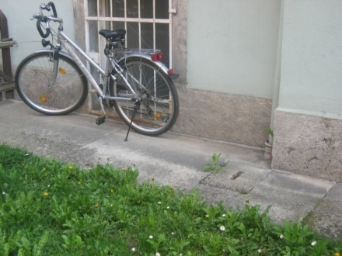
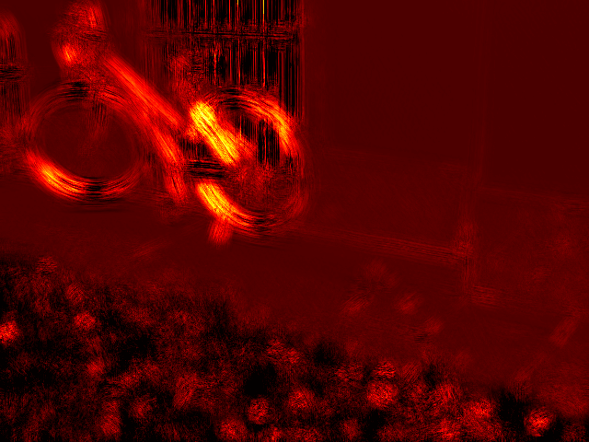
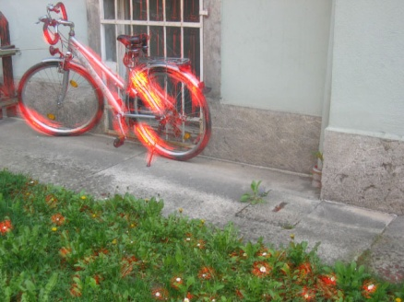










Pixel-level classification results
Qualitative results, Graz 02 data
Quantative results
Comparaison with Pantofaru et al. (2006)
and Tuytelaars & Schmid (2007).

Slide 29
L₁ local sparse image representations
(Mairal, Leordeanu, Bach, Hebert, Ponce, ECCV’08)
α*(x,D) = Argmin | x - Dα |₂² s.t. |α|₁ ≤ L
R*(x,D) = | x – Dα*|₂²
Reconstruction (Lee, Battle, Rajat, Ng’07):
min ∑_{l} R*(x_{l},D)
Discrimination:
min ∑_{i,l} C_{i}^{λ} [R*(x_{l},D₁),…,R*(x_{l},D_{n})] + λγ R*(x_{l},D_{i})
(Partial dictionary update with Newtown iterations on the dual problem; partial fast sparse coding with projected gradient descent.)
Lasso: Convex optimization
(LARS: Efron et al.’04)
D
D₁,…,D_{n}

Slide 30






Edge detection results
Quantitative results on the Berkeley segmentation dataset and benchmark (Martin et al., ICCV’01)
Rank | Score | Algorithm
0 | 0.79 | Human labeling
1 | 0.70 | (Maire et al., 2008)
2 | 0.67 | (Aerbelaez, 2006)
3 | 0.66 | (Dollar et al., 2006)
3 | 0.66 | Us – no post-processing
4 | 0.65 | (Martin et al., 2001)
5 | 0.57 | Color gradient
6 | 0.43 | Random

Slide 31


Input edges Bike edges Bottle edges People edges
Pascal 07 data
Us + L’07
L’07
Comparaison with Leordeanu et al. (2007)
on Pascal’07 benchmark. Mean error rate
reduction: 33%.

Slide 32
Sparse coding on the move!
Linear/bilinear models with shared dictionaries
(Mairal et al., NIPS’08)
Group Lasso consistency (Bach, JMLR’08)
α*(x,D) = Argmin | x - Dα |₂² s.t. ∑_{j}|α_{j}|₂ ≤ L
  - NCS conditions for consistency
  - Application to multiple-kernel learning
In preparation: mixing non-local means (Buades et
al.’05), sparse coding, and stochastic gradient
methods in image/video denoising/deblurring.
In preparation: open-source software suite.

Slide 33


Inpainting a 12MP image with a
dictionary learned from 7x10⁶
patches (Mairal et al., 2009)
Notes:
Resultats d’inpainting sur une image de 12MP grace a l’algorithme stochastique de Julien soumis a ICML-09.

Slide 34


Learned simultaneous sparse coding for image denoising (Mairal et al., 2009)
PSNR comparison between our method (LSSC) and Portilla et al.’03 [23];
Roth & Black’05 [25]; Elad & Aharon’06 [12]; and Dabov et al.’07 [8].
Notes:
Denoising avec du bruit synthetique. Noter qu’on retrouve la structure de briques. Meilleure methode sur les images standard habituelles (Lena etc.). SC et lSC sont des versions simplifiees de la methode ou on n’apprend pas le dictionnaire (SC) ou on l’apprend mais on ne fais pas de groupes (LSC).

Slide 35


Learned simultaneous sparse coding for image demosaicking (Mairal et al., 2009)
LSC
LSSC
……………………………………………...……………
PSNR comparison between our method (LSSC) and Gunturk et al.’02 [AP];
Zhang & Wu’05 [DL]; and Paliy et al.’07 [LPA] on the Kodak PhotoCD data.
Notes:
Meilleurs resultats sur les donnees standard. LSC (qui est deja tres bon) donne comme les autres methodes standard des artefacts de couleur sur la barriere). LSSC n’a pas ces problemes.

Slide 36

Real noise (Canon Powershot G9, 1600 ISO)
Raw camera
jpeg output
Adobe Photoshop
DxO Optics Pro
LSSC
Notes:
Images reelles. La camera et Photoshop donnent des resultats tres bruites. DxO et LSSC donnent des resultats satisfaisants.

Slide 37
Outline
Rationale and objectives
3D object and scene modeling, analysis, and retrieval
Category-level object and scene recognition
Machine learning
Human activity capture and classification
Projects and partnerships

Slide 38

Naming people in videos: A Buffy example
(Everingham, Sivic, Zisserman, BMVC ’06)
Labelling at 100% recall (all faces labelled)
1,900 frames, 2 errors (1 non-face, 1 wrong name)
Notes:
Etiquetage des visages grace a la synchronisation automatique des sous titres et des scripts: Premiers pas vers l’annotation automatique.

Slide 39
Automatic detection of human actions in video
(Duchenne, Bach, Laptev, Sivic, Ponce, ICCV’09)
Notes:
39

Slide 40
Outline
Rationale and objectives
3D object and scene modeling, analysis, and retrieval
Category-level object and scene recognition
Machine learning
Human activity capture and classification
Projects and partnerships

Slide 41
Image and video mining for
sciences and humanities
A new MSR-INRIA Lab project
Willow, Lear, Vista, INA, MSR
Fundamental research in
  computer vision and
  machine learning
applied to sciences and humanities:
  archaeology and cultural heritage
  preservation,
  environmental sciences, and
  sociology.

Slide 42

LEAR INRIA/CNRS/INPG/UJF
Permanent researchers:
Cordelia Schmid (INRIA)
Hervé Jégou (INRIA)
Roger Mohr (ENSIMAG)
Jakob Verbeek (INRIA)
Laurent Zwald (UJF)
External collaborator:
Frédéric Jurie (U. Caen)
Post-docs:
Moray Allan
Tingting Jiang
Research Engineers:
Matthijs Douze
Benoît Mordelet
Christophe Smekens
PhD students:
Adrien Gaidon
Matthieu Guillaumin
Hedi Harzallah
Alexander Kläser
Josip Krapac
Diane Larlus
Jörg Liebelt
Marcin Marszalek

Slide 43

VISTA IRISA/INRIA-Rennes
Permanent researchers:
Patrick Pérez (INRIA)
Patrick Bouthemy (INRIA)
Charles Kervrann (INRA)
Ivan Laptev (INRIA)
Jean-Pierre Le Cadre (CNRS)
Étienne Mémin (Univ. Rennes)
PhD students:
Kamel Aouichat
Vijay Badrinarayanan
Aurélie Bugeau
Émilie Dexter
Matthieu Fradet
Alexandre Hervieu
Adrien Ickowicz
Nicolas Papadakis
Thierry Pécot

Slide 44


Action understanding for sociological studies
Institut National de l’Audiovisuel
    - R&D: L. Laborelli and D. Teruggi
- 1.5 Mhours of annotated audiovisual archives,
50 years of TV, 60 years of radio…
The Inathèque de France at BNF
- Communication, history, sociology research
- Studies of events, programming, representation…
Perhaps the Socio-Digital Systems group in CML at MSR Cambridge

Slide 45
Expression and gender from videos
(Cherniavsky, Laptev, Sivic, Zisserman, 2009)
INA data: 10 1963 episodes of « Les Actualités Françaises »
Notes:
45

Slide 46

Change detection for environmental sciences
From Voigt et al. (IEEE TGRS, 2007)
Potential partners:
Comp. Ecology and Env. Science Group, MSR Cambridge
Dynamic Meterology Group, Ecole Polytechnique, Paris
LIAMA Laboratory, Beijing

Slide 47





Gell
Mazois
Casa di Championnet, Pompei,
courtesy of Hélène Dessales,
ENS archaeology lab.

Slide 48





Casa di Narcisso
Casa di Sallustio
Paintings from the sketchbooks of W. Gell, copyright Ecole Nationale d’Histoire de l’Art, Paris.
Photos courtesy of H. Dessales, archaeology laboratory, Ecole Normale Supérieure, Paris.

Slide 49
Projects
ANR blanc (HFIBMR), with LASMEA, INRIA (Artis).
ANR blanc (MGA), with Ecole des Mines.
ANR blanc (Triangles), with INRIA (Geometrica), U. Lyon.
DGA (2ACI), with Bertin, INRIA (Vista), U. Caen.
DGA (Itisecure), with E-vitech.
EADS.
INRIA associated team (Tethys) with Lear, CMU, UIUC.
MSR-INRIA Lab, with ENS (archaeology lab), INRIA (Lear, Vista), INA, and MSR.

Slide 50
Academic partnerships
INRIA Artis (N. Holzschuch), Lear (C. Schmid), Vegas (X. Goaoc), Geometrica (O. Devillers, M. Teillaud), Vista (I. Laptev, P. Pérez)
Ecole des Mines (J.-P. Vert)
ENS Archeology lab (H. Dessales)
ENST (O. Cappé)
LASMEA (A. Bartoli)
U. Caen (F. Jurie)
U. Lyon I (R. Chaine, J.-P. Morvan)
Caltech (P. Perona)
Carnegie-Mellon University (A. Efros, M. Hebert)
KAIST (I. Kweon)
MIT (B. Freeman, A. Torralba)
New York University (Y. LeCun)
UC Berkeley (M. Jordan)
University of Illinois (D. Forsyth, D. Hoiem)
University of North Carolina (S. Lazebnik)
University of Washington (Y. Furukawa)

Slide 51


