Slide 1
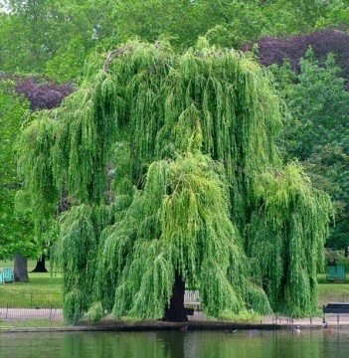
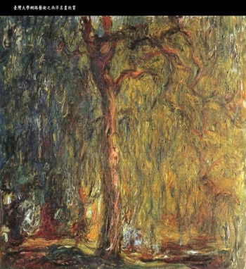



Sparse Coding
for
Image and Video Understanding
Jean Ponce
http://www.di.ens.fr/willow/
Willow team, LIENS, UMR 8548
Ecole normale supérieure, Paris
Joint work with Julien Mairal, Francis Bach,
Guillermo Sapiro and Andrew Zisserman

Slide 2
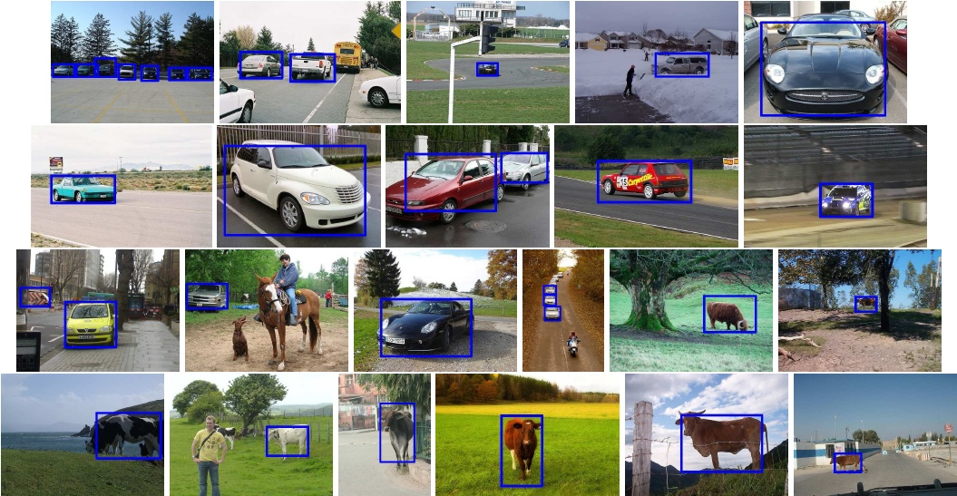
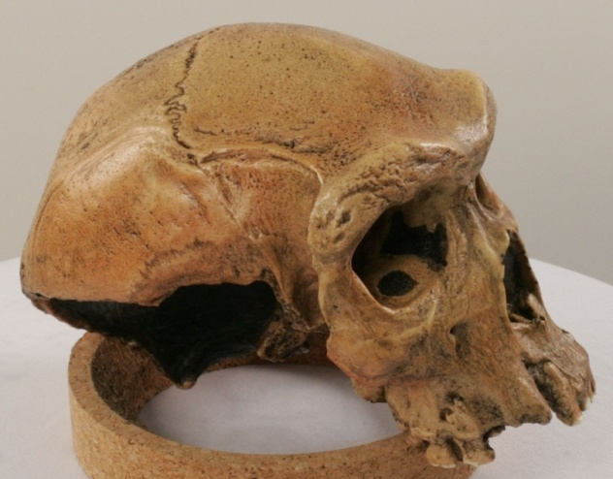
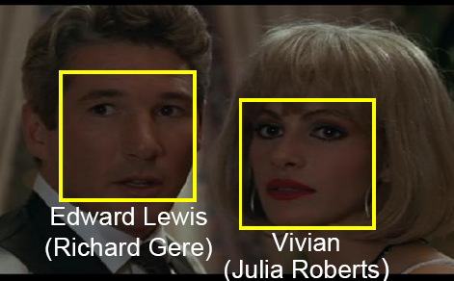
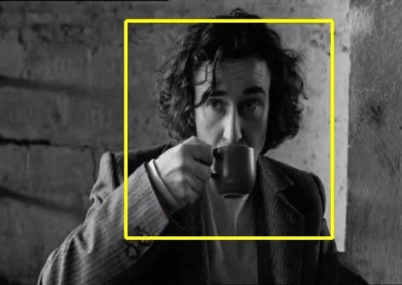
What this is all about.. (Courtesy Ivan Laptev)
Object class recognition
3D scene reconstruction
Face recognition
Action recognition
(Furukawa & Ponce’07)
(Sivic & Zisserman’03)
(Laptev & Perez’07)
Drinking

Slide 3
What this is all about.. (Courtesy Ivan Laptev)
Object class recognition
3D scene reconstruction
Face recognition
Action recognition
(Sivic & Zisserman’03)
(Laptev & Perez’07)
Drinking

Slide 4
Outline
What this is all about
A quick glance at Willow
Sparse linear models
Learning to classify image features
Learning to detect edges
On-line sparse matrix factorization
Learning to restore an image
Notes:
Les deux focus sont la partie 3D et la partie apprentissage. Le reste est presente assez brievement.

Slide 5
Willow tenet:
  Image interpretation ≠ statistical pattern matching.
  Representational issues must be addressed.
Scientific challenges:
  3D object and scene modeling, analysis, and retrieval
  Category-level object and scene recognition
  Human activity capture and classification
  Machine learning
Applications:
  Film post production and special effects
  Quantitative image analysis in archaeology,
  anthropology, and cultural heritage preservation
  Video annotation, interpretation, and retrieval
  Others in an opportunistic manner
Notes:
Le tenet est le theme de l’equipe, raffine dans les 4 challenges. Place de plus en plus importante a l’apprentissage.

Slide 6

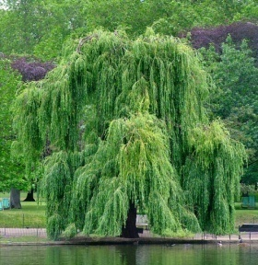

WILLOW
LIENS: ENS/INRIA/CNRS UMR 8548
Assistant:
C. Espiègle (INRIA)
PhD students:
L. Benoît (ENS)
Y. Boureau (INRIA)
F. Couzinie-Devy (ENSC)
O. Duchenne (ENS)
L. Février (ENS)
R. Jenatton (DGA)
A. Joulin (Polytechnique)
J. Mairal (INRIA)
M. Sturzel (EADS)
O. Whyte (ANR)
Invited professors:
F. Durand (MIT/ENS)
A. Efros (CMU/INRIA)
Faculty:
S. Arlot (CNRS)
J.-Y. Audibert (ENPC)
F. Bach (INRIA)
I. Laptev (INRIA)
J. Ponce (ENS)
J. Sivic (INRIA)
A. Zisserman (Oxford/ENS - EADS)
Post-docs:
B. Russell (MSR/INRIA)
J. van Gemert (DGA)
Kong H. (ANR)
N. Cherniavsky (MSR/INRIA)
T. Cour (INRIA)
G. Obozinski (ANR)
Notes:
Hui: Nanyang Tech., U. Singapore, Jan: U. Amsterdam, Guillaume: UC Berkeley, Timothee: UPenn, Neva: U. Washington.

Slide 7
Markerless motion capture
(Furukawa & Ponce, CVPR’08-09; data courtesy of IMD)
Notes:
Dans ce cas le modele local n’est pas rigide pour laisser la peau s’etirer. Le maquillage ne serait pas un probleme en pratique, le mouvement retrouve etant utilise pour anumer un avatar parametrique.

Slide 8
Finding human actions in videos
(O. Duchenne, I. Laptev, J. Sivic, F. Bach, J. Ponce, ICCV’09)

Slide 9
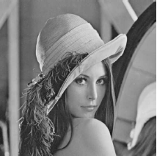
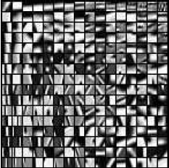
Sparse linear models
Dictionary:
D=[d₁,...,dp]2R^{m x p}
Signal: x2 R^{m}
D may be overcomplete, i.e. p> m
x ≈ ∑ ®₁d₁ + ®₂d₂ + ... + ®_{p}d_{p}

Slide 10
Sparse linear models
Dictionary:
D=[d₁,...,dp]2R^{m x p}
Signal: x2 R^{m}
D is adapted to x when x admits a sparse
decomposition on D, i.e.,
x ≈ ∑_{j2J} ®_{j}d_{j} where |J| = |®|₀ is small

Slide 11
Sparse linear models
Dictionary:
D=[d₁,...,dp]2R^{m x p}
Signal: x2 R^{m}
A priori dictionaries such as wavelets and learned dictionaries are adapted to sparse modeling of audio signals and natural images (see, e.g., [Donoho, Bruckstein, Elad, 2009]).

Slide 12
Sparse coding and dictionary learning:
A hierarchy of problems
min ® | x – D® |₂²
min ® | x – D® |₂² + ¸ |®|₀
min ® | x – D® |₂² + ¸ Ã(®)
min _{DєC,®1,..., ®n}∑_{1≤i≤n} [ 1/2 | x_{i} – D®_{i} |₂² + ¸ Ã(®_{i}) ]
min _{DєC,®1,..., ®n}∑_{1≤i≤n} [ f (x_{i}, D, ®_{i}) + ¸ Ã(®_{i}) ]
min _{DєC,®1,..., ®n}∑_{1≤i≤n} [ f (x_{i}, D, ®_{i}) + ¸ ∑_{1≤k≤q} Ã(d_{k}) ]
Least squares
Sparse coding
Dictionary learning
Learning for a task
Learning structures

Slide 13
Discriminative dictionaries for
local image analysis
(Mairal, Bach, Ponce, Sapiro, Zisserman, CVPR’08)
α*(x,D) = Argmin | x - Dα |₂² s.t. |α|₀ ≤ L
R*(x,D) = | x – Dα*|₂²
Reconstruction (MOD: Engan, Aase, Husoy’99;
K-SVD: Aharon, Elad, Bruckstein’06):
min ∑_{l} R*(x_{l},D)
Discrimination:
min ∑_{i,l} C_{i}^{λ} [R*(x_{l},D₁),…,R*(x_{l},D_{n})] + λγ R*(x_{l},D_{i})
(Both MOD and K-SVD version with truncated Newton iterations.)
Orthogonal matching pursuit
(Mallat & Zhang’93, Tropp’04)
D
D₁,…,D_{n}
Notes:
Trucs de Julien, version l_0. Comment aller du reconstructif au discriminatif.

Slide 14
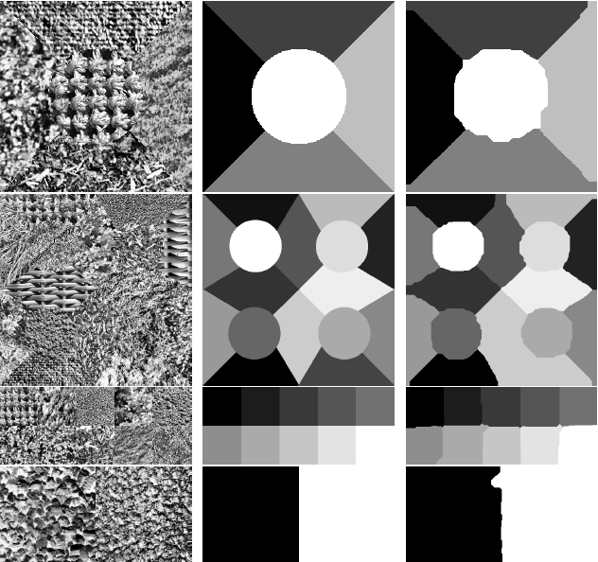
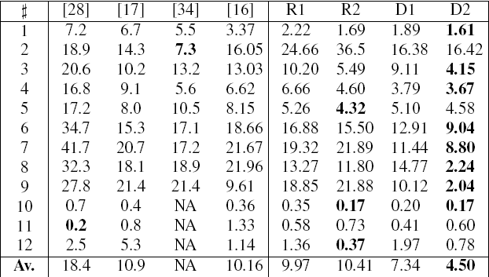
Texture classification results

Slide 15
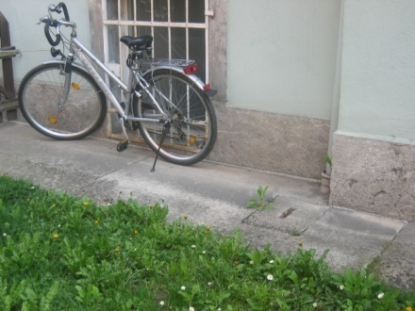
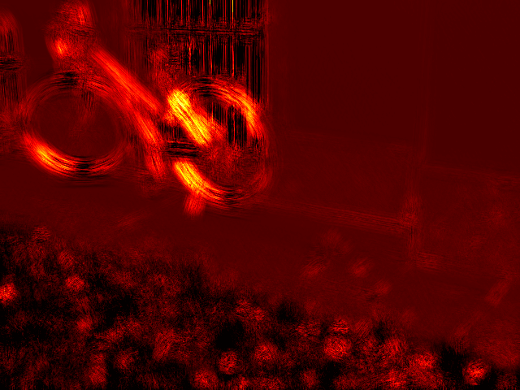
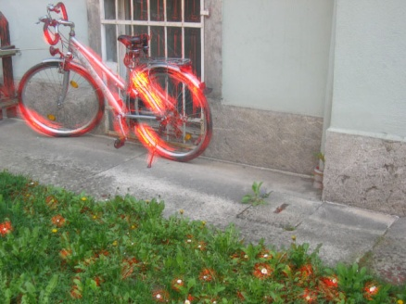
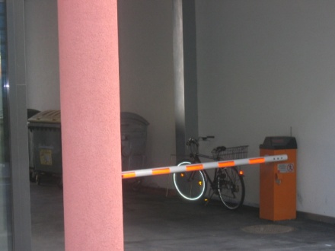
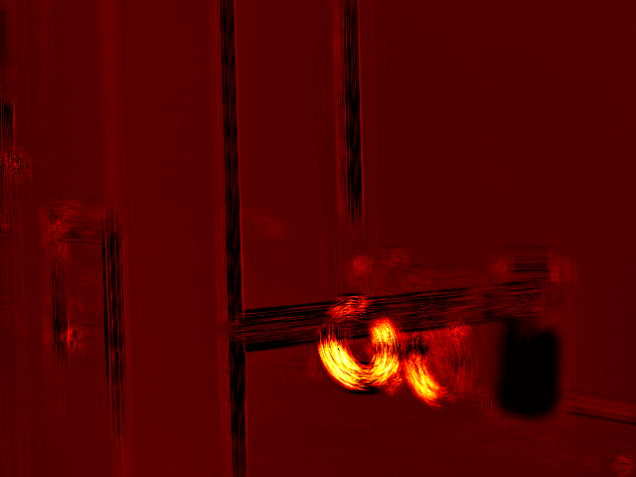
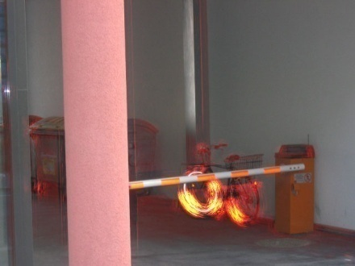
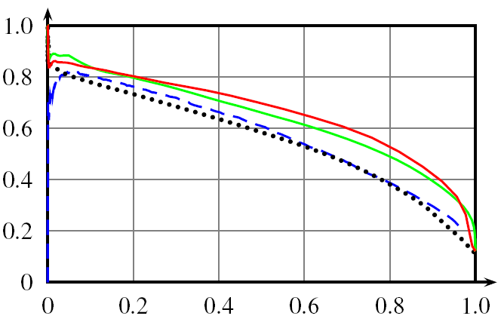
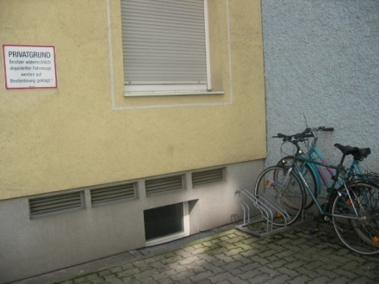
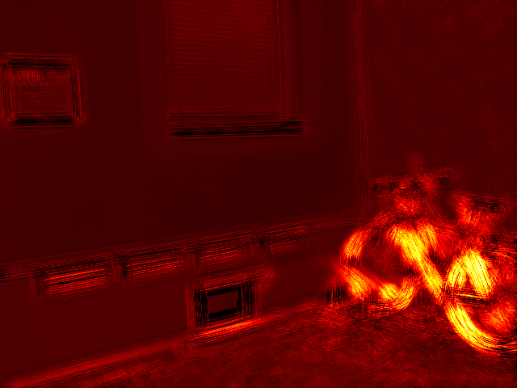
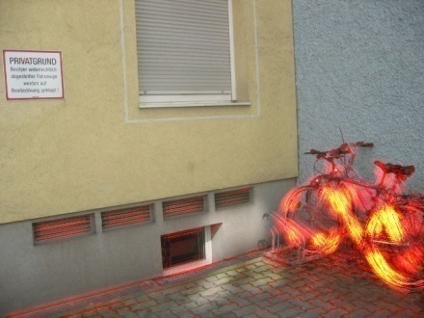
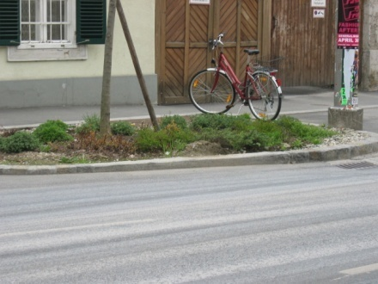
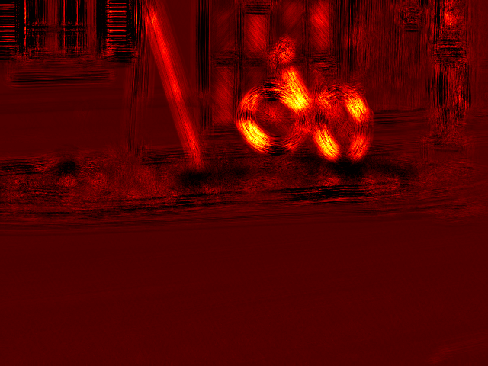
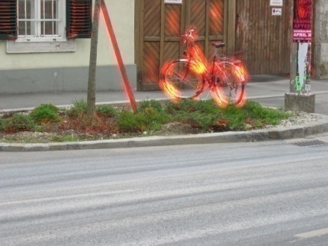
Pixel-level classification results
Qualitative results, Graz 02 data
Quantitative results
Comparaison with Pantofaru et al. (2006)
and Tuytelaars & Schmid (2007).
Notes:
On apprend a classifier les pixels de velo a partir d’images contenant des velos (mais ou on ne sait pas ou ils sont) et d’images n’en contenant pas. Resultats sur une image test.

Slide 16
L₁ local sparse image representations
(Mairal, Leordeanu, Bach, Hebert, Ponce, ECCV’08)
α*(x,D) = Argmin | x - Dα |₂²s.t. |α|₁ ≤ L
R*(x,D) = | x – Dα*|₂²
Reconstruction (Lee, Battle, Rajat, Ng’07):
min ∑_{l} R*(x_{l},D)
Discrimination:
min ∑_{i,l}C_{i}^{λ} [R*(x_{l},D₁),…,R*(x_{l},D_{n})] + λγ R*(x_{l},D_{i})
(Partial dictionary update with Newtown iterations on the dual problem; partial fast sparse coding with projected gradient descent.)
Lasso: Convex optimization
(LARS: Efron et al.’04)
D
D₁,…,D_{n}
Notes:
Version l1. Nouveaux algorithmes efficaces pour la reconstruction et la discrimination.

Slide 17
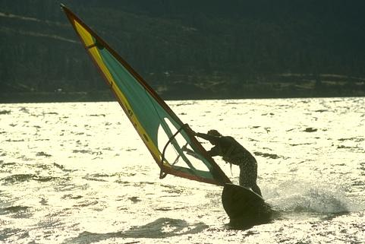
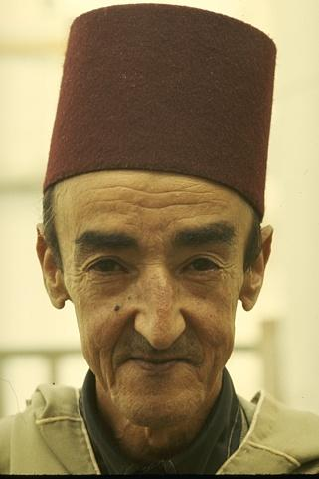
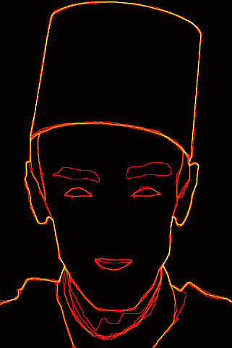
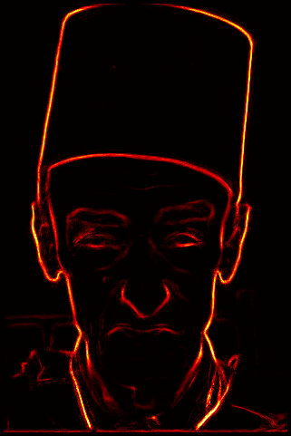
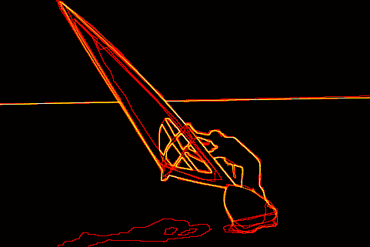
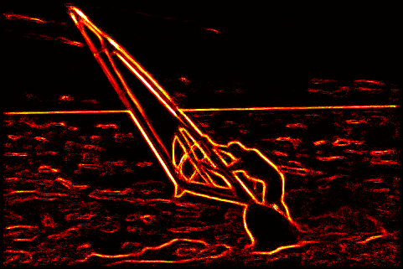
Edge detection results
Quantitative results on the Berkeley segmentation dataset and benchmark (Martin et al., ICCV’01)
Rank | Score | Algorithm
0 | 0.79 | Human labeling
1 | 0.70 | (Maire et al., 2008)
2 | 0.67 | (Aerbelaez, 2006)
3 | 0.66 | (Dollar et al., 2006)
3 | 0.66 | Us – no post-processing
4 | 0.65 | (Martin et al., 2001)
5 | 0.57 | Color gradient
6 | 0.43 | Random
Notes:
Apprentissage d’un detecteur de contours.

Slide 18
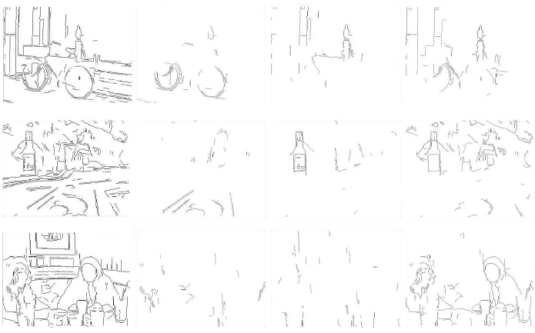
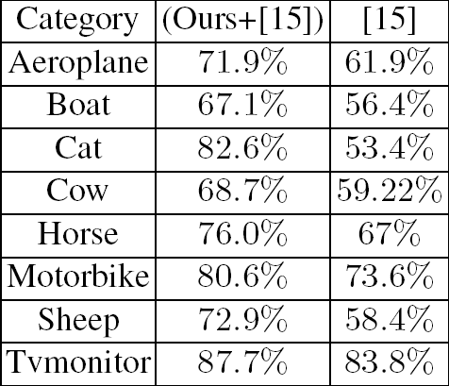
Input edges Bike edges Bottle edges People edges
Pascal 07 data
Us + L’07
L’07
Comparaison with Leordeanu et al. (2007)
on Pascal’07 benchmark. Mean error rate
reduction: 33%.
Notes:
Detecteurs de contours specialises pour des categories donnees.

Slide 19
Dictionary learning
Given some loss function, e.g.,
L ( x, D ) = 1/2 | x – D® |₂² + ¸ |®|₁
One usually minimizes, given some data
x_{i}, i = 1, ..., n, the empirical risk:
min _{D} f_{n} ( D ) = ∑_{1≤i≤n} L ( x_{i}, D )
But, one would really like to minimize the
expected one, that is:
min _{D} f ( D ) = E_{x} [ L ( x, D ) ]
(Bottou& Bousquet’08 ! Large-scale stochastic gradient)

Slide 20
Online sparse matrix factorization
(Mairal, Bach, Ponce, Sapiro, ICML’09)
Problem:
min _{DєC,®1,..., ®n}∑_{1≤i≤n} [ 1/2 | x – D®_{i} |₂² + ¸ |®_{i}|₁ ]
min _{DєC, A}∑_{1≤i≤n} [ 1/2 | X – DA |_{F}² + ¸ |A|₁ ]
Algorithm:
Iteratively draw one random training sample x_{t}
and minimize the quadratic surrogate function:
g_{t} ( D ) = 1/t ∑_{1≤i≤t}[ 1/2 | x – D®_{i} |₂² + ¸ |®_{i}|₁ ]
(Lars/Lasso for sparse coding, block-coordinate descent with warm
restarts for dictionary updates, mini-batch extensions, etc.)
Notes:
Version l1. Nouveaux algorithmes efficaces pour la reconstruction et la discrimination.

Slide 21
Online sparse matrix factorization
(Mairal, Bach, Ponce, Sapiro, ICML’09)
Proposition:
Under mild assumptions, D_{t} converges with
probability one to a stationary point of the
dictionary learning problem.
Proof: Convergence of empirical processes (van der Vaart’98)
and, a la Bottou’98, convergence of quasi martingales (Fisk’65).
Extensions (submitted, JMLR’09):
Non negative matrix factorization (Lee & Seung’01)
Non negative sparse coding (Hoyer’02)
Sparse principal component analysis (Jolliffe et
al.’03; Zou et al.’06; Zass& Shashua’07;
d’Aspremont et al.’08; Witten et al.’09)
Notes:
Version l1. Nouveaux algorithmes efficaces pour la reconstruction et la discrimination.

Slide 22
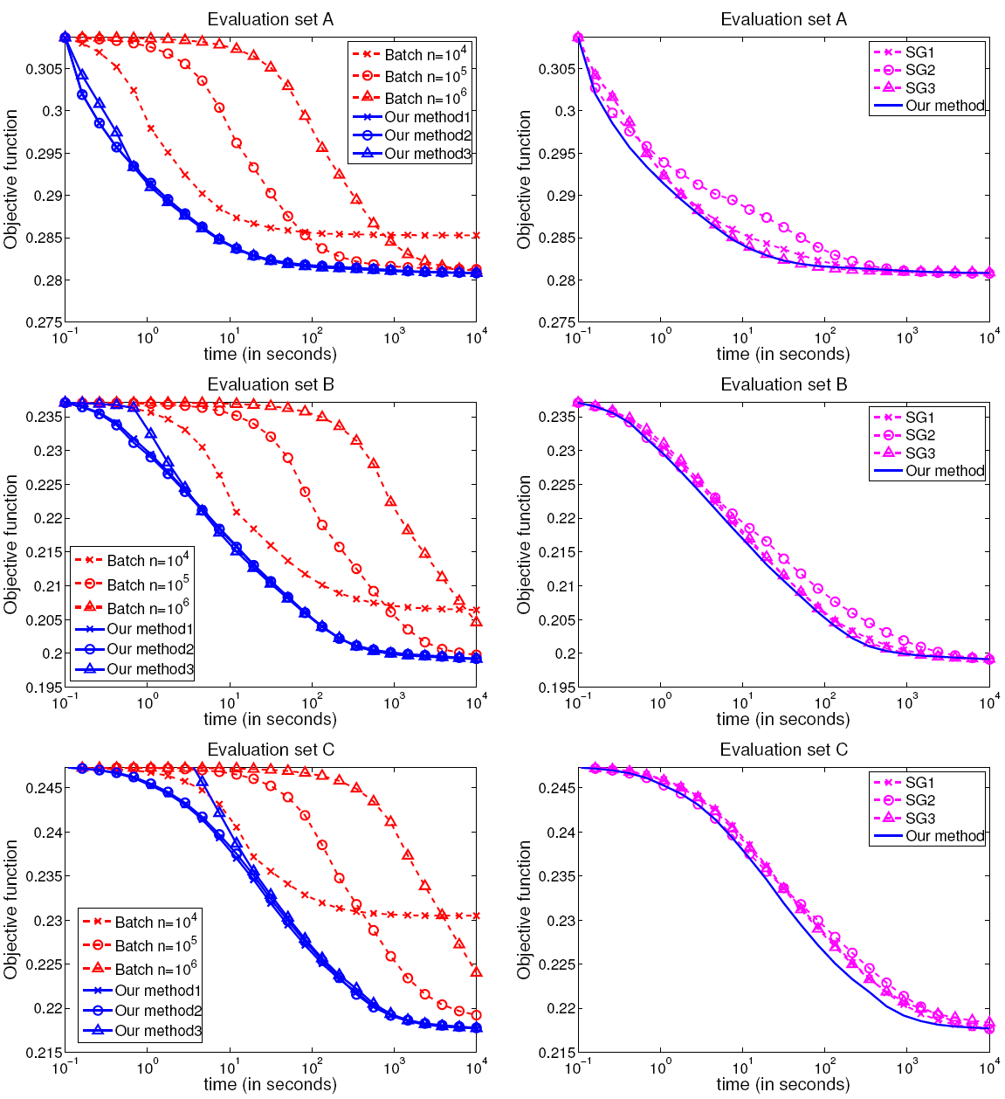
Performance evaluation
Three datasets constructed from 1,250,000 Pascal’06
patches (1,000,000 for training, 250,000 for testing):
A: 8£8 b&w patches, 256 atoms.
B: 12£16£3 color patches, 512 atoms.
C: 16£16 b&w patches, 1024 atoms.
Two variants of our algorithm:
Online version with different choices of parameters.
Batch version on different subsets of training data.
Online vs batch
Online vs stochastic
gradient descent

Slide 23
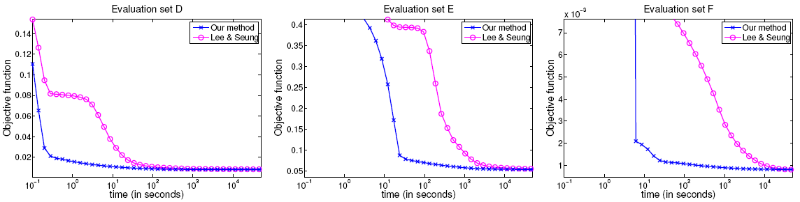
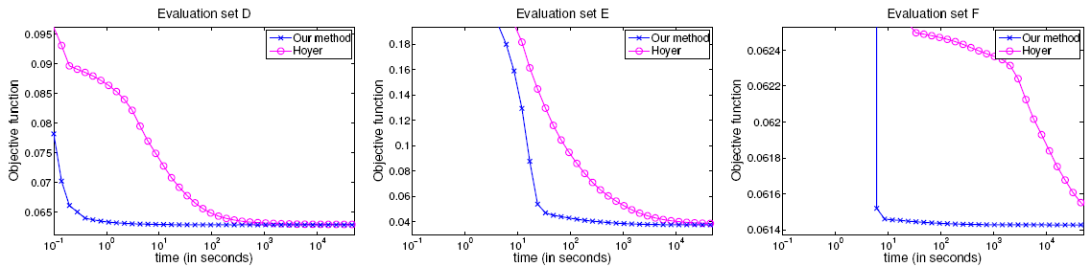
Sparse PCA: Adding sparsity on the atoms
Three datasets:
D: 2429 19£19 images from MIT-CBCL #1.
E: 2414 192£168 images from extended Yale B.
F: 100,000 16£16 patches from Pascal VOC’06.
Three implementations:
Hoyer’s Matlab implementation of NNMF (Lee & Seung’01).
Hoyer’s Matlab implementation of NNSC (Hoyer’02).
Our C++/Matlab implementation of SPCA (elastic net on D).
SPCA vs NNMF
SPCA vs NNSC

Slide 24
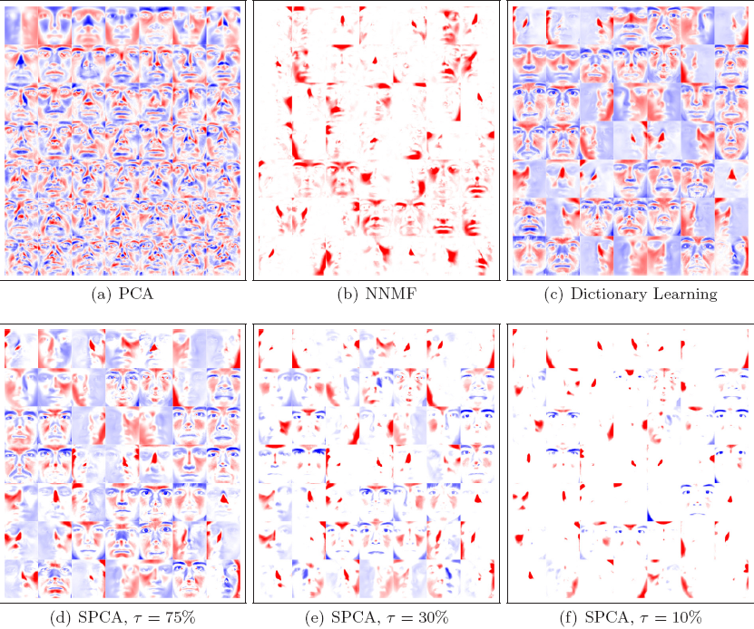
Faces

Slide 25
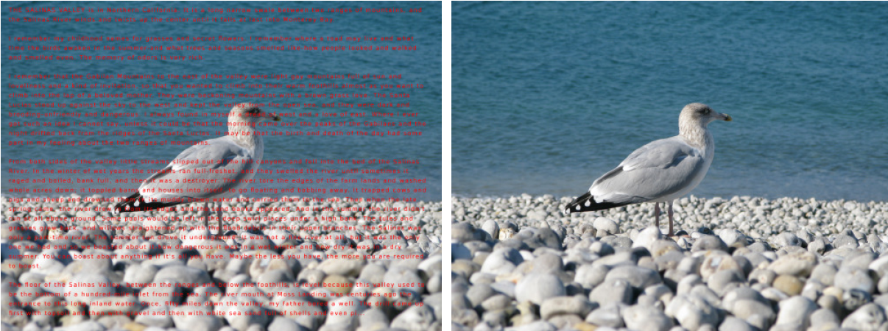
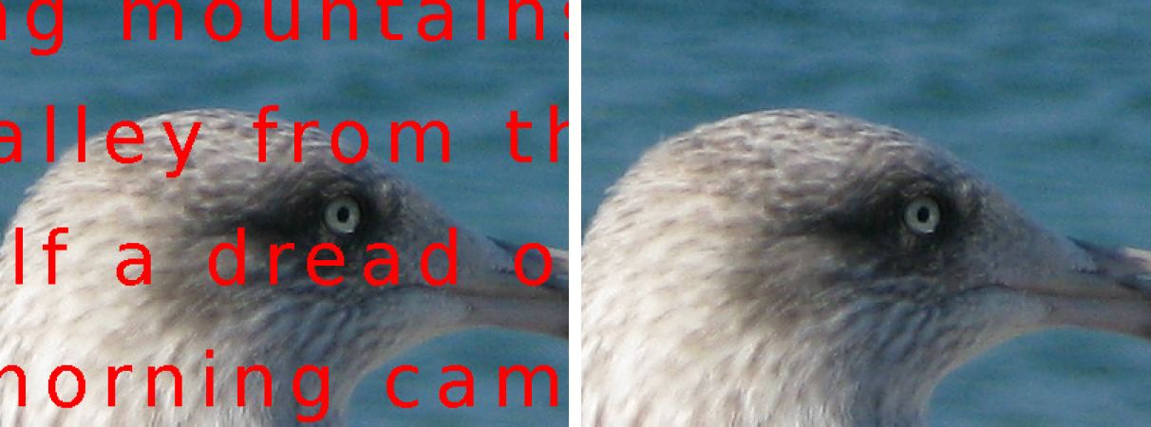
Inpainting a 12MP image with a
dictionary learned from 7x10⁶
patches (Mairal et al., 2009)
Notes:
Resultats d’inpainting sur une image de 12MP grace a l’algorithme stochastique de Julien soumis a ICML-09.

Slide 26
State of the art in image denoising
Non-local means filtering
(Buades et al.’05)
Dictionary learning for denoising (Elad & Aharon’06;
Mairal, Elad & Sapiro’08)
min _{DєC,®1,..., ®n}∑_{1≤i≤n} [ 1/2 | y_{i} – D®_{i} |₂² + ¸ |®_{i}|₁ ]
x = 1/n ∑_{1≤i≤n} R_{i}D®_{i}

Slide 27
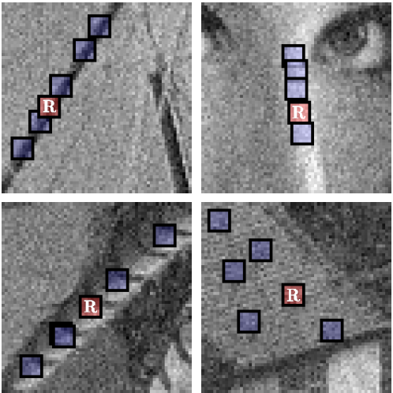

State of the art in image denoising
BM3D (Dabov et al.’07)
Non-local means filtering
(Buades et al.’05)
Dictionary learning for denoising (Elad & Aharon’06;
Mairal, Elad & Sapiro’08)
min _{DєC,®1,..., ®n}∑_{1≤i≤n} [ 1/2 | y_{i} – D®_{i} |₂² + ¸ |®_{i}|₁ ]
x = 1/n ∑_{1≤i≤n} R_{i}D®_{i}

Slide 28
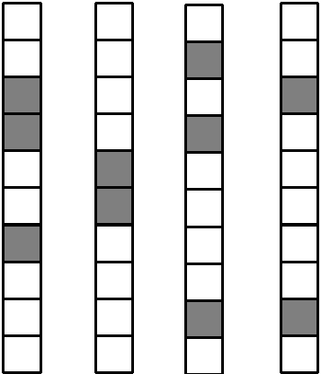
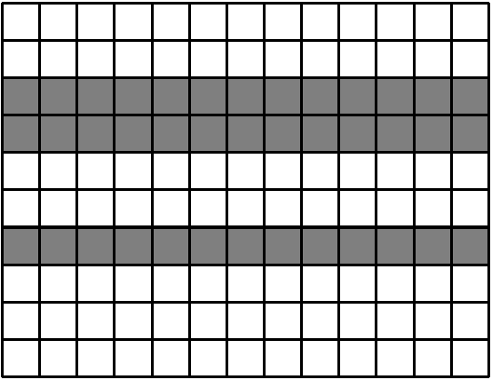
Non-local SparseModels for Image Restoration
(Mairal, Bach, Ponce, Sapiro, Zisserman, ICCV’09)
Sparsity vs Joint sparsity
min ∑ [∑1/2 | y_{j} – D®_{ij} |_{F}²] + ¸ |A_{i}|_{p,q}
D2 C
A₁,...,A_{n}
i j2S_{i}
|A|_{p,q}= ∑_{1≤i≤k} |®^{i}|_{q}^{p} (p,q) = (1,2) or (0,1)

Slide 29
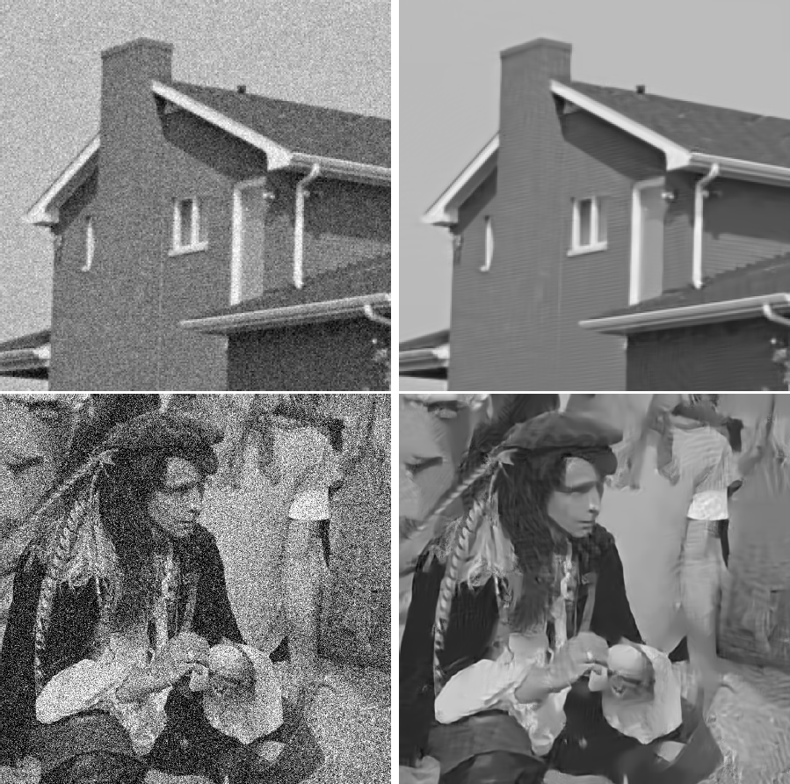
Notes:
Denoising avec du bruit synthetique. Noter qu’on retrouve la structure de briques. Meilleure methode sur les images standard habituelles (Lena etc.). SC et lSC sont des versions simplifiees de la methode ou on n’apprend pas le dictionnaire (SC) ou on l’apprend mais on ne fais pas de groupes (LSC).

Slide 30
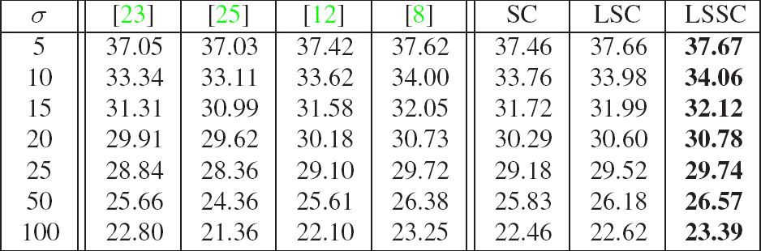
PSNR comparison between our method (LSSC) and Portilla et al.’03 [23];
Roth & Black’05 [25]; Elad& Aharon’06 [12]; and Dabov et al.’07 [8].
Notes:
Denoising avec du bruit synthetique. Noter qu’on retrouve la structure de briques. Meilleure methode sur les images standard habituelles (Lena etc.). SC et lSC sont des versions simplifiees de la methode ou on n’apprend pas le dictionnaire (SC) ou on l’apprend mais on ne fais pas de groupes (LSC).

Slide 31
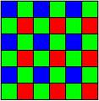
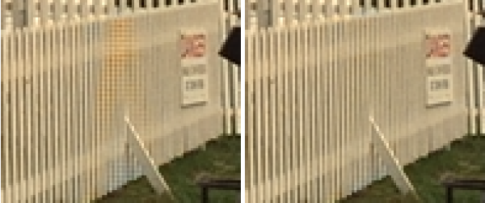
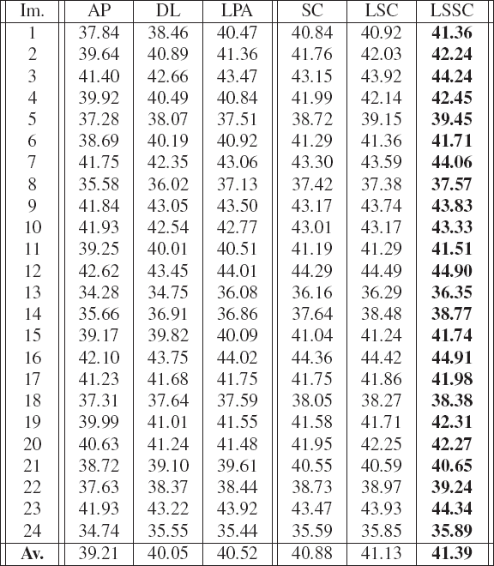
Demosaicking experiments
LSC
LSSC
Bayer pattern
……………………………………………...……………
PSNR comparison between our method (LSSC) and Gunturk et al.’02 [AP];
Zhang & Wu’05 [DL]; and Paliy et al.’07 [LPA] on the Kodak PhotoCD data.
Notes:
Meilleurs resultats sur les donnees standard. LSC (qui est deja tres bon) donne comme les autres methodes standard des artefacts de couleur sur la barriere). LSSC n’a pas ces problemes.

Slide 32
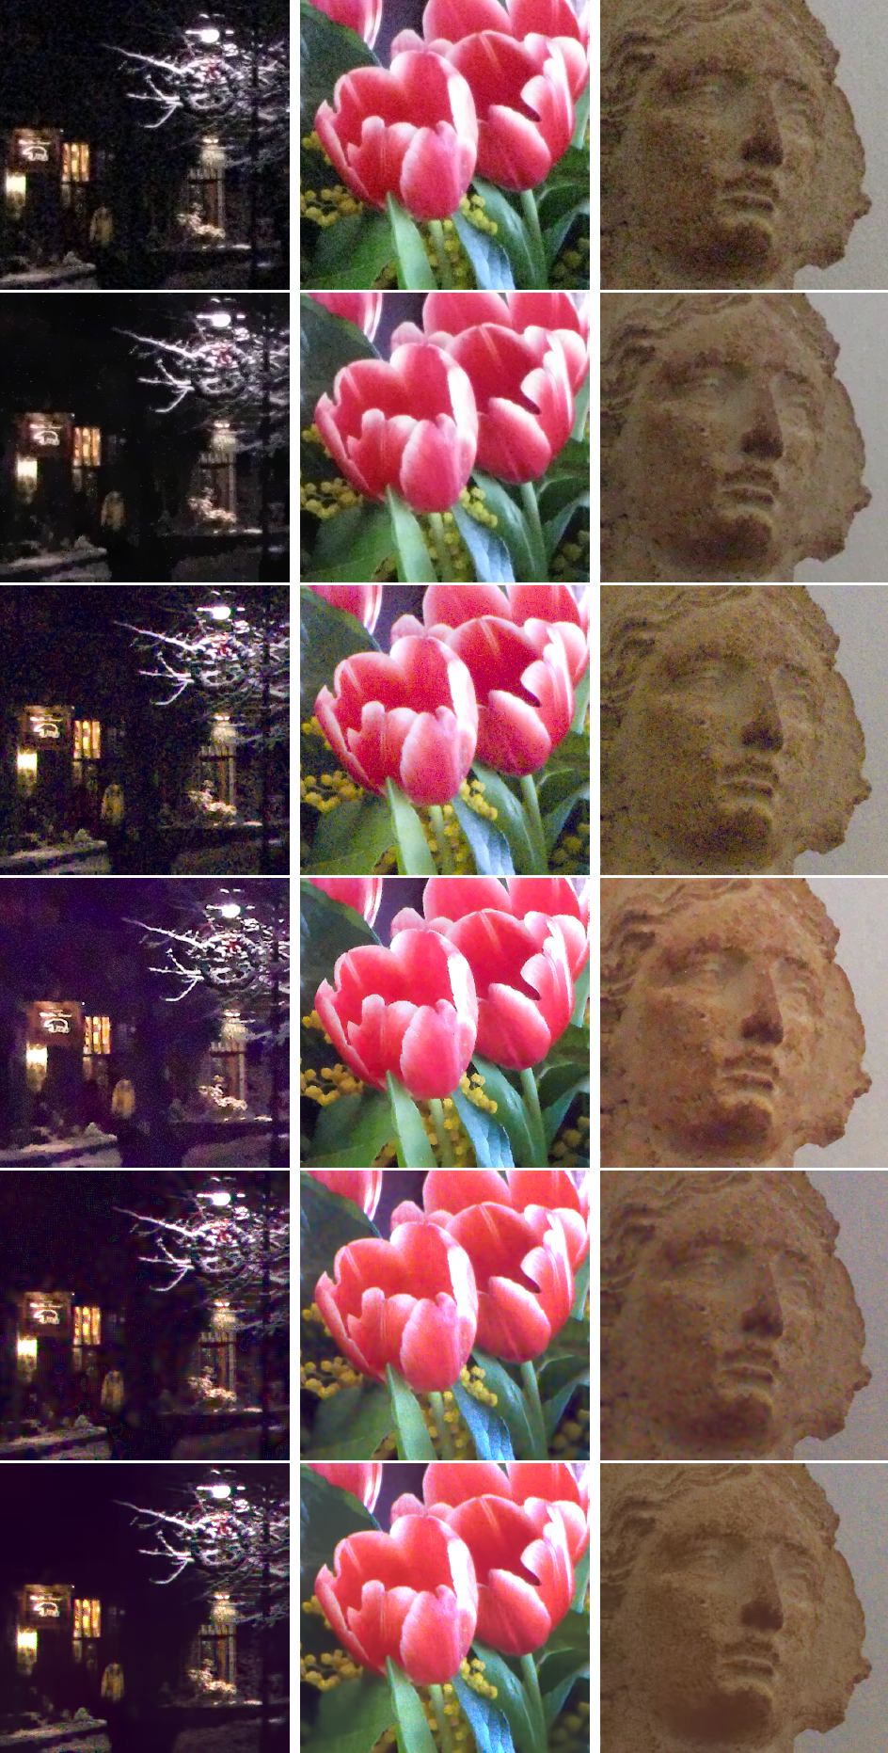
Real noise (Canon Powershot G9, 1600 ISO)
Raw camera
jpeg output
Adobe Photoshop
DxO Optics Pro
LSSC
Notes:
Images reelles. La camera et Photoshop donnent des resultats tres bruites. DxO et LSSC donnent des resultats satisfaisants.

Slide 33
Sparse coding on the move!
Linear/bilinear models with shared dictionaries
(Mairal et al., NIPS’08)
Group Lasso consistency (Bach, JMLR’08)
α*(x,D) = Argmin | x - Dα|₂²s.t. ∑_{j}|α_{j}|₂ ≤ L
  - NCS conditions for consistency
  - Application to multiple-kernel learning
Structured variable selection by sparsity-
inducing norms (Jenatton, Audibert, Bach’09)
Next: Deblurring, inpainting, super resolution
Notes:
Nouveaux resultats.

Slide 34
SPArse Modeling software (SPAMS)
http://www.di.ens.fr/willow/SPAMS/
Tutorial on sparse coding and dictionary learning for image analysis
http://www.di.ens.fr/~mairal/tutorial_iccv09/
Notes:
Les deux focus sont la partie 3D et la partie apprentissage. Le reste est presente assez brievement.

